Slide 1
Information Technology

Slide 2
Lecture recording with Windows PowerPoint 2019
Khalid Sarwar Warraich

Slide 3
Exporting presentation as a video

Slide 4
Export slides as a video

Slide 5
Export slides as a video

Slide 6
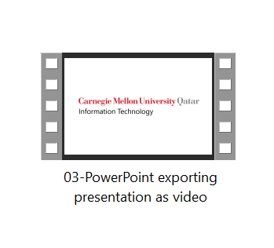
Export slides as a video

Slide 7
Information Technology

