Slide 1
Information Technology

Slide 2
Lecture recording with Windows PowerPoint 2019
Khalid Sarwar Warraich
Notes:
Hi. Welcome to lecture recording with PowerPoint and Zoom. My name is Khalid Sarwar Warraich. In this presentation we will learn how to record lectures using PowerPoint and Zoom: two tools that make the task very easy.

Slide 3
Embed videos in slides

Slide 4
Embed videos in slides
1
2
3
4
5

Slide 5
Placing the video
Video will insert in the slide
Resize, trim and adjust the video
Add more text or graphics elements to the slide

Slide 6
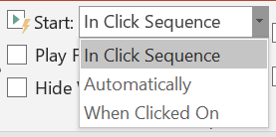
Adjusting the video

Slide 8
A view from the window

Slide 9
Information Technology

