Slide 1
Information Technology

Slide 2
Lecture recording with Mac PowerPoint 2019
Khalid Sarwar Warraich

Slide 3
PowerPoint can make videos?

Slide 4
PowerPoint 2019’s video related features
Export slides as a video
Record the screen (using macOS QuickTime Player)
Embed videos in slides
Slide transitions and animations
Add audio narration to slides

Slide 5
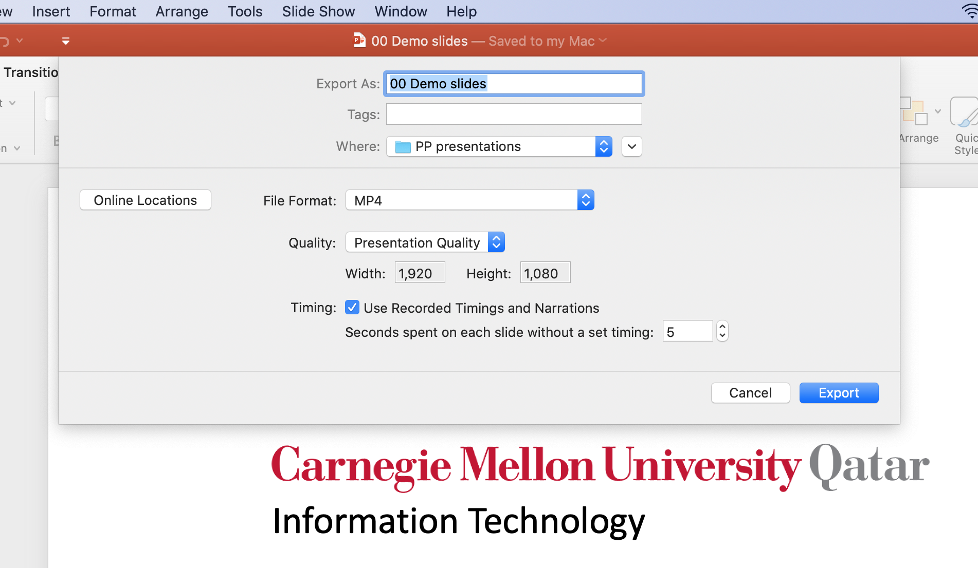
Export slides as a video

Slide 6
Record the screen (using QuickTime player)

Slide 7
Embed videos in slides

Slide 8
Slide transitions and animations
Transitions are visual effects between slides
Animations are visual effects within a slide
We can add transition and animation effects
With timings
Manual advancement
These effects will be transferred to the exported video

Slide 9
Add audio narration to slides
Narration lets you add background audio to your slides
The timings of your transitions and animations are also recorded
When exporting, the narration becomes part of the video
The words you are listening to right now are added as narration to this slide

Slide 10
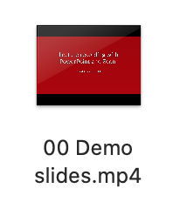
Putting it all together
Slide 1
Auto-timed
Slide 2
Embedded video
Slide 3
Video of screen recording
Slide 4
Animations with timings
transition
transition
transition
Slide 5
Audio narration with animation
Slide 6
Audio narration with animation
Export video
transition
transition

Slide 11
Information Technology

