Slide 1
Information Technology

Slide 2
Lecture recording with Mac PowerPoint 2019
Khalid Sarwar Warraich

Slide 3
Exporting presentation as a video

Slide 4
Export slides as a video

Slide 5
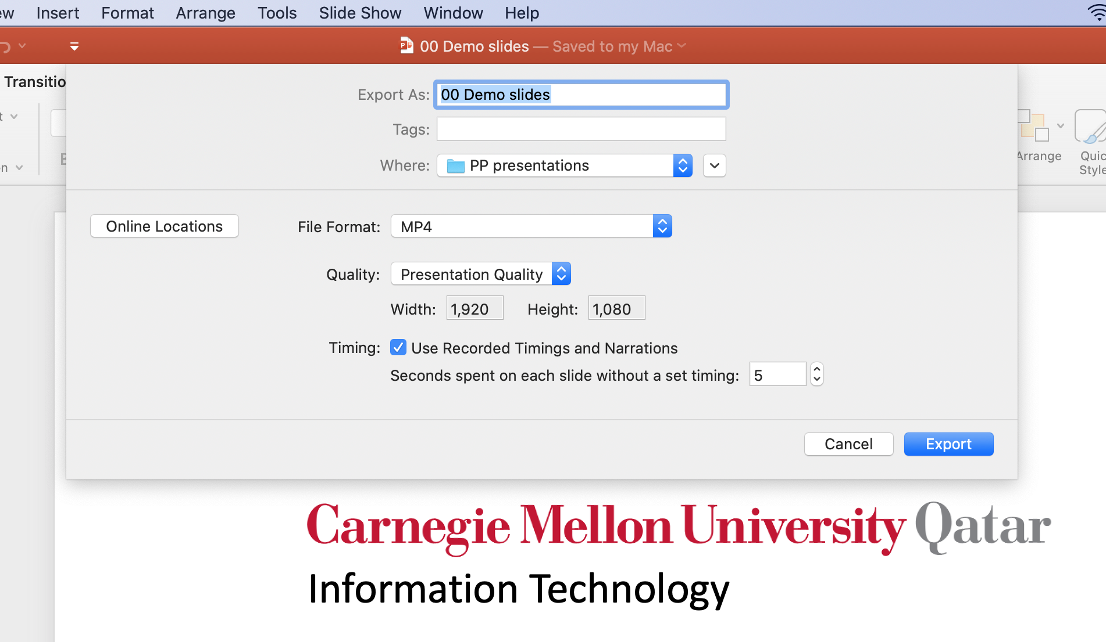
Export slides as a video
Video resolutions
Ultra HD (4K) is 3840 x 2160
Full HD (1080p) is 1920 x 1080 (recommended)
HD (720p) is 1280 x 720
Standard (480p) is 852 x 480

Slide 6
Export slides as a video

Slide 7
Information Technology

