Slide 1
Information Technology

Slide 2
Lecture recording with Mac PowerPoint 2019
Khalid Sarwar Warraich
Notes:
.

Slide 3
Slide transitions and animations

Slide 4
Transitions (push)

Slide 5
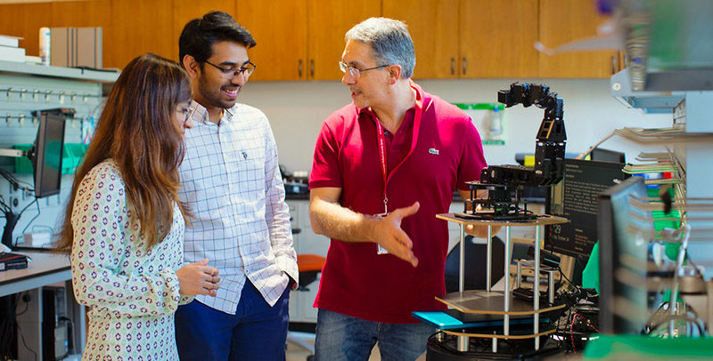
Transitions (fade)

Slide 6
Transitions (split)

Slide 7
Transitions (random bars)

Slide 8
Transitions (between slides)

Slide 9
Animations
Appear text
Fade text
Fly in text
Bounce text
Pulse text
Font color text
Spin text
Disappear text
Fly out text
Split text
Shrink and turn text

Slide 10
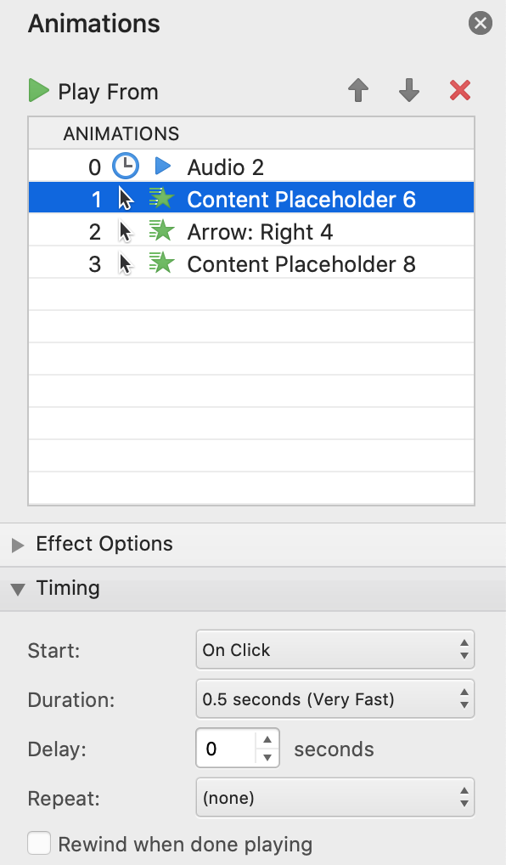
Animation settings
On click
On click
On click

Slide 11
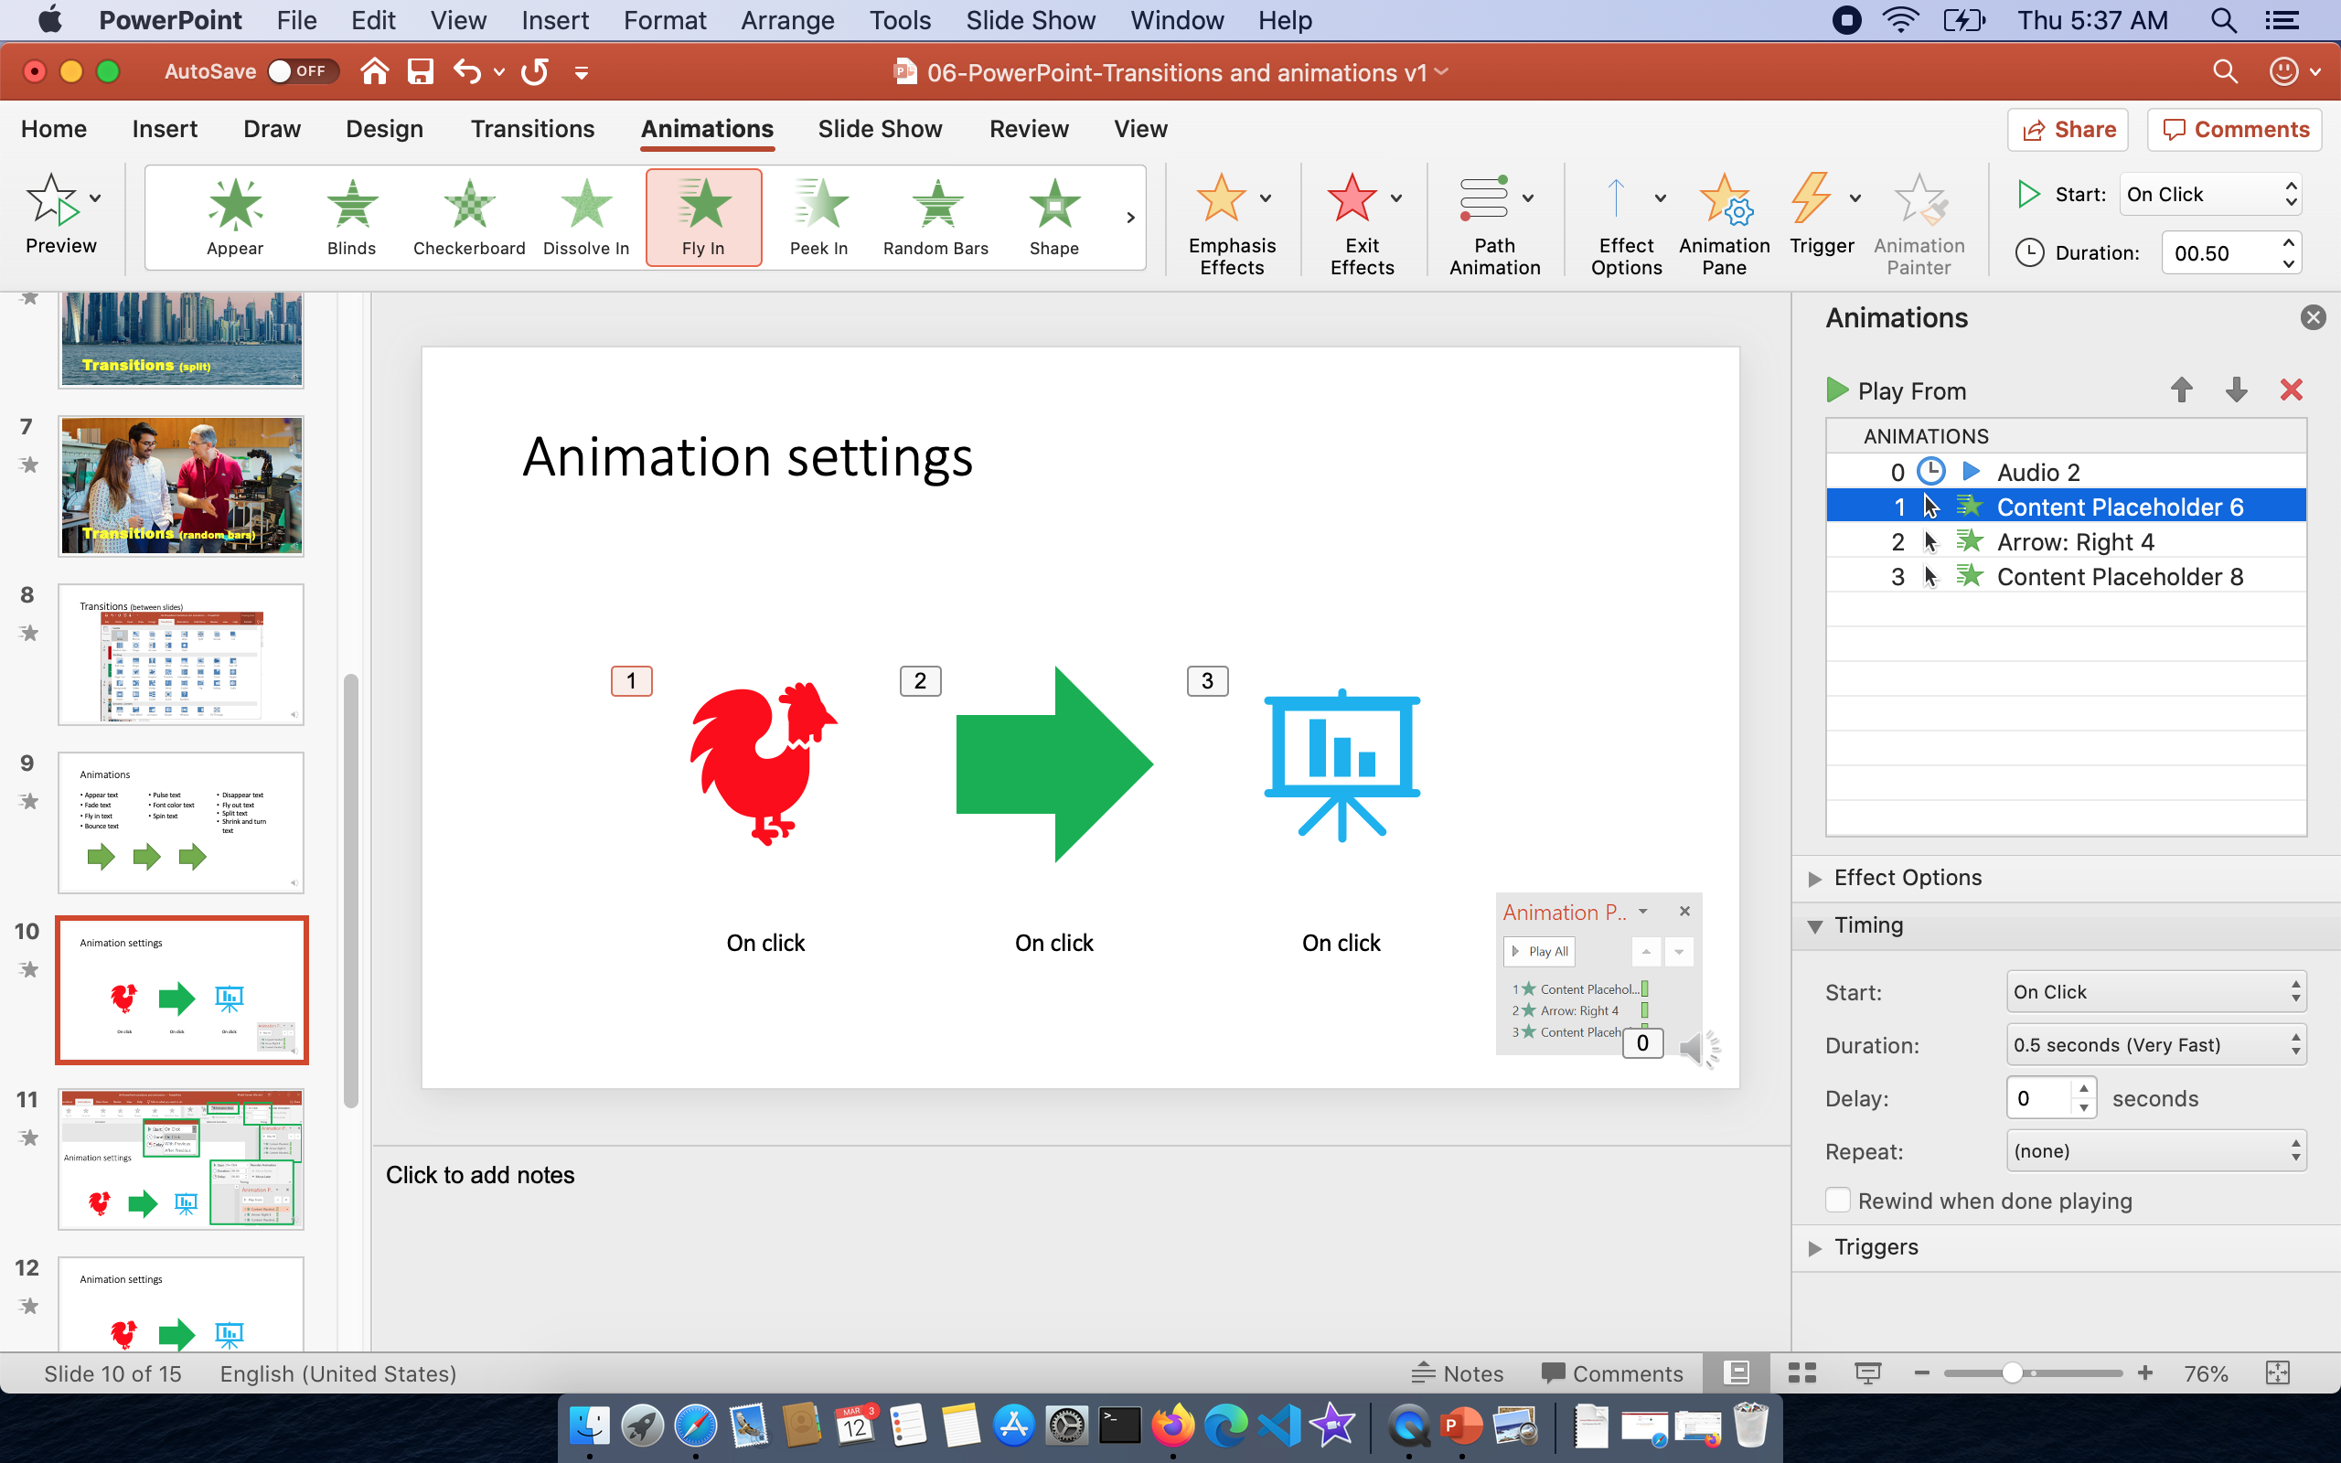

Slide 12
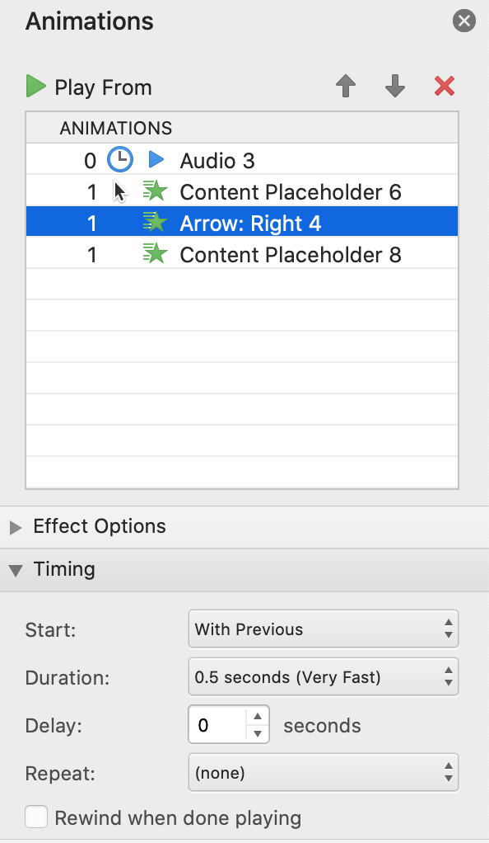
Animation settings
On click
With Previous
With Previous

Slide 13
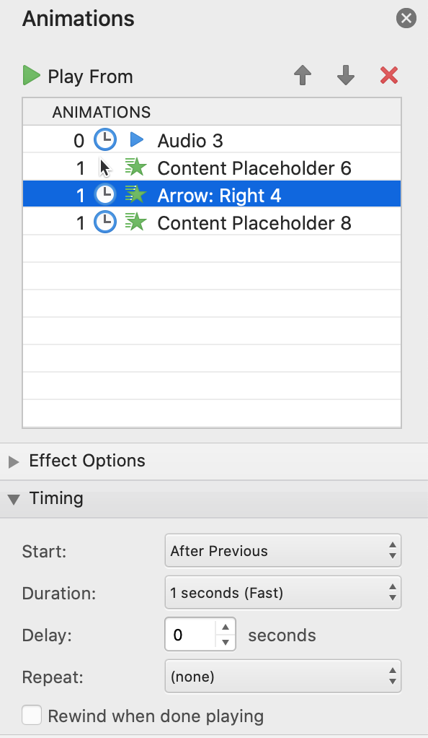
Animation settings
On click
Start after previous
Start after previous

Slide 14
How are transitions and animations used in video?
Transitions “play” in the exported video
Transition durations determine how fast they play
Transitions and animations add motion and sense of dynamism to the video
Animations also “play” in the video
Animation delays and durations determine how fast they play
Once the animations have played, the slide will advance
If there are no animations, the slide will stay for the “Export: seconds spent on each slide” amount

Slide 15
Information Technology

