Slide 1
Information Technology

Slide 2
Lecture recording with Mac PowerPoint 2019
Khalid Sarwar Warraich

Slide 3
Conclusion

Slide 4
PowerPoint 2019’s video related features
Export slides as a video
Record the screen (using macOS QuickTime Player)
Embed videos in slides
Slide transitions and animations
Add audio narration to slides

Slide 5
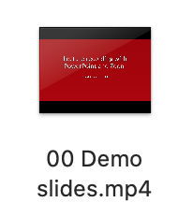
Putting it all together
Slide 1
Auto-timed
Slide 2
Embedded video
Slide 3
Video of screen recording
Slide 4
Animations with timings
transition
transition
transition
Slide 5
Audio narration with animation timings
Slide 6
Audio narration
Export video
transition
transition

Slide 6
Information Technology

