Slide 1
18 – Motivation
Design of Educational Games
05418/05818 Human-Computer Interaction Institute
Erik Harpstead

Slide 2
Announcements
Assignment 2 grades posted
I WILL get crits 3 and 4 back to you by the end of the weekend
Push Crits 5 and 6 back 1 week?

Slide 3
Plan for Today
Talk about Final Project Check-ins
Talk a bit about models of motivation
Give you time to meet with your groups

Slide 4
Final Project Check-ins

Slide 5
Final Project Check-ins
Expectations for the check-ins are loosely define to allow for projects to evolve adaptively
Typically, teams focus on Knowledge Elicitation work for the first check-in but this isn’t a requirement
Concretely, the expectation is that you will have completed ~30% of the final project by Check-in 1

Slide 6
Check-in Grading
Final Project Check-ins are graded against the rubric for the final deliverable but with a lower bar
This lets me help you figure out where to focus your energy between deliverables
Final Project Rubric has 125 points
Check-in 1 caps at 40
Check-in 2 caps at 80
Learning Goals | 25
Experience Goals | 25
Ideation + Prototyping | 25
Playtesting + Evaluation | 25
Final Product | 25

Slide 7
Motivation

Slide 8
Why do you play games?
It’s a self contained environment where you can break it down in a finite amount of time and become an expert
Competition
The social element, a good way to spend time with friends (esp distance)
Having a dialog with the designer, feeling them “ask you questions” and you responding to them
The dopamine of winning
Fun actitivy to participat with friends
Design and creativity, customizing things
Experiencing the story telling of the game
Just to escape normal daily life

Slide 9
Why do you NOT play games?
It requires of hot keys of practice to get good
When it feels like work (educational games do this a lot)
Getting sick of the grind
Failing a lot at the same task
Being too hard to understand
If the game just doesn’t feel right, like if you transition from a basketball game in one franchise to another
Too busy with real obligations
When there isn’t enough challenge
Games with communities you don’t connect with
Toxicity
If the mechanics or core experience are something you don’t resonate with
VR sickness or other perceptual issues
Being aware that you’re spending too much time on a game
If there aren’t enough hints in the beginning or if the learning curve is abrupt

Slide 10
Why is motivation important?

Slide 11
Why is motivation important?
Learning
Engagement

Slide 12
Video Games are Boring
Most games are made by a small affinity group for a small affinity group
If we can better understand a wider range of why people engage with media, we can connect to a wider audience

Slide 13
Motivation Models

Slide 14
Leblanc’s (non-exhaustive) Taxonomy of Experiential Aesthetics
Sensation
Game as sense-pleasure
Fantasy
Game as make-believe
Narrative
Game as drama
Challenge
Game as obstacle course
Fellowship
Game as social framework
Discovery
Game as uncharted territory
Expression
Game as self-discovery
Submission / Masochism / Abnegation
Game as pastime

Slide 15
Leblanc’s (non-exhaustive) Taxonomy of Experiential Aesthetics
Sensation
Game as sense-pleasure
Fantasy
Game as make-believe
Narrative
Game as drama
Challenge
Game as obstacle course
Fellowship
Game as social framework
Discovery
Game as uncharted territory
Expression
Game as self-discovery
Submission / Masochism / Abnegation
Game as pastime
Not the greatest model of why people play games

Slide 16
Silpasuwanchai’s Themes of Motivation

Slide 17
Silpasuwanchai’s Themes of Motivation
Needs Satisfaction: People play games to satisfy fundamental human needs
Dominated by Self-determination theory

Slide 18
Silpasuwanchai’s Themes of Motivation
Emotion: People play games because they evoke certain feelings and emotions
Centers on mood and affect
MDA Aesthetics go here

Slide 19
Silpasuwanchai’s Themes of Motivation
Cognition: People are drawn to games because of particular cognitive states
Flow
Presence
Immersion
Goal direction
Embodiment

Slide 20
Silpasuwanchai’s Themes of Motivation
Relationships: People play games for social connection and relationships
Includes standing within a community (competition)
The sense of belonging to a group (socializing via games)

Slide 21
Silpasuwanchai’s Themes of Motivation
[sensory] Aesthetics: People play games for their sensory aspects
Includes ideas of art style and direction
Relates Juiciness and game feel
Will talk about these more later

Slide 22
Silpasuwanchai’s Themes of Motivation
Needs Satisfaction
Emotion
Cognition
Relationships
[sensory] Aesthetics
Who is right?

Slide 23
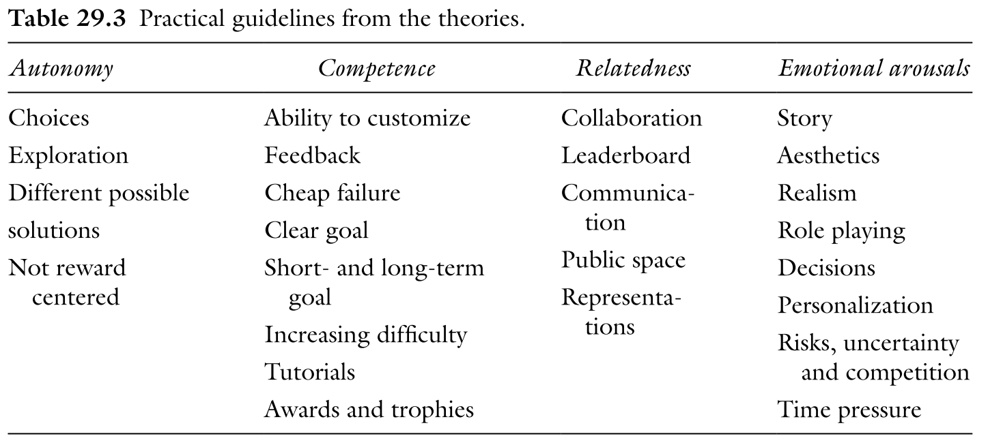
Silpasuwanchai’s Themes of Motivation

Slide 24
Self-Determination Theory
Quintessential needs satisfaction theory
Probably the most influential psychological theory in the games industry

Slide 25
Self-Determination Theory
Intrinsic
Motivations
Extrinsic
Motivations

Slide 26
Self-Determination Theory
Competence: The universal want to seek to control outcomes and experience mastery
Most often associated with learning and education
The feeling you get from using something you’ve learned
Notes:
Everyone wants to get better at what you do

Slide 27
Self-Determination Theory
Competence
Autonomy: The universal urge to be causal agents of one's own life and act in harmony with one's integrated self
Basically, choice however…
It is NOT the availability of choices but the act of choosing
Notes:
Its choice
Not satisfied by the act of choosing
You have a desk?
You have decorated your desk?
The act of decorating your desk is not autonomy
Autonomy is returning to your desk the next day and feeling ah I exist
Consequences of your choices

Slide 28
Self-Determination Theory
Competence
Autonomy
Relatedness: The universal want to interact, be connected to, and experience caring for others
Often thought of as “the social one”
Not satisfied by social interaction per se but more the knowledge of where I fit
Notes:
Rank / relation
Often thought of as “the social one”
Not satisfied by social interaction but the knowledge of where I fit

Slide 29
Self-Determination Theory
Competence: The universal want to seek to control outcomes and experience mastery
Autonomy: The universal urge to be causal agents of one's own life and act in harmony with one's integrated self
Relatedness: The universal want to interact, be connected to, and experience caring for others

Slide 35
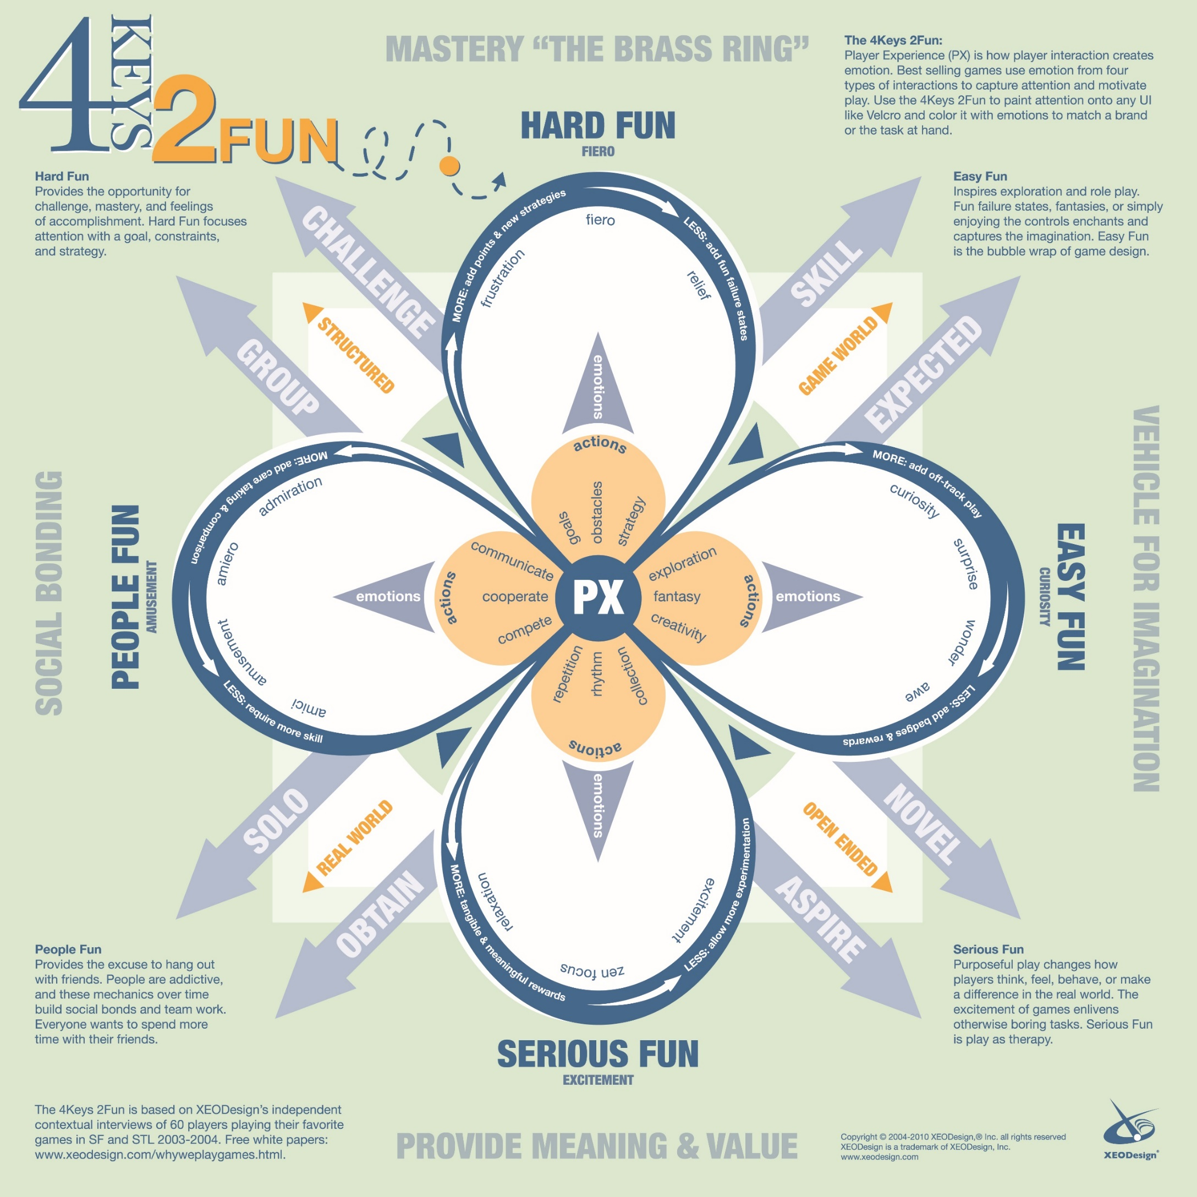
4 Keys 2 Fun
Nicole Lazzaro

Slide 41
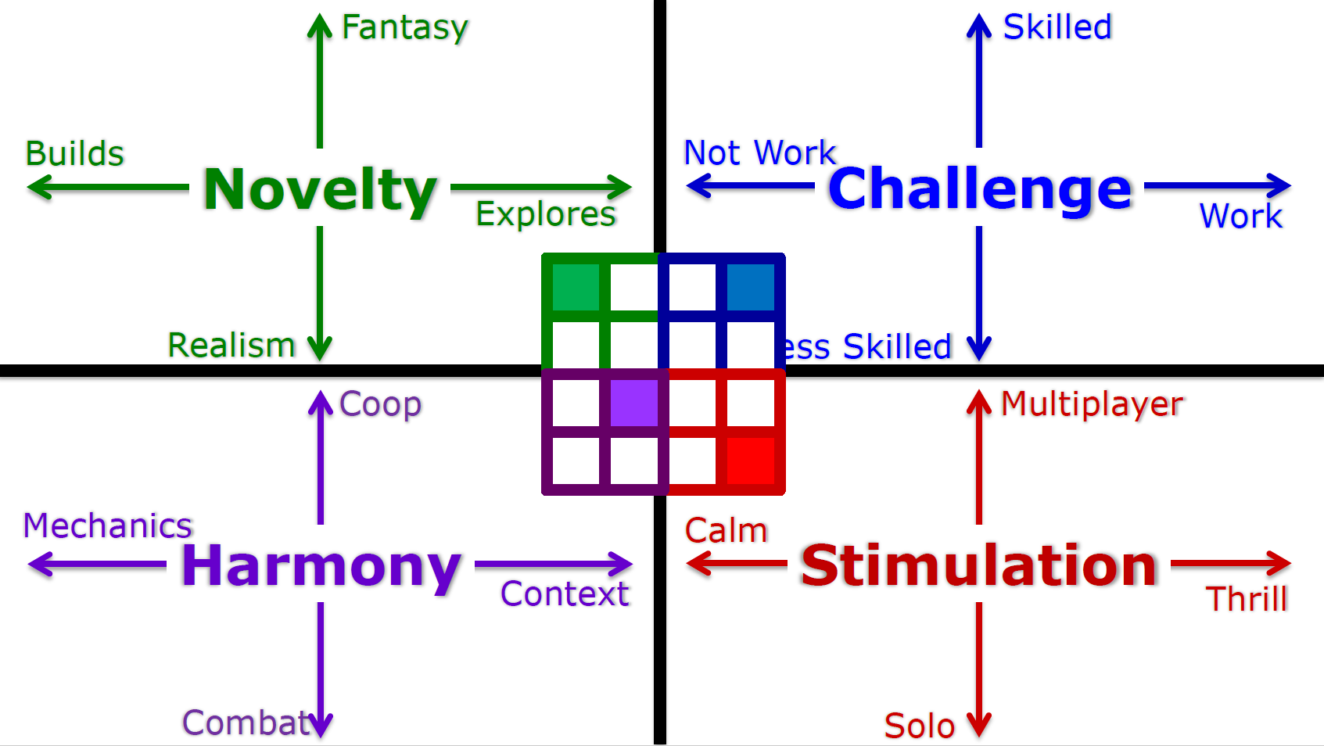

Slide 42
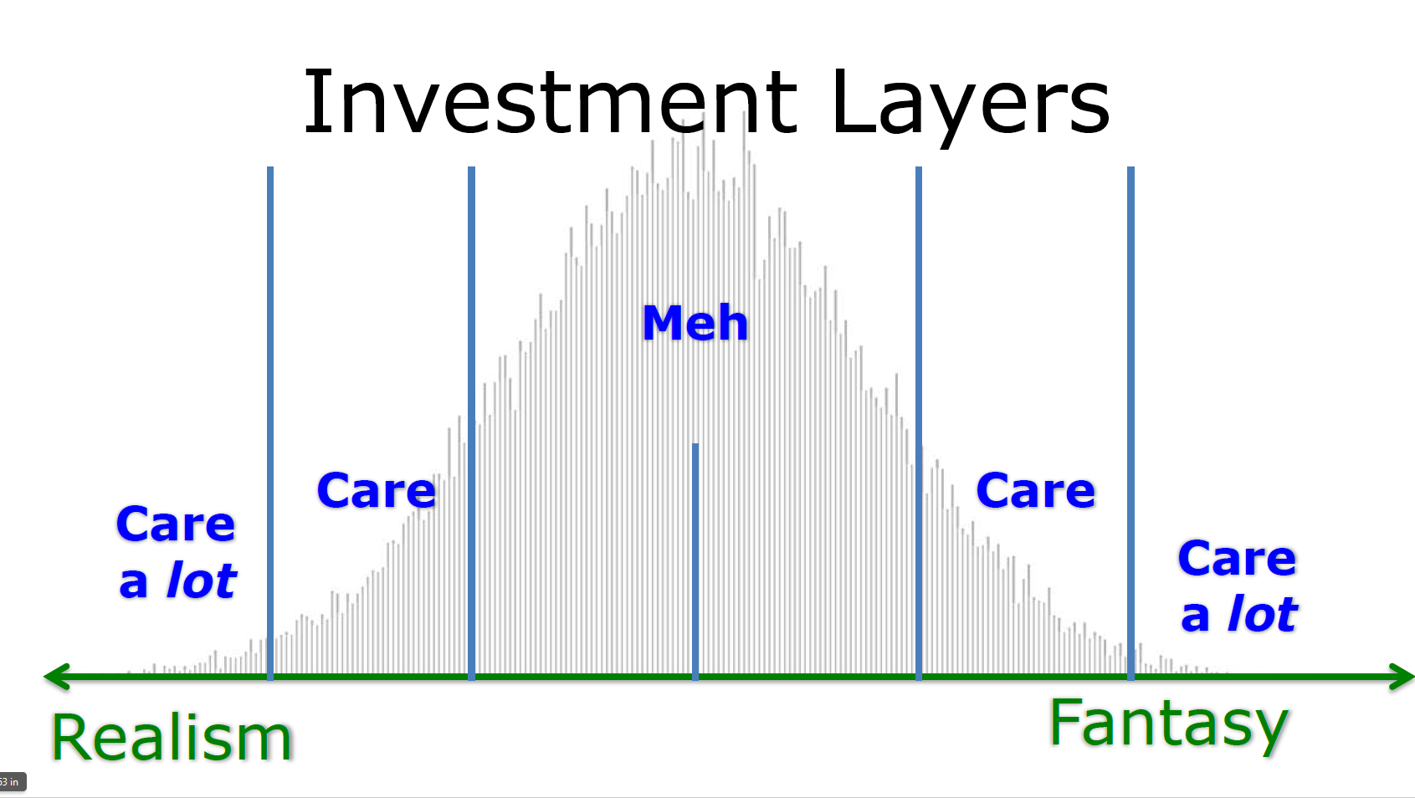

Slide 43
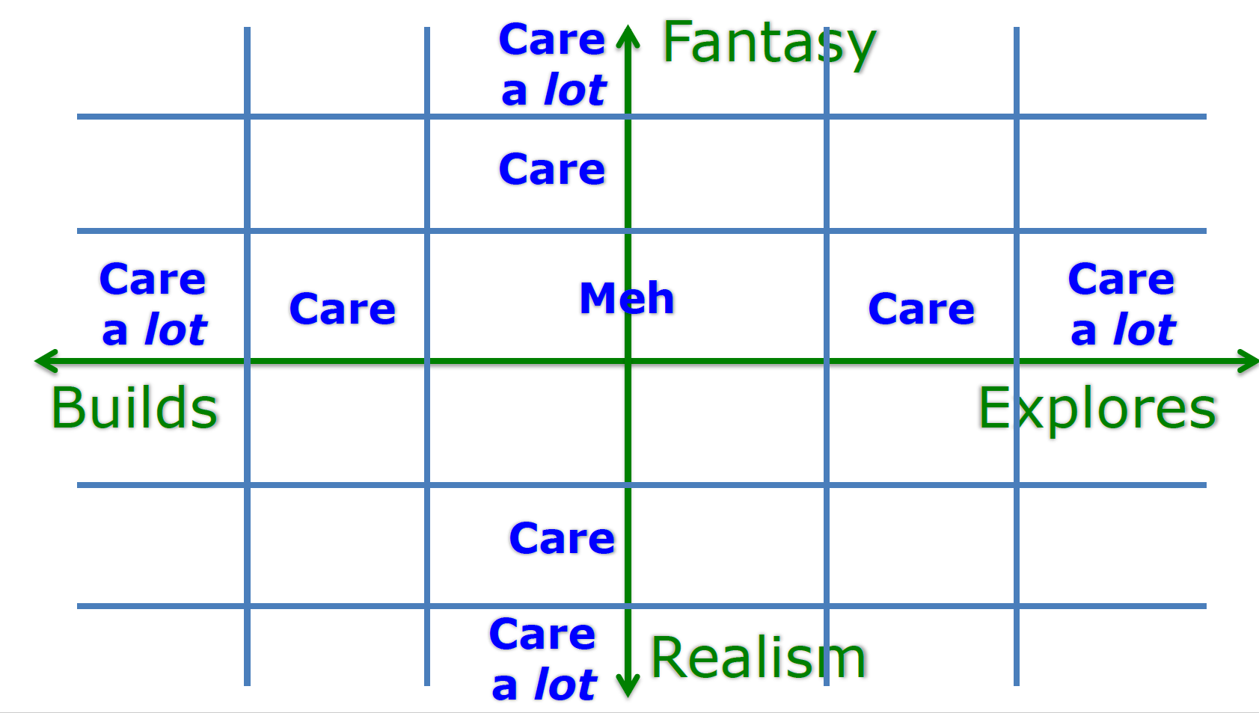

Slide 44
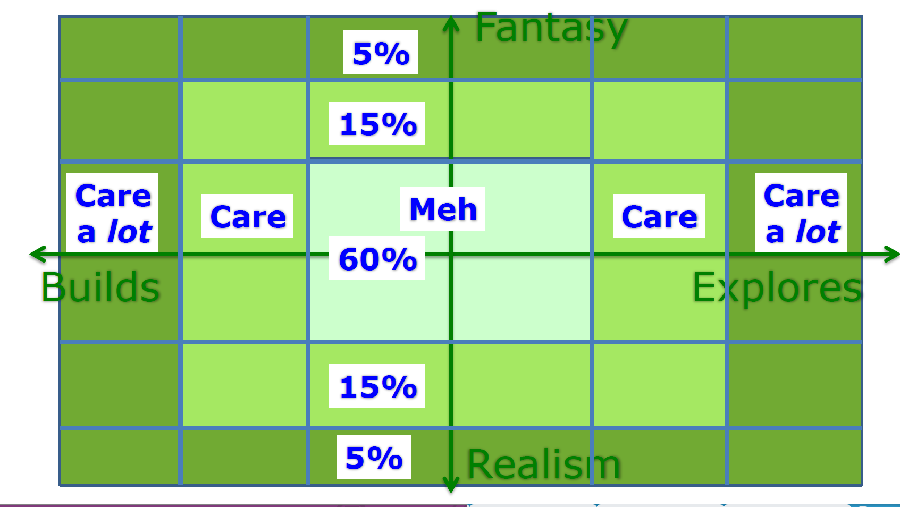

Slide 45
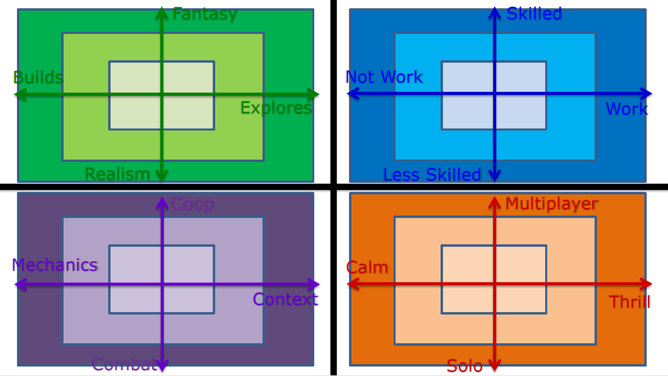

Slide 46
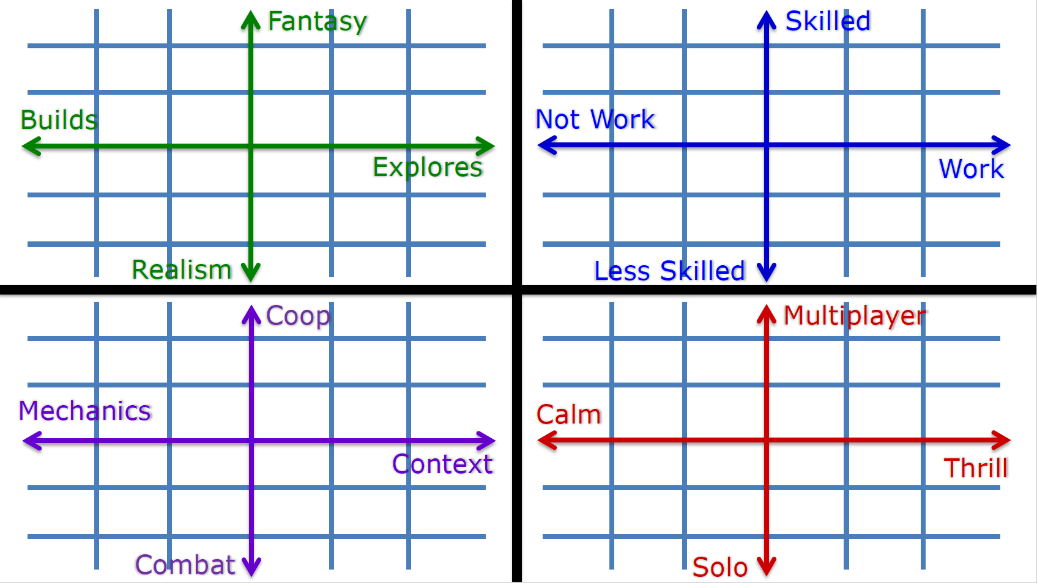

Slide 47
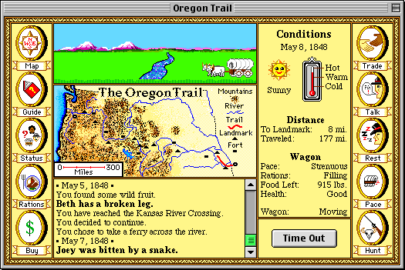

Slide 51
But Motivation changes over time
How do we account for player’s lifetime motivations?

Slide 52
Forrester Research

Slide 54
For next time
If you have any feedback about how live sessions are going please let me know: https://edugames.design/feedback

