Slide 1
5 – Educational Game Design Process
Design of Educational Games
05418/05818 Human-Computer Interaction Institute
Erik Harpstead

Slide 2
Announcements
Crit Post 1 Due TODAY @23:59 US Eastern Time

Slide 3
Any Questions about Crit Post Assignments?
How do I share a Twitch stream?
Whatever works for now, let me know if/when you get clips working
Can people double up off the list
Yes
If I want to do a blog how do I send it?
Youtube
How long should a blog be?
About 1-2 paragraphs per pieces
Is there a great expemplay post?
Not for the truncated version
I could reach to prior students and share theirs
Copyright issue for recordings
I wouldn’t worry about it?
How can we share posts?
Look for something in the announcement after class
Guidance on how to write the learning objective
Don’t trust what they say
Try to state what could be learned in your own words

Slide 4
Plan for Today
Talk about Design Processes in General
Introduce the Tandem Transformational Game Design Process
Walkthrough an iterative case study of the process
Talk about some logistical realities of ed game design

Slide 5
3 Wisdoms of Educational Game Design
Educational Objectives
But how do you do it?
Mechanics Dynamics Aesthetics
Learning Science Principles
Notes:
Educational game = game designed to meet pre-defined educational objectives
Educational game development project will be more successful if:
Educational objectives have been clearly specified early on
Designers have a notion of how the game’s mechanics, though the dynamics, realize the intended aesthetics
Game observes well-established instructional design principles

Slide 6
 |  | Topic | Assignments | Blog Posts | Final Project
Feb | 2 | Intro & the EDGE Framework
 | 4 | Instructional Design
 | 9 | Game Design
 | 11 | Learning Science
 | 16 | Ed Game Design Process |  | Post 1
 | 18 | Knowledge Ellicitation | Assignment 1 OUT
 | 23 | No Class
 | 25 | Transfer | Assignment 1A DUE
Mar | 2 | Integration and Alignment |  | Post 2
 | 4 | Ideation + Player Experience | Assignment 1B DUE Assignment 2 OUT
 | 9 | Prototying + Playtesting | Assignment 2A DUE
 | 11 | Systems and Mechanics
 | 16 | Spectrum of Evaluation |  | Post 3 | Begin Team Formation
 | 18 | Spectrum of Evaluation
 | 23 | Tabletop vs Digital Games
 | 25 | Peer Feedback & Pitching | Assignment 2B DUE
 | 30 | Pitch Presentations |  | Post 4 | Scoping Proposals Due
Apr | 1 | Pitch Processing
 | 6 | [Special Topic]
 | 8 | [Special Topic]
 | 13 | Check-in 1 Presentations |  | Post 5 | Final Project Check-in 1
 | 15 | No Class
 | 20 | [Special Topic]
 | 22 | [Speical Topic]
 | 27 | Check-in 2 Presentations |  | Post 6 | Final Project Check-in 2
 | 29 | Check-in 2 Processing
May | 4 | [Special Topic]
 | 6 | Last Lecture
 | TBD | Final Project Showcase (Finals Week) |  |  | Final Project Deliverable
The EDGE Framework
You are Here
Process Techniques
&
Practice
A Course in
3 Acts
Final Projects
&
Special Topics / Theory

Slide 7
Zoom in on Act 2 Topics
 |  | Topic | Assignments | Blog Posts | Final Project
Feb | 16 | Ed Game Design Process |  | Post 1
 | 18 | Knowledge Ellicitation | Assignment 1 OUT
Mar | 23 | No Class
 | 25 | Transfer | Assignment 1A DUE
 | 2 | Integration and Alignment |  | Post 2
 | 4 | Ideation + Player Experience | Assignment 1B DUE Assignment 2 OUT
 | 9 | Prototying + Playtesting | Assignment 2A DUE
 | 11 | Systems and Mechanics
 | 16 | Spectrum of Evaluation |  | Post 3 | Begin Team Formation
 | 18 | Spectrum of Evaluation
Apr | 23 | Tabletop vs Digital Games
 | 25 | Peer Feedback & Pitching | Assignment 2B DUE
Knowledge Elicitation
Prototyping & Playtesting
Evaluation
Starting Final Projects

Slide 8
Zoom in on Act 2 Projects
 |  | Topic | Assignments | Blog Posts | Final Project
Feb | 16 | Ed Game Design Process |  | Post 1
 | 18 | Knowledge Ellicitation | Assignment 1 OUT
Mar | 23 | No Class
 | 25 | Transfer | Assignment 1A DUE
 | 2 | Integration and Alignment |  | Post 2
 | 4 | Ideation + Player Experience | Assignment 1B DUE Assignment 2 OUT
 | 9 | Prototying + Playtesting | Assignment 2A DUE
 | 11 | Systems and Mechanics
 | 16 | Spectrum of Evaluation |  | Post 3 | Begin Team Formation
 | 18 | Spectrum of Evaluation
Apr | 23 | Tabletop vs Digital Games
 | 25 | Peer Feedback & Pitching | Assignment 2B DUE
Knowledge Elicitation
Prototyping & Playtesting

Slide 9
The General Challenge of Design

Slide 10
General Challenge of Design
How do I get to something from nothing?
How do I get from something to something better?

Slide 11
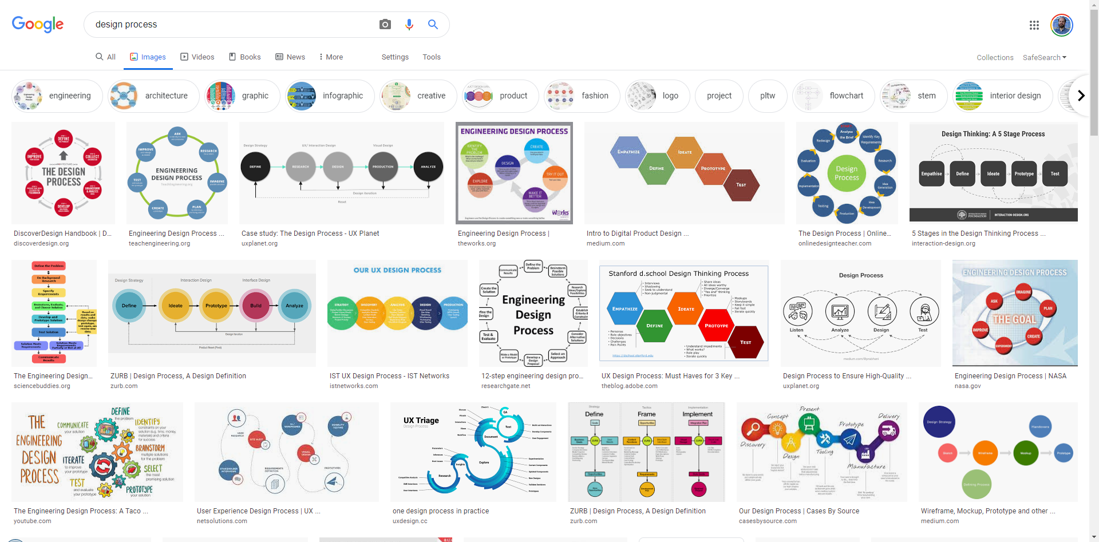

Slide 12
What design processes are you familiar with, what are their steps?
Instructional Design (Backwards Design)
Goals
Assessment
Instructional Activities
Alignment
Iterate
Engineering Design Process
Iterating a lot over prototypes
1-2-3
Design based Research (DBR)
Design
Deploy
Analyze
Iterate
Iterate while there are papers

Slide 13
Tandem Transformational Games Design

Slide 14
Tandem Transformational Game Design
Alexandra To
+ A bunch of people in the OH! Lab
To, A., Fath, E., Zhang, E., Ali, S., Kildunne, C., Fan, A., … Kaufman, G. (2016). Tandem Transformational Game Design: A Game Design Process Case Study. Proceedings of the International Academic Conference on Meaningful Play.

Slide 15
Thoughts on Tandem?

Slide 18
Game-Driven Goal Delineation
Focused on defining and refining the learning (or other) goals for your game
Usually where you would start

Slide 19
Where Can you Find Learning Objectives?
Usually clients or educator you’re working with
National (or other) standard depending on discipline
Your own curiosity
If you are funded by a grant they will say explicitly

Slide 20
Common Sources of Objectives
A client
A subject matter expert (SME)
State or other standards
Prior Literature

Slide 21
How can you refine learning objectives?
You can analyze the task using CTA, how do students or players see the task and how do they accomplish it?
Reconsolidate to better match up with what you wanted it to be
Analyzing learning curve
Researching work already done in the field to see if there are more narrow focuses than what you were given

Slide 22
Knowledge Elicitation
An empirical process working with experts and/or novices to better understand the knowledge they use or need to do a particular task
Often involves interviews or observations of actual performance on a task
Helpful for defining and refining objectives throughout design
We will talk more about this on Thursday

Slide 24
Goal-Driven Game Design
Iteratively developing game mechanics and systems
Cycling through a process of:
Ideation
Prototyping
Playtesting
Game Designers often emphasize prototyping

Slide 25
Superbrothers. 2010. Less Talk, More Rock. boingboing. Retrieved May 17, 2018 from https://boingboing.net/features/morerock.html

Slide 26
What did you think? (Less Talk More Rock)
Seemed like the author wasn’t really interested in narrative games
Interesting question of what “narrative game” means
This person seems extremely naïve in the industry
An air of elitism about how games should work
Thought it was a really interesting perspective, don’t waste you time planning, but the next one said don’t ever skip the planning
It almost felt old fashioned, don’t worry about it just do it
We tend to lean heavily on text in design, liked how it tried to focus on different affordances of play
Interesting to think how graphic designers vs instructional designers would view it
Almost a philosophical debate about trying everything or planning everything

Slide 27
VS

Slide 28
Remember these people?

Slide 29
Remember these people?
Talk

Slide 30
Remember these people?
Rock

Slide 31
Talk vs Rock: Example
You play as a low-level bureaucrat and the game consist of you going over paperwork looking for errors deciding whether or not to approve them.
Does this sound like a good game?

Slide 32
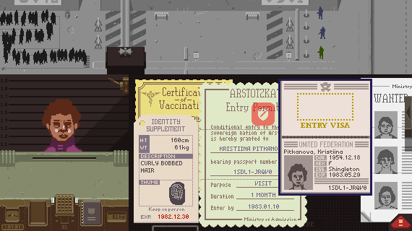

Slide 33
Prototyping and Playtesting
Want to get to the experience as quickly as you can so you can decide if its on the right track
We will talk more about this in a couple weeks and is the focus of assignment 2

Slide 35
Alignment
Checking in to make sure you’re game and you goals agree with each other
Making adjustments to the process and going back into one of the other loops
Often where you think about the EDGE Framework
Where formative and summative evaluations take place
We will talk more about these with the spectrum of evaluation

Slide 36
Alignment with the EDGE Framework
Consider your design from the each lens
Think about a change from that lens would impact the others
Educational Objectives
Mechanics Dynamics Aesthetics
Learning Science Principles
Notes:
Educational game = game designed to meet pre-defined educational objectives
Educational game development project will be more successful if:
Educational objectives have been clearly specified early on
Designers have a notion of how the game’s mechanics, though the dynamics, realize the intended aesthetics
Game observes well-established instructional design principles

Slide 37
Any surprising elements or notable holes to the approach?
Where is defining the problem space?
It can be more complicated
A little hard to see how the process works if the goal is changing over time, at what point can you finally settle on a goal
Excellent seque

Slide 39
ENGAGE
Collaboration between HCII and ETC
Developing educational games to teach STEM topics to Pre-K – 3rd graders
Also explore positive social emotional learning
Focusing first on teaching stability and balance to 1st grade

Slide 40
RumbleBlocks Iteration 1

Slide 41
Iteration 1

Slide 42
Funder Requirements
Develop science games for K-3 Learners
Several teams participated nationally
We were assigned to work on non-projectile physics (statics)

Slide 43
Goals for Science Process & Content from National Research Council Framework

Slide 44
Structure-Building Context
The Young Scientist Series:
Building Structures with Young Children
By Ingrid Chalufour and Karen Worth
The second installment in the Young Scientist
Series, Building Structures with Young
Children guides children's explorations to help deepen their understanding of the physical science present in building block structures, including concepts such as gravity, stability, and balance. This nationally field-tested curriculum supports children’s early development of important science inquiry skills such as questioning, investigating, discussing, and formulating ideas and theories through curriculum ranging from exploring and designing structures to building block creations.

Slide 45
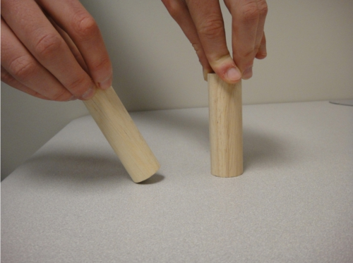
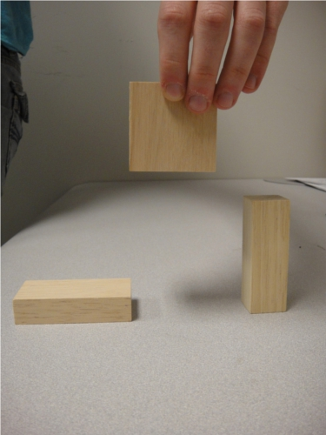
Early interactions with kids
What will happen?
Why?
Which block should I place the square on to build a tall tower that won’t fall over?
Why?
Notes:
Do kids understand gravity?
How do they describe their reasoning behind fall objects
---
Do they have an idea of what makes a good base?

Slide 46
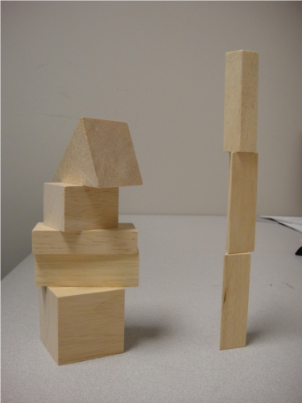
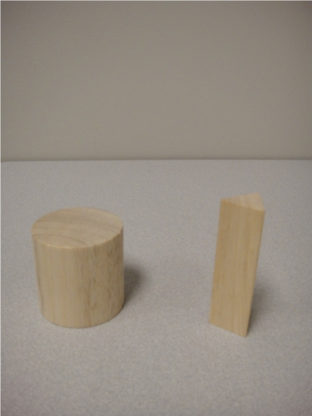
Early interactions with kids
Which tower is less likely to fall over if the table is bumped?
Why?
Which of these would make a better base?
Why?
Notes:
Can they distinguish stable structures from unstable ones?
Do they characterize the distinction using center of mass?
---
Do they understand the concept of a base?
Can they use qualities other than orientation to determine a good base?

Slide 47
Early interactions with kids
Make the Tallest Tower
How do they build without direction?
What patterns do they use in forced choice tasks of blocks?

Slide 48
Initial Educational Objectives Science Content
Principles for designing stable systems | 1 | Shorter objects tend to be more stable
 | 2 | Objects with a wider base tend to be more stable
 | 3 | Objects with more weight at the bottom and less at the top tend to be more stable
 | 4 | Symmetrical objects tend to be more stable
 | 5 | No single principle is always true; these principles interact with one another to affect stability
Stability and instability in physical systems | 1 | Gravity is an invisible force that pulls and object downwards
 | 2 | An object has a center of mass (where mass is evenly distributed on all sides)
 | 3 | An object is subject to the force of gravity, which acts at the center of mass
 | 4 | An object will topple when its center of mass is not over its base
Notes:
gravity, stability, and balance
principles were culled from various building structures curricula/books and our own exploration of the domain
Similar to FOSS and Science Start! Goals
The Young Scientist Series:
Building Structures with Young Children
By Ingrid Chalufour and Karen Worth

Slide 49
Iteration 1

Slide 50
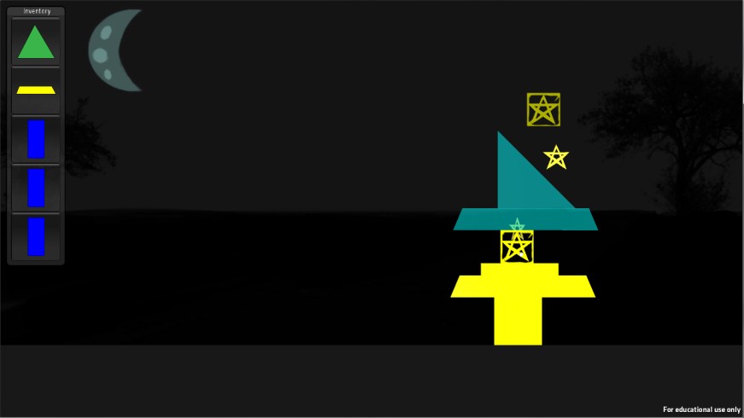
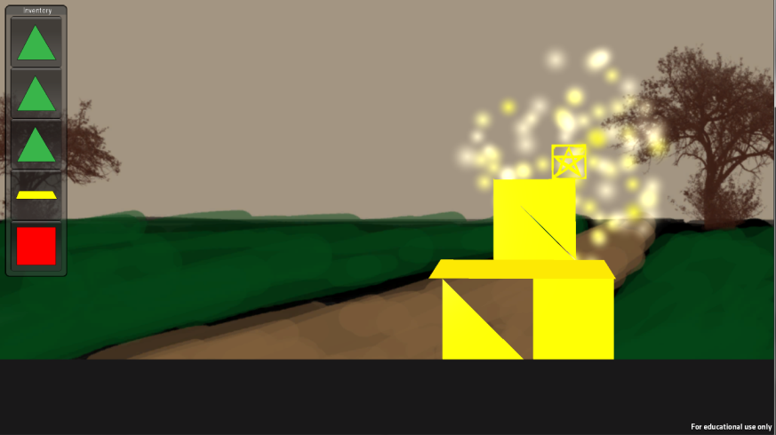
Early Game Demos

Slide 51
Early Game Demos
Implemented several kinds of building mechanics
Played with towers sticking together vs falling apart
Building things up toward a goal made sense
Towers falling apart was fun
Gameplay dynamics heavily dependent on available blocks

Slide 52
Iteration 1

Slide 53
Aligning Design Concepts with Stated Goals
Principles for designing stable systems | 1 | Shorter objects tend to be more stable
 | 2 | Objects with a wider base tend to be more stable
 | 3 | Objects with more weight at the bottom and less at the top tend to be more stable
 | 4 | Symmetrical objects tend to be more stable
 | 5 | No single principle is always true; these principles interact with one another to affect stability
Stability and instability in physical systems | 1 | Gravity is an invisible force that pulls and object downwards
 | 2 | An object has a center of mass (where mass is evenly distributed on all sides)
 | 3 | An object is subject to the force of gravity, which acts at the center of mass
 | 4 | An object will topple when its center of mass is not over its base

Slide 54
RumbleBlocks Iteration 2

Slide 55
Iteration 2

Slide 56
More Formal Knowledge Elicitation
No existing instruments to assess the targeted building principles
Novel approach: Use contrasting cases to isolate a single principle
Student explanations of contrasting cases provide further insight into misconceptions or prior conceptions
Piloted instrument with ~14 kindergarteners (CMU Children’s School)
Notes:
Leads students to notice features such as height, width, symmetry, etc.
Allows us to measure students’ understanding of a particular stability principle
Traditionally used in constructivist instructional approaches (e.g., structured invention tasks)
In-game instruction
Students may see a series of cases about a single stability principle and generalize a pattern across them
Student A sees cases on principle A; Student B sees cases on principle B; they work together to predict A-B integrating cases
Students select a pair of cases as supporting evidence for a scientific claim

Slide 57
“because it’s taller”
Student prediction
Principle: Height
Correct prediction
If the table shakes, will these two blocks fall at the same time or will one fall first?

Slide 58
“because it’s pointy at the top”
Misconception: objects with narrow tops are less stable
Student prediction
Principle: low weight
Correct prediction
If the table shakes, will these two blocks fall at the same time or will one fall first?
Notes:
The one on the left falls first.
Relates to our third principle: More weight at the bottom and less weight at the top tends to be more stable
OTHER RESPONSES:
“this one is fatter, this one is skinnier”
“they both have the same amount of support”

Slide 59
“because they both have the same amount of support”
Student prediction
Principle: Symmetry
Correct prediction
If the table shakes, will these two blocks fall at the same time or will one fall first?
Notes:
The one on the left falls first
Relates to our fourth principle: Symmetrical objects tend to be more stable
OTHER RESPONSES:
“because it only has one thing to balance on”
“because this one has one turn at the bottom and this one has two turns at the bottom”

Slide 60
“because it’s a little bit crooked”
Students tend to reason from a single principle
Student prediction
Principles: Symmetry and low weight
Correct prediction
If the table shakes, will these two blocks fall at the same time or will one fall first?
Notes:
The one on the left falls first
Integrating case: integrates two principles – symmetry and weight at the bottom
OTHER RESPONSES:
“I’m just guessing” – sophisticated response. He can’t figure it out using a single principle, so he’s confused. At least he knows he’s confused!
“because it’s leaning” “because it has more turns and this one only has an angle”

Slide 61
“because it’s taller”
Students tend to reason from a single principle
Student prediction
Principles: height and base width
Correct prediction
If the table shakes, will these two blocks fall at the same time or will one fall first?
Notes:
These should fall at the same time because the ratio of height to width is proportional
This is an ambiguous integrating case, that many studnets have difficulty with
OTHER RESPONSES:
“because it’s less heavy”
“the smaller one”
“because it has a little amount of support”

Slide 62
Accuracy of Students’ Predictions
Single Principle
Width | Height | Symmetry | Low weight
79% | 71% | 50% | 21%
Multiple Principles
Non-amb | Ambiguous
60% | 31%
Requires reasoning from 2 principles
Notes:
Table of proportion of correct predictions about single principles
Students have good understanding of wide base and height principles
Their understanding of symmetry and low weight are less solid.
The do particularly poorly on low weight cases, perhaps due to their persistent misconception that “pointy” things are less stable
We had two kinds of items that required students to think about two principles
Non-ambiguous items where one principle is so exaggerated that it clearly “wins”
Ambiguous items where each principle contributes equally (so kids should say “they fall at the same time” or “I’m not sure because it’s taller but also wider…”)
Kids perform quite poorly on the ambiguous items, which suggests that they have a hard time dealing with ambiguity, where the answer is “unclear”. This also suggests (and the qualitative data confirms this) that students reason from a single principle for a given problem.

Slide 63
Example Non-explanations
No explanation
“I just think so”
“I don’t know”
Explanations that don’t answer “why”
“because it could tip over and go whee”
“it would start to fall. it would break into a million pieces on the floor”
“this one go poof”

Slide 64
Observations
Misconceptions
Heavier structures are more stable
Bigger structures are more stable
“Pointy” structures are less stable
Imprecise understandings
“Skinny” (rather than narrow base) structures are less stable
Other difficulties
1/3 of the sample had difficulty explaining “why”
Children had difficulty on multiple-principle items
Some children responded consistently across items with a single principle
It was difficult for children to reason about all 4 principles.
Notes:
So "skinny is less stable" depends on what is meant by skinny. If the whole block is skinny, then yes. But if only the top is skinny, then no.
Other observations
1/3 of the sample had difficulty explaining “why”. This suggests a need for in-game explanation scaffolds.
Children had tremendous difficulty on items that required reasoning from more than 1 principle. This suggests a need for instruction to integrate the principles.
Some children responded consistently across items with a single principle, others were inconsistent, driven by the particular item. In general, it was difficult for children to reason about all 4 principles.

Slide 65
Design implications
Moved away from multi-principle levels
Basing the game around reaching a target height (technically violating a principle) would be ok because kids were good at that already
Initially moved away from including explanation based mechanics because kids were bad at formulating explanations
We did eventually add a more scaffolded explanation system in later

Slide 66
Iteration 2

Slide 68
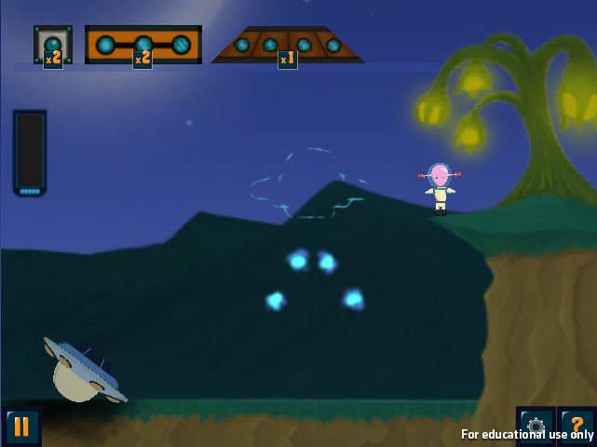
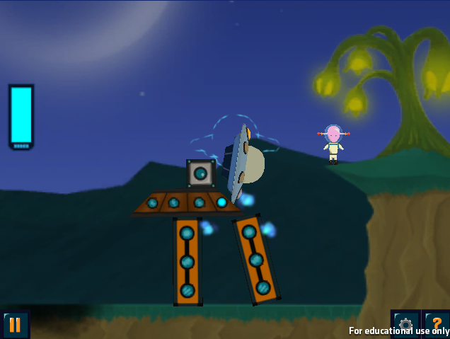
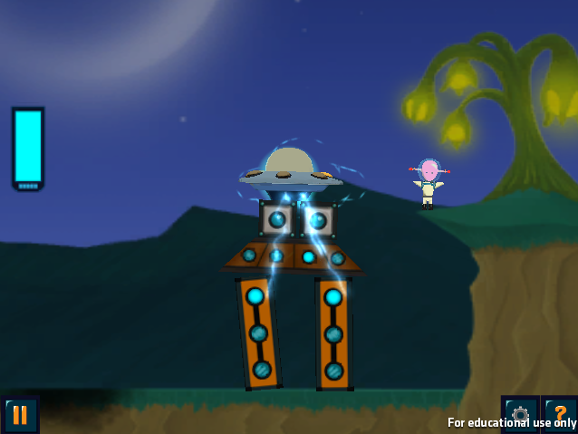
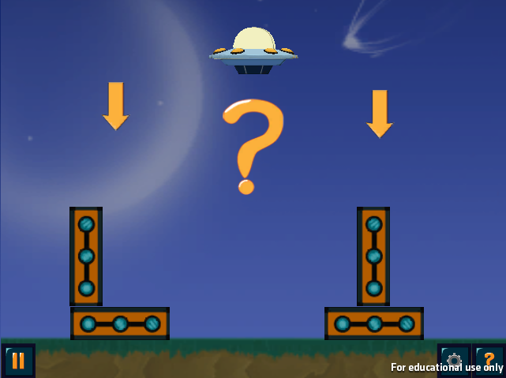
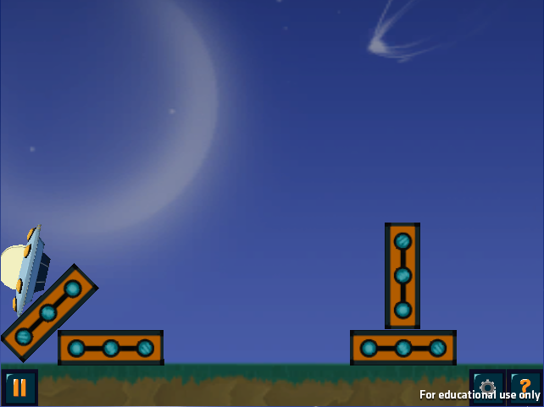
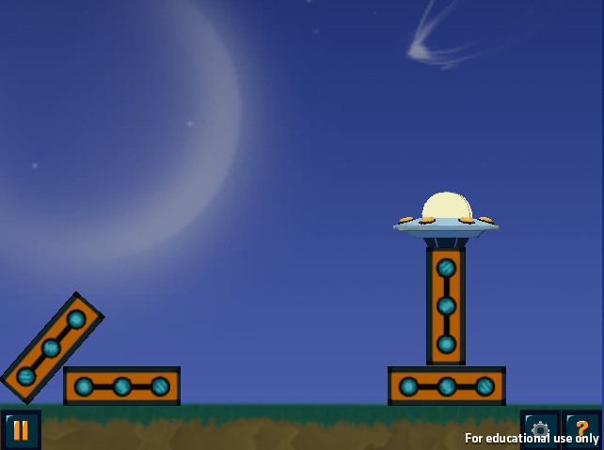
Different Types of Levels
Build
Contrasting Cases
Notes:
RB is a block-building game w/ an alien theme
There are two kinds of levels in RumbelBlocks
Standard levels
-- The goal is to construct a tower that will reach a certain height and withstand an earthquake, using a given set of blocks. Towers must also cover energy dots which scaffold learners into building structures that follow the principles. Here, the dots lead learners to build a symmetrical tower.
-- Apply physics principles to achieve game goals but without strong scaffolds that focus learners on noticing the principles.
Contrast levels
--- Players choose which of two towers will remain standing in the earthquake, then receive feedback.
– Use contrast to draw attention to principles.

Slide 69
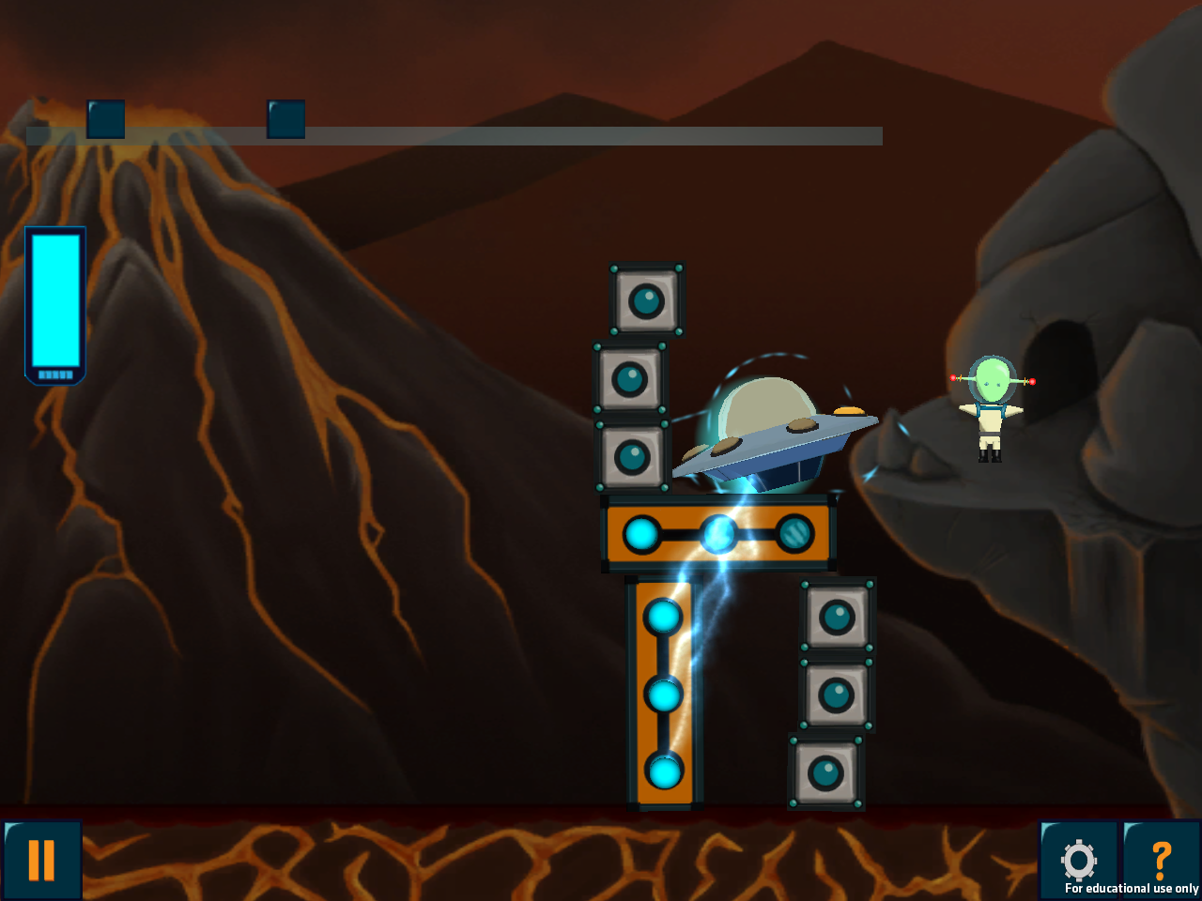
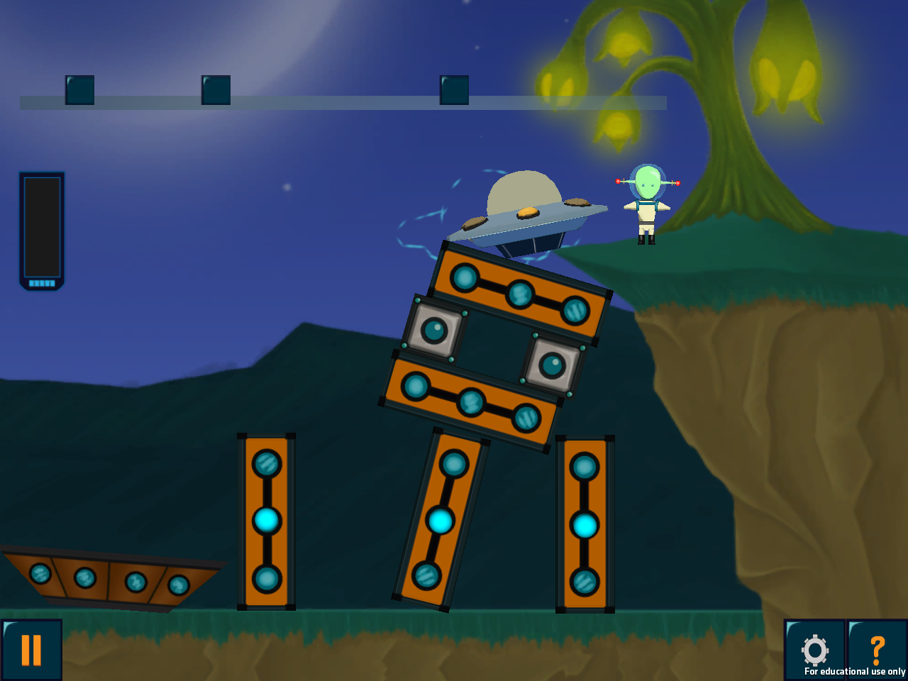
Mechanical flaws in early prototypes

Slide 70
Iteration 2

Slide 71
Formal Evaluation
First big playtest of the game with students in classrooms
281 K-3 students from 2 Pittsburgh Public Schools
Implemented counter-balanced pre-posttest levels in-game
In-game PRE
In-game POST
External PRE
Game play
(~40 min total)
External POST
Day 1
Day 2
Day 3
Day 4

Slide 72
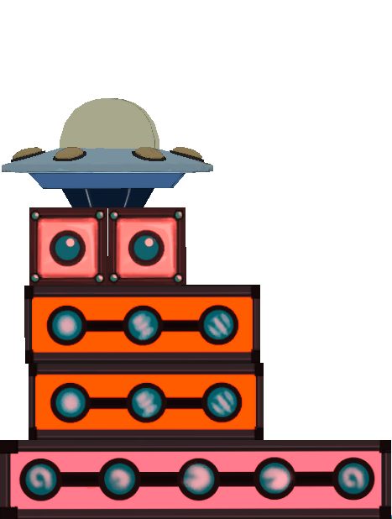
Principle-Relevant Metrics (PRMs)
Base Width
Center of Mass Height
Symmetry Angle
Notes:
Normalized per level to account for

Slide 73
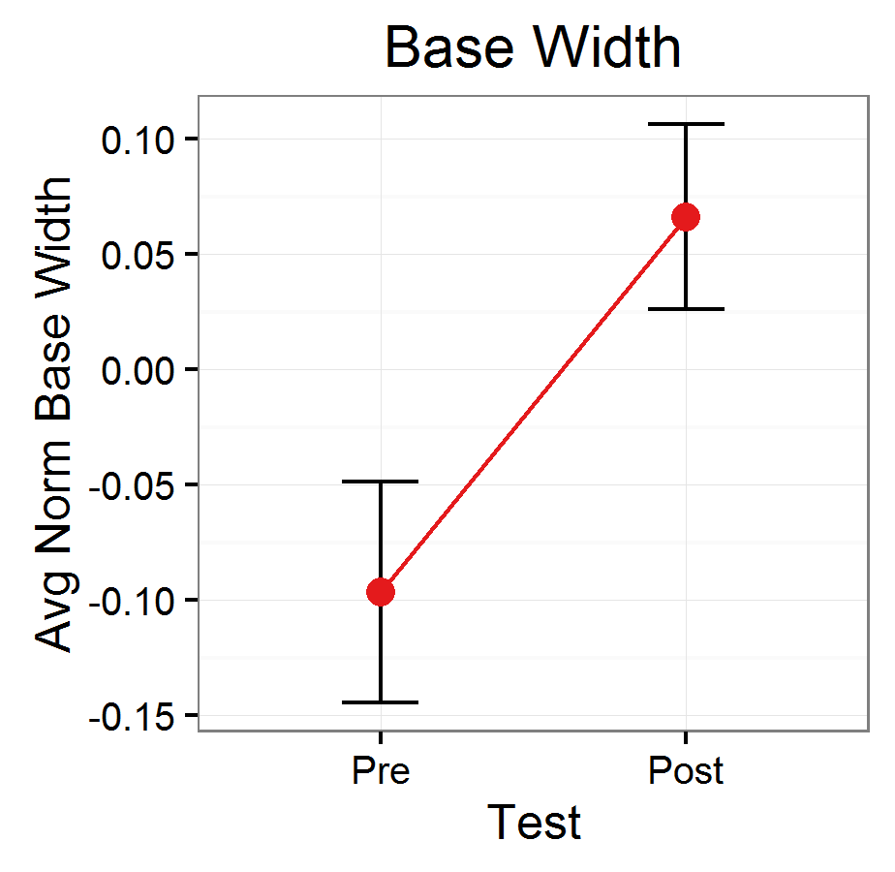
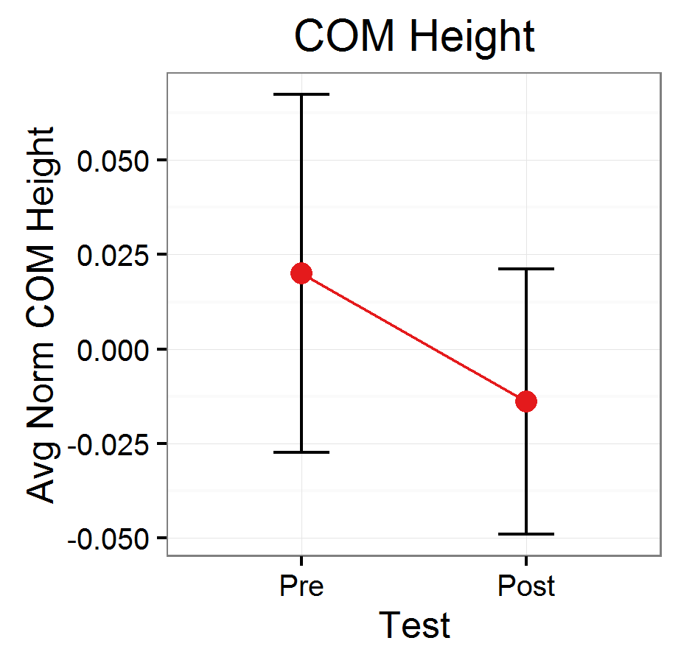
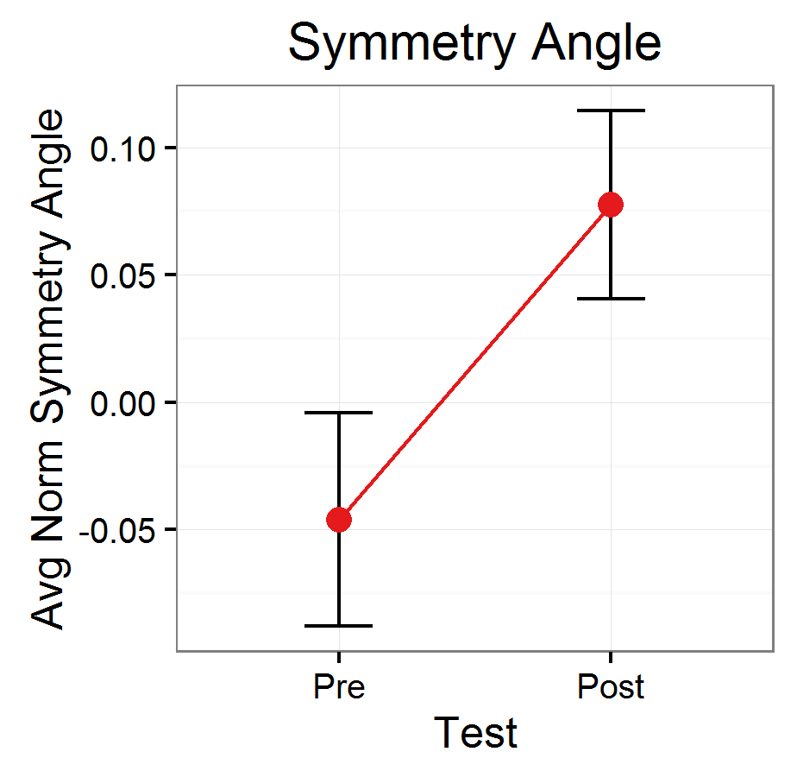
In-Game Pre-posttest Results
** p < .01
* p < .05
Notes:
174 students in these analyses

Slide 74
Alignment Regression Results
Can you predict whether a tower would stand, or fall based on the principle-relevant metrics?
Coefficient | B | SE B | β | p
(Intercept) | 1.08 | 0.45 | 1.75 | -
Base Width | 0.14 | 0.03 | 0.19 | < 0.001 | ***
COM Height | -0.05 | 0.05 | -0.04 | 0.295
Symmetry Angle | 0.05 | 0.01 | 0.32 | < 0.001 | ***

Slide 75
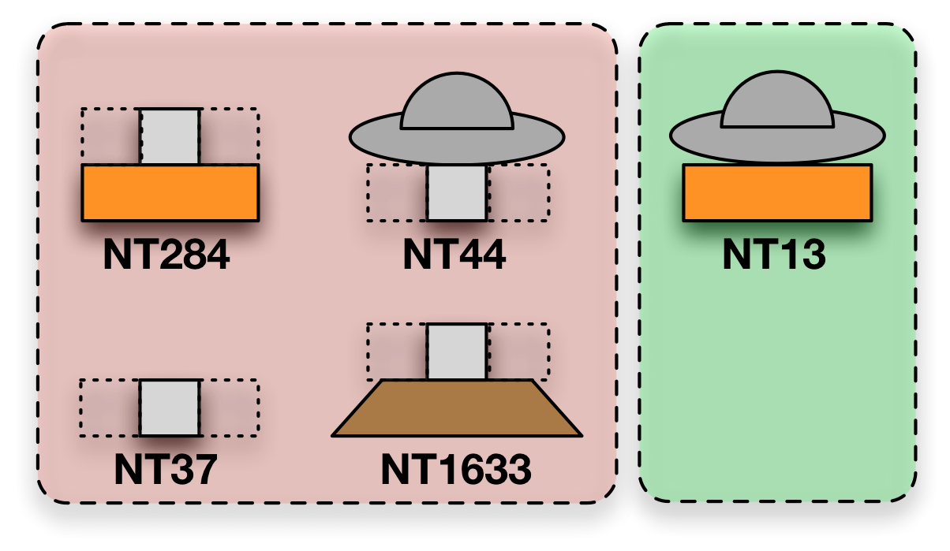
Issues we found
Students don’t seem to learn the low-center of mass principle very well
Micro-faults in towers are highly predictive of success and failure, rather than whole structures as principles suggest
How might we fix these things?
Failure
Success

Slide 76
Continued Iterations…
Explored several more iterations:
Introduced self-explanation mechanics
Improved learning ☺
Explore several design variations to fix micro-faults issue
Did not improve learning ☹
Ultimately the project ended and the game is stuck where we left it

Slide 78
Practicalities of Ed Game Design

Slide 79
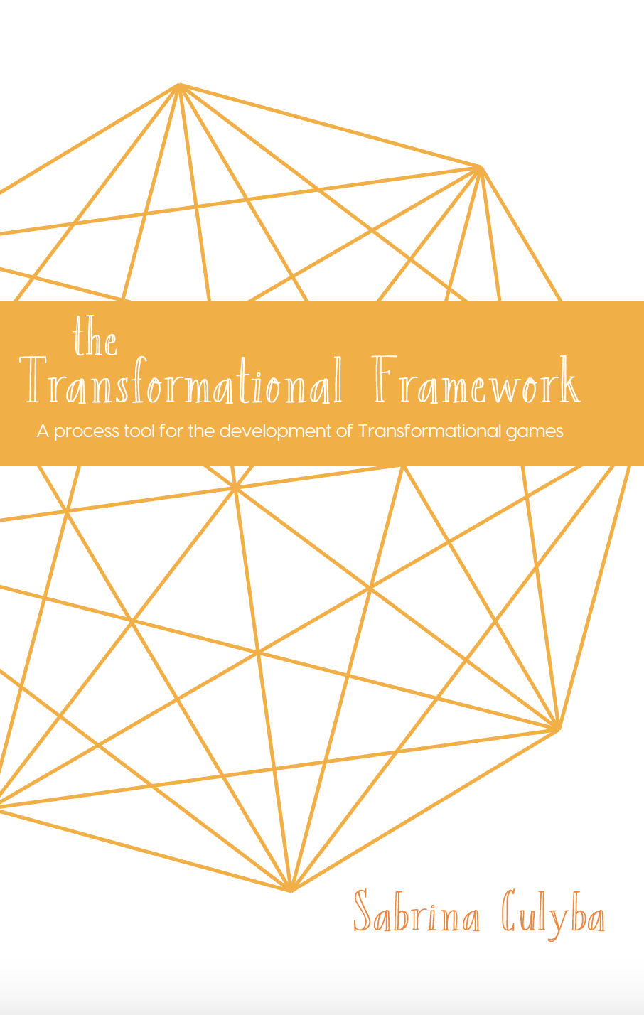
Game Development Primer and Production Considerations
Sabrina Culyba
Culyba, S. H. (2018). The Transformational Framework: A process tool for the development of Transformational games. Retrieved from http://press.etc.cmu.edu/index.php/product/the-transformational-framework/

Slide 80
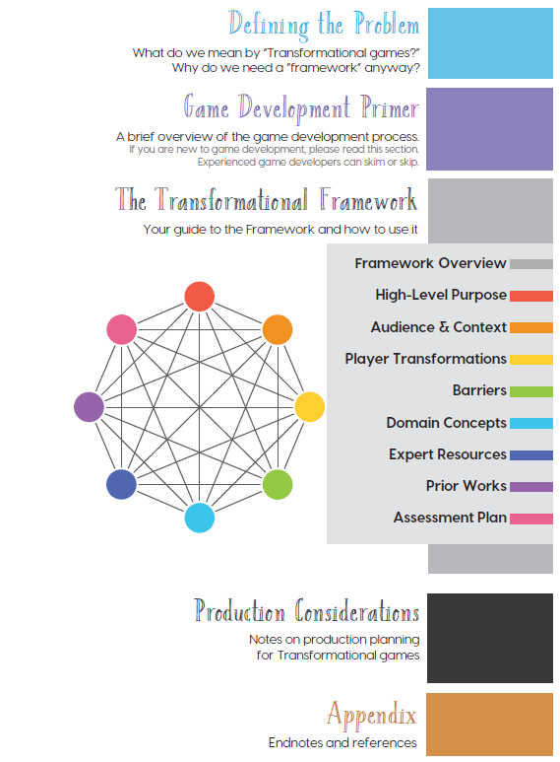
Some Quick Context
You read these

Slide 81
Other thoughts (Culyba)

Slide 82
Game Dev Timeline
Concept
Pre-production
Production
pre-Alpha
Alpha
Beta
QA
Ship

Slide 83
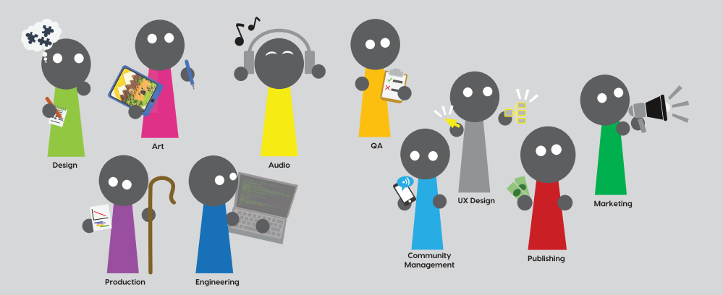
The Game Development Team

Slide 84
What Developers Want You to Know

Slide 85
What Developers Want You to Know What you should ask for as a developer

Slide 86
What you should ask for as a developer
“Everyone” is not an audience

Slide 87
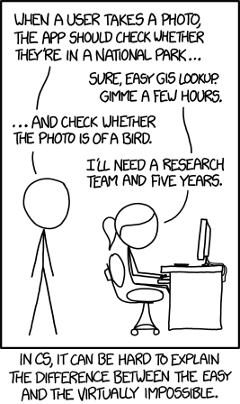
What you should ask for as a developer
“Everyone” is not an audience
Not always obvious what is hard vs easy
https://xkcd.com/1425/

Slide 88
What you should ask for as a developer
“Everyone” is not an audience
Not always obvious what is hard vs easy
Surprises are bad
Need to know about deliverable and demo requirements early
Any dislikes or strong opinions of particular stakeholders

Slide 89
What you should ask for as a developer
“Everyone” is not an audience
Not always obvious what is hard vs easy
Surprises are bad
Part of managing risk is making cuts

Slide 90
What you should ask for as a developer
“Everyone” is not an audience
Not always obvious what is hard vs easy
Surprises are bad
Part of managing risk is making cuts
Have a clear chain of approval

Slide 91
What you should ask for as a developer
“Everyone” is not an audience
Not always obvious what is hard vs easy
Surprises are bad
Part of managing risk is making cuts
Have a clear chain of approval
Late feedback is the worst feedback

Slide 92
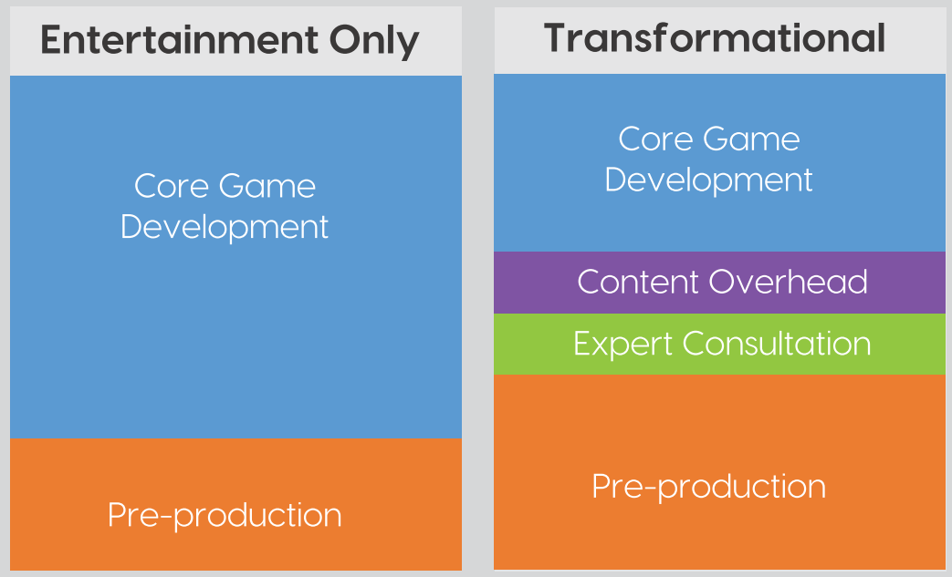
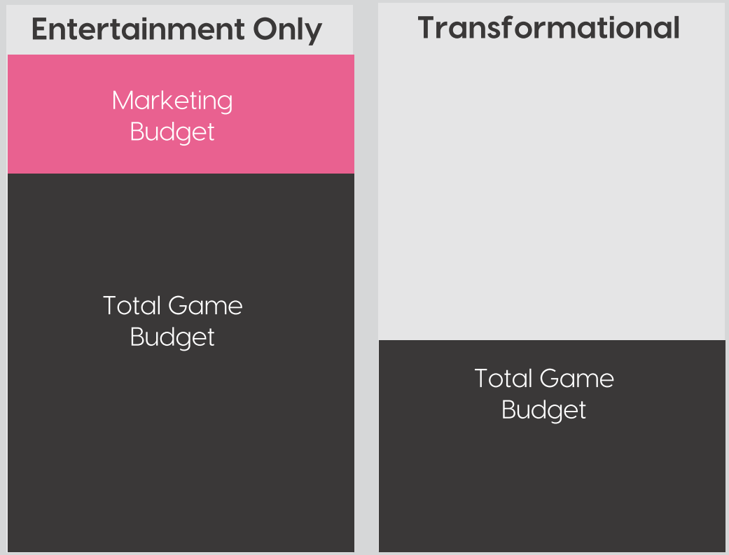
Doing More with Less…
Relative Effort Required
Relative Resources Available

Slide 93
Additional Considerations
Pre-production will take longer
More people will be involved in content and review
You have to test for more than fun/engagement
Educators’ use of your game is dependent on the support you provide
Stakes are generally higher
content mistakes are more important and fixing them is a priority

Slide 94
For next time
First Critique Blog Post Due Today @23:59 US Eastern
RWPs posted for Thursday
We will talk more about and practice Knowledge Elicitation
No Class next Tuesday
If you have any feedback about how live sessions are going please let me know: https://edugames.design/feedback

