Slide 1
7 – Transfer
Design of Educational Games
05418/05818 Human-Computer Interaction Institute
Erik Harpstead

Slide 2
Announcements
Crit 1 Grades have been released
Assignment 1A was due yesterday
Upcoming Assignments:
Crit post 2 is DUE next Tuesday Mar 2
Assignment 1B is DUE next Thursday Mar 4

Slide 3
Plan for Today
Debrief on Crit 1
Introduce types of transfer
Tell the story of research on transfer

Slide 4
Any Assignment 1 Questions?

Slide 5
Crit 1 Feedback

Slide 6
Critique 1
In general pretty good
I graded this one a bit harshly so you have the ability to course correct on future critiques
Your lowest Crit grade for the semester will be dropped

Slide 8
Scoring Levels
Points | Level | Description
5x | Impressive Work | You cover all the important aspect of a dimension and your take on it is a particularly insightful or compelling treatment of the concept
4x | Good Work | You adequately covered the important aspects of a dimension to a level we would expect from a student of your level without missing anything obvious
3x | Ok Work | You mostly cover the important aspects of a dimension but might have missed something obvious or applied a concept incorrectly
2x | Flawed Work | You cover a dimension but your treatment of it has several major flaws or is substantially incomplete
1x | Present | Coverage of a dimension is at least present but lacks any substance
0 | Missing | We cannot find anything we could attribute to the dimension

Slide 9
Common Issues (General)
Missing dimensions
Easy way to lose points is to leave something off
Be sure you have something to check off for every dimension of the rubric
Not using a blog format

Slide 10
Common Issues (Learning Goals)
Staying at the high-level subject area for potential learning or transfer
Try to give at least an example of a more specific concept or skill a player might acquire
Simply reiterating the developer’s stated goal or what’s entered on the Big List
Articulate the potential learning as you see it from playing the game
Saying that a game requires no prior knowledge
There is almost always something even if its just the language the game uses or how to work the interface

Slide 11
Common Issues (Game Elements)
Not tying Game Elements together
A lot of people described a personal narrative of what the game was like the first time they played it
I want to see how you’re thinking about how mechanics and systems giving rise to interesting gameplay
Not mentioning player experience
What does it feel like playing the game?
Can you envision how someone else might feel differently than you?

Slide 12
Common Issues (Principles)
The principle needs to be in the space of the instructional content
Ex, many games have aspects of variability but is that variability relevant to the instructional domain?

Slide 13
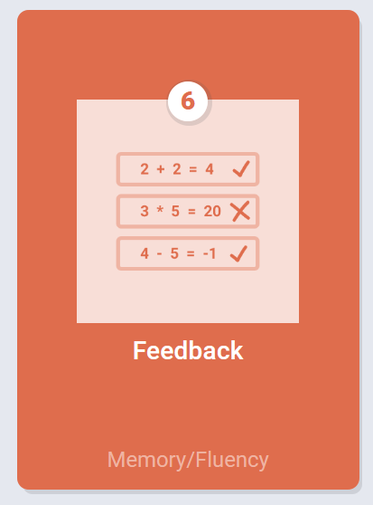
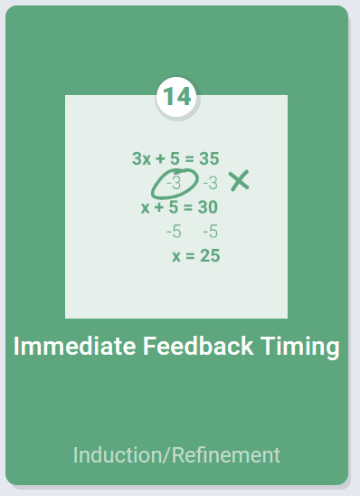
Feedback principles
* Actually pretty good so far but I see this often
Immediate feedback on Errors > delayed feedback
Programming tasks are NOT examples of immediate feedback! They are delayed on-demand feedback
Debugging wouldn’t be a skill if programming feedback was immediate

Slide 14
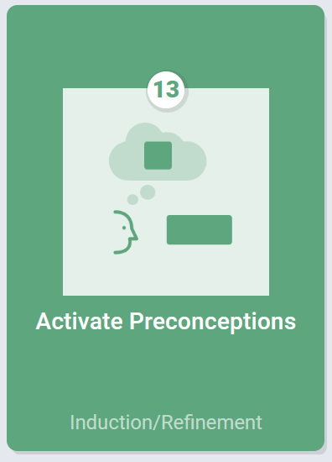
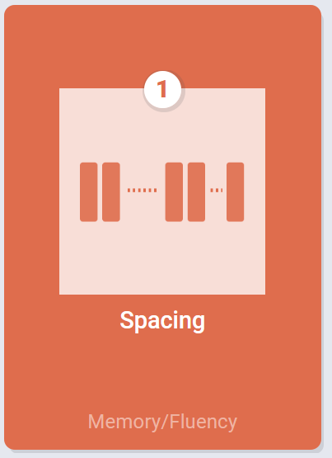
Pretraining and Activate Preconceptions vs Spacing
Many mentioned pre-training or activating preconcetions in cases where games reviewed or incorporated older content
This is more an example of the spacing principle
Pretraining is about practice prerequisite skills before doing a real task
Activating preconceptions is about recalling current understanding of a thing before dealing with it in more depth

Slide 16
The Story of Transfer

Slide 17
What makes a game educational?
Learning that transfers out of the game and game context into “real life”
New skills/concepts/competencies/abilities/ dispositions that help in important situations
Ideally, there is some predictability as to what you will learn
I.e., the game effectively supports learning for a wide range of learners
Ideally, the learning is efficient
Since time, as always, is a scarce resource
Ideally, the learning is robust
I.e., it lasts, can be applied in new situations, and perhaps even, helps future learning
Notes:
Couple more examples?
You got better at killing monsters in a dungeon, that is great, but really, in real life, how often do you find yourself in a dungeon killing monsters
“Transfer” is a key concept here
→ Now, you might say, that is unfair, because Gee and others also point out that games may support

Slide 18
Educational Objectives
Prior knowledge: What knowledge or skills will students need before playing the game?
Learning and retention: What knowledge or skills will students learn from the game?
Potential transfer: How far are these knowledge and skills likely to transfer?
Notes:
(as in any instructional design project)
Framework considers game designed with an explicit set of educational goals in mind
rather than an opportunistic and less coherent set of educational goals
Helps avoid creating games that
address only simple instances of a targeted cognitive skill
assume prior knowledge that the student/player is not likely to have
make it easy for the student/player to work around the learning embedded in the game
etc.
may they learn beyond what they encountered in the game?
Not enough to just say that students will learn whole-number division – want something far more specific here.
Each question has a three-part answer: (a) written description, (b) examples of tasks from which to learn each learning objective (may even though this at the level of steps within tasks, rather than tasks) (may even though this at the level of steps within tasks, rather than tasks)

Slide 19
What is Transfer?

Slide 20
What is Transfer?
The movement of skills between different fields or areas or even vertically within a single area or field
Lacking a connection between the behavioral transfer we can observe and the essence of transfer neurologically
Someone practices in one area, how well do they do in a different area
The ability to use pieces of knowledge that are known in the field to discover something new in the same field or a different one
6 facets of understanding, achieving self knowledge with the ability to self-reflect, self-examine, self-evaluate
When you’re learning something you are integrated in a context and transfer is being able to access that knowledge in a different context
You have a deep and meta-understanding of knowledge, a balance between generality and specificity

Slide 21
“The study of transfer is the study of how knowledge acquired in one situation applies (or fails to apply) in other situations.”
Singley & Anderson, 1989, p. 1

Slide 22
Finding One’s Place in Transfer Space
Transfer can be thought of as existing across dimensions
How similar are the performance and training tasks?
How similar is the context of performance versus training?
How much time as passed between performance and training?
Klahr, D., & Chen, Z. (2011). Finding One’s place in transfer space. Child Development Perspectives, 5(3), 196–204. https://doi.org/10.1111/j.1750-8606.2011.00171.x

Slide 23
“ … the problem of transfer is perhaps the fundamental educational question. It is rare that people learn things in school which apply directly to life and work. For education to be effective, curricula must be designed with an eye toward transfer.”
Singley & Anderson, 1989, p. 1-2

Slide 24
Lack of Transfer?

Slide 25
Unsuccessful Transfer?

Slide 26
Examples of Transfer?
Game design principles transferting to other softdev cources
A lot of the interdisciplinary design of college
[insert domain] thinking
Thinking of spatial cognition in Tetris and how you pack your car
Diff Eq as a math course and then using differential equations through out
In computer programming having to think about a way to divide up tasks and how you might manage a team of people

Slide 27
Examples of Lack of Transfer? Negative Transfer?
Adobe Photoshop versus Adobe illustrator
False assumptions between software
Being good at math but not being good at physics

Slide 28
Overview
Different Perspectives on Transfer
General vs. specific transfer
Meaningful vs. rote learning
Analogical transfer
Lateral vs. vertical transfer
Specificity of transfer
Direct Application vs. Preparation for Future Learning

Slide 29
General vs. specific transfer
General: Doctrine of formal discipline
Mind is muscle you exercise with subjects like Latin and geometry
General faculties of mind: Observation, attention, discrimination, reasoning
=> Transfer is broad & general, across domains
Example: Training in chess transfers to computer programming b/c both involve your reasoning faculty
John Locke*
*some times attributed to Plato
Notes:
The Doctrine of Formal discipline is kind of where braintraining lives, which is why many learning scientists are skeptical of it

Slide 30
General vs. specific transfer
Specific: Theory of identical elements
Mind is made up of stimulus-response elements
Transfer only occurs between tasks with elements in common
=> Transfer is narrow, within domains
Edward Thorndike
Notes:
The Doctrine of Formal discipline is kind of where braintraining lives, which is why many learning scientists are skeptical of it

Slide 31
Thorndike’s 1922 Experiment on Transfer
Slight changes in equations led to significantly worse performance
Familiar: “Square x + y” → 94% correct Novel: “Square b₁ + b₂“ → 72% correct
Familiar: “Multiply xª & x^{b}“ → 44% correct Novel: “Multiply 4ª & 4^{b}“ → 30% correct
Thorndike’s point:
If there are slight changes in stimulus… then the stimulus-response element does not apply... therefore, no transfer

Slide 32
But there was some transfer
1/6 of Thorndike’s novel problems weren’t harder
Familiar: “Solve e² + ef = 8/x for x” → 48% correct Novel: “Solve e² + ef = 8/p for p” → 47% correct
Performance on novel problems averaged ~50%
…well above 0% expected if there was no transfer

Slide 33
Weaknesses of Thorndike’s Theory
“What can we say of a theory that the training of the mind is so specific that each particular act gives facility only for the performing again of that same act just as it was before?“
Alexander Meiklejohn
Notes:
Think of learning to drive a nail with a yellow hammer,
and then realize your helplessness if, in time of need, you should borrow your neighbor's hammer and find it painted red.
Nay, further think of learning to use a hammer at all if at each other stroke the nail has gone further into the wood,
and the sun has gone lower in the sky,
and the temperature of the body has risen from the exercise,
and in fact, everything on earth and under the earth has changed so far as to give each new stroke a new particularity all of its own,
and thus has cut it off from all possibility of influence upon or influence from its fellows“(Meiklejohn, 1908, p. 126)

Slide 34
Weaknesses of Thorndike’s Theory
Meiklejohn, 1908
Notes:
Think of learning to drive a nail with a yellow hammer,
and then realize your helplessness if, in time of need, you should borrow your neighbor's hammer and find it painted red.
Nay, further think of learning to use a hammer at all if at each other stroke the nail has gone further into the wood,
and the sun has gone lower in the sky,
and the temperature of the body has risen from the exercise,
and in fact, everything on earth and under the earth has changed so far as to give each new stroke a new particularity all of its own,
and thus has cut it off from all possibility of influence upon or influence from its fellows“(Meiklejohn, 1908, p. 126)

Slide 35
Weaknesses of Thorndike’s Theory
Didn’t allow for intelligent adaptation or flexible reconstruction of knowledge
No two situations are truly identical so some kind of transformation or adaptation of existing knowledge must happen.
Made no use of abstract mental representations
Mainly because it was 1922 and he predated them
No explicit representation language for cognitive skill
Vague about exact nature of “elements” making it hard to define what “identical” means
Notes:
"What can we say of a theory that the training of the mind is so specific that each particular act gives facility only for the performing again of that same act just as it was before? Think of learning to drive a nail with a yellow hammer, and then realize your helplessness if, in time of need, you should borrow your neighbor's hammer and find it painted red. Nay, further think of learning to use a hammer at all if at each other stroke the nail has gone further into the wood, and the sun has gone lower in the sky, and the temperature of the body has risen from the exercise, and in fact, everything on earth and under the earth has changed so far as to give each new stroke a new particularity all of its own, and thus has cut it off from all possibility of influence upon or influence from its fellows“(Meiklejohn, 1908, p. 126)

Slide 36
Meaningful vs. rote learning
Between the general-specific extremes:
Breadth of transfer dependent on type of instruction
Transfer depends on whether a common representation can be found & communicated

Slide 37
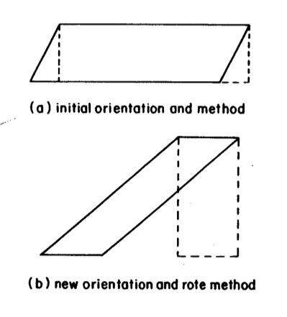
Wertheimer’s Sensible and Insensible Transfer Tasks
Participants were shown how to calculate the area of a parallelogram by dropping perpendiculars to transform the parallelogram into a rectangle, then calculate the area of that.
Some participants grasped the transformation
Others viewed it as a set of rote steps
Notes:
This is probably one of the most common thing lay people talk about in transfer
Wertheimer relied on the natural variation in strategy for this study
(b) Students that didn’t develop a meaningful strategy for the task continued to drop verticals which is wrong
(c) Student that developed a meaningful strategy could perform the sensible transfer tasks and could reject the others as malformed

Slide 38
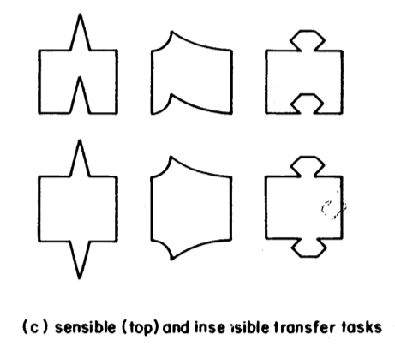
Wertheimer’s Sensible and Insensible Transfer Tasks
Notes:
This is probably one of the most common thing lay people talk about in transfer
Wertheimer relied on the natural variation in strategy for this study
(b) Students that didn’t develop a meaningful strategy for the task continued to drop verticals which is wrong
(c) Student that developed a meaningful strategy could perform the sensible transfer tasks and could reject the others as malformed

Slide 39
Judd’s refraction study
Task: Throw darts at underwater target
Experimental group instructed on refraction theory
Control group just practiced
Training task: Target was 12” under water
Transfer task: Target was 4” under water
What happened during training?
> No difference in performance
What happened during transfer task?
> Experimental group did much better. Why?
> Experimental group had better representation of the task, more flexibly adapted to new conditions
Aim at where target appears through water & dart misses!

Slide 40
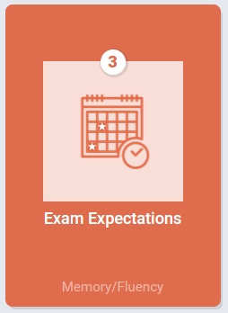
Analogical transfer
Perfetto, Bransford, & Franks study:
Participants solved insight problems like:
A man who lived in a small town in the U.S. married twenty different women of the same town. All are still living and he has never divorced any of them. Yet, he has broken no law. Can you explain?
Experimental participants had previously been asked to rate the truthfulness of a number of sentences including: “A minister marries several people each week”
Such exposure had no effect on insight problem performance!
If Participants were told explicitly of sentences relevance, then performance was improved
Notes:
Adding connections is important

Slide 41
Simple 2-Stage Model of Analogical Transfer
1. Retrieve a similar prior problem
2. Map it on to your current situation
Many studies, like Perfetto et al., show difficulties with retrieval (#1)
But in more complex domains, mapping (#2) is also a challenge
Need deep, not surface feature encodings of problems to make a productive mapping

Slide 42
Deep vs. Shallow Features
Chi, Feltovich, Glaser:
Novice physics students categorize problems by surface features
pulley or inclined plane in diagram, similar words in problem text
Experts categorize based on abstract, solution-relevant features
Problems solved using the same principle, e.g., conservation of momentum

Slide 43
Lateral vs. vertical transfer
Lateral transfer: Spreads over sets of situations at the same level of complexity
E.g., write a for-loop in different programming languages
Vertical transfer: Spreads from lower-level to higher-level skills, from parts to whole
E.g., writing loops in isolation transfers to doing so in the context of a large problem
Vertical transfer is common, lateral is rare
Vertical transfer was applied in early instructional design theories
Gagne & programmed instruction (Behaviorist)
Identify hierarchy of parts that need to be learned
Sequence instruction so that smaller parts are mastered first before larger wholes

Slide 44
Specificity of transfer
How much transfer occurs depends on the way in which people “encode” or “represent” the problem situation.

Slide 45
Wason Card Selection Task
Test whether this rule is true:
If a card has a vowel on one side, then it has an even number on the other side
Which cards must you turn over to test the rule?
E
B
4
7
Notes:
Answer = 1 and 4

Slide 46
Abstract Selection Task Results
Subjects said:
E & 4 → 46%
E only → 33%
E & 7 → 4%
Other → 17%
Subjects with formal training in logic do not perform significantly better
Take that doctrine of formal discipline!

Slide 47
Wason Selection Task - Concrete Version
Test whether this rule is true:
If a person is drinking alcohol, then they must be over 21
Which cards must you turn over to test the rule?
Someone
Drinking Alcohol
Someone
Drinking Soft Drink
Someone
Over
21
Someone Under
21

Slide 48
Concrete Selection Task Results
Subjects had no difficulty whatsoever correctly selecting “drinking alcohol” (if-part) & “under 21” (not of then-part)
Other scenarios involving social rules yield same results, rule need not be familiar:
If a person enters the country, then they must be tested for cholera.
=> Neither doctrine of formal discipline nor Thorndike’s identical Stimulus-Response elements account for these results
=> People’s knowledge is induced from the ground up & intermediate in abstraction

Slide 49
The Ghost of General Transfer
General transfer could “liberate students & teachers from the shackles of narrow, disciplinary education”
Is general transfer possible?

Slide 50
Evidence Against General Transfer
Thorndike’s original experiments disconfirming formal discipline
Latin & geometry courses don’t increase reasoning test scores any better than bookkeeping or shop courses
Problem solving study (Post & Brennan)
Heuristics: determine given, check result
Did not transfer to word problem solving
Notes:
Post and Brennan (1976) trained subjects for several weeks on a general heuristic procedure for solving algebra word problems. Their instructions included such things as "determine what is given" and "check your result." On a problem-solving postest, the performance of the trained subjects was no better than that of a control group.

Slide 51
Evidence for General Transfer
No evidence for General transfer!
Some evidence for limited general transfer:
LOGO programming (Carver & Klahr)
LOGO programming & debugging instruction transfers to other debugging tasks
Math problem solving (Schoenfeld)
Heuristics with a specific “if-part” led to transfer
Heuristics with a vague “if-part” did not transfer

Slide 52
Why is even limited general transfer hard to produce?
Knowledge is largely domain specific
Simon estimate from chess studies: Experts acquire > 10,000 chunks of knowledge
General methods are often either:
Too vague to effectively apply
Heuristics like “avoid getting lost in detail” depend on substantial domain-specific knowledge (which novices lack!) to distinguish irrelevant detail from key features
“Search paths simultaneously, use signs of progress to guide you” again depends on domain specific knowledge to detect signs of progress
Effective ones may already be known by novices
Working backwards, means-ends analysis

Slide 53
Maybe we’ve been going about it all wrong?
“Prevailing theories and methods of measuring transfer work well for studying full-blown expertise, but they represent too blunt an instrument for studying the smaller changes in learning that lead to the development of expertise.” (Bransford, and Schwartz, 1999)
John Bransford
Dan Schwartz

Slide 54
Two Perspectives on Transfer
Direct Application Theory of Transfer
Focuses on measuring people’s ability to directly apply their previous learning to a new setting or problem
Final transfer tasks are done as sequestered problem solving without the ability to seek help, try things out, get feedback, or revise
Preparation for Future Learning
Shifts the focus to assessments of people's abilities to learn in knowledge-rich environments
Not, can you do the transfer task? Instead, are you better prepared to approach it?
(Bransford, and Schwartz, 1999)

Slide 55
Eagle Habitat Study
Asked fifth graders and college students to create a statewide recovery plan to protect bald eagles from the threat of extinction
Both groups failed to come up with truly viable solutions
Did not mention the danger of baby eagles imprinting on humans
Did not mention creating hacking towers so fledglings would imprint on the territory
Etc.
From a direct application perspective college students were not successfully transferring any biology knowledge they might have learned during their education
(Bransford, and Schwartz, 1999)

Slide 56
Eagle Habitat Study
Participants were also asked to generate questions about important issues they would research to design an effective plan
5th graders focused on individual features
How big are they, what do they eat?
College students focused on issues of interdependence between eagles and their habitats
What type of ecosystem supports eagles? What about predators of eagles and eagle babies? Are today’s threats like the initial threats to eagles?
From a PFL perspective college students’ biology learning had prepared them to approach the novel problem even if their ultimate answer would not have worked
(Bransford, and Schwartz, 1999)

Slide 57
Transfer as a different kind of Knowing
Knowing that
Replicative knowledge, restating facts or conceptions
Knowing how
Applicative knowledge, being able to apply what you know
Knowing with
Using our cumulative set of knowledge and experiences, we perceive, interpret, and judge situations based on our past experiences
Associative
activation of nonlogical relationships based on contiguity, resemblance, frequency, and other features
Interpretive
how people categorize, classify, predict, and infer information about a problem
(Broudy, 1977)

Slide 58
What about brain training?
The idea that general cognitive ability or core cognitive mechanisms can be enhanced by engaging in cognitively demanding exercises
Often focuses on:
Working memory
Inhibition
Processing speed
Notes:
Brain training is the idea that you can exercise general cognitive systems like working memory or logical reasoning to get better at doing stuff

Slide 59
Evidence Against Cognitive Training
A large second-order Meta-Analysis investigated the impact of working-memory training on near-transfer (i.e., memory) and far-transfer (e.g., reasoning, speed, and language) measures and whether it is mediated by the type of population.
Model 1 [99 studies] showed that working-memory training does induce near transfer, and that the size of this effect is moderated by the type of population [i.e., works better in kids].
Models 2 [119 studies] and 3 [233 studies] highlighted that far-transfer effects are small or null.
Giovanni Sala, N. Deniz Aksayli, K. Semir Tatlidil, Tomoko Tatsumi, Yasuyuki Gondo, and Fernand Gobet. 2019. Near and Far Transfer in Cognitive Training: A Second-Order Meta-Analysis. Collabra: Psychology 5, 1: 18. https://doi.org/10.1525/collabra.203

Slide 60
Evidence Against Cognitive Training
When placebo effects and publication bias were controlled for, the overall effect size and true variance equaled zero.
That is, no impact on far-transfer measures was observed regardless of the type of population and cognitive-training program. The lack of generalization of skills acquired by training is thus an invariant of human cognition.
Giovanni Sala, N. Deniz Aksayli, K. Semir Tatlidil, Tomoko Tatsumi, Yasuyuki Gondo, and Fernand Gobet. 2019. Near and Far Transfer in Cognitive Training: A Second-Order Meta-Analysis. Collabra: Psychology 5, 1: 18. https://doi.org/10.1525/collabra.203

Slide 61
What about brain training?
The idea that general cognitive ability or core cognitive mechanisms can be enhanced by engaging in cognitively demanding exercises
Often focuses on:
Working memory
Inhibition
Processing speed
Notes:
Brain training is the idea that you can exercise general cognitive systems like working memory or logical reasoning to get better at doing stuff

Slide 62
What about brain training?
The idea that general cognitive ability or core cognitive mechanisms can be enhanced by engaging in cognitively demanding exercises
Often focuses on:
Working memory
Inhibition
Processing speed
John Locke’s
Doctrine of Formal Discipline
Notes:
Brain training is the idea that you can exercise general cognitive systems like working memory or logical reasoning to get better at doing stuff

Slide 63
Summary
Out-of-game transfer of learning is key to effective educational games
Transfer depends on how students encode instructional tasks & target tasks
To design for transfer, need to help students arrive at a general encoding
Learning principles are helpful, especially those dealing with sense-making and induction/refinement
General transfer does not occur
People must learn “details” of a domain
But transfer can prepare for future learning
Does not need to be a direct application of existing skills to new contexts, can look to impact how people approach problems

Slide 64
For next time
Remember:
Crit Post 2 is DUE next Tuesday
Assignment 1B is DUE next Thursday
RWPs for next week will go up soon
If you have any feedback about how live sessions are going please let me know: https://edugames.design/feedback

