Slide 1
15 – Pitching and Peer Feeback
Design of Educational Games
05418/05818 Human-Computer Interaction Institute
Erik Harpstead

Slide 2
Announcements
Nailed down the Special Topics Schedule
Office Hours:
Wednesdays @ 2 in NSH 2614 or on Zoom at: https://cmu.zoom.us/my/harpstead
Also by appointment at: https://erik-harpstead.youcanbook.me/

Slide 3
Final Project Announcements
Final Project Showcase time announced (May 5 @5:30 pm)
You should all have feedback on your scoping proposals
Please name your teams
Please make sure your team google drives are shared with:
eharpste@andrew.cmu.edu
lrountre@andrew.cmu.edu
hcarter@andrew.cmu.edu

Slide 4
Plan for Today
Talk briefly about how we’re going to do peer feedback
Go through expectations for the concept pitch
Give you time to work with your groups

Slide 5
Peer Feedback

Slide 6
What has been your experience with Peer Feedback in the past?
Assigned to a pair and exchange work to grade against a rubric
At the end of the phase of work you share feedback
Other systems is more informal
Anonymous (though you can usually tell)
Different levels of granulatiry in terms of how detailed the feedback is
Catme – within team feedback
It’s inconsistent because some people give more detailed ones than others. But helps if more than one other person reviews your work
Not really trained on how to give feedback so its not very helpful
2 points you specifically like about a given team member
Sandwhich feedback
Positive (constructive) negative positive
Poster sessions
If the system doesn’t schedule people to visit posters you odn’t get as much feedback

Slide 7
When are we using peer feedback in this class?
Final Project Concept Pitches
Check-in 1 Presentations
Check-in 2 Presentations

Slide 8
Why are we using peer feedback in this class?
Peer feedback processes are common in creative industries
Students are rarely taught how to use them well
Learn how to consolidate and prioritize feedback
Learn how to use feedback to iterate on a design
Learn how to give and receive helpful critique
It’s not a design course without peer feedback
Joseph Seering, Ray Mayol, Erik Harpstead, Tianying Chen, Amy Cook, and Jessica Hammer. 2019. Peer Feedback Processes in the Game Industry. In Proceedings of the 2019 Annual Symposium on Computer-Human Interaction in Play - CHI PLAY ’19

Slide 9
Giving Good Feedback

Slide 10
What makes peer feedback helpful?
Helpful
Unhelpful
Specific and Actionable
The feedback being directed toward the product rather than the person
The use of examples and analogies
Alternatives or suggestions
Highlighting strengths
A recap of what you understood
Questions can be helpful to guide how to think about why they are raising it
Having a third party facilitate the session
Some level of planning or preparation
Giving suggestions about different aspects of the design
So talking across different angles
Anonymous negative feedback
You can be more harsh when anonymous
Not given context for the feedback, don’t know why or when
“Everything is great!”
If its all positive its very helpful
If the person doesn’t understand the context and suggests something that isn’t possible

Slide 11
Qualities of helpful feedback
Less Helpful
More Helpful
Abstract
Concrete
General
Specific
Descriptive
Actionable
Evaluative
Formative
About the Person
About the Work
Notes:
TO DO: give (or ask for) specific examples of each type of feedback here
Abstract = ideas, concrete = observable
General = group, specific = individual

Slide 12
PeerPresents
Go to: https://peerpresents-test.andrew.cmu.edu/
Create an account and add the course
Is having technical difficulties

Slide 13
Google Doc Fallback
We will try to replicate PeerPresents as close as possible using Google docs
Each team will make a separate doc with their guiding questions
People can type into the shared doc as you talk

Slide 14
Activity: Mock Feedback Session
Questions:
Does the game seem engaging?
On a scale of 1 to 5, how clear is the objective of the game?
What do you remember being hard about division?
How could we make the game harder?
What’s the coolest thing about our game?
http://edugames.design/peer-demo
Notes:
I’ll give a 1 minute pitch of a game idea.
You’ll write down feedback to answer these questions.

Slide 15
Example Questions
Questions:
Does the game seem engaging?
On a scale of 1 to 5, how clear is the objective of the game?
What do you remember being hard about division?
How could we make the game harder?
What’s the coolest thing about our game?
Qualities of Helpful Feedback:
Concrete
Specific
Actionable
Formative
About the work
Notes:
I’m Amy… Pacha, Protector of Mother Earth! Mobile ed game for upper elementary school kids. Play as a tucan, protector of the forest, like a forest ranger. Defeat the carbon monster machine! Sense of danger that forest could be destroyed at any moment. Protect by exploring 10 kinds of forests and collecting items to heal plants and animals. Also in-game puzzles to solve. Learn to appreciate nature as kid, so they grow up to preserve nature as an adult.

Slide 16
StarShip Division
Team Professor:
Erik Harpstead (only member)
Notes:
We are team professor and we are going to make a web game to teach elementary school kids about division concepts

Slide 17
Domain
Fluency with Divisibility judgments with dividends < 100 and divisors < 10
Example: By which of these divisors can you divide 42: 3, 5, or 6? Or none of the above?
Existing curricula target these concepts
We will also be doing some CTAs with kids to see which tasks they struggle the most with

Slide 18
Demographic
Middle school aged kids using this game for fluency practice
We will assume they have some prior training in division but have not mastered it
We have contacts at some local schools who will help us get playtesters

Slide 19
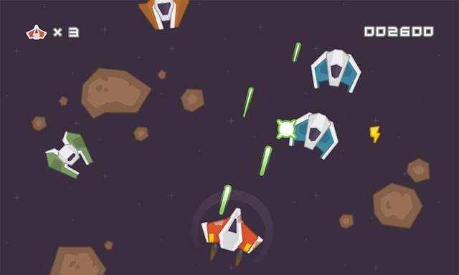
18
2
2
15
12
2
2
Game Concept

Slide 20
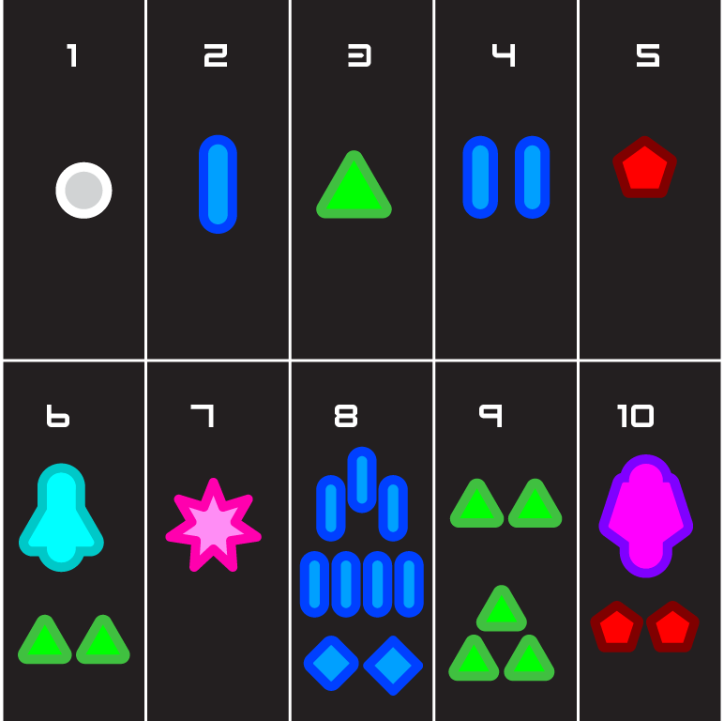
Game Ideas
The shape and color of shots correspond to numbers
Could do the same thing with player shields to avoid enemy shots

Slide 21
Next Steps
Create an initial demo scene
Talk to some kids about divison
Find the time to actually build the rest…

Slide 22
Lets look at the feedback you wrote…
Questions:
Does the game seem engaging?
On a scale of 1 to 5, how clear is the objective of the game?
What do you remember being hard about division?
How could we make the game harder?
What’s the coolest thing about our game?
Qualities of Helpful Feedback:
Concrete
Specific
Actionable
Formative
About the work
Notes:
Ask to make statements more specific, concrete, actionable as needed

Slide 23
Which questions elicit “good” feedback?
Questions:
Does the game seem engaging?
On a scale of 1 to 5, how clear is the objective of the game?
What do you remember being hard about division?
How could we make the game harder?
What’s the coolest thing about our game?
Notes:
(discuss what they thought of the example questions)
#3 is pretty good.
Something is missing...

Slide 24
How could we rewrite these questions?
Questions:
Does the game seem engaging?
On a scale of 1 to 5, how clear is the objective of the game?
What do you remember being hard about division?
How could we make the game harder?
What’s the coolest thing about our game?
What about the game do you think our target audience would like?
How would you expect our audience to feel about game?
What do you think is the objective of the game?
What are some difficulties of division that the game doesn't tackle? How could you include these in the game?
What would you change or add to the game to make it harder?
What’s the most memorable aspect of the game?
Notes:
Potential improved questions? (why are these better?)
When did the main character seem most relatable? When least relatable?
Which player choices did you find engaging? Which choices did you not care about?
What elements of the game created suspense? (this is a good question though!)
What question is missing!!

Slide 25
How we do Peer Feedback in this class On Presentation Days
Every team writes at least 5 questions they want to prompt feedback from the class before presenting
Create a google doc for each presentation and link them here:
http://edugames.design/peer
During your pitch/presentation everyone else answers your questions while you present
For the pitch we won’t do follow up questions but for the check-in presentations we will

Slide 27
Final Project Pitches

Slide 28
Final Project Pitches
You and your team will have the opportunity to pitch your final project concept to the class
The goal is to solidify your direction for yourselves and to get peer feedback
Format:
8 minute presentation
Either use a single spokesperson or have the whole team talk but everyone should be there

Slide 29
What you should cover
Who you are
Project title
Team members

Slide 30
What you should cover
Your Domain
An example of a task that players should get better at by playing your game
A hypothesis of what is hard for players in learning to do your task
Any sources for domain knowledge you’ll be consulting
Some Pitfalls:
“Understanding…” is not a task
“Appreciating…” is not a task

Slide 31
What you should cover
Your target demographic
How old are they?
Do they need particular expertise or prior experience?
How will you be finding them?
Some Pitfalls:
“Everyone” is not a demographic
“People interested in our domain” is not a sufficiently specific demographic

Slide 32
What you should cover
Initial Game Ideas
What platform(s) are you thinking about
What mechanic ideas do you have
What player experience do you want to create?
Some Pitfalls:
Having too defined an idea at this stage is probably a bad thing
Having vague ideas and directions is ok

Slide 33
What you should cover
Plans for next steps
What do you plan to do in the next 2 weeks?
Where do you hope to be by check-in 1?
What challenges do you anticipate you will have to deal with?

Slide 34
Pitching Multiple Concepts
If you still haven’t settled no a single concept you can pitch multiple
Ideally they would only vary on 1 dimension, eg:
Two possible domains each with a single game idea
One domain but three possible game directions
A general domain and game direction but more than one audience
Some pitfalls:
You don’t get any more time for multiple concepts so you will describe each one less
If you want to use peer feedback to vote the most concrete concept with likely win

Slide 35
Other things to keep in mind
This is more about helping you guys make something awesome than it is grading your presentation skills
Using pictures / sketches can help a lot
It’s ok to be up front about aspects of the project you haven’t figured out yet
You only have 8 minutes

Slide 37
Work with your Teams!

Slide 38
For next time
Sign your team up to the presentation slots here:
First come first serve, don’t edit other teams’ entries
http://edugames.design/peer
If you have any feedback about how live sessions are going please let me know: https://edugames.design/feedback

