Slide 1
27 – Last Lecture
Design of Educational Games
05418/05818 Human-Computer Interaction Institute
Erik Harpstead

Slide 2
Plan for Today
Go over some Final Project Showcase logistics
Reflect a bit on the semester
Give you the rest of the time to talk to your teams

Slide 3
Final Project Reminders
Final Project Showcase
May 5 @ 17:30-20:30 US ET
Event will be in the Kiesler-Kraut Commons (the HCII Lobby)
Final Project Reports + Individual Reflections
Turn in to Canvas by May 6 @ 23:59
Please update your team’s info at:
http://edugames.design/showcase2022

Slide 4
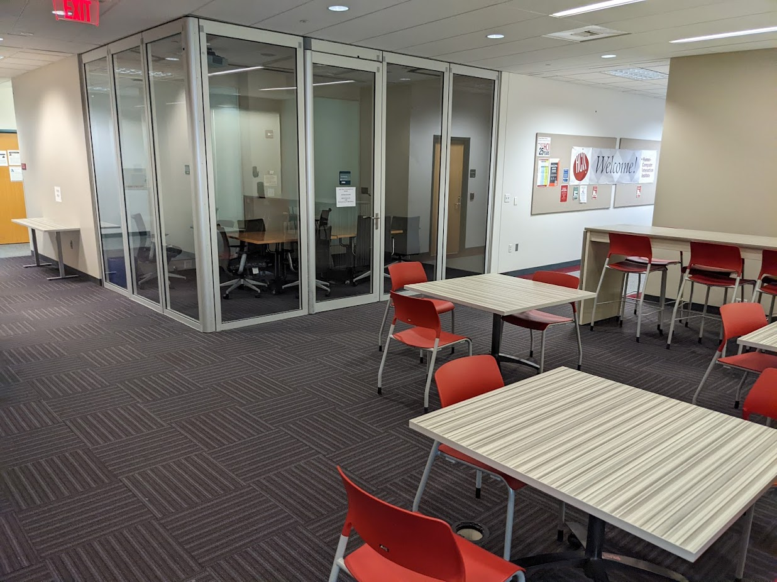
Showcase Format
Each team will get a table space in the Kiesler-Kraut Commons
Will be open to the public and advertised to the HCII and ETC (you can also invite people)
I will go around for 15 min pitches from each team
You’re free to staff your table however you want or go around and play each others’ games

Slide 5
Pitch Should Include
High-level Intro
Ex: “We are team [TEAM NAME] and we are making a [PLATFORM] game to teach [DOMAIN] to [AUDIENCE].”
Think about it like the beginning of a shark tank pitch

Slide 6
Pitch Should Include
At least one specific learning objective of the game and justification / sourcing
Where did your learning goals come from?
Why are they the important ones for the domain?
Don’t have to tell the whole story of your research give a summary

Slide 7
Pitch Should Include
A description of the game AND a gameplay demo
Description should be a quick verbal description of your game’s core features
What’s the player’s goal?
What’s the story / gameplay arch?
The gameplay demo should be done with the actual playable prototype
For digital games this might be a scene or two
For tabletop games it might be round or two of a game in progress

Slide 8
Pitch Should Include
Why I should believe this game is likely to be educational
What is the strongest argument you can make for your game’s efficacy?
Do you have evidence from playtests?
Did you use learning principles?
Were you inspired by existing materials?
If you were to do a more formal eval what would that look like?

Slide 9
General Tips
Treat it more like a conversation on a show floor rather than a formal presentation
I will not look at slides!
This pitch is more about putting your game in its best light than showing your work
Assume I have never heard of you and that I don’t have an context of your development game’s history
Practice your game demo
You only get 15 min

Slide 10
Any Remaining Final Project Questions?

Slide 11
What to do with your games
Pick it up and take it home
I can give back physical copies after a week
Leave them with me and walk away
Submit them to a competition
The Gee Awards: Deadline June 1
https://www.geeawards.com/
CHI PLAY Student Game Design Competition: Deadline July 20
https://chiplay.acm.org/2022/student-game-design-competition/
Other venues exist with fall and early spring deadlines
Carry it forward
Run an evaluation study with it
Turn it into a product

Slide 12
End of Semester Reflection

Slide 13
What have you learned from this class?
This is the class that has required the most robust brainstorming process for me
Rapid prototyping skill
Less talk more rock!
For me, I felt that I learned a strong framework to build and critique games that I didn’t have before.
That educational games and gamification are so much more different than I initially thought! What I initially thought were games are really just game-like experiences
Learned more about how to integrate games with learning (avoiding chocolate covered broccoli situation)
There are a handful of universal game mechanisms/elements that we see repeatedly in most games
I felt like I had so many ideas but when you actually start prototyping your game doesn’t make sense
The capacity for taking a risk in prototyping games is higher
Making up rules
I started playing more games and started critiquing them more

Slide 14
What was the most surprising thing from this course?
Some of the games that were presented as crit games that aren’t necessarily educational
How challenging it is to integrate gameplay into core learning science principles.
Also found it surprising how changes are made based on a series of playtests and how helpful playtests are in the overall process
It’s a really complex process to make a game simple

Slide 15
What is a change you would make to the course?
Would have appreciated a little more scaffolding in the final project
Here’s some frameworks not cut loose
More time to work on final projects versus assignment 2. The process is very collaborative and I learnt more working in a group versus individually
Working on the final project earlier
Maybe make a single game over the whole semester
There were a lot of RWPs initially and it was exhausting but after that, it started became interesting.
Looking forward to special topics a lot but the work sessions were also really important
could be interesting to have a day where we share games we reviewed in our critiques for inspiration
Contrary opinion, I think I like assignment 2 (over assignment 1) because we get to make our mistakes and learn how to build a small micro game early on + before creating a massive final game. It’s good exposure.
Assignment 2 builds up interestingly but then drops as you start the final
Maybe connect through to the final
In the check-in presentations, how can we learn more from each other?
I can be a good audience to give feedback but can’t learn much from it
check-in 2 people didn’t get much how the game actually works
The critiques felt like an individual battle
Maybe bring people together to try collaborative games
Assignment 1 was cool to get practice with (we dove really deep into it but never used it again)

Slide 16
What have I learned from this class?
Trying to admit up to 55 people is probably too many…
Collaboration on individual assignments is a great idea but needs way more guidance
Flexible hybrid attendance works pretty well
I should probably just commit to the whole second half of the semester being studio time

Slide 17
The EDGE Framework
Educational Objectives
Mechanics Dynamics Aesthetics
Learning Science Principles
Notes:
Educational game = game designed to meet pre-defined educational objectives
Educational game development project will be more successful if:
Educational objectives have been clearly specified early on
Designers have a notion of how the game’s mechanics, though the dynamics, realize the intended aesthetics
Game observes well-established instructional design principles

Slide 18
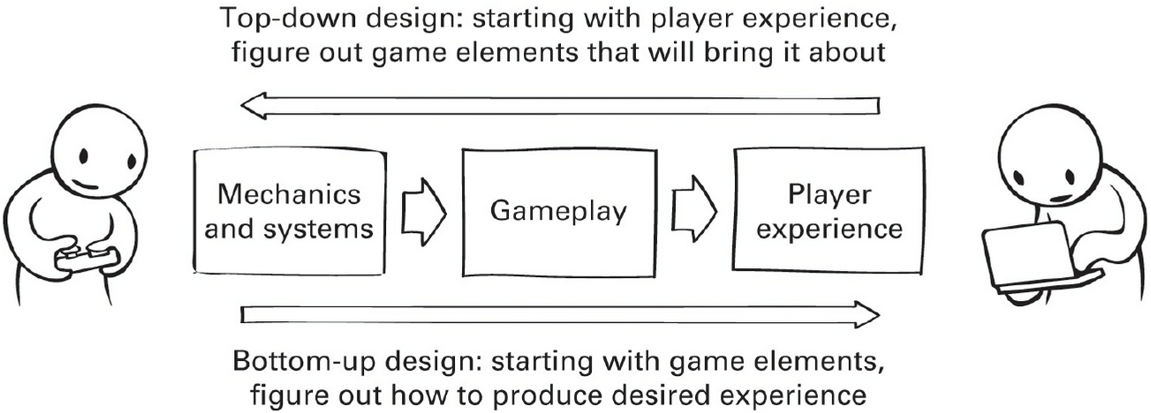
Game Elements (MDA)
Zubeck, 2020

Slide 19
Sets of Learning Science Principles
Memory / Fluency | 1 | Spacing | Space practice across time > mass practice all at once
 | 2 | Scaffolding | Sequence instruction toward higher goals > no sequencing
 | 3 | Exam expectations | Students expect to be tested > no testing expected
 | 4 | Testing | Quiz for retrieval practice > study same material
 | 5 | Segmenting | Present lesson in learner-paced segments > as a continuous unit
 | 6 | Feedback | Provide feedback during learning > no feedback provided
Induction / Refinement | 7 | Pretraining | Practice key prior skills before lesson > jump in
 | 8 | Worked example | Worked examples + problem-solving practice > practice alone
 | 9 | Concreteness fading | Concrete to abstract representations > starting with abstract
 | 10 | Guided attention | Words include cues about organization > no organization cues
 | 11 | Linking | Integrate instructional components > no integration
 | 12 | Goldilocks | Instruct at intermediate difficulty level > too hard or too easy
 | 13 | Activate preconceptions | Cue student's prior knowledge > no prior knowledge cues
 | 14 | Feedback timing | Immediate feedback on errors > delayed feedback
 | 15 | Interleaving | Intermix practice on different skills > block practice all at once
 | 16 | Application | Practice applying new knowledge > no application
 | 17 | Variability | Practice with varied instances > similar instances
Sense-making / Understanding | 18 | Comparison | Compare multiple instances > only one instance
 | 19 | Multimedia | Graphics + verbal descriptions > verbal descriptions alone
 | 20 | Modality | Verbal descriptions presented in audio > in written form
 | 21 | Redundancy | Verbal descriptions in audio > both audio & written
 | 22 | Spatial contiguity | Present description next to image element described > separated
 | 23 | Temporal contiguity | Present audio & image element at the same time > separated
 | 24 | Coherence | Extraneous words, pictures, sounds excluded > included
 | 25 | Anchored learning | Real-world problems > abstract problems
 | 26 | Metacognition | Metacognition supported > no support for metacognition
 | 27 | Explanation | Prompt for self-explanation > give explanation > no prompt
 | 28 | Questioning | Time for reflection & questioning > instruction alone
 | 29 | Cognitive dissonance | Present incorrect or alternate perspectives > only correct
 | 30 | Interest | Instruction relevant to student interests > not relevant
Extraneous | Signaling | People learn better from a game when cues highlight the organization of the essential material area added
 | Redundancy | People do not learn better in games where words are printed and spoken rather than formal style
 | Immersion | People do not learn better when a game is rendered in realistic 3-D virtual reality rather than in 2-D
Essential | Pretraining | People learn better in a game when they receive pretraining in the key concepts
 | Modality | People learn better in games where words are spoken rather than printed
Generative | Self-explanation | People learn better in a game when they are asked to select an explanation for their moves
 | Explanatory Feedback | People learn better in games when they receive explanatory feedback after key moves
 | Prompting | People learn deeply in games when they are asked to reflect
 | Personalization | People learn better in games when words are in conversational style rather than formal style
 | Image | People do not learn much better in games when an agent’s image is on the screen
 | Narrative theme | People do not learn better in games with strong narrative themes

Slide 20
Notes:
It was hard to use this
Maybe more hands=on stuff to better engage with this
Something you write about and I can comment on it
Maybe grouping the prototyping process

Slide 21
Learning / Gameplay Integration Continuum
Tight = Gameplay and learning are one and the same
Loose = Gameplay and learning are separate choices

Slide 22
Verb Based Brainstorming
Lie
Harvest
Wriggle
Combine
Hop
Introduce
Reflect
Escape
Lick
Betray
Flood
Punch
Swim
Freeze
Text
Scribble
Hang
Reminisce
Shield
Swipe
Buy
Climb
Lock
Filter
Float
Write
Punish
Twist
Roll
Destroy
Move
Travel
Kick
Pick
Decorate
Enter
Bid
Dream
Invent
Swat
Thank
Glow
Draw
Throw
Haunt
Read
Slide
Offer
Irritate
Squeeze
Flounce
Balance
Pop
Absorb
Promise
Wither
Give
Frighten
Radiate
Sink
Spin
Applaud
Grab
Shiver
Carry
Drop
Pull
Smell
Scold
Discover
Leave
Tap
Thrive
Observe
Pinch
Rush
Hum
Giggle
Steal
Crawl
Record
Polish
Trigger
Talk
Shout
Interrupt
Scratch
Wipe
Guard
Drip
Tempt
Dare
Hurry
Hunt
Push
Waltz
Skip
Admire
Stick
Swing
Beg
March
Drive
Fade
Confess
Suffer
Puncture
Obey
Pierce
Collect
Marry
Soothe
Deliver
Mourn
Dive
Smash
Drag
Catch
Judge
Trade
Hold

Slide 23
The Spectrum of Evaluation
Self
Reflection
Theoretical Justification
Expert Evaluation
Anecdata
Descriptive Data
Correlational Data
Pre-Experimental Studies
Quasi-Experimental Studies
True
Experiments

Slide 24
PEOPLE DO NOT LEARN FROM GAMES

Slide 25
Educational Game Design is a Third-order Design Problem
Game
Dynamics
Player Experience
Knowledge
Change
Notes:
Ephemeral
Unpredictable
Invisible
Are we screwed?

Slide 26
Keep in Touch
This semester has been challenging but you have all handled it incredibly well
If you continue into the Educational Game space you have my email: harpstead@cmu.edu
If you’re still around next spring and interested in TAing please reach out
Good Luck to those graduating
To those coming back hopefully I’ll see you on campus some day

