Slide 1
1 – Design of Educational Games
Design of Educational Games
05418/05818 Human-Computer Interaction Institute
Erik Harpstead

Slide 2
Who am I?
Dr. Erik Harpstead
Systems Scientist in HCII
Completed my PhD at the HCII in 2017
Been studying Educational Game Design for over 10 years

Slide 3
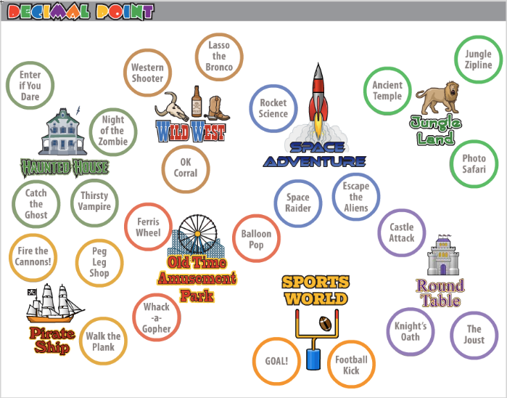
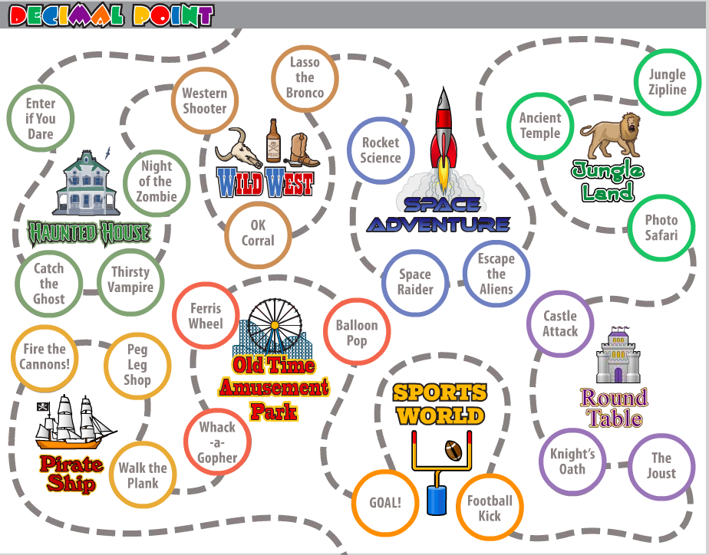
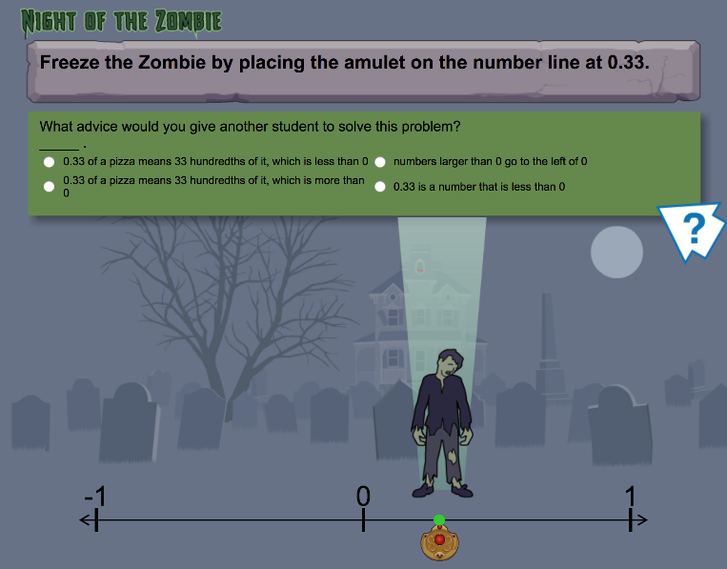
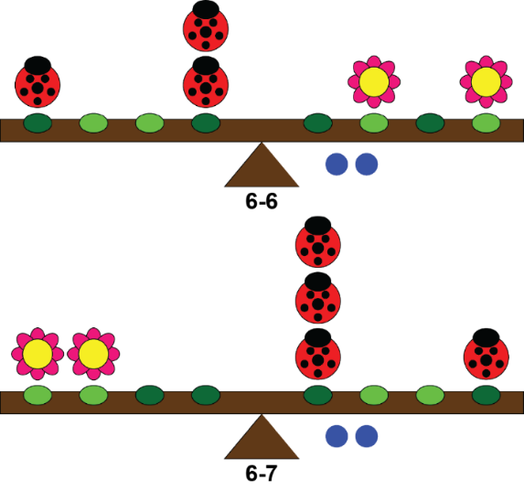
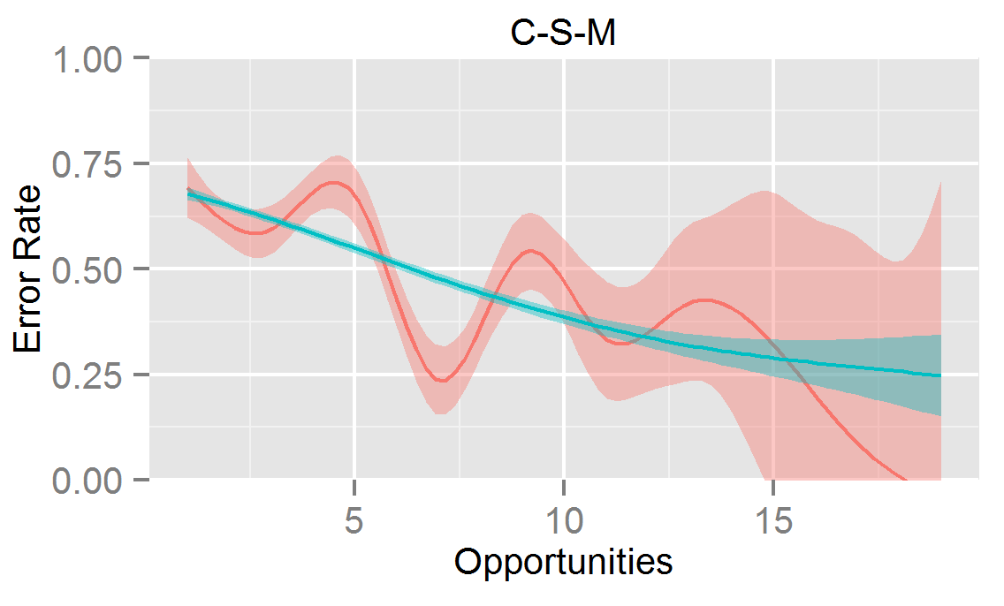
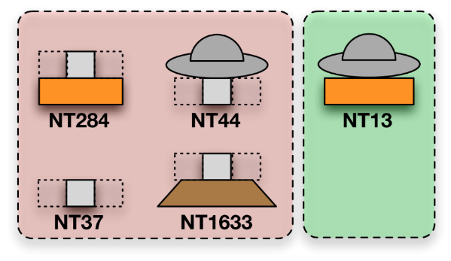
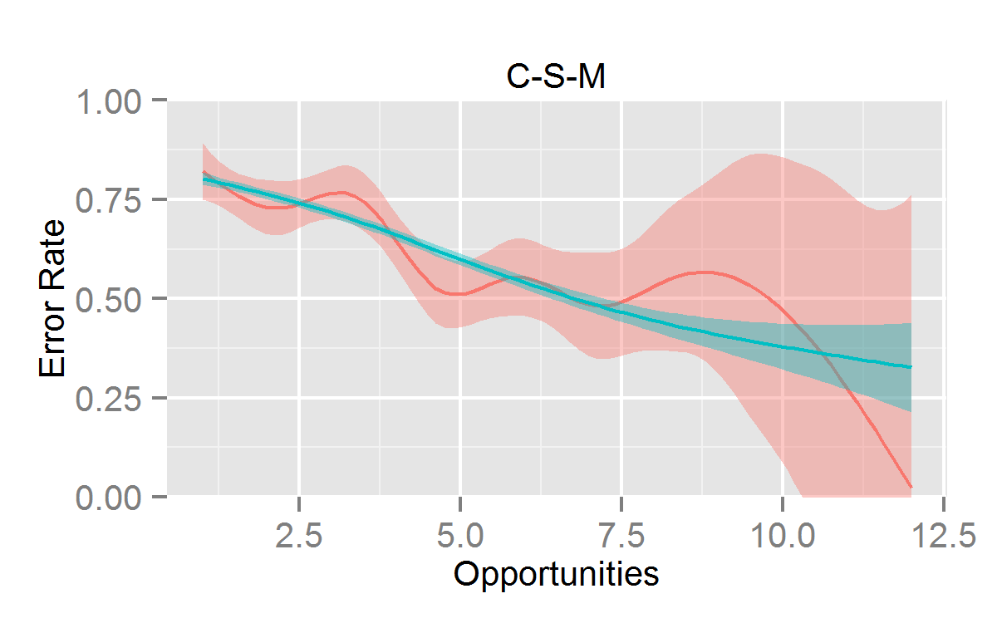
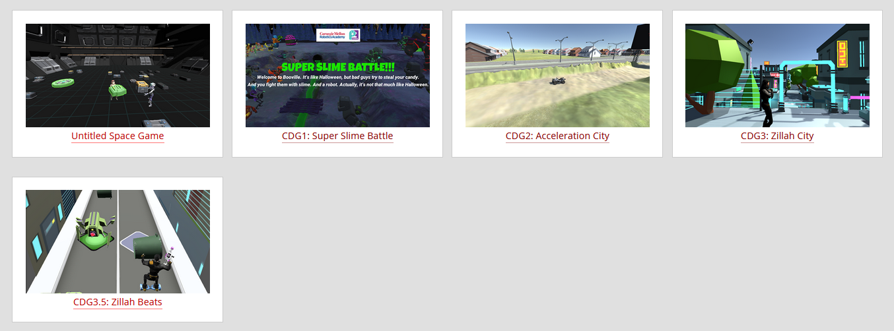
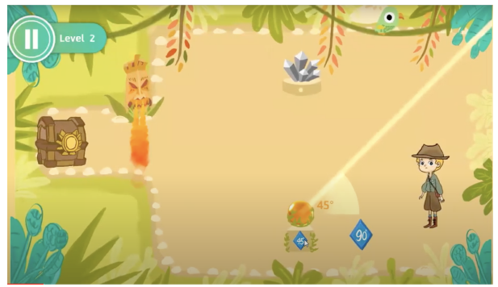

Slide 4
Teaching Assistant
Morgan Evans
PhD Student in the Center for Transformational Play
Design Lead on the award winning transformational game Bloomwood Stories: Block Party
A proud member of the Pittsburgh acro community

Slide 5
What is this course about?

Slide 6
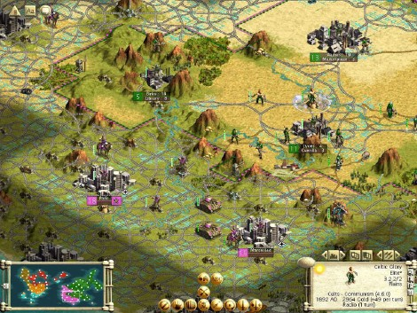
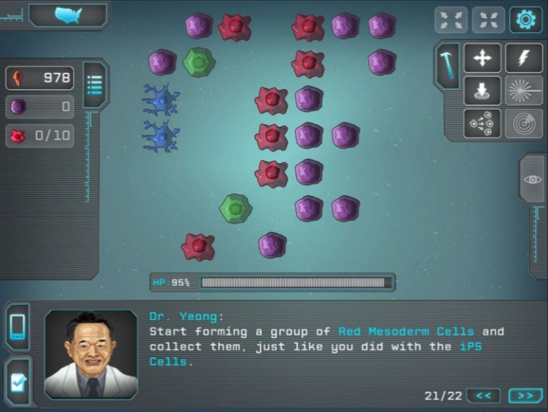
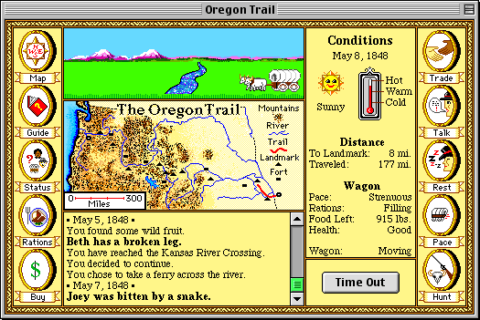
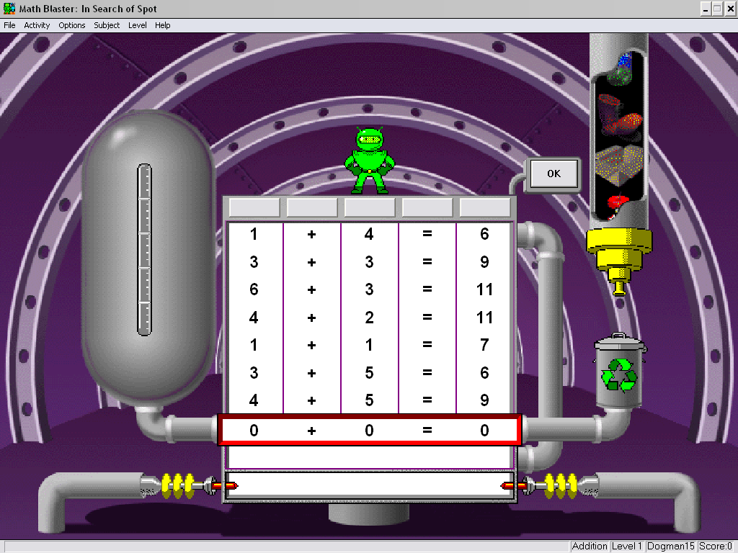
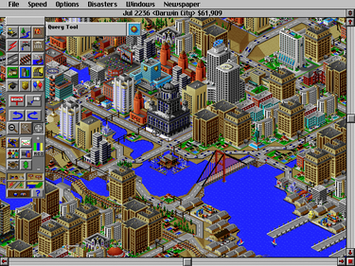
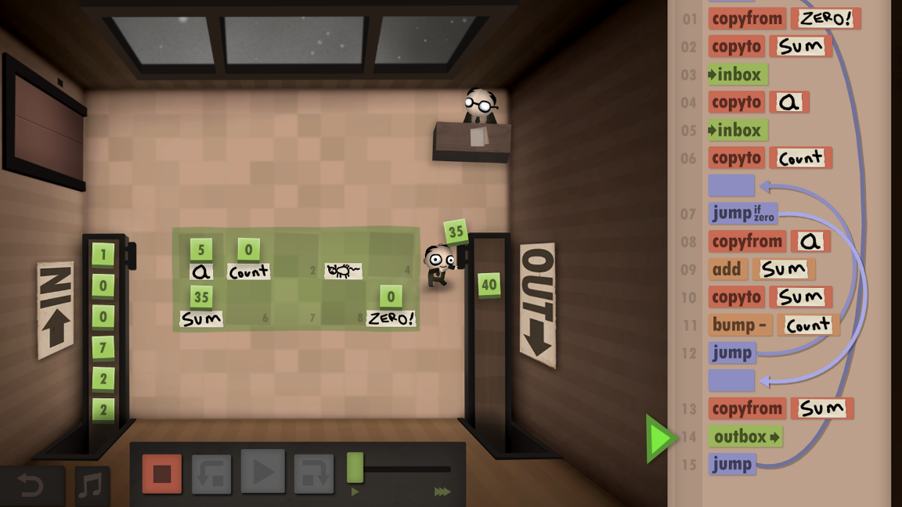
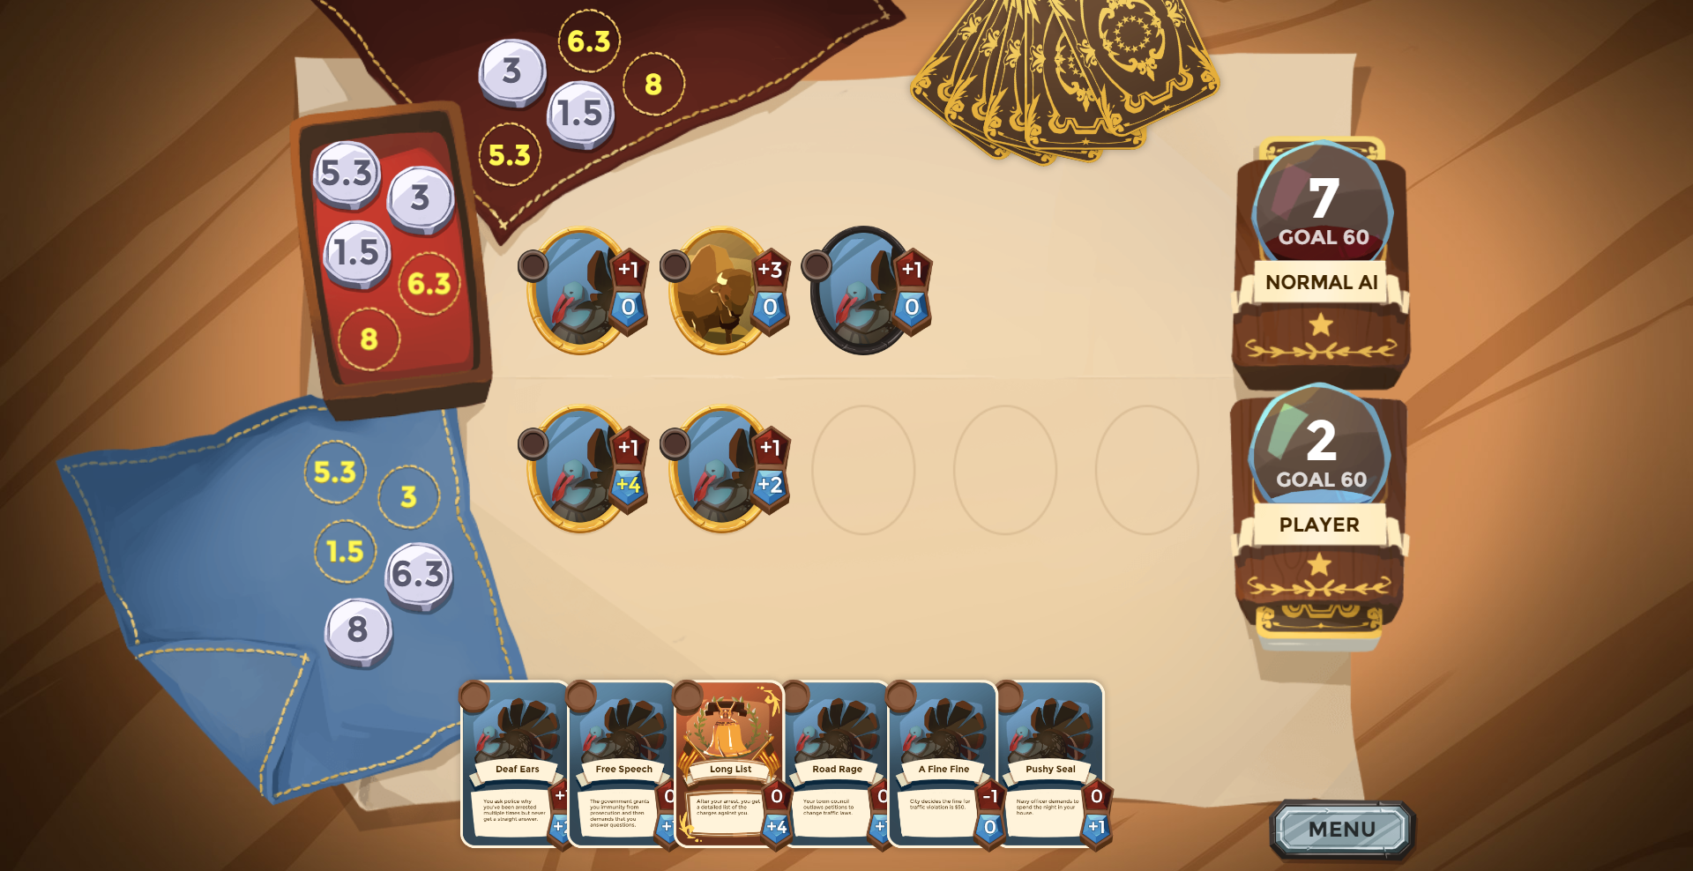
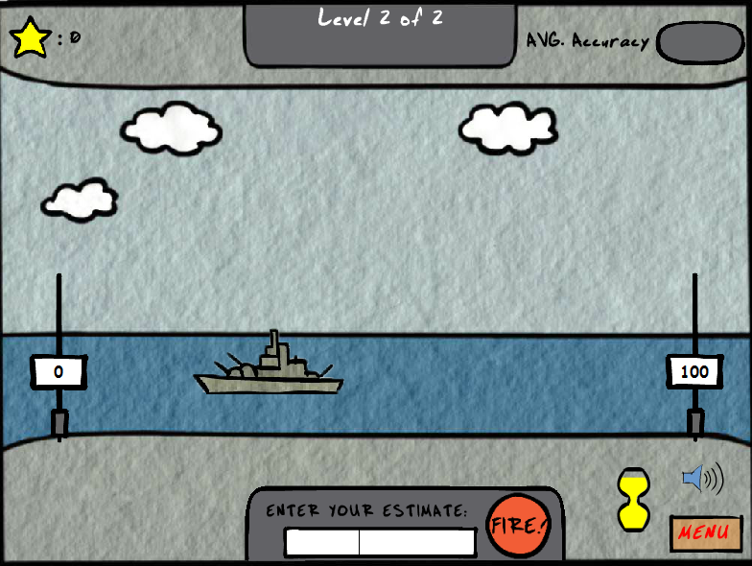
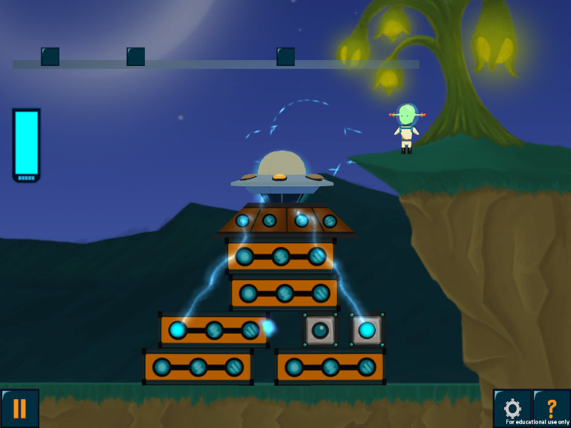
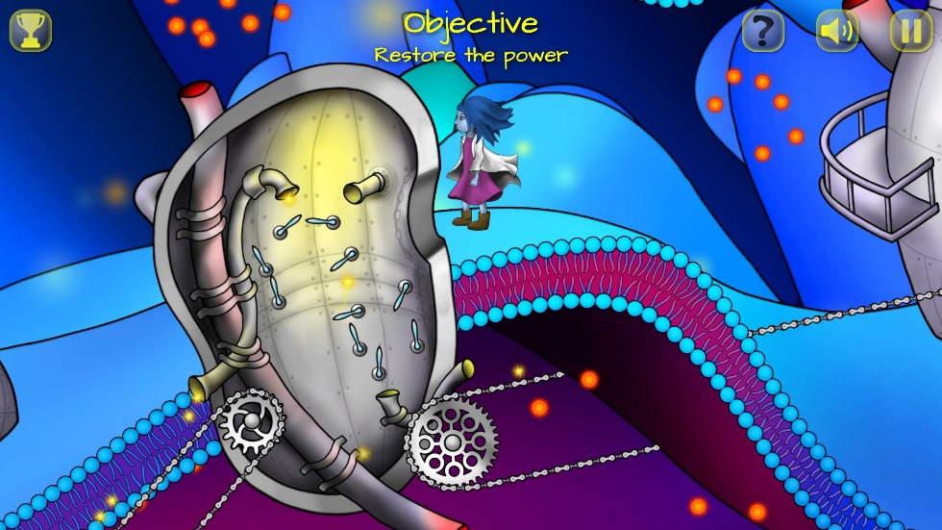
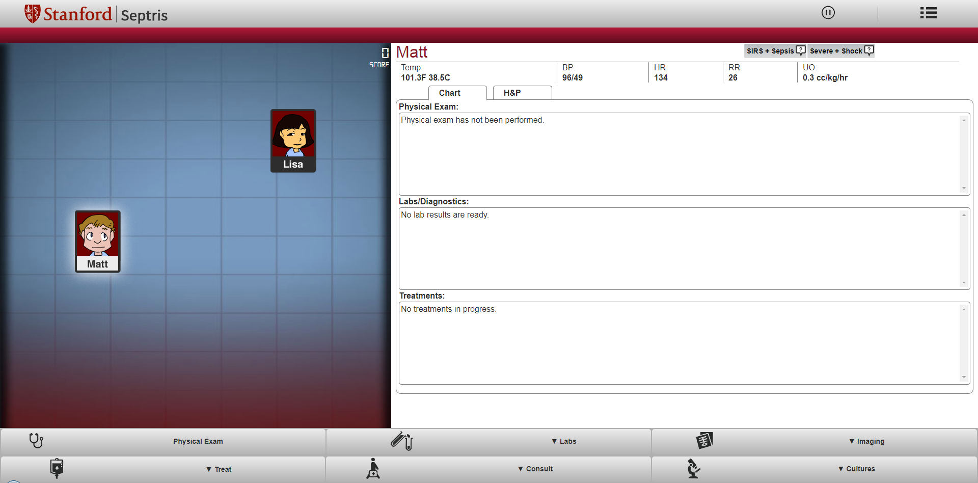
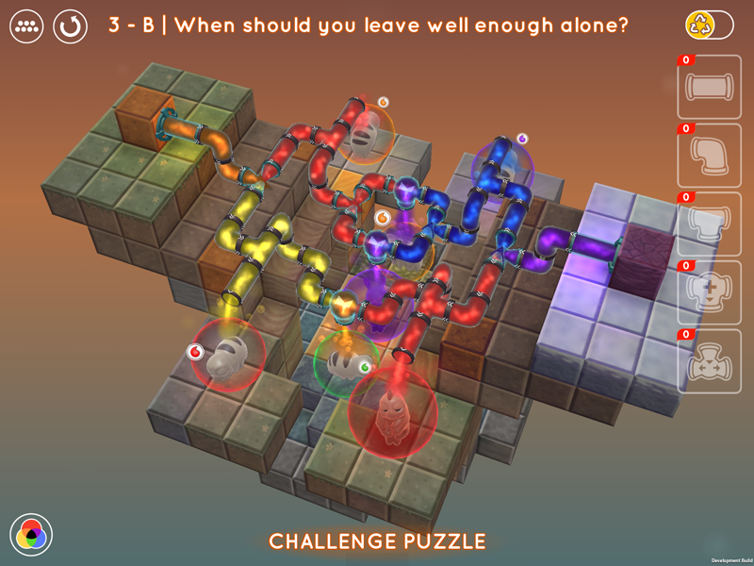
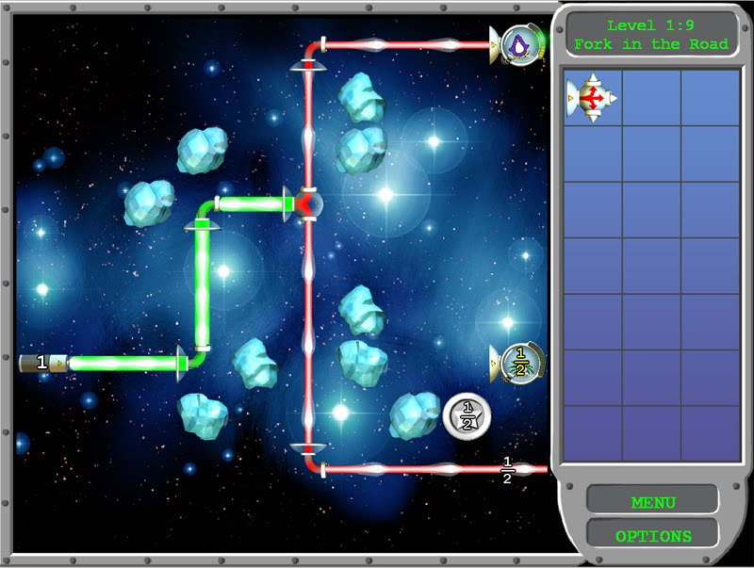
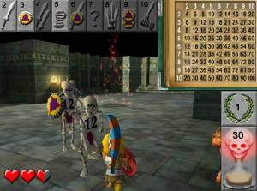
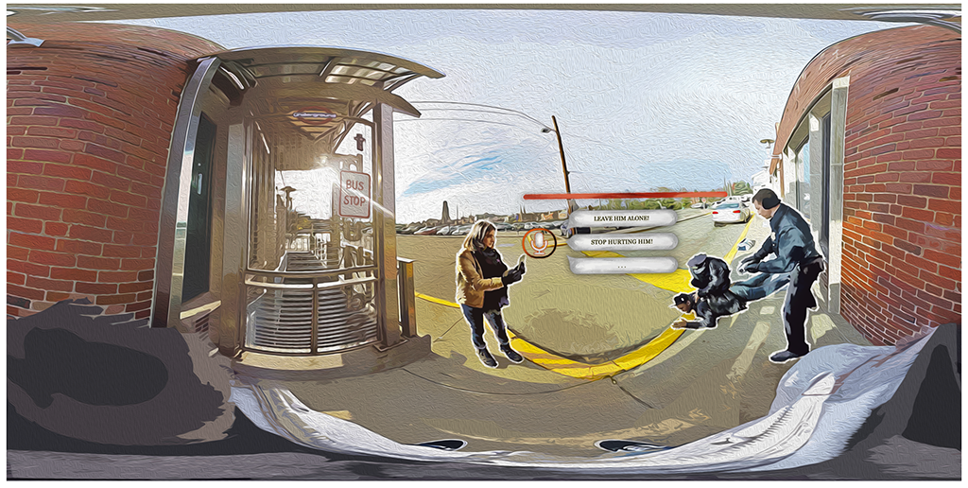
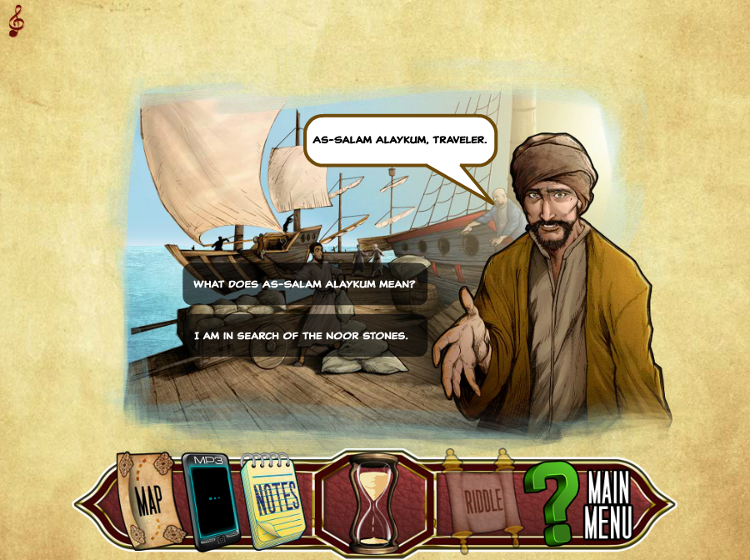
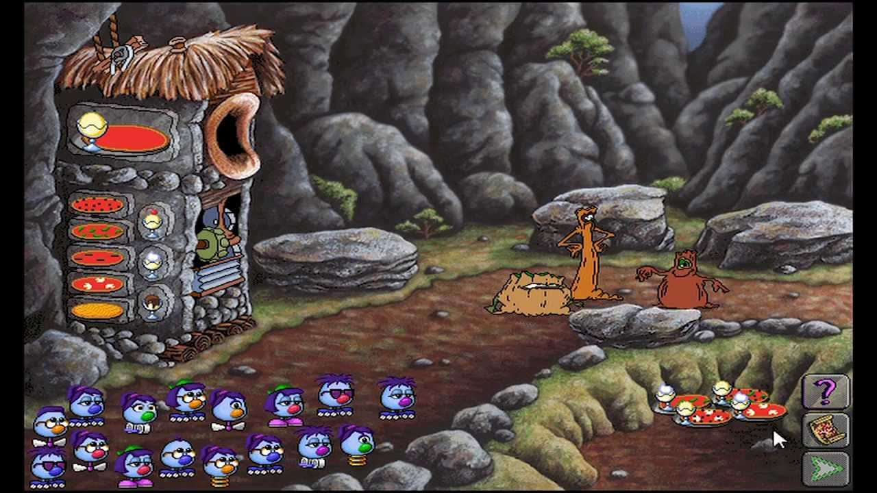

Slide 7
The 3 Wisdoms of Ed Game Design
Instructional Design
Game Design
Learning Science
What do we know about how to structure effective instruction?
What do we know about crafting compelling experiences?
What do we know about how people learn from their experiences?
Notes:
Educational game = game designed to meet pre-defined educational objectives
Educational game development project will be more successful if:
Educational objectives have been clearly specified early on
Designers have a notion of how the game’s mechanics, though the dynamics, realize the intended aesthetics
Game observes well-established instructional design principles

Slide 8
The EDGE Framework
Educational Goals
Game Elements
Learning Mechanisms
Notes:
Educational game = game designed to meet pre-defined educational objectives
Educational game development project will be more successful if:
Educational objectives have been clearly specified early on
Designers have a notion of how the game’s mechanics, though the dynamics, realize the intended aesthetics
Game observes well-established instructional design principles

Slide 9
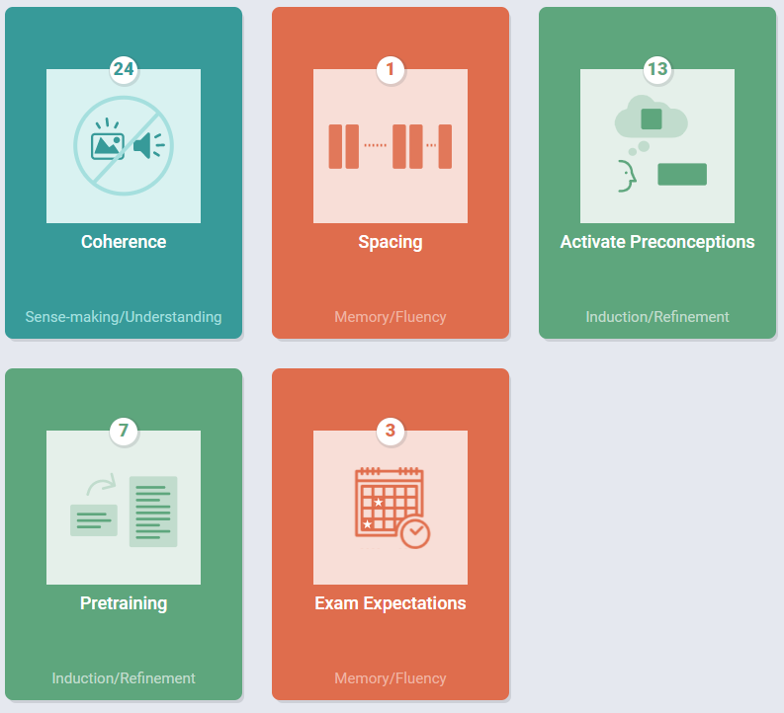
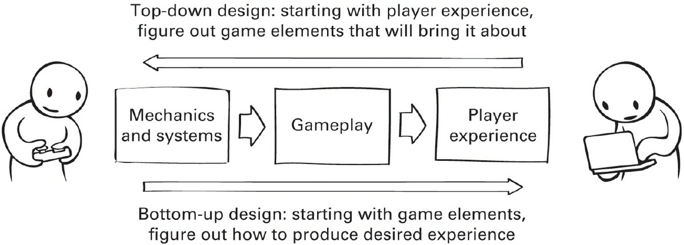
Useful Design Tools
The EDGE Framework
The “MDA Framework”
Learning Science Principles
Educational Goals
Game Elements
Learning Mechanisms
Tandem Transformation Game Design
Learning / Gameplay Integration Continuum
The Spectrum of Evaluation
Tight = Gameplay and learning are one and the same
Loose = Gameplay and learning are separate choices
Self
Reflection
Theoretical Justification
Expert Evaluation
Anecdata
Descriptive Data
Correlational Data
Pre-Experimental Studies
Quasi-Experimental Studies
True
Experiments

Slide 10
What do you hope to learn from this course?
Like to explore more game theories and ways to make games
Want to see how to balance being instructional vs playful
What goes into making something fun while still teaching
To see some ways to use game design to make education better
Currently working on some games and not make them worse
Heard this was a particularly challenging area and want t oknow how

Slide 11
What I hope you get out of this course
A taste for the space of educational games and a developed sense to judge what makes one good or bad
An understanding of the different perspectives on educational game design
Some experience applying the various skills used in creating an educational game
A compelling educational game that you can speak to the design of and be proud to show off

Slide 12
What is this course NOT about?
Game development/programming
It’s about design not development
Gamification
It’s about creating games not applying game ideas to non-game contexts
Developing curriculum to adapt existing entertainment games
It’s about creating new games not adapting existing ones

Slide 13
How will this course be structured?

Slide 14
Month | Day | Week | Topic | Blogs | Assignments | Group Projects
Jan | 17 | 1 | Introduction + the EDGE Framework | Blogs Out
 | 19 |  | Educational Goals
 | 24 | 2 | Game Elements
 | 26 |  | Learning Mechanisms
 | 31 | 3 | Process
Feb | 2 |  | Knowledge Elicitation |  | 1 Out
 | 7 | 4 | Transfer | Blog 1 In | 1A In
 | 9 |  | Integration
 | 14 | 5 | Ideation |  | 1B In; 2 Out
 | 16 |  | Prototyping + Playtesting |  | 2A In (Friday)
 | 21 | 6 | Motivation |  |  | Team Formation Survey
 | 23 |  | In-class Playtesting |  | 2B In (Friday)
 | 28 | 7 | Pre-Production and Final Project Kick-off | Blog 2 In |  | Teams Formed (Monday)
Mar | 2 |  | Evaluation |  | 2C In (Friday) | Final Project Scoping Proposal (Friday)
 | 7 |  | Spring Break; No Class
 | 9 |  | Spring Break; No Class
 | 14 | 8 | Pitching and Peer Feedback
 | 16 |  | Final Project Pitches |  |  | Pitch
 | 21 | 9 | [Special Topics] + Studio Time | Blog 3 In
 | 23 |  | [Special Topics] + Studio Time
 | 28 | 10 | Check-in 1 A (half of teams)
 | 30 |  | Check-in 1 B (half of teams) |  |  | Check-in 1 Report
Apr | 4 | 11 | [Special Topics] + Studio Time
 | 6 |  | Group Work
 | 11 | 12 | [Special Topics] + Studio Time | Blog 4 In
 | 13 |  | Carnival; No Class
 | 18 | 13 | Check-in 2 A (half of teams)
 | 20 |  | Check-in 2 B (half of teams) |  |  | Check-in 2 Report
 | 25 | 14 | [Special Topics] + Studio Time
 | 27 |  | Last Lecture
May | TBD |  | Final Project Showcase | Blog Make Up |  | Final Project
Background & EDGE Framework
Process Techniques
&
Practice
A Course in
3 Acts
Final Projects
&
Special Topics / Theory
http://edugames.design/schedule

Slide 15
Activities and Deliverables | % Total
Readings, Watchings, & Playings | 10.00
Discussion Board Posts for RWPs
Educational Game Critique Blogs | 20.00
Bi-weekly post x3
Skills Assignments | 30.00
Assignment 1: Knowledge Elicitation (CTA)
Assignment 2: Prototyping & Playtesting
Final Project | 40.00
Scoping Proposal & Pitch
Project Check-in 1
Project Check-in 2
Final Presentation, Report, and Deliverable
Total | 100.00
Assignment Breakdown

Slide 16
Game Critique Blogs
Find existing educational games, play them, then make a blog post / video critiquing them in terms of topics we discuss in class
There will be submission opportunities for grading every 3 weeks (for a total of 5) but you only need to submit 3 posts all semester
More on this later…

Slide 17
Skills Assignments
1. Knowledge Elicitation
Perform a Cognitive Task Analysis of a provided task with a group of participants to determine what skills novices struggle with
2. Prototyping and Playtesting
Go through a process of brainstorming, prototyping, and playtesting a non-digital game for a provided content area

Slide 18
Final Projects
Develop a full-fledged Educational Game
Document the process from concept through initial testing
Done in groups of ~5
Digital or Physical up to you
Subject up to you with a few restrictions

Slide 19
Readings, Watchings, & Playings
Most class sessions will have required and optional RWPs
Used to introduce you to concepts and ideas in the field
The diversity of the field leads to a diversity of formats
Academic articles
Books / chapters
Blog posts
Youtube videos
Playable explanations
Example games
Digital books are sourced from the library where possible, let me know if you have access issues

Slide 20
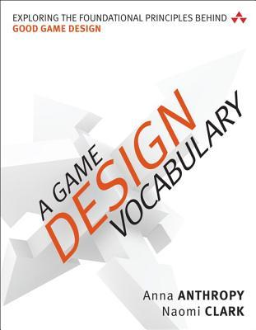
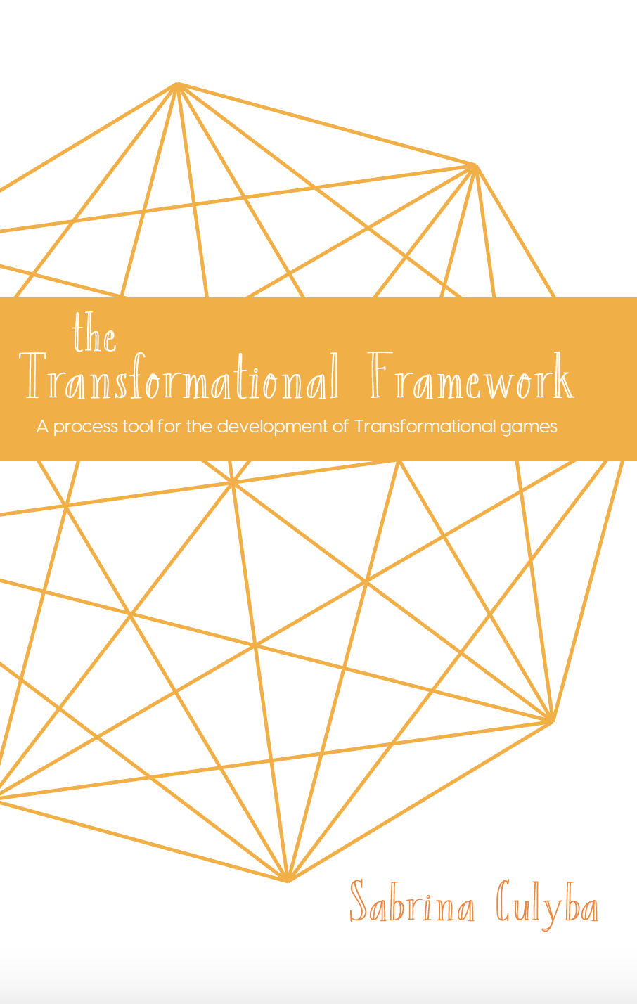
Further Reading
All available as digital books from the library
https://www.transformationalframework.com/
https://www.resonant.games/
Both available for free online

Slide 21
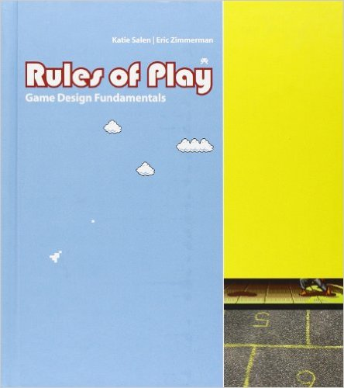
Further Reading (cont)

Slide 22
Game Development Tutorials
We can provide some basic walkthroughs for building games in 3 tools: Unity, Construct 3, and Tabletop Simulator (maybe Tabletopia)
These guides will be provided outside of regular class instruction and are designed to give people who might want to make a digital game for the final project some experience

Slide 23
Communication
Canvas
Course content will primarily be delivered via Canvas
If you have any issues accessing content let us know
Slack
Informal communication and coordination will be on Slack
Good for organizing groups or asking quick questions
Office Hours
Erik – Fridays at 11:00 am in NSH 2614 and on Zoom
or by appointment: https://erik-harpstead.youcanbook.me/

Slide 25
What is an Educational Game?

Slide 26
What is an Educational Game?
7 min
The player needs to be able to learn something that is transferable outside the context of the game
It’s a game that teaches you how to do stuff
There is osme other goal outside of just playing or learning
What makes a game education
Coolmathgames.com
How its sort of tricking you into learning
Should a game be MORE educational OR entertaining?
Single vs multiplayer game
Educational games more focused on single player
A game that an intentional educational
The most effective games the gaol is not so obvious to the player
Distinguishing form gamified apps, has some kind of story structure
How do you pace the learning
The gameplay itself should be teaching you something, you should be learning through PLAYING the game not just themed after something
The game mechaniscs should be design so that a player has to learn something to achieve a goal
There should be levels so you’re learning more basic stuff in the bigging and building from there
Concepts to incentivze the player to engage
Should it be replayable
Notes:
10 min on goals
20 min total here?

Slide 27
2 Flavors to the question
What makes
an educational thing a game?
What makes
a game
educational?

Slide 28
What makes an educational thing a game?

Slide 29
What makes an educational thing a game?
What distinguishes games from more serious pursuits like…
Simulations?
Intelligent tutors?
From other fun experiences like…
Toys?
Puzzles?
Shows or Movies?
These are great questions…
to ask next Tuesday!
For now we will follow the Stewart Definition:
“I know it when I see it”
Notes:
e.g, watching a ball game, reading a book,
Would be interesting to approach this as follows: make a list of fun activities that are / are not game-like, and see if our definition distinguishes

Slide 30
What makes a game educational?

Slide 31
Some argue that all games support learning!
“You actually trust the design and learning of Halo better than you trust the design and learning of [an] algebra class.”
- James Paul Gee
https://www.youtube.com/watch?v=LNfPdaKYOPI

Slide 33
What do you think about Gee’s argument
Agree
Disagree
The idea that assessment is trying to prove that students have learned in their classes is kind of silly
Agree with a lot but not the “trust the current system” assessments are not always trying to measure learning
Its all possible but if the game and test can replace
Don’t know if that’s going to happen
Don’t know about timeframe
Mechanical skill transfer play Halo and play all FPSs
The comparsion between the test and playing a game
Beating Halo is the test!
Sure a game could replace a test but its implied that it would make it better and not sure that’s the case
Replace current problems with new ones
Accessibility
Not everyone plays games to learn how to play games
You might be playing games just to experience a narrative or something else
Games take a huge time commitment and that’s not being considered here
The concepts in them are simpler
Oversimplifies things in learning science
Individual differences
Just comparing to summative assessments not formative

Slide 34
What makes a game educational?
A game that causes learning that transfers out of the game and game context into “real life”
Ideally, the learning is generalizable across a wide range of learners
Ideally, the learning is efficient…ish
Ideally, the learning is robust and lasts over time
Notes:
Learning that transfers out of the game and game context into “real life”
New skills/concepts/competencies/abilities/ dispositions that help in important situations
Ideally, the learning is generalizable across a wide range of learners
There is some predictability as to what a player will learn
Ideally, the learning is efficient
Since time, as always, is a scarce resource
Ideally, the learning is robust
It lasts, can be applied in new situations, and perhaps even, helps future learning

Slide 35
How do you know learning is happening, or happened?
Some misconceptions about learning
Just because the kids are working in quiet concentration does not mean they are learning
Good performance during a learning task may mean not much learning is happening
Just because a game involves a subject does not mean players will learn it
Positive examples may get too much attention
Transfer of learning is often narrow
Notes:
But it is actually more subtle than this.
One complicating factor is that some of this stuff is bound to happen, so some level of it is probably not a reason to think that the game is not educational, but how much it too much? Sometimes, the argument is made that exactly because games evoke situations like this, they may help people learn how to deal with them. I agree with that argument, but I also think it is an incomplete argument. Just cause you know you screwed up doesn’t mean you know how to do better next time. So there also needs to be some support for helping you learn from your mistakes.
Pure discovery learning is not an effective instructional method
Even without these obvious problems, there can be a more subtle problem: learning that happened in the game does not transfer out of the game.
Correlation is not causation.
Steinkuhler and Duncan?

Slide 36
“Educational Games” Out Dated?
Some people don’t use the term “educational game” any more
It evokes formal educational settings that some believe games are poised to disrupt
It reminds some people of poorly designed shovel ware from the 90s

Slide 37
Other Terms
Game-based Learning / Learning Games
Basically a synonym for educational game but possibly with connotations to be used in less formal settings
Edutainment
An older term for educational games and other kinds of educational programming; generally frowned upon because of a crash in the market in the mid 90s
Transformational Games
games developed with the intention of changing players in a specific way that transfers and persists beyond the game.
Serious Games / Games with a Purpose
catch-all term used in many different contexts for any game that has a real-world purpose beyond entertainment.
Training Simulations / Simulation-based Learning
frequently used in reference to programs that train employees on technical skills, industry procedures, or social interactions through simulation and role-play.
Behavior Change Games
used most often in games initiated in part as research, particularly around health-related behaviors.
Games for Health
games aimed at improving health-related behaviors and outcomes
Impact Games / Social Good Games / Games for Change
often trying to raise awareness about a societal issue or cause
Empathy Games
sometimes applied to games that focus less on game mechanics and more on storytelling. They are often centered around evoking an emotional response in players.
Citizen Science / Crowdsourcing Games
games that allow the masses to contribute to real-world research or data analysis by encoding the tasks into a game

Slide 38
Time Check

Slide 39
The EDGE Framework [Short Version]

Slide 40
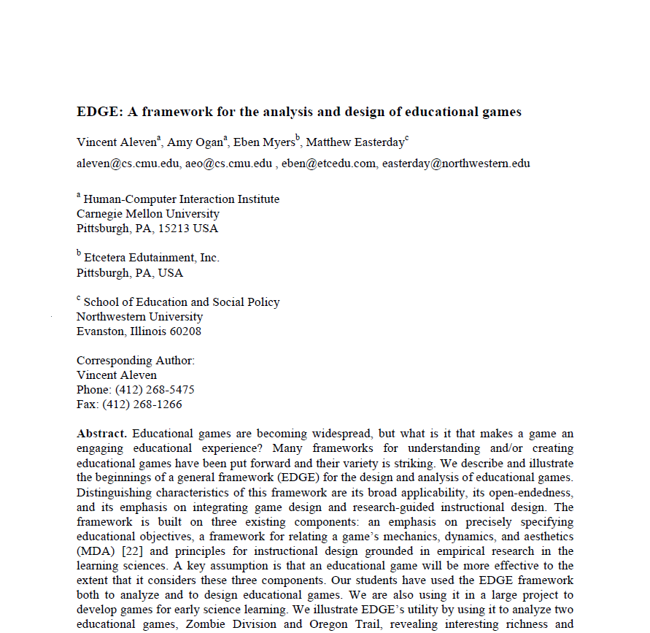
The EDGE Framework
Vincent
Aleven
Amy
Ogan
Eben
Myers
Matthew Easterday
Aleven, V., Ogan, A., Myers, E., & Easterday, M. EDGE: A framework for the analysis and design of educational games. Unpublished manuscript.

Slide 41
The EDGE Framework
Educational Goals
Game Elements
Learning Mechanisms
Notes:
Educational game = game designed to meet pre-defined educational objectives
Educational game development project will be more successful if:
Educational objectives have been clearly specified early on
Designers have a notion of how the game’s mechanics, though the dynamics, realize the intended aesthetics
Game observes well-established instructional design principles

Slide 42
Example: Zombie Division
3D action-adventure game
Designed to support learning of whole number division
Evaluation studies show that ZD supports learning and enhances motivation
Jacob Habgood
Sheffield Hallam University
Shaaron Ainsworth
University of Nottingham
Habgood, M. P. J., & Ainsworth, S. E. (2011). Does intrinsic integration matter? Exploring the value of intrinsic integration in educational games. Journal of the Learning Sciences.
Notes:
Complements classroom instruction
Learning is integrated in the game’s core mechanic
About 20 different levels with 20 zombies each

Slide 43
Example: Zombie Division
Notes:
Complements classroom instruction
Learning is integrated in the game’s core mechanic
About 20 different levels with 20 zombies each

Slide 44
Example: Zombie Division
Notes:
Complements classroom instruction
Learning is integrated in the game’s core mechanic
About 20 different levels with 20 zombies each

Slide 45
Example: Zombie Division
Notes:
Complements classroom instruction
Learning is integrated in the game’s core mechanic
About 20 different levels with 20 zombies each

Slide 46
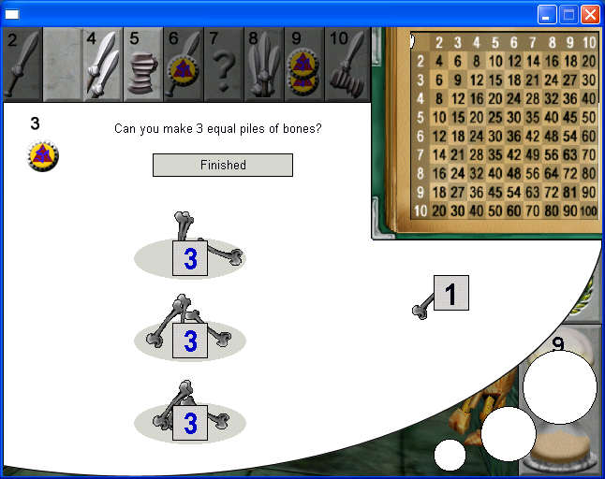
Example: Zombie Division
Notes:
Complements classroom instruction
Learning is integrated in the game’s core mechanic
About 20 different levels with 20 zombies each

Slide 47
The EDGE Framework
Educational Goals
Game Elements
Learning Mechanisms
Notes:
Educational game = game designed to meet pre-defined educational objectives
Educational game development project will be more successful if:
Educational objectives have been clearly specified early on
Designers have a notion of how the game’s mechanics, though the dynamics, realize the intended aesthetics
Game observes well-established instructional design principles

Slide 48
Educational Goals
Prior knowledge: What knowledge or skills will players need before playing the game?
Learning and retention: What knowledge or skills will players learn from the game?
Potential transfer: How far are these knowledge and skills likely to transfer?
Notes:
(as in any instructional design project)
Framework considers game designed with an explicit set of educational goals in mind
rather than an opportunistic and less coherent set of educational goals
Helps avoid creating games that
address only simple instances of a targeted cognitive skill
assume prior knowledge that the student/player is not likely to have
make it easy for the student/player to work around the learning embedded in the game
etc.
may they learn beyond what they encountered in the game?
Not enough to just say that students will learn whole-number division – want something far more specific here.
Each question has a three-part answer: (a) written description, (b) examples of tasks from which to learn each learning objective (may even though this at the level of steps within tasks, rather than tasks) (may even though this at the level of steps within tasks, rather than tasks)

Slide 49
Educational Goals in Zombie Division
Prior knowledge: What knowledge or skills will students need before playing the game?
Notion of whole numbers up to 100
Understanding of whole-number multiplication
Basic notion of division
Learning and retention: What knowledge or skills will students learn from the game?
Skill and fluency with divisibility judgments with dividends < 100 and divisors < 10
Conceptual understanding of division as “making equal groups”
Conceptual understanding of division as the inverse of multiplication, using multiplication table
Potential transfer: How far are these knowledge and skills likely to transfer?
Skill and fluency with division?
Will students learn to recognize prime numbers?

Slide 50
The EDGE Framework
Educational Goals
Game Elements
Learning Mechanisms
Notes:
Educational game = game designed to meet pre-defined educational objectives
Educational game development project will be more successful if:
Educational objectives have been clearly specified early on
Designers have a notion of how the game’s mechanics, though the dynamics, realize the intended aesthetics
Game observes well-established instructional design principles

Slide 51
Game Elements
Mechanics + Systems: what are the objects in the game and what verbs can players use to interact with them?
Gameplay Dynamics: what are the activity loops that players go through while playing?
Player Experience: what is the experience that the mechanics, systems, and loops create for the player?

Slide 52
Zombie Division Mechanics
Objects
Skeletons around the dungeon with numbers on their chests
Player weapons that correspond to numbers
Verbs
Players can hit skeletons with their weapons
Players can move around the dungeon
Rules
Player gathers points by defeating skeletons
Skeleton succumbs if the weapon’s number is a divisor of the skeleton’s number
Skeleton can fend off the attack if it has the same weapon with which it is attacked
Players looses health if the attack is with the wrong weapon (not a divisor), or if skeleton strikes first
Notes:
Walk around in a dungeon inhabited by zombies
Armed with weapons that represent numbers
Students gain access to more weapons as the game progresses
Gather points by successfully attacking zombies; zombie succumbs if the weapon is a divisor of the zombie’s number and zombie does not have the same weapon to fend off the attack
Loose health if the attack is with the wrong weapon (not a divisor)
Zombies have more weapons to defends themselves as the game progresses
Attacks on giant skeletons succeed outright only if a proper weapon is used and the quotient is less than 10; if the quotient is larger than 10, the zombie divides into multiple zombies with smaller number
Multiplication table is available to help with the math; help screen is available (voluntarily) to do bone-dragging exercise
When slow to attack a zombie, the zombie may strike first
When player is slow to attack, the zombie strikes first
Furthers educational objectives by blocking easy solutions

Slide 53
Zombie Division Gameplay Dynamics
Core Gameplay Loop:
A “deliberate style of suspenseful hunting” navigating the dungeon looking for skeletons they can defeat and avoiding those they can’t
Need to apply math skills under mild time pressure but skeletons can be avoided by walking out of the room, or by stopping when they’re far away
Other loops:
Bone-dragging exercise on the help screen is very slow
Some levels have fast-skeleton spawners that ramp up the time pressure

Slide 54
Zombie Division Player Experience
Challenge: Attacking Zombies
The math adds to the challenge.
Fantasy: Greek warrior identity, kill monsters in a dungeon
Discovery: Explore the dungeon, find keys
Notes:
Aesthetics mainly function to raise interest?
So the challenge generated by the math as a reason to play the game? That would be a really good thing!

Slide 55
The EDGE Framework
Educational Objectives
Game Elements
Learning Mechanisms
Notes:
Educational game = game designed to meet pre-defined educational objectives
Educational game development project will be more successful if:
Educational objectives have been clearly specified early on
Designers have a notion of how the game’s mechanics, though the dynamics, realize the intended aesthetics
Game observes well-established instructional design principles

Slide 56
Learning Mechanisms
Learning Mechanisms: What processes of learning does the game encourage?
Learning Science Principles: What research results provide evidence for the learning supports in the game?

Slide 57
Zombie Division Learning Mechanisms
Memory and fluency-building
Lots of practice opportunities to help build fluency with division judgements
Induction and refinement
Immediate feedback and varied number values support skill induction
Understanding and sense-making
Bone dragging exercise provides opportunities to see the conceptual basis for division

Slide 58
Principles supported in Zombie Division
Gee #12: “Learners get lots and lots of practice in a context where the practice is not boring.”
CT #6: “Provide immediate feedback on errors”
LLL #13: “Learning wrong information can be reduced when feedback is immediate.”
LLL #11: “An understanding of an abstract concept improves with multiple and varied examples.”
Gee # 27 “The learner is given explicit information both on-demand and just-in-time. … ”
LLL #21 “Assignments should … be … at the right level of difficulty for the student’s level of skill or prior knowledge.”
Notes:
We add that there is no expectation that any game, or any instructional intervention, covers all the principles. Rather, one looks for a coherent story as to how the game supports learning, backed up by principles, and one considers whether and how the game might be extended to support learning even more effectively through the use of additional principles.
when analyzing or designing a game or other type of learning environment, one looks for a coherent story, supported by principles, as to how the game supports learning. One does not look for complete coverage of all principles.
Measured by this yardstick, Zombie Division succeeds admirably, an impression that is confirmed by the evaluation studies done by Habgood and Ainsworth [6].
,
when the learner needs it or just at the point where the information can best be understood and used in practice

Slide 59
Summary: Use of framework for analysis
Viewing the game from 3 analytical angles and relations between them
Yields rich description (and appreciation) of the thoughtful design of the game
Not just fluency! Conceptual understanding as well
“Deliberate hunting” dynamic
Time pressure is varied consistent with the varying learning objectives
Tedium aesthetic reinforces value of educational goals
Rich coverage of learning principles
We see interesting connections between Game Elements and Learning at all three levels
Notes:
Resulting analysis has “interesting richness”

Slide 61
The EDGE Framework [Long Version]

Slide 62
The EDGE Framework
Vincent
Aleven
Amy
Ogan
Eben
Myers
Matthew Easterday
Aleven, V., Ogan, A., Myers, E., & Easterday, M. EDGE: A framework for the analysis and design of educational games. Unpublished manuscript.

Slide 63
The EDGE Framework
Educational Goals
Game Elements
Learning Mechanisms
Notes:
Educational game = game designed to meet pre-defined educational objectives
Educational game development project will be more successful if:
Educational objectives have been clearly specified early on
Designers have a notion of how the game’s mechanics, though the dynamics, realize the intended aesthetics
Game observes well-established instructional design principles

Slide 64
Example: Zombie Division
3D action-adventure game
Designed to support learning of whole number division
Evaluation studies show that ZD supports learning and enhances motivation
Jacob Habgood
Sheffield Hallam University
Shaaron Ainsworth
University of Nottingham
Habgood, M. P. J., & Ainsworth, S. E. (2011). Does intrinsic integration matter? Exploring the value of intrinsic integration in educational games. Journal of the Learning Sciences.
Notes:
Complements classroom instruction
Learning is integrated in the game’s core mechanic
About 20 different levels with 20 zombies each

Slide 65
Example: Zombie Division
Notes:
Complements classroom instruction
Learning is integrated in the game’s core mechanic
About 20 different levels with 20 zombies each

Slide 66
Example: Zombie Division
Notes:
Complements classroom instruction
Learning is integrated in the game’s core mechanic
About 20 different levels with 20 zombies each

Slide 67
Example: Zombie Division
Notes:
Complements classroom instruction
Learning is integrated in the game’s core mechanic
About 20 different levels with 20 zombies each

Slide 68
Example: Zombie Division
Notes:
Complements classroom instruction
Learning is integrated in the game’s core mechanic
About 20 different levels with 20 zombies each

Slide 69
The EDGE Framework
Educational Goals
Game Elements
Learning Mechanisms
Notes:
Educational game = game designed to meet pre-defined educational objectives
Educational game development project will be more successful if:
Educational objectives have been clearly specified early on
Designers have a notion of how the game’s mechanics, though the dynamics, realize the intended aesthetics
Game observes well-established instructional design principles

Slide 70
Educational Goals
Prior knowledge: What knowledge or skills will players need before playing the game?
Learning and retention: What knowledge or skills will players learn from the game?
Potential transfer: How far are these knowledge and skills likely to transfer?
Notes:
(as in any instructional design project)
Framework considers game designed with an explicit set of educational goals in mind
rather than an opportunistic and less coherent set of educational goals
Helps avoid creating games that
address only simple instances of a targeted cognitive skill
assume prior knowledge that the student/player is not likely to have
make it easy for the student/player to work around the learning embedded in the game
etc.
may they learn beyond what they encountered in the game?
Not enough to just say that students will learn whole-number division – want something far more specific here.
Each question has a three-part answer: (a) written description, (b) examples of tasks from which to learn each learning objective (may even though this at the level of steps within tasks, rather than tasks) (may even though this at the level of steps within tasks, rather than tasks)

Slide 71
What prior knowledge is needed for Zombie Division?
Notion of whole numbers up to 100
Understanding of whole-number multiplication
Example: what it means to say 7 x 8 = 56
Basic notion of division
Example problem: 6 ÷ 3 = ?
Notes:
, since the multiplication table reinforces a notion of division as the inverse of multiplication

Slide 72
What will the player learn from Zombie Division?
Skill and fluency with divisibility judgments with dividends < 100 and divisors < 10
Example: By which of these divisors can you divide 42: 3, 5, or 6? Or none of the above?
Conceptual understanding of division as “making equal groups”
Example: 12 is divisible by 3, because if you can make 3 equal groups out of 12
Conceptual understanding of division as the inverse of multiplication, using multiplication table
Example: 21 ÷ 3 = 7 because 7 x 3 = 21
Notes:
Example: by which of these divisors can you divide 41: 3, 5, or 6? Or none of the above?
Example: which of these numbers can be divided by 6: 15, 26, or 48? Or none of the above?
Seems that ZD covers this space pretty well (e.g., student cannot easily avoid hard problems as in DKJrMath; or can she?)
Why is it important to be so precise and detailed?
Instructional designers would not be surprised when seeing this.
May be clear how this level of precision about instructional objectives has led to specific features in the game to support them …
So, in this regard, Zombie Division is very well designed – many math games seem to support fluency with certain skills but not understanding. So you can practice a skill but you need to have a basic understanding to begign with.
Will the game help students develop shortcut rules (such as numbers that end in 0 or 5 can be divided by 5; or, numbers whose digits sum to a multiple of 3 are themselves multiples of 3 – and that this rule can be applied recursively)
Will students learn to (reliably) determine all factors of a given number?

Slide 73
How far will skills and knowledge learned with ZD transfer?
Should we expect to see improvement on tasks or skills that are related to but different from the original learning content?
Skill and fluency with division?
Example: What is 42 ÷ 3?
Will students learn to recognize prime numbers?
Example: Can 41 be divided evenly by any number?
Notes:
Will students get better at problems such as: Does 2 divide (6*6)?
, only that it is not divisible by any of the given divisors (e.g., 14 is not divisible by 3, 5, or 6 but is not prime; 17 is not divisible by 3, 5, or 6 but it is prime). So perhaps the good students will realize that some numbers cannot be divided at all, but it would have to be induction across different encounters with the same number, or perhaps some good theoretical thinking.

Slide 74
Educational Goals in Zombie Division
Prior knowledge: What knowledge or skills will students need before playing the game?
Notion of whole numbers up to 100
Understanding of whole-number multiplication
Basic notion of division
Learning and retention: What knowledge or skills will students learn from the game?
Skill and fluency with divisibility judgments with dividends < 100 and divisors < 10
Conceptual understanding of division as “making equal groups”
Conceptual understanding of division as the inverse of multiplication, using multiplication table
Potential transfer: How far are these knowledge and skills likely to transfer?
Skill and fluency with division?
Will students learn to recognize prime numbers?

Slide 75
The EDGE Framework
Educational Goals
Game Elements
Learning Mechanisms
Notes:
Educational game = game designed to meet pre-defined educational objectives
Educational game development project will be more successful if:
Educational objectives have been clearly specified early on
Designers have a notion of how the game’s mechanics, though the dynamics, realize the intended aesthetics
Game observes well-established instructional design principles

Slide 76
Game Elements
Mechanics + Systems: what are the objects in the game and what verbs can players use to interact with them?
Gameplay Dynamics: what are the activity loops that players go through while playing?
Player Experience: what is the experience that the mechanics, systems, and loops create for the player?

Slide 77
Zombie Division Mechanics
Objects
Skeletons around the dungeon with numbers on their chests
Player weapons that correspond to numbers
Verbs
Players can hit skeletons with their weapons
Players can move around the dungeon
Rules
Player gathers points by defeating skeletons
Skeleton succumbs if the weapon’s number is a divisor of the skeleton’s number
Skeleton can fend off the attack if it has the same weapon with which it is attacked
Players looses health if the attack is with the wrong weapon (not a divisor), or if skeleton strikes first
Relation with ZD learning goals:
Learning content is tightly integrated in the game’s core mechanic
Reflection: How does walking through the dungeon (another key mechanic) relate to learning objectives?
Notes:
Walk around in a dungeon inhabited by zombies
Armed with weapons that represent numbers
Students gain access to more weapons as the game progresses
Gather points by successfully attacking zombies; zombie succumbs if the weapon is a divisor of the zombie’s number and zombie does not have the same weapon to fend off the attack
Loose health if the attack is with the wrong weapon (not a divisor)
Zombies have more weapons to defends themselves as the game progresses
Attacks on giant skeletons succeed outright only if a proper weapon is used and the quotient is less than 10; if the quotient is larger than 10, the zombie divides into multiple zombies with smaller number
Multiplication table is available to help with the math; help screen is available (voluntarily) to do bone-dragging exercise
When slow to attack a zombie, the zombie may strike first
When player is slow to attack, the zombie strikes first
Furthers educational objectives by blocking easy solutions

Slide 78
Zombie Division Gameplay Dynamics
Core Gameplay Loop:
A “deliberate style of suspenseful hunting” navigating the dungeon looking for skeletons they can defeat and avoiding those they can’t
Need to apply math skills under mild time pressure but skeletons can be avoided by walking out of the room, or by stopping when they’re far away
Other loops:
Bone-dragging exercise on the help screen is very slow
Some levels have fast-skeleton spawners that ramp up the time pressure
Relation to learning goals:
Different levels of urgency allow for both initial learning and fluency practice
Contrast between slow bone-dragging and fluent gameplay gives reason for learning

Slide 79
Zombie Division Player Experience
Challenge: Attacking Zombies
The math adds to the challenge.
Fantasy: Greek warrior identity, kill monsters in a dungeon
Discovery: Explore the dungeon, find keys
Relation with educational goals
Challenge of doing math helps learning
Tedium of the bone-dragging exercise may have an educational purpose: Division as an operator avoids the tedium of dragging items one-by-one into piles
Notes:
Aesthetics mainly function to raise interest?
So the challenge generated by the math as a reason to play the game? That would be a really good thing!

Slide 80
The EDGE Framework
Educational Objectives
Game Elements
Learning Mechanisms
Notes:
Educational game = game designed to meet pre-defined educational objectives
Educational game development project will be more successful if:
Educational objectives have been clearly specified early on
Designers have a notion of how the game’s mechanics, though the dynamics, realize the intended aesthetics
Game observes well-established instructional design principles

Slide 81
Learning Mechanisms
Learning Mechanisms: What processes of learning does the game encourage?
Learning Science Principles: What research results provide evidence for the learning supports in the game?

Slide 82
Zombie Division Learning Mechanisms
Memory and fluency-building
Lots of practice opportunities to help build fluency with division judgements
Induction and refinement
Immediate feedback and varied number values support skill induction
Understanding and sense-making
Bone dragging exercise provides opportunities to see the conceptual basis for division

Slide 83
What are learning science principles?
Key way in which educational researchers communicate the results of their research to practitioners
Statements of the form:
“all else being equal, instruction that has feature X leads to more robust learning and/or greater interest than instruction that does not have feature X”
Ideally, backed up by A theoretical rationale and empirical evidence
Notes:
Helps designers use science to inform their intuitions
And maybe there are addition

Slide 84
Lots of Lists of Principles
PSLC Principles
Distilled from classroom research
IES Practice Guide
Pashler, H., Bain, P., Bottge, B., Graesser, A., Koedinger, K., McDaniel, M., & Metcalfe, J. (2007). Organizing instruction and study to improve student learning (NCER 2007-2004). Washington, DC: National Center for Education Research, Institute of Education Sciences, U.S. Department of Education. http://ies.ed.gov/ncer/pubs/practiceguides/20072004.asp
Cognitive Tutor (CT) Principles
Koedinger, K. R. & Corbett, A. T. (2006). Cognitive Tutors: Technology bringing learning science to the classroom. Handbook of the Learning Sciences.
Anderson, J. R., Corbett, A. T., Koedinger, K. R., & Pelletier, R. (1995). Cognitive tutors: Lessons learned. The Journal of the Learning Sciences, 4 (2), 167-207.
Multimedia & eLearning (MM) Principles
Mayer, R. E., & Moreno, R. (2003). Nine ways to reduce cognitive load in multimedia learning. Educational Psychologist, 38(1), 43-52.
Mayer, R. E. (2001). Multimedia Learning. Cambridge University Press.
Clark, R. C., & Mayer, R. E. (2003). e-Learning and the Science of Instruction: Proven Guidelines for Consumers and Designers of Multimedia Learning. San Francisco: Jossey-Bass.
Life-Long Learning Principles (LLL)
http://www.psyc.memphis.edu/learning/whatweknow/index.shtml
Jim Gee’s principles of learning embedded in video games (Gee)
Gee, J. P. (2007). What video games have to teach us about learning and literacy (2nd ed.). New York: Palgrave Macmillan.
https://canvas.cmu.edu/courses/32318/pages/list-of-lists-of-learning-science-principles
Notes:
How People Learn Principles
Donovan, M. S., Bransford, J. D., & Pellegrino, J.W. (1999). How people learn: Bridging research and practice. Washington, D.C.: National Academy Press.
Progressive Abstraction or “Bridging” Principles
Koedinger, K. R. (2002). Toward evidence for instructional design principles: Examples from Cognitive Tutor Math 6. Invited paper in Proceedings of PME-NA.

Slide 85
A unified list of instructional principles
Memory/Fluency | 1 | Spacing | Space practice across time > mass practice all at once
 | 2 | Scaffolding | Sequence instruction toward higher goals > no sequencing
 | 3 | Exam expectations | Students expect to be tested > no testing expected
 | 4 | Testing | Quiz for retrieval practice > study same material
 | 5 | Segmenting | Present lesson in learner-paced segments > as a continuous unit
 | 6 | Feedback | Provide feedback during learning > no feedback provided
Induction/Refinement | 7 | Pretraining | Practice key prior skills before lesson > jump in
 | 8 | Worked example | Worked examples + problem-solving practice > practice alone
 | 9 | Concreteness fading | Concrete to abstract representations > starting with abstract
 | 10 | Guided attention | Words include cues about organization > no organization cues
 | 11 | Linking | Integrate instructional components > no integration
 | 12 | Goldilocks | Instruct at intermediate difficulty level > too hard or too easy
 | 13 | Activate preconceptions | Cue student's prior knowledge > no prior knowledge cues
 | 14 | Feedback timing | Immediate feedback on errors > delayed feedback
 | 15 | Interleaving | Intermix practice on different skills > block practice all at once
 | 16 | Application | Practice applying new knowledge > no application
 | 17 | Variability | Practice with varied instances > similar instances
Sense-making/Understanding | 18 | Comparison | Compare multiple instances > only one instance
 | 19 | Multimedia | Graphics + verbal descriptions > verbal descriptions alone
 | 20 | Modality | Verbal descriptions presented in audio > in written form
 | 21 | Redundancy | Verbal descriptions in audio > both audio & written
 | 22 | Spatial contiguity | Present description next to image element described > separated
 | 23 | Temporal contiguity | Present audio & image element at the same time > separated
 | 24 | Coherence | Extraneous words, pictures, sounds excluded > included
 | 25 | Anchored learning | Real-world problems > abstract problems
 | 26 | Metacognition | Metacognition supported > no support for metacognition
 | 27 | Explanation | Prompt for self-explanation > give explanation > no prompt
 | 28 | Questioning | Time for reflection & questioning > instruction alone
 | 29 | Cognitive dissonance | Present incorrect or alternate perspectives > only correct
 | 30 | Interest | Instruction relevant to student interests > not relevant
Koedinger, K. R., Booth, J. L., & Klahr, D. (2013, November). Instructional complexity and the science to constrain it. Science, 342(6161), 935-937. doi:10.1126/science.1238056
We will talk about these more next week

Slide 86
Principles supported in Zombie Division
Gee #12: “Learners get lots and lots of practice in a context where the practice is not boring.”
CT #6: “Provide immediate feedback on errors”
LLL #13: “Learning wrong information can be reduced when feedback is immediate.”
LLL #11: “An understanding of an abstract concept improves with multiple and varied examples.”
Gee # 27 “The learner is given explicit information both on-demand and just-in-time. … ”
LLL #21 “Assignments should … be … at the right level of difficulty for the student’s level of skill or prior knowledge.”
Notes:
We add that there is no expectation that any game, or any instructional intervention, covers all the principles. Rather, one looks for a coherent story as to how the game supports learning, backed up by principles, and one considers whether and how the game might be extended to support learning even more effectively through the use of additional principles.
when analyzing or designing a game or other type of learning environment, one looks for a coherent story, supported by principles, as to how the game supports learning. One does not look for complete coverage of all principles.
Measured by this yardstick, Zombie Division succeeds admirably, an impression that is confirmed by the evaluation studies done by Habgood and Ainsworth [6].
,
when the learner needs it or just at the point where the information can best be understood and used in practice

Slide 87
Summary: Use of framework for analysis
Viewing the game from 3 analytical angles and relations between them
Yields rich description (and appreciation) of the thoughtful design of the game
Not just fluency! Conceptual understanding as well
“Deliberate hunting” dynamic
Time pressure is varied consistent with the varying learning objectives
Tedium aesthetic reinforces value of educational goals
Rich coverage of learning principles
We see interesting connections between Game Elements and Learning at all three levels
Notes:
Resulting analysis has “interesting richness”

Slide 89
Critique Blogs

Slide 90
Game Critique Blog Posts
Find existing educational games, play them, then make a blog post / video critiquing them in terms of topics we discuss in class
The goals of this assignment are:
Get you to play more games
Get you to practice breaking down how games are structured
Foster a community of practice around critique

Slide 91
How do I find games?
We have been building a Big List of Educational Games (http://edugames.design/big-list) to help you find them
One of your posts for the semester MUST add a new game (http://edugames.design/new-game) to the list
You MAY add more than one new game to the list
If you do add a game please at least make a post about it whether or not you submit that post for grading

Slide 92
Requirements for adding a new game
You may select any games you like as long as you are able to fill out the fields in the submission form, and one of these is true:
You can demonstrate that the game is clearly meant to be educational by its creators
You can find an example of the game being used in some educational setting for a learning purpose
You can make a strong argument that the game could be building some transferable knowledge/skill/disposition/etc.

Slide 93
Critique Elements
Game metadata - title/developer/platform/target knowledge/link
Educational Goals - Describe the apparent learning objectives
Game Elements- Describe the game’s main elements (mechanics, systems, gameplay dynamics, experience etc.)
Learning Mechanisms - Describe any relevant learning science principles
Overall Critique – Come to a final verdict on the game’s success as a game or a learning experience.

Slide 94
Submission Format
Create a blog post or video of your analysis and submit it to the assignment page on Canvas
Don’t have a blog? You can create one:
https://medium.com/
https://wordpress.com/
You can also use a YouTube channel or Twitch stream for video
Blogs will be shared with the rest of the class so please post a link to yours in the [Slack/Discord] channel.

Slide 95
Submission Opportunities
There will be submission opportunities to turn in a post for grading every 3 weeks for a total of 5 all semester
We will only keep your 3 best scores for grading
First submission opportunity is Feb 7

Slide 97
For next time
RWPs for Thursday are posted
Join and introduce yourself on the Slack channel:
http://edugames.design/slack
Fill out the pre survey:
http://edugames.design/pre-survey
Start looking for Educational Games to critique:
http://edugames.design/big-list
If you have any feedback about how live sessions are going please let me know:
https://edugames.design/feedback
*If you’re on the Waitlist* please send me a message so I know you were here

