Slide 1
2 – Educational Goals
Design of Educational Games
05418/05818 Human-Computer Interaction Institute
Erik Harpstead

Slide 2
Announcements
Cleared some waitlist slots, more to come this week
If you’re on the wrong waitlist you may need to resolve that first but invite order won’t change
RWPs
I will accept RWP posts for this week through Friday, will start counting things for real next week
Next week’s RWPs are already live

Slide 3
Some Cool Upcoming Events
Bad Game Arcade: https://www.badgamearcade.ca/
A hybrid event exploring the question Are Educational Games Bad?
Has an “arcade” of games that were selected for showcasing that could be good blog games
January 23-27
ScottyCon 2023: https://www.scottycon.com/
A student run Anime and Games Convention at CMU
March 18

Slide 4
Plan for Today
Talk about instructional design
Discuss the RWPs
Talk about kinds of Educational Goals
What makes a good Educational Goal
Where Educational Goals come from

Slide 5
Quick note on fields and terms
Throughout this course we will discuss ideas for several diverse disciplines
No one in this class is an expert in all the topics we will discuss

Slide 6
Game Design | Instructional Design | Graphic Design | UX Design | Programming | Game Dev | 2D Art | 3D Art | Experimental
I’m pretty good at
I’m comfortable with
I have tried
I have looked into
I am totally new to

Slide 7
Quick note on fields and terms
Throughout this course we will discuss ideas for several diverse disciplines
No one in this class is an expert in all the topics we will discuss
If you don’t understand a word or idea please stop me and ask
You can also reach out to the course staff on Slack if you don’t want to speak up publicly

Slide 8
Educational Goals

Slide 9
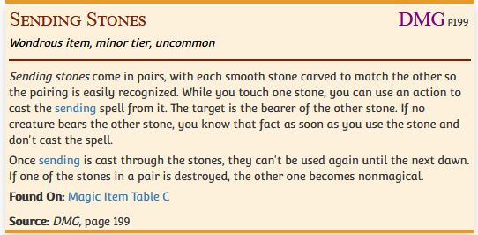
The Magic Trick of Educational Game Design
Notes:
https://forgottenrealms.fandom.com/wiki/Sending_stones
https://roll20.net/compendium/dnd5e/Sending
https://knowyourmeme.com/memes/galaxy-brain

Slide 10
Instructional Design

Slide 11
Instructional Design
The discipline of creating interventions to help people transition from being novices to experts
A central question is what exactly is the expertise we’re trying to get to?

Slide 12
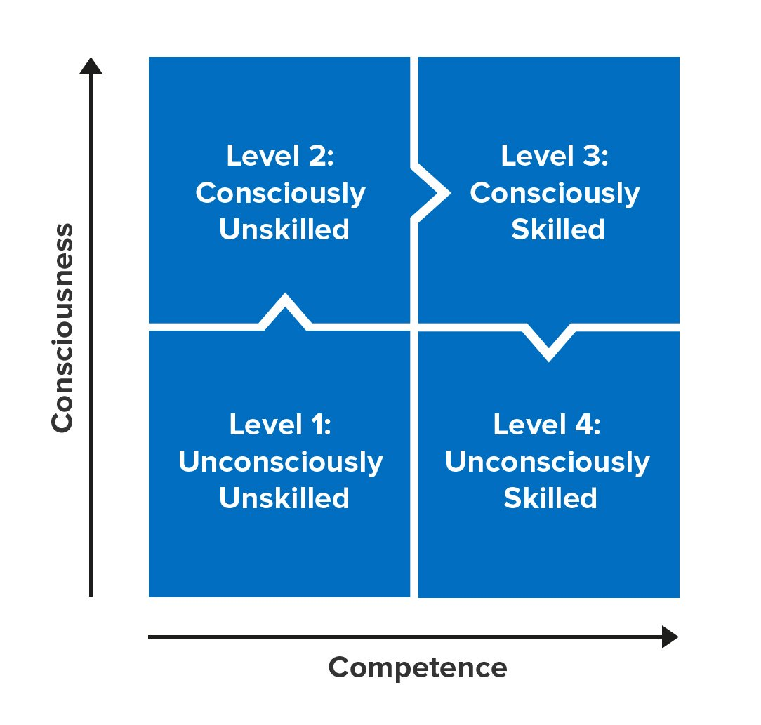
Process of Expertise Development

Slide 13
Backwards Design
Goals
Assessment
Instruction
[Wiggins & McTighe, 2005]

Slide 14
Backwards Design
Gives you a place to start
Grounds your work in what you are trying to do
Teaching to the test is not a bad thing if you have a good test

Slide 15
Backwards Design
Goals
Assessment
Instruction
What are these things?
[Wiggins & McTighe, 2005]

Slide 16
RWPs

Slide 17
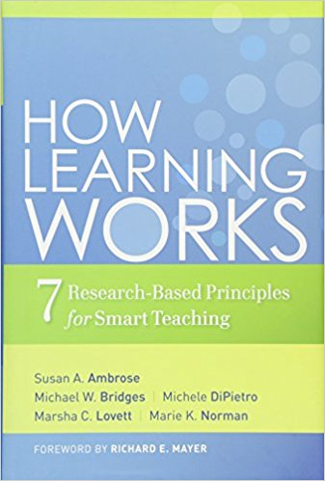
How does the way students organize knowledge affect their learning?
Susan Ambrose
Michael Bridges
Michele DiPietro
Marsha Lovett
Marie Norman
Ambrose, S. A., Bridges, M. W., DiPietro, M., Lovett, M. C., & Norman, M. K. (2010). How does the way students organize knowledge affect their learning? In How learning works: Seven research-based principles for smart teaching (First Edit, pp. 40–65). San Francisco, CA: Wiley.

Slide 18
On behalf of formal education…
Photograph by Kalhh at Pixabay

Slide 19
3. What did you think? (Ambrose et al.)
Why is backwards design called backwards?
Students interact with it
Felt like it really nailed what makes a good teacher versus a bad teacher
Definitiely relatable
Eg memorization in a lot of contexts

Slide 20
My take
This is intimidating to read as an instructor

Slide 21
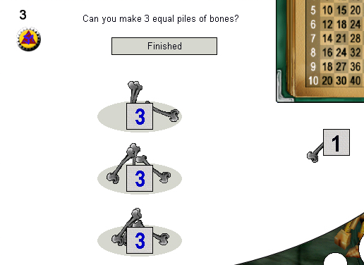
My take
Knowledge has a structure, it looks like something
If you teach to the wrong structure don’t expect to see learning

Slide 22
An observation from previous years
Students often say this reading is repetitive
“I find the [example] of the British's victory over Spanish Armada particularly thought-provoking.” – Student A
“As per the art history example, I think it is important to show things chronologically and point out key terms.” – Student B
“…like the example given with chess masters seeing whole patterns of chess pieces…” – Student C
Having lots of examples at the expense of being repetitive can be a good strategy

Slide 23
Semiotic Domains
James Gee
Gee, J. P. (2007). Semiotic Domains: Is Playing Video Games a “Waste of Time”? In What Video Games Have to Teach Us About Learning and Literacy (Revised an, pp. 17–43). New York, NY: Palgrave Macmillan.

Slide 24
4. What did you think? (Gee)
The way that he used the term semiotic was kind of confusing
The baskbeall example helped a lot
Felt a lot likf a philosophy reading but felt less actionable

Slide 25
My take
I hated this book when I was starting in the field
Semiotics is confusing!
Notes:
If you were confused by the concept of semiotics check out the less talk more rock reading for next week
A lot of what we tend to talk about in a domain is the internal bits what is the platonic ideal objective facts and skills?
valuable to think about the external view
For internal design grammar he even uses a similar example to Ambrose et al.

Slide 26
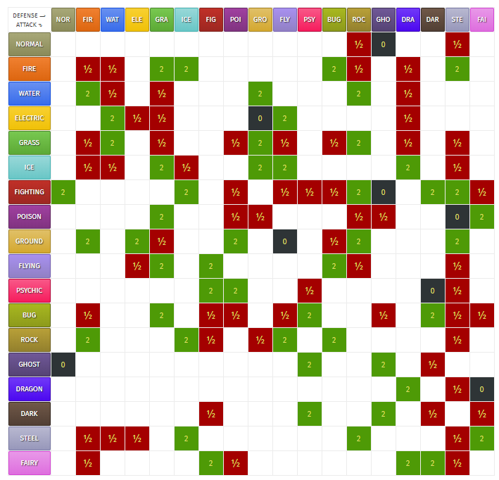
Semiotic Domain Example
Notes:
What would type of move should you use if I had:
a Fire pokemon? – water, ground, rock
Water/Poison? – electric, ground, psychic
Flying/electric? – Ice/rock
Bug/Dragon? – Ice <- doesn’t exist

Slide 27
My take
Valuable bits:
The distinction between Internal vs External views of a domain is useful
Semiotic domains are contextualized knowledge
Internal design grammar ~= Ambrose et al.’s knowledge structure
Striving for critical learning, getting learners to engage with a domain on a meta level
Games aren’t just content in a box
The world is filled with (semiotic) domains and we have arbitrarily labeled some of them as “academic”
Notes:
If you were confused by the concept of semiotics check out the less talk more rock reading for next week
A lot of what we tend to talk about in a domain is the internal bits what is the platonic ideal objective facts and skills?
valuable to think about the external view
For internal design grammar he even uses a similar example to Ambrose et al.

Slide 28
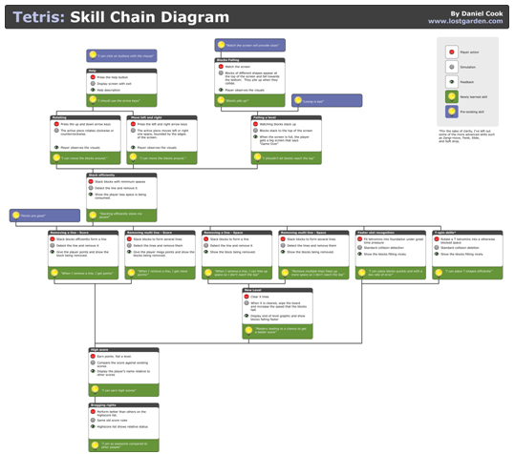
The Chemistry of Game Design
Dan Cook
Cook, D. (2007). The Chemistry Of Game Design. Retrieved January 23, 2018, from http://www.gamasutra.com/view/feature/129948/the_chemistry_of_game_design.php

Slide 29
5. What did you think? (Cook)
Interesting to note that several people were pointing out skill chains as linear
Skill Chains really similar to Ambrose’s knowledge organization ideas
Or a kind of knowledge organization
Liked that it modeled burn out
Make sure the player actually has the prior knowledge needed to understand a thing
Game design is really well suited for educational game design and attending to motivation
The idea of scaffolding
One challenge is having the right level fo complexity for the individual
Seems like responsibility is more on the designer than the teacher and student together
Designer needs to make sure the affordance comes through clearly
Teachers have more of a captive audience

Slide 30
My Take
Skill atoms are a useful, if imperfect, formalism
They occupy a weird theoretical space between a model of player knowledge and a model of design
Shows a common tendency in game design literature to appeal to neuroscience
Arbitrary separation between “useless” (e.g. story) and “useful” (e.g., actions) atoms
Notes:
The sense of linearity might be better thought of like a customer journey. It’s not that the “domain” is linear but that each player will necessarily acquire knowledge thorugh

Slide 31
The EDGE Framework
Educational Goals
Game Elements
Learning Mechanisms
Notes:
Educational game = game designed to meet pre-defined educational objectives
Educational game development project will be more successful if:
Educational objectives have been clearly specified early on
Designers have a notion of how the game’s mechanics, though the dynamics, realize the intended aesthetics
Game observes well-established instructional design principles

Slide 32
Educational Goals
Prior knowledge: What knowledge or skills will players need before playing the game?
Learning and retention: What knowledge or skills will players learn from the game?
Potential transfer: How far are these knowledge and skills likely to transfer?
Notes:
(as in any instructional design project)
Framework considers game designed with an explicit set of educational goals in mind
rather than an opportunistic and less coherent set of educational goals
Helps avoid creating games that
address only simple instances of a targeted cognitive skill
assume prior knowledge that the student/player is not likely to have
make it easy for the student/player to work around the learning embedded in the game
etc.
may they learn beyond what they encountered in the game?
Not enough to just say that students will learn whole-number division – want something far more specific here.
Each question has a three-part answer: (a) written description, (b) examples of tasks from which to learn each learning objective (may even though this at the level of steps within tasks, rather than tasks) (may even though this at the level of steps within tasks, rather than tasks)

Slide 33
1. What is knowledge?
From learning science, the definition is variable from who you’re reading and who you’re following
From a cognitive perspective there is
declarative (some times knowledge)
Soemthing you can describe (or “declare”)
Procedural (some times skill)
Soemthing you know ohw to do
From KLI (Knoweldge-Learnng-instruction framework)
Facts you know
skills you can do
Principles
A model of what you can learn and how it fits into your head, and how instruction impacts that stuff
Knowedge from your own experience versus things from others
A distinction between just knowing a fact (2+2=4) versus knowing the process but don’t just have the answer
Rational knowledge and emotive knowledge
Mental models
You model of something not necessarily the true model of something
Intuition things you know without really knowing
Metacognitive knowledge (know what you know)

Slide 34
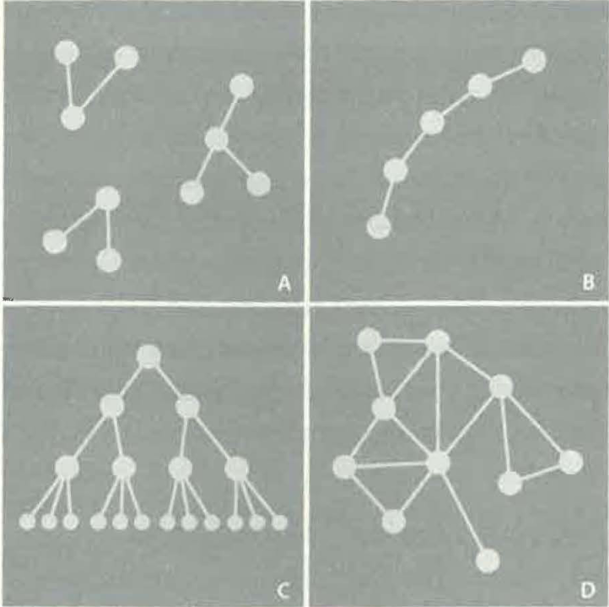
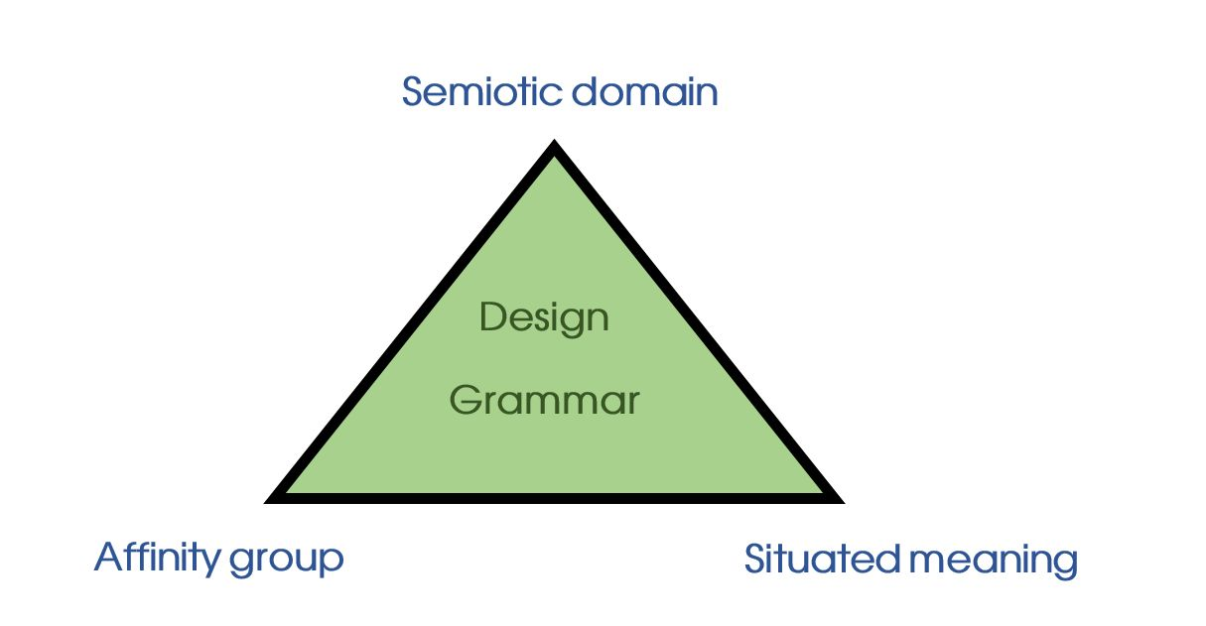
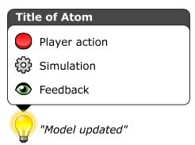
Knowledge looks like something

Slide 35
3 ways to organize knowledge goals
Performance Based goals
What do we want to be able to say a learner can do when they are an expert?
Based on activities learners can do
Cognitive Based goals
What kinds of knowledge do we want to be able to say a learner has when they are an expert?
Based on how the mind organizes knowledge
Transformational goals
How do we want the learner to change after play?
Based on a delta from where they are now

Slide 36
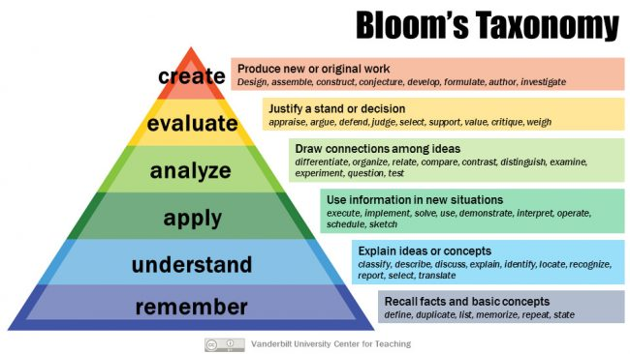
Performance Based:

Slide 37
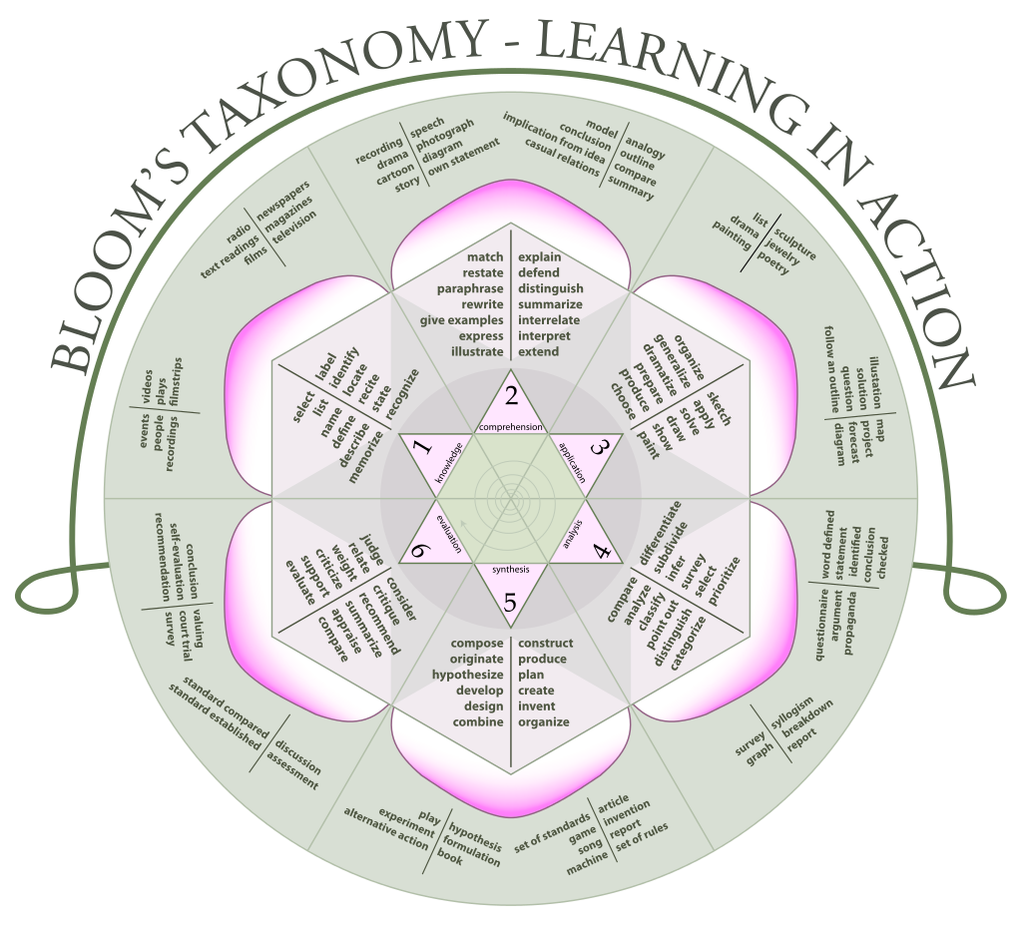
By K. Aainsqatsi - Own work, CC BY-SA 3.0, https://commons.wikimedia.org/w/index.php?curid=4000460

Slide 38
By K. Aainsqatsi - Own work, CC BY-SA 3.0, https://commons.wikimedia.org/w/index.php?curid=4000460

Slide 39
Cognitive Based:
Facts – specific declarative information, things you can recall
Concepts – organization and relationship between facts (or skills)
Skills – procedures, steps to a process, recipes
Dispositions – habits of mind and orientations toward problems, domains, and people

Slide 40
Knowledge Components (KCs)
“an acquired unit of cognitive function or structure that can be inferred from performance on a set of related tasks.”
‘‘knowledge component’’ broadly generalize across terms for describing pieces of cognition or knowledge, including production rule, schema, misconception, or facet, as well as everyday terms, such as concept, principle, fact, or skill.
Koedinger, K. R., Corbett, A. T., & Perfetti, C. (2012). The Knowledge-Learning-Instruction Framework: Bridging the Science-Practice Chasm to Enhance Robust Student Learning. Cognitive Science, 36(5), 757–798. https://doi.org/10.1111/j.1551-6709.2012.01245.x

Slide 41
Knowledge Components (KCs)
Koedinger, K. R., Corbett, A. T., & Perfetti, C. (2012). The Knowledge-Learning-Instruction Framework: Bridging the Science-Practice Chasm to Enhance Robust Student Learning. Cognitive Science, 36(5), 757–798. https://doi.org/10.1111/j.1551-6709.2012.01245.x

Slide 42
A unified taxonomy used by SimCoach Games
 | Performance Dimensions
Knowledge Dimension | Remember | Understand | Apply | Analyze | Evaluate | Create
Factual Knowledge
Conceptual Knowledge
Procedural Knowledge
Metacognitive Knowledge

Slide 43
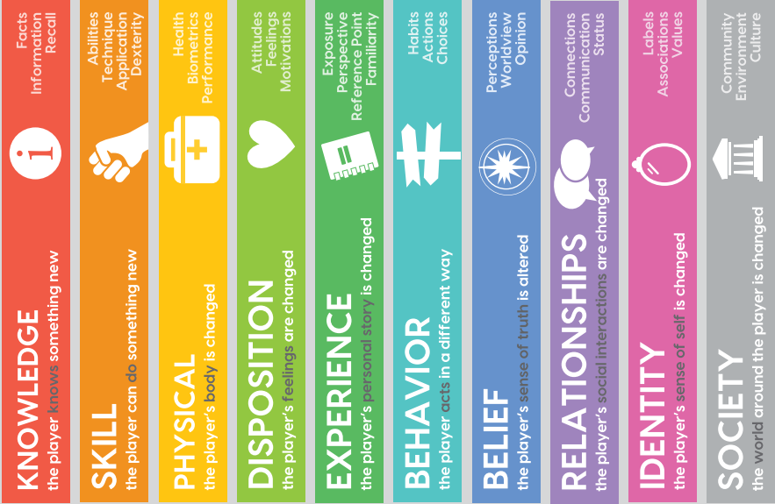
Kinds of Transformation
Schell Games’
Transformational Framework
Sabrina Haskell Culyba. 2018. The Transformational Framework: A process tool for the development of Transformational games. ETC Press, Pittsburgh, PA. Retrieved from http://press.etc.cmu.edu/index.php/product/the-transformational-framework/

Slide 44
Defining Goals

Slide 45
6. What makes a good educational goal?
Measurable
Something yo ucan define and see if you’ve achieve it or not
ABCD Method
Audience
Behavior
Context
Degree
Basic step to making a good goal but not a guarantee
Can be mapped to real world
Can be trasnfered outside of a game
It takes into account the audience and their skill level
Actionalbe?
IT should be reasonable achievable in a reasonable amount of time
SMART
Specific
Measureable
Actionable/Attainable
Relevant
Timely
Challenging for players

Slide 46
What makes a good Educational Goal?
Student/Player centered

Slide 47
What makes a good Educational Goal?
Student/Player centered
Specific

Slide 48
Is Chess a skill?
Notes:
Is “chess” a skill?

Slide 49
What about Math?

Slide 50
What makes a good Educational Goal?
Student/Player centered
Specific
Active

Slide 51
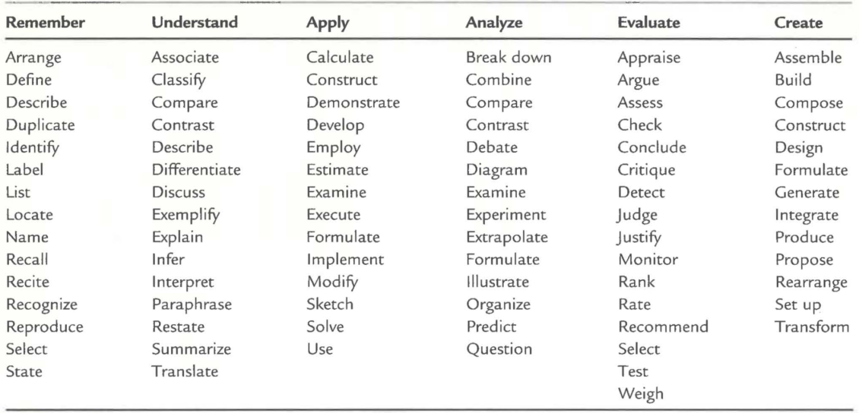

Slide 52
What makes a good Educational Goal?
Student/Player centered
Specific
Active
Measurable
We will address measurement more later
Basically you should be able to define what mastery means

Slide 53
The ABCD Method to Define Learning Goals
(A)udience: Who should be able to achieve the goal?
(B)ehavior: What should they be able to do?
(C)ondition: Under what conditions (if any) should they be able to do it?
(D)egree: To what level should they be able to do the thing (e.g., speed, volume, quality, accuracy)?
https://educationaltechnology.net/using-blooms-taxonomy-to-write-effective-learning-objectives-the-abcd-approach/

Slide 54
The ABCD Method to Define Learning Goals
Example objectives which include Audience, Behavior, Condition, Degree
“Students will be able to apply the standard deviation rule to the special case of distributions having a normal shape.”
“Given a specific case study, learners will be able to conduct at least 2 needs analysis. “
“Given a diagram of the eye, students will be able to label the 9 extra-ocular muscles and describe at least 2 of their actions.”
“Students will explain the social justice needed to ensure that adequate social services are provided to those who need them in three paragraphs.”
https://educationaltechnology.net/using-blooms-taxonomy-to-write-effective-learning-objectives-the-abcd-approach/

Slide 55
What I hope you get out of this course
Remember these?
A taste for the space of educational games and a developed sense to judge what makes one good or bad
An understanding of the different perspectives on educational game design
Some experience applying the various skills used in creating an educational game
A compelling educational game that you can speak to the design of and be proud to show off

Slide 56
What I hope you get out of this course
A taste for the space of educational games and a developed sense to judge what makes one good or bad
An understanding of the different perspectives on educational game design
Some experience applying the various skills used in creating an educational game
A compelling educational game that you can speak to the design of and be proud to show off
How are they?

Slide 57
How could we make these goals better?
~10 min
What I hope you get out of this course:
A taste for the space of educational games and a developed sense to judge what makes one good or bad
An understanding of the different perspectives on educational game design
Some experience applying the various skills used in creating an educational game
A compelling educational game that you can speak to the design of and be proud to show off
Remember good Goals are:
Student/Player centered
Specific
Active
Measurable
Consider the ABCD Method to define the:
Audience
Behavior
Conditions
Degree

Slide 58
How could we make these goals better?
Talked a lot about measurability
Talked about the student centered-ness, could it be more specific about the students from different backgrounds
Talked about conditions in terms of who are we desiging these games for
Talking about how to make the transformation of the knowledge easier
Some of the goals were compouns so they got split up

Slide 59
Sourcing Goals

Slide 60
Where do educational goals come from?
Curriculum set by the state (standards)
Pesonally what you want to achiee (a student setting their own goals)
Family or cultural influence
Indsutry standards
The instructor

Slide 61
Common Sources of Objectives
A client
A subject matter experts (SMEs)
State or other standards
Task Analysis
Previous Literature
Notes:
From the perspective of Ed games in practice
We are going to attack this order slightly differently

Slide 62
Key Points
Knowledge has a structure
How you define it will impact learning and design
Good goals are:
Student/Player centered
Specific
Active
Measurable
Objectives come from many places but still need to be well defined

Slide 63
For next time
RWPs for next week are posted
Join and introduce yourself on the Slack channel:
http://edugames.design/slack
Fill out the pre survey:
http://edugames.design/pre-survey
Start looking for Educational Games to critique:
http://edugames.design/big-list
If you have any feedback about how live sessions are going please let me know:
https://edugames.design/feedback
*If you’re on the Waitlist* please send me a message so I know you were here

