Slide 1
3 – Game Elements
Design of Educational Games
05418/05818 Human-Computer Interaction Institute
Erik Harpstead

Slide 2
Announcements
Almost all waitlist issues should now be resolved
If you are still here and on a wait list please let me know

Slide 3
Plan for Today
What is a Game
Second order design of games
Talk about elements of games
Mechanics
Systems
Gameplay
Player Experience

Slide 4
What is a Game?

Slide 5
Why start here?
You’ve been playing and having fun with games your whole life but have probably never stopped to think what any of those words actually mean
In order to approach design in this space it helps to have some words to talk about how games work

Slide 6
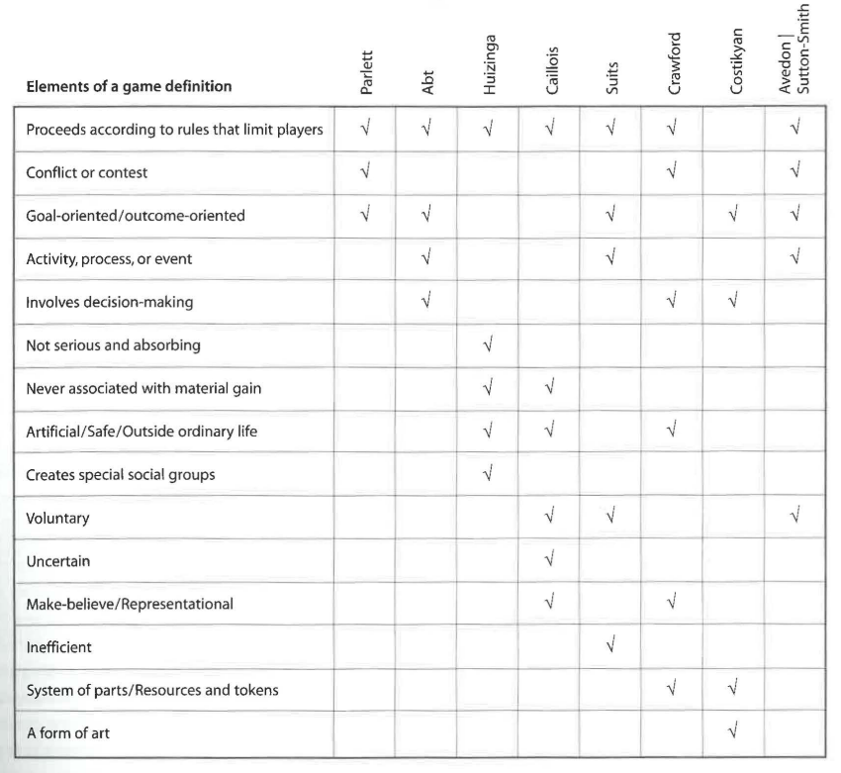
Defining Games
Katie Salen Tekinbaş
Eric Zimmerman
Katie Salen Tekinbaş and Eric Zimmerman. 2004. Defining Games. In Rules of Play: Game Design Fundamentals. MIT Press, Boston, MA, 71–83.

Slide 7
What aspects of game definitions were notable to you?
Interesting that both play and game talk about make believe (being apart from the real world)
Games are played to be enjoyed
A game being unproductive
The lusory attitude is interesting
Its ineffieicent but you follow it because it makes it possible
Not many definitions talked about games as art
Notes:
Costikyan: An interactive structure of endogenous meaning that requires players to struggle toward a goal
Suits: The voluntary effort to overcome unnecessary obstacles
Schell: A problem-solving activity, approached with a playful attitude
Fullerton: A closed, formal system, that engages players in structured conflict, and resolves in an unequal outcome

Slide 9
Highlighted Concepts from Game Definitions
Auto-Telic (goal/outcome oriented)
Games are directed at some kind of goal, though players may create their own goals separate from the state goal
Constraining
Games proceed according to Rules and Systems that limit how players can approach goals
Internally meaningful
Game objects mean something in the game in a way that is set apart from the “real world”
Voluntary
Players choose to enter into the goals, systems, and meaning of a game and cannot be forced to play

Slide 10
What do Game Designers Design?

Slide 11
What is the
game designer designing in this picture?
https://www.missiondrive.io/services/datopolis
Notes:
Image credit: https://www.missiondrive.io/services/datopolis

Slide 12
What is the
game designer designing in this picture?
This?
https://www.missiondrive.io/services/datopolis

Slide 13
What is the
game designer designing in this picture?
This?
https://www.missiondrive.io/services/datopolis

Slide 14
What is the
game designer designing in this picture?
This?
https://www.missiondrive.io/services/datopolis

Slide 15
What is the
game designer designing in this picture?
THIS!
https://www.missiondrive.io/services/datopolis

Slide 16
What is the
game designer designing in this picture?
Especially
THIS!
https://www.missiondrive.io/services/datopolis

Slide 17
These are the Tools of the
Game Designer
Tools
https://www.missiondrive.io/services/datopolis

Slide 18
This is the Goal of what they are designing
Goal
https://www.missiondrive.io/services/datopolis

Slide 19
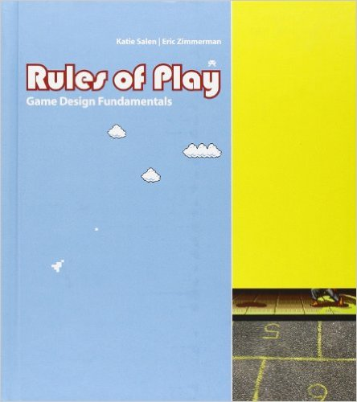
The Second-Order Design Problem
“The goal of successful game design is meaningful play, but play is something that emerges from the functioning of the rules. As a game designer, you can never directly design play. You can only design the rules that give rise to it.“
[Salen, & Zimmermann, 2004]

Slide 20
Why is this important for us?
Relates to…

Slide 21
PEOPLE DO NOT LEARN FROM GAMES

Slide 22
PEOPLE DO NOT LEARN FROM BOOKS

Slide 23
PEOPLE DO NOT LEARN FROM LECTURES…

Slide 24
PEOPLE DO NOT LEARN FROM MEDIA

Slide 25
People learn from their
with media

Slide 26
Educational Game Design is a Third-order Design Problem
Game Mechanics
and Systems
Dynamic
Gameplay
Player Experience
Knowledge
Change
So what are these things about?
Notes:
Ephemeral
Unpredictable
Invisible
Are we screwed?

Slide 27
Game Elements (The MDA Framework)

Slide 28
MDA: A Formal Approach to Game Design and Game Research
Robin Hunicke
Marc LeBlanc
Robert Zubek
Robin Hunicke, Marc Leblanc, and Robert Zubek. 2004. MDA : A Formal Approach to Game Design and Game Research. In Proc. of the AAAI Workshop on Challenges in Game AI, 1–5.

Slide 29
Elements of Game Design
Zubeck’s reformulation of MDA
Updates terminology to better align with how practicing game developers talk
Introduces a distinction in the mechanics and systems
Provides much more detail and connections to other concepts in game design

Slide 30
The Elements of Games
Zubeck, 2020

Slide 31
The Elements of Games
Mechanics
Dynamics
Aesthetics
Related to the MDA Framework
Zubeck, 2020

Slide 32
The Elements of Games
Zubeck, 2020

Slide 33
The Player’s Perspective
*Note: opposite from how it appears in the book
Zubeck, 2020

Slide 34
The Designer's Perspective
*Note: opposite from how it appears in the book
Zubeck, 2020

Slide 35
Bi-directional Design Strategies
*Note: opposite from how it appears in the book
Zubeck, 2020

Slide 36
The Elements of Games
Zubeck, 2020

Slide 37
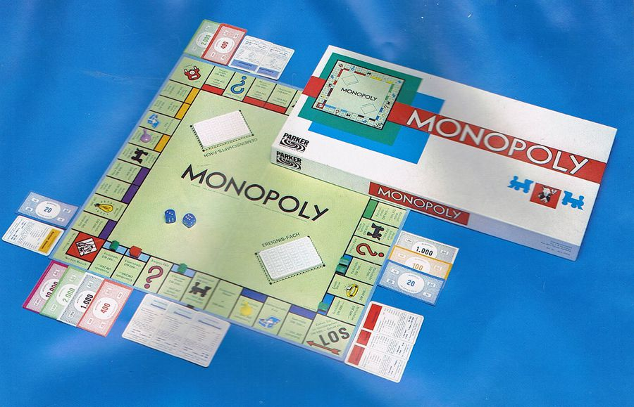

Slide 38
The Elements of Games
Zubeck, 2020

Slide 39
Mechanics
The most basic components of the game
The objects or pieces that can be manipulated by the player
The actions players can can perform with objects
The rules that govern what actions can be taken and what should happen as a result
Parts of the game that designers have total control over
The “stuff in the box” (including the rule book) of a board game
The entities or assets within a digital game

Slide 40
Mechanics Language Metaphor
Basic Elements
Objects = nouns
Actions = verbs
Rules = grammar
Can be extended further
Adjectives can modify nouns
heavy vs light armor
Adverbs can modify verbs
a high jump compared a normal jump
Prepositions that modify relationships
Placing a card next to another for an added effect

Slide 41
What are the mechanics of Monopoly?
Objects
Actions
Rules
The money
Denominations
Dice
Cards (community chest and chance)
Player pieces
Properties
Colors
Houses and hotels
The board
Rolling dice
Move your piece along the boar
Auctioning
Buy houses and hotels
Buy properties
Cllect money
Collect rent
Go to jail
Mortgaging
Collect 200 as you pass go
Pay money to get thproperty
Getting out jail
Use a card
Roll doubles
Getting into jail
Landing on the space
Rolling doubles 3 times
If you land on owned property you have to pay money
You the need the monopoly set to upgrade stuff
Community chest / chance cards
If you roll doubles yo uget to go again
Taxes
The trains are different
Ultiilities

Slide 42
Systems
Collections of mechanics that work together to create specific coherent processes or ideas
Analogous but not synonymous with software systems within digital games
Ex: the “rendering system” generally doesn’t involve game mechanics but a “physics system” might
Often the level at which we talk about games or initial design ideas

Slide 43
Mechanical Description of Minecraft
The player exists in a 3D world made of 1 unit blocks
The player moves around using WASD and looks with a mouse
The player has a two main actions, left click and right click
(Most of the time) if a player left clicks on a block they hit it
Blocks have durability defining how many time they can be hit
If the player hits the block enough it “breaks” disappearing and creating a smaller version of the block
Picking up a small dropped block adds it to the player’s inventory
Players have an inventory consisting of a limited number of cells
Players also have a “quick access” inventory where they can put items
Players can focus on one item in the quick access inventory to hold it in their hand by pressing its number of using a mouse wheel to select it
If a player is holding a dropped block in their hand they can place it back into the world by right clicking
The player’s inventory also has a 2x2 crafting grid
When certain patterns are made with specific types of blocks in the grid the player can exchange the blocks for a new item
Some items are tools
Some tools make it easier or possible to break higher durability blocks
Some items can be placed as blocks giving more actions
One example of a placed block is a crafting table which has a 3x3 grid to make more complex items
Another placable item is a furnace which can turn some items into other items when paired with a fuel source
The world has a day/night cycle
Some items generate light to see at night
The world also has other creatures called mobs
Touching some mobs hurts the player, while others do not
Most mobs only spawn in dark areas (at night)
…

Slide 44
Systems Description Minecraft
Players explore a 3D world made of blocks. They can mine blocks for resources and craft new things using those resources
These new things can help them:
Survive (health/hunger system)
Fight mobs (combat and XP systems)
Explore the generated map (world generation and biome systems)

Slide 45
Genres as Systems
Most game genre descriptors are actually shorts-hands for common systems of mechanics used across several games
First Person Shooter
Quake, Half-Life, Halo, Call of Duty…
Trick-taking card game
Spades, Hearts, Bridge, Whist, Euchre…
Roguelike
Rouge, Hades, FTL: Faster Than Light, Spelunky…
Soulslike
Dark Souls, Demon’s Souls, Sekiro, Bloodborne
Social Deduction
Werewolf, The Resistance Avalon, Among Us…
4x (explore, expand, exploit, exterminate)
Civilization, Stellaris, Age of Wonders, Crusader Kings…
Match-3
Candy Crush, Bejeweled, Zuma…
Deck builder
Dominion, Clank!, Wingspan…

Slide 46
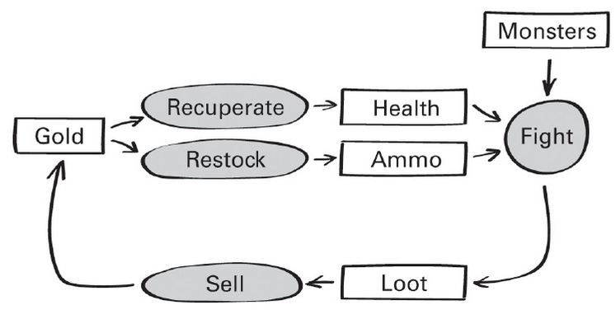
Systems Loops and Interactions
Systems are usually structured in some kind of loop and involve to one or more resources
Systems are often layered and interlocking
The crafting system in Minecraft interacts with the resource mining system, the combat system, the farming system…
Key to identifying systems: Look for how things (currency, resources, objects, etc.) move through the game
Zubeck, 2020

Slide 47
Draw the Monopoly System Loop Here

Slide 48
Monopoly System Loop

Slide 49
Monopoly System Loop

Slide 50
Systems and Balance
Systems are the primary lever for how designers can balance games toward or aware from intended outcomes
Looking at how fast or slow certain systems move can impact play experiences
Great chapter on these ideas later in the Zubeck book

Slide 51
How to break the Monopoly System
https://imgur.com/a/vX3zm

Slide 52
How to break the Monopoly system
Step 1. Acquire Properties as you would normally
i.e. engage with the standard money -> property system

Slide 53
How to break the Monopoly system
Step 2: Trade to acquire an early Monopoly
i.e. optimize for monopoly coverage
TIP 1: People are more likely to give up cheaper properties (light blue, light purple, orange)
TIP 2: Orange is statistically the most visited color set

Slide 54
How to break the Monopoly system
Step 3: Improve your properties with 3 houses each
i.e. engage in some of the property improvement system

Slide 55
How to break the Monopoly system
Step 4: Use your profits to acquire a second monopoly and build them up to 4 houses each
i.e. continue to engage with the improvement system but…
DO NOT BUILD HOTELS

Slide 56
How to break the Monopoly system
Step 5: Profit
As the rules state, a player cannot build a house if there are none left in the box…
With two 3 property monopolies full of 4 houses each you control 75% of the housing stock with only 27% of the properties
Both Land Area Coverage and Housing Stock are scarce resource systems but the Housing Stock system can be maximized faster

Slide 57
Monopoly System Loop

Slide 58
Monopoly System Loop

Slide 59
The Elements of Games
Zubeck, 2020

Slide 60
Gameplay (Dynamics)
The run-time behavior of the game-as-system
What happens when a player (who isn’t the designer) interacts with the mechanics and systems using their knowledge and decision making
The (unintentional) implications of mechanics

Slide 61
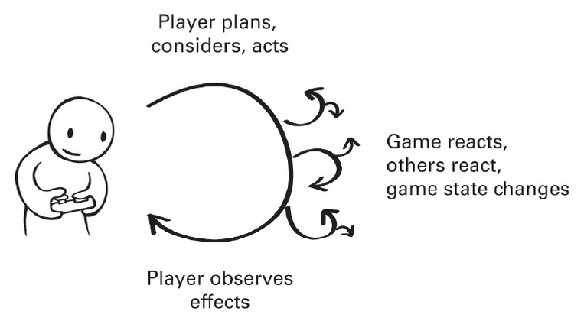
Gameplay Loops
Gameplay Loop
Useful to think about gameplay in terms of decision making loops
Similar to the loops of systems but now involving the player’s decision making and reactions
Game System Loops
Zubeck, 2020

Slide 62
Gameplay Loops are Nested
The Core Loop: the smallest activity loop that the player will find interesting
Micro loops: shorter decision making loops for actions inside the core loop
Macro loops: broader scale decision making around the core loop
Zubeck, 2020

Slide 63
Gameplay Loops in Minecraft
Quick inner loops are primarily built around collecting resources and not dying
At an intermediate levels players can be creative and plan for adventures
At the highest levels players can explore their own creativity or progress toward the Ender Dragon
Explore the world, progress toward The End
Build structures, farm resources
Craft tools, mine resources, maintain health
avoid mobs, break blocks, collect dropped resources

Slide 64
What are the Gameplay Dynamics of Monopoly?
Core Loop
Micro Loops
Macro Loops
Planning to Get Monopoly sets
Taking a turn / deciding whether or not to buy A thing / paying rent
Haggling for payment
Eliminating other players
Taking all their money
Waiting them out
Trying to take as much land as possible

Slide 65
Players can create Dynamics
Gameplay is also impacted by player choice, judgement, and interpretation

Slide 66
Monopoly Pop Quiz
If you have to pay the luxury or income taxes where does the money go?
To the middle of the board
On free parking
Given to the player playing banker
To the bank

Slide 67
Monopoly Pop Quiz
What happens if you land on free parking?
You get the money in the middle of the board
Pick a random unowned property and auction it off
Nothing happens
You get $1000

Slide 68
Monopoly Pop Quiz
What happens if you land on an unowned property space and you do not want to pay full price for it?
It stays with the bank (i.e., nothing happens)
It must go up for auction to the highest bidder, which you can use to get it cheaper than list price
You can exchange it for one of your properties of equal or greater value
If you own other properties in the same group you can buy it for discounted price

Slide 69
Players can create Dynamics
Gameplay is also impacted by player choice, judgement, and interpretation
Monopoly is a very different game to many people because no one plays it by the book
House rules and culture history can play into how people play games

Slide 70
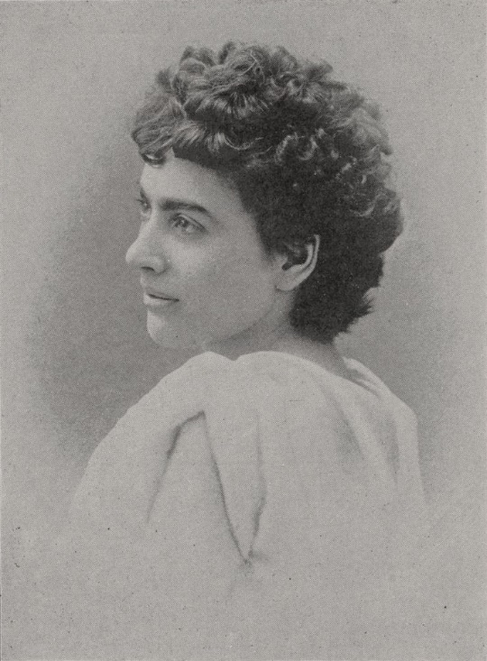
Landlords’ Game a possible origin of Monopoly house rules?
The Landlords’ Game was the original inspiration for what become Monopoly
It’s also a much better game…
You were meant to play both Monopolist rule set and a Georgist Single-tax rule set and compare them
Some aspects of popular house rules exist within the Georgist verion

Slide 71
Emergent Behavior of Systems can create Dynamics
Even when a game’s systems are running as “intended” they can cause odd behavior that players may exploit

Slide 73
More on how this works: https://www.ryanliptak.com/blog/rampsliding-quake-engine-quirk/

Slide 74
Emergent Behavior of Systems can create Dynamics
Even when a game’s systems are running as “intended” they can cause odd behavior that players may exploit
Players may invent new goals or whole new games when given the systems you provide them as a designer
Highlights that gameplay doesn’t just manifest in code / objects but also in how the player values them

Slide 75
The Elements of Games
Zubeck, 2020

Slide 76
Player Experience (Aesthetics)
The desirable emotional responses evoked by the gameplay
The feeling and emotional state created by the game
Why people might want to play the game
Not guaranteed to be the same for all players
Almost guaranteed not to be the same

Slide 77
Kinds of Player Experience Theories
Motivational theories try to explain what keeps people engaged and motivated to complete games
Emotional theories try to explain how game experiences make players feel
Designer theories try to encompass the designers’ intended expression with the game
We will talk more about each of these later when we cover Motivation, but some quick advice…

Slide 78
Avoid the word fun
fun is fundamental to an aesthetic of play and games…
but it is also a weirdly ambiguous term that means different things to different people in different contexts
If you want to dig more into this check out: John Sharp and David Thomas. 2019. Fun, Taste, & Games: An Aesthetic of the Idle, Unproductive, and Otherwise Playful. MIT Press, Cambridge, MA. Available from the library!
As a novice game designer it can be hard to think about make something more or less fun so try to think of terms
Notes:
Hanging out with friends is fun
Being scared at horror movies is fun
Jumping out of airplanes skydiving is fun
Sitting inside meticulously painting models is fun

Slide 79
Leblanc’s (non-exhaustive) Taxonomy of Experiential Aesthetics
Sensation
Game as sense-pleasure
Fantasy
Game as make-believe
Narrative
Game as drama
Challenge
Game as obstacle course
Fellowship
Game as social framework
Discovery
Game as uncharted territory
Expression
Game as self-discovery
Submission / Masochism / Abnegation
Game as pastime

Slide 80
Think of a specific game you like to play, why do you like playing it?
Coup or social deduction games
I like to win
I like other people to lose
King making / blocking others from winning
Surprise / randomness
Pokemon
I gotta catch ‘em all!
I want to se what they all are
Magic the Gathering
Trading and collecting
Eck building
Stardew Valley
I want all the recipes / fish / goods
Gloom
Like the macabe humor
FPS
Like the adrenaline rush
Open world advencture games
Experience a certain world
A certain story telling
Persona 5
Creative use of story
RPGs (KOTR)
Intertwining a story and
Payoffs for prior decisions
Compettitve fighting games
The sense of community
Rougelikes (HADES)
The feeling of being more powerful and seeing evience of the power

Slide 81
What are some potential the Player Experiences of playing Monopoly?
The feeling getting really rich
Trying to hoard all the properties (collections)
Feeling of others getting poor
The surprise of randomness or a strategy paying or getting lucky
Sense of gambling
Social intercations with other players
Bantering with friends
The feeling planning strategies and how to invest

Slide 82
Take Home Message
The Game is the tool to get to the Experience which is the goal

Slide 83
PEOPLE DO NOT LEARN FROM GAMES

Slide 84
Take Home Message
The Game is the tool to get to the Experience which is the goal
PEOPLE DO NOT LEARN FROM GAMES
Educational Games are Third Order Design
Game Elements
Mechanics (objects, actions, rules)
Systems (collections of mechanics)
Gameplay (what happens when the player hits the game)
Player Experience (why people play)

Slide 85
For next time
RWPs for next week will be posted soon after class
Get started on the Critique Blogs
If you haven’t already
Introduce yourself on the Slack channel (http://edugames.design/slack)
Fill out the pre survey
If you have any feedback about how live sessions are going please let me know: http://edugames.design/feedback

