Slide 1
4 – Learning Mechanisms
Design of Educational Games
05418/05818 Human-Computer Interaction Institute
Erik Harpstead

Slide 2
Announcements
First Crit Post submission opportunity in 2 weeks
RWPs for next week are posted
Final Waitlist stuff will be done by the end of the day
If you still want a seat let me know

Slide 3
Plan for Today
Do a primer on how learning works
Talk about principles related to cognitive processing limits
Talk about principles related to different learning processes
Give some ideas on how to use them in design

Slide 4
Feedback is Welcome
Wanted to make sure people were aware of the rolling feedback from in the course
Particularly interested in feedback on this sessions as I’m still not happy with how I cover learning science principles
http://edugames.design/feedback

Slide 5
Learning Science Principles

Slide 6
The EDGE Framework
Educational Goals
Game Elements
Learning Mechanisms
Notes:
Educational game = game designed to meet pre-defined educational objectives
Educational game development project will be more successful if:
Educational objectives have been clearly specified early on
Designers have a notion of how the game’s mechanics, though the dynamics, realize the intended aesthetics
Game observes well-established instructional design principles

Slide 7
List of Lists of Learning Science Principles
https://canvas.cmu.edu/courses/21116/pages/list-of-lists-of-learning-science-principles
Currently contains 138 principles!
many are duplicates…
I’ve always found this a bit dissatisfying…

Slide 8
Tensions in Learning Science Principles
Do I cut this out?

Slide 9
Organizing Instruction and Study to Improve Student Learning
Harold Pashler
Patrice Bain
Brian Bottge
Art Graesser
Ken
Koedinger
Mark McDaniel
Janet Metcalfe
Pashler, H., Bain, P. M., Bottge, B. A., Graesser, A. C., Koedinger, K. R., McDaniel, M., & Metcalfe, J. (2007). Organizing Instruction and Study to Improve Student Learning (NCER 2007-2004). Washington, D.C.

Slide 10
Instructional Design Principles IES Practice Guide http://ies.ed.gov/ncer/pubs/practiceguides/20072004.asp
Space learning over time
Interleave worked example solutions and problem-solving exercises
Combine graphics with verbal description
Connect and integrate abstract and concrete representations of concepts
Use quizzing to promote learning
Use pre-questions to introduce a new topic
Use quizzes to re-expose students to information
Help students allocate study time efficiently
Teach students how to use delayed judgment of learning techniques to identify concepts that need further study
Use tests and quizzes to identify content that needs to be learned
Help students build explanations by asking and answering deep questions

Slide 11
IES Practice Guide
Probably the most rigorously backed set of principles
Also, probably the most uncontroversial set of principles
This is the most general practice guide but there are more:
https://ies.ed.gov/ncee/wwc/PracticeGuides
Including recommendations for practice is amazing, but rare…

Slide 12
The What Works Clearinghouse standards have always bugged me

Slide 13
The dilemma of rigor or relevance
Schön, D. A. (1982). The Reflective Practitioner: How Professionals Think in Action. New York, New York, USA: Basic Books. Pg. 42
Image from: https://trapaski.deviantart.com/art/swamp-castle-192418591
Notes:
In the varied topography of professional practice, there is a high, hard ground where practitioners can make effective use of research-based theory and technique, and there is a swampy lowland where situations are confusing "messes" incapable of technical solution. The difficulty is that the problems of the high ground, however great their technical interest, are often relatively unimportant to clients or to the larger society, while in the swamp are the problems of greatest human concern.
Shall the practitioner stay on the high, hard ground where they can practice rigorously, as they understand rigor, but where they are constrained to deal with problems of relatively little social importance? Or shall they descend to the swamp where they can engage the most important and challenging problems if they are willing to forsake technical rigor?
Image from: https://trapaski.deviantart.com/art/swamp-castle-192418591

Slide 14
The dilemma of rigor or relevance
In the varied topography of professional practice, there is a high, hard ground where practitioners can make effective use of research-based theory and technique, and there is a swampy lowland where situations are confusing "messes" incapable of technical solution. The difficulty is that the problems of the high ground, however great their technical interest, are often relatively unimportant to clients or to the larger society, while in the swamp are the problems of greatest human concern.
Shall the practitioner stay on the high, hard ground where they can practice rigorously, as they understand rigor, but where they are constrained to deal with problems of relatively little social importance? Or shall they descend to the swamp where they can engage the most important and challenging problems if they are willing to forsake technical rigor?
Schön, D. A. (1982). The Reflective Practitioner: How Professionals Think in Action. New York, New York, USA: Basic Books. Pg. 42
Notes:
It seems clear, however, that the dilemma which afflicts the professions hinges not on science per se but on the Positivist view of science. From this perspective, we tend to see science, after the fact, as a body of established propositions derived from research. When we recognize their limited utility in practice, we experience the dilemma of rigor or relevance. But we may also consider science before the fact as a process in which scientists grapple with uncertainties and display arts of inquiry akin to the un-certainties and arts of practice.

Slide 15
Tensions in Learning Science Principles
Few Learning Science principles have been studied in the context of games
Handbook of Game-Based Learning was published in 2020!
Usually they assume that learners have no say in using a system or focus solely on measurable learning outcomes without considering affective side effects
Studies often done with WEIRD (Western, educated, industrialized, rich and democratic), neurotypical, and non-disabled populations

Slide 16
What does this mean?
You might be tempted to look at “rigorously proven principles of learning” and think that adding them to your game will make it educational

Slide 17
You can’t just apply learning science you have to do learning science
Great! How do we do that?
First you apply some learning science principles…
Then you do some learning science by iterating, testing, and evaluating your design
While you may have followed the best science in making it, your game has never existed before and it should be tested

Slide 19
What are Learning Science Principles?
Before we do that

Slide 20
How I used to teach this content

Slide 21
Memory/Fluency | 1 | Spacing | Space practice across time > mass practice all at once
 | 2 | Scaffolding | Sequence instruction toward higher goals > no sequencing
 | 3 | Exam expectations | Students expect to be tested > no testing expected
 | 4 | Testing | Quiz for retrieval practice > study same material
 | 5 | Segmenting | Present lesson in learner-paced segments > as a continuous unit
 | 6 | Feedback | Provide feedback during learning > no feedback provided
Induction/Refinement | 7 | Pretraining | Practice key prior skills before lesson > jump in
 | 8 | Worked example | Worked examples + problem-solving practice > practice alone
 | 9 | Concreteness fading | Concrete to abstract representations > starting with abstract
 | 10 | Guided attention | Words include cues about organization > no organization cues
 | 11 | Linking | Integrate instructional components > no integration
 | 12 | Goldilocks | Instruct at intermediate difficulty level > too hard or too easy
 | 13 | Activate preconceptions | Cue student's prior knowledge > no prior knowledge cues
 | 14 | Feedback timing | Immediate feedbac on errors > delayed feedback
 | 15 | Interleaving | Intermix practice on different skills > block practice all at once
 | 16 | Application | Practice applying new knowledge > no application
 | 17 | Variability | Practice with varied instances > similar instances
Sense-making/Understanding | 18 | Comparison | Compare multiple instances > only one instance
 | 19 | Multimedia | Graphics + verbal descriptions > verbal descriptions alone
 | 20 | Modality | Verbal descriptions presented in audio > in written form
 | 21 | Redundancy | Verbal descriptions in audio > both audio & written
 | 22 | Spatial contiguity | Present description next to image element described > separated
 | 23 | Temporal contiguity | Present audio & image element at the same time > separated
 | 24 | Coherence | Extraneous words, pictures, sounds excluded > included
 | 25 | Anchored learning | Real-world problems > abstract problems
 | 26 | Metacognition | Metacognition supported > no support for metacognition
 | 27 | Explanation | Prompt for self-explanation > give explanation > no prompt
 | 28 | Questioning | Time for reflection & questioning > instruction alone
 | 29 | Cognitive dissonance | Present incorrect or alternate perspectives > only correct
 | 30 | Interest | Instruction relevant to student interests > not relevant
Any questions?

Slide 22
How Does Learning Work?

Slide 23
Perspectives in Learning Science
Learning Science is the study of how learning works
Can be viewed from many different lenses of psychological theory, for example:
Behaviorism Theory: How people act based on conditions and situations
Social Cognitive Theory: How people learn by observing others
Cognitive Theory: How people think and process information
Developmental Theory: How people learn and behave as they age and grow
Constructivist Theory: How people learn via acrued personal experience

Slide 24
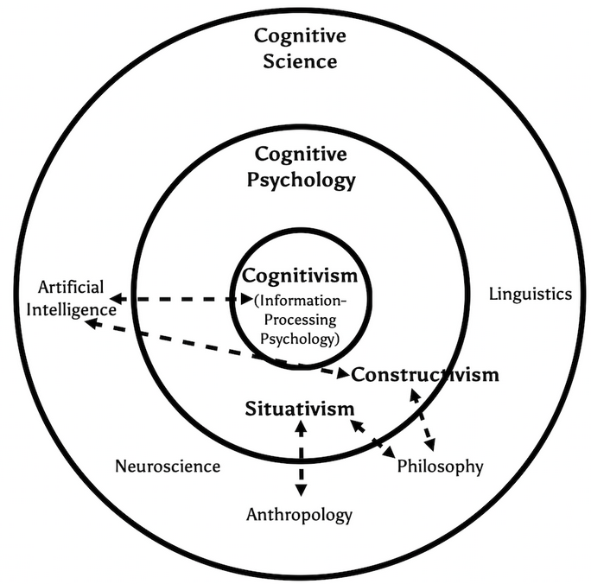
A Primer on Learning Theories
Shayan Doroudi
Shayan Doroudi. 2021. A Primer on Learning Theories.

Slide 25
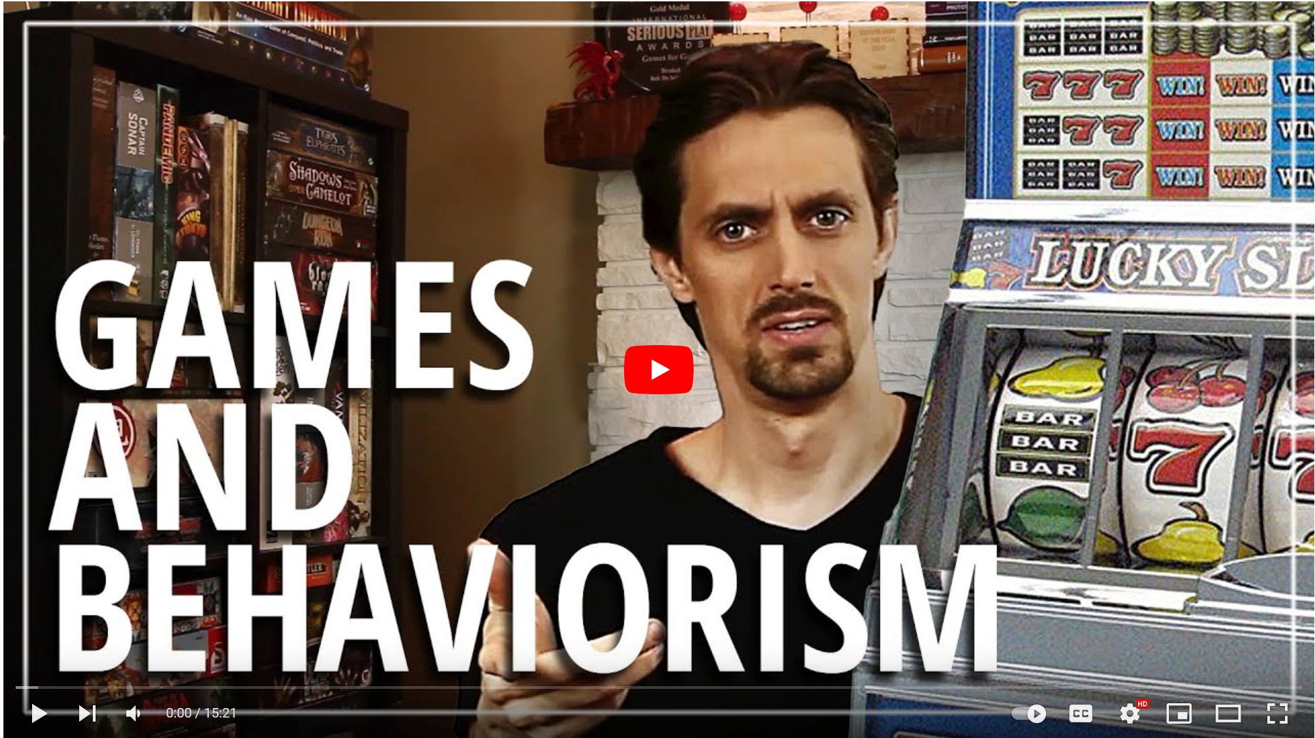
Bob De Schutter’s series on Applied Game Design

Slide 26
What did you think about either Primer?
Nice to see some context of learning science ideas connected to games
The emphasis on thought leaders was kind of interesting
Interesting how ethics came up in prior work
In industry no one is doing these deep theoretical dives

Slide 27
My Take
A really nice grounding in where different learning theorists are coming from to help you interpret what they recommend
The case studies in particular are really valuable
Making a distinction between Descriptive and Prescriptive theories is useful with learning principles

Slide 28
How Does Learning Work?
* From a Cognitivist Perspective

Slide 29
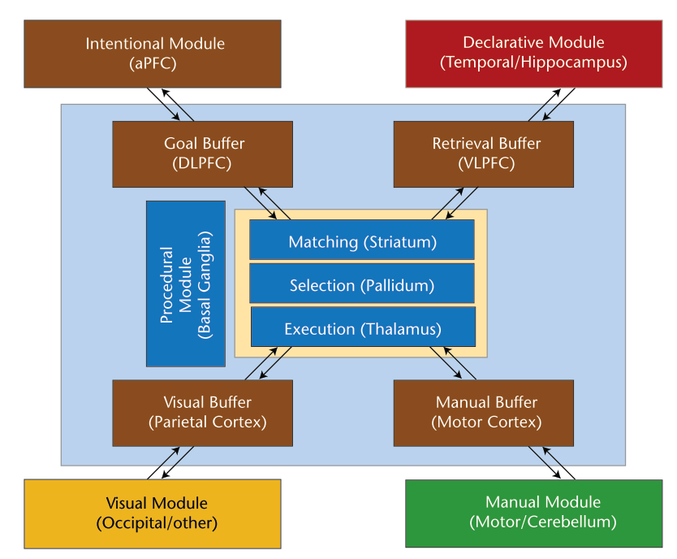
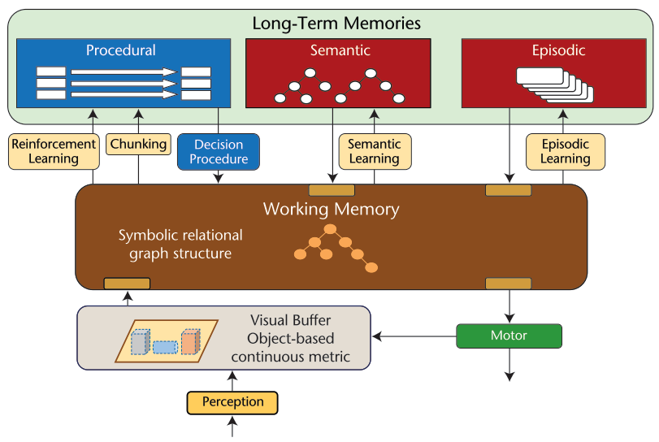
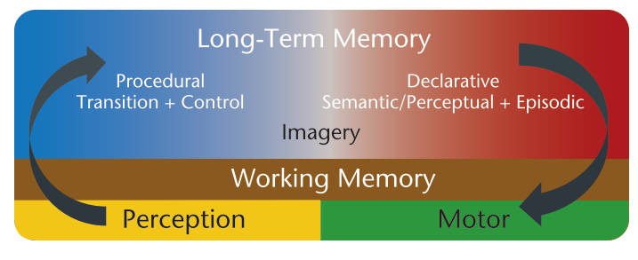
Cognitive Models describe how our minds process information and act
ACT-R
SOAR
Sigma

Slide 30
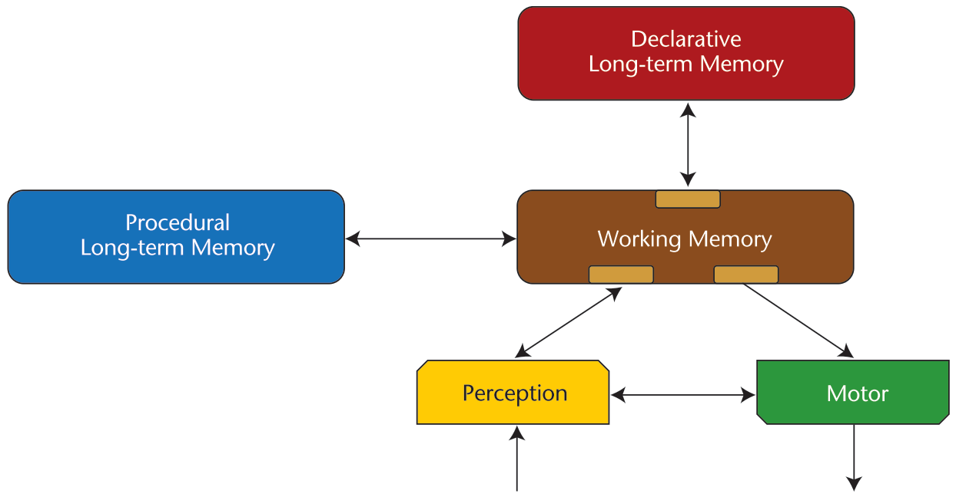
A Standard Model of the Mind
Laird, J. E., Lebiere, C., & Rosenbloom, P. S. (2017). A Standard Model of the Mind: Toward a Common Computational Framework across Artificial Intelligence, Cognitive Science, Neuroscience, and Robotics. AI Magazine, 38(4), 13. https://doi.org/10.1609/aimag.v38i4.2744

Slide 31
Principles Related to Processing Limits

Slide 32
Handbook of Game-Based Learning
Chapter 4: Cognitive Foundations of Game-Based Learning
Chapter 12: Multimedia Design Principles in Game-Based Learning
Richard Mayer
Brian Nelson
Younsu
Kim
Jan L. Plass, Richard E. Mayer, & Bruce D. Homer. (2020). Handbook of Game-Based Learning. The MIT Press.

Slide 33
What did you think? (HGBL)
Seen Mayer before in his other book
Interesting that immersive tech doesn't have a strong track record
Found it interesting how there were differences baed on subject

Slide 34
My Take
This is a relatively new book
Hard to pick which chapter (4 or 12) is more relevant, may be worth looking at both if you’re interested
Great to finally see evidence directly in games

Slide 35
Principles from Handbook of Game-Based Learning
Extraneous | Signaling | People learn better from a game when cues highlight the organization of the essential material area added
 | Redundancy | People do not learn better in games where words are printed and spoken rather than formal style
 | Immersion | People do not learn better when a game is rendered in realistic 3-D virtual reality rather than in 2-D
Essential | Pretraining | People learn better in a game when they receive pretraining in the key concepts
 | Modality | People learn better in games when words are spoken rather than printed
Generative | Self-explanation | People learn better in a game when they are asked to select an explanation for their moves
 | Explanatory Feedback | People learn better in games when they receive explanatory feedback after key moves
 | Prompting | People learn deeply in games when they are asked to reflect
 | Personalization | People learn better in games when words are in conversational style rather than formal style
 | Image | People do not learn much better in games when an agent’s image is on the screen
 | Narrative theme | People do not learn better in games with strong narrative themes
Notes:
Purple = Extraneous
Yellow = Essential
Red = Generative
Interleve these down with the load explanation

Slide 36
Cognitive Processing is Limited
Dual-channels principle
People have separate (but interacting) channels for processing visual and verbal information.
Limited capacity principle
People can process only a small amount of material in each channel at any one time.
Active processing
People learn by paying attention to relevant incoming information, mentally organizing it into a coherent structure, and integrating it with relevant prior knowledge activated from long- term memory.
Mayer, R. E. (2020). Cognitive Foundations of Game-Based Learning. In J. L. Plass, R. E. Mayer, & B. D. Homer (Eds.), Handbook of Game-Based Learning (pp. 83–110). MIT Press.

Slide 37
Cognitive Processing is Limited
Mayer, R. E. (2020). Cognitive Foundations of Game-Based Learning. In J. L. Plass, R. E. Mayer, & B. D. Homer (Eds.), Handbook of Game-Based Learning (pp. 83–110). MIT Press.

Slide 38
Learning Science Principles Can Control Processing Conflicts
Extraneous Cognitive Load
Cognitive Load
Extraneous Process (extraneous cognitive load) – is everything that can overwhelm or get in the way of your thinking
Cognitive Load Limit

Slide 39
Extraneous Processing Principles
Signaling | People learn better from a game when cues highlight the organization of the essential material area added
Redundancy | People do not learn better in games where words are printed and spoken at the same time
Immersion | People do not learn better when a game is rendered in realistic 3-D virtual reality rather than in 2-D
Notes:
Purple = Extraneous
Yellow = Essential
Red = Generative
Interleve these down with the load explanation

Slide 40
Learning Science Principles Can Control Processing Conflicts
Extraneous Cognitive Load
Cognitive Load
Extraneous Process (extraneous cognitive load) – is everything that can overwhelm or get in the way of your thinking
Essential Processing (intrinsic cognitive load) – is the baseline level of processing required to work on a particular task
Cognitive Load Limit
Intrinsic Cognitive Load

Slide 41
Essential Processing Principles
Pretraining | People learn better in a game when they receive pretraining in the key concepts
Modality | People learn better in games where words are spoken rather than printed
Notes:
Purple = Extraneous
Yellow = Essential
Red = Generative
Interleve these down with the load explanation

Slide 42
Learning Science Principles Can Control Processing Conflicts
Extraneous Cognitive Load
Cognitive Load
Extraneous Process (extraneous cognitive load) – is everything that can overwhelm or get in the way of your thinking
Essential Processing (intrinsic cognitive load) – is the baseline level of processing required to work on a particular task
Generative Processing (germane cognitive load) – is the processing done to organize and integrate knowledge in learning
Cognitive Load Limit
Germane Cognitive Load
Intrinsic Cognitive Load

Slide 43
Generative Processing Principles
Self-explanation | People learn better in a game when they are asked to select an explanation for their moves
Explanatory Feedback | People learn better in games when they receive explanatory feedback after key moves
Prompting | People learn deeply in games when they are asked to reflect
Personalization | People learn better in games when words are in conversational style rather than formal style
Image | People do not learn much better in games when an agent’s image is on the screen
Narrative theme | People do not learn better in games with strong narrative themes
Notes:
Purple = Extraneous
Yellow = Essential
Red = Generative
Interleve these down with the load explanation

Slide 45
You might be thinking…
If some learning science principles advocate for reducing unnecessary processing…
And games are fundamentally unnecessary obstacles…
Doesn’t that mean we shouldn’t use games?
NO!

Slide 46
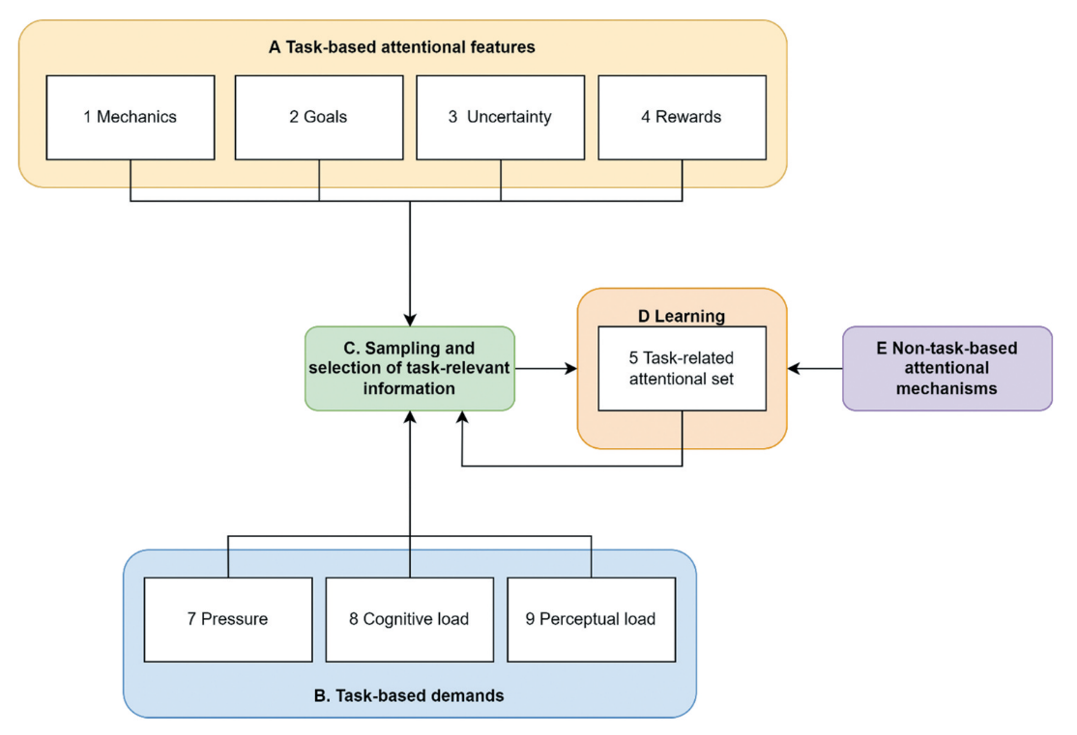
Task-Attention Theory of Game Learning
Joe Cutting
Sebastian Deterding
Joe Cutting and Sebastian Deterding. 2022. The task-attention theory of game learning: a theory and research agenda. Human–Computer Interaction 00, 00: 1–31. https://doi.org/10.1080/07370024.2022.2047971

Slide 47
Task Attention Theory of Game Learning
Future home of a segment on the Task-Attention Theory of Game Learning

Slide 48
Task Attention Theory of Game Learning… in brief
Proposes an account for the efficacy of games for learning that is based on how they manage attention
Makes several predictions about how game variations should play out
Extremely new theory awaiting empirical results
We’ll talk more about this when we get to Integration in a couple weeks

Slide 49
Principles Related to Types of Learning Mechanism

Slide 50
Learning Mechanisms vs Processes
People in the past have pointed out that I tend to use both of these terms throughout the course
I almost always intend them to mean the same thing…
I’ve tried to standardize around “Mechanism”

Slide 51
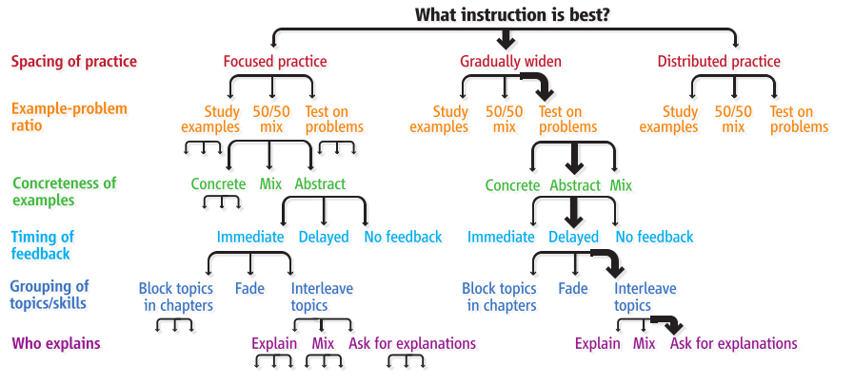
Instructional Complexity and the Science to Constrain It
Ken
Koedinger
Julie
Booth
David
Klahr
Koedinger, K. R., Booth, J. L., & Klahr, D. (2013). Instructional Complexity and the Science to Constrain It. Science, 342(6161), 935–937.

Slide 52
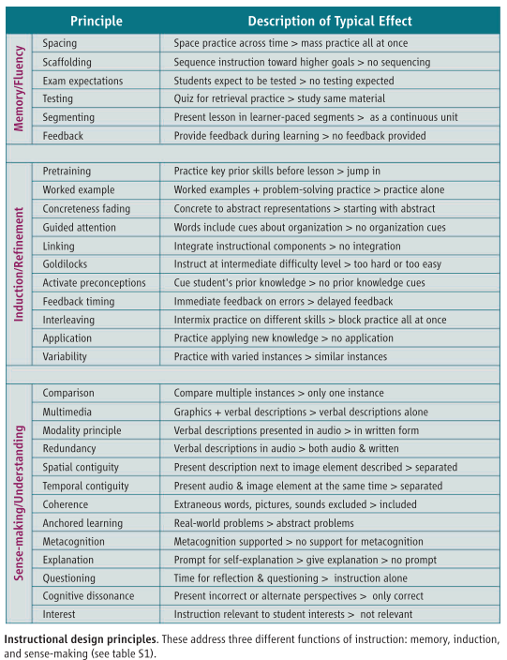

Slide 53
Other Thoughts? (Instructional Complexity)

Slide 54
My take
What I think they want to take away:
We have the tools to reason through options and optimize instruction to be most beneficial to learners… please give us money
What I take away:
There are >205,000,000,000,000 ways to rationally design instruction!!!!
And that’s only the result of making 30 decisions!
Still one of the best compact set of instructional principles available
Even if that’s not really what the article is about…

Slide 55
Pro-tip on reading Science Articles

Slide 56
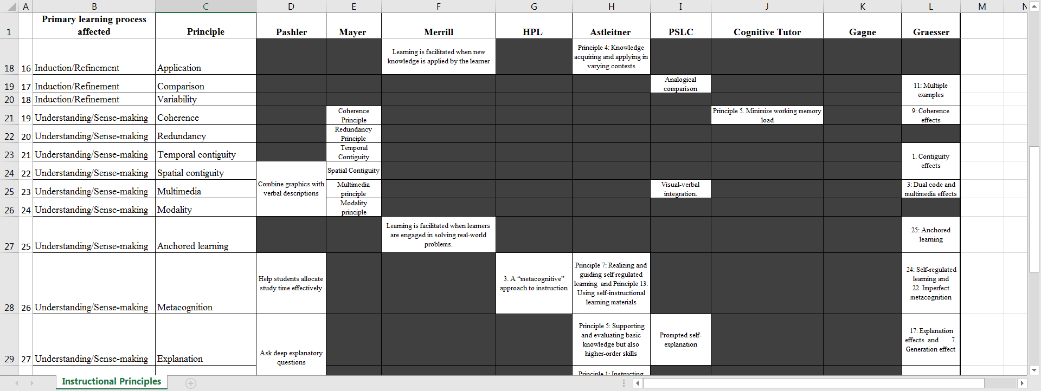

Slide 57
The Knowledge-Learning-Instruction Framework
Koedinger, K. R., Corbett, A. T., & Perfetti, C. (2012). The Knowledge-Learning-Instruction Framework: Bridging the Science-Practice Chasm to Enhance Robust Student Learning. Cognitive Science, 36(5), 757–798. https://doi.org/10.1111/j.1551-6709.2012.01245.x

Slide 58
The Knowledge-Learning-Instruction Framework
Observable
(In the world)
Unobservable
(In the learner’s head)
Koedinger, K. R., Corbett, A. T., & Perfetti, C. (2012). The Knowledge-Learning-Instruction Framework: Bridging the Science-Practice Chasm to Enhance Robust Student Learning. Cognitive Science, 36(5), 757–798. https://doi.org/10.1111/j.1551-6709.2012.01245.x

Slide 59
The Knowledge-Learning-Instruction Framework
Observable
(In the world)
Unobservable
(In the learner’s head)
Knowledge
Components
Koedinger, K. R., Corbett, A. T., & Perfetti, C. (2012). The Knowledge-Learning-Instruction Framework: Bridging the Science-Practice Chasm to Enhance Robust Student Learning. Cognitive Science, 36(5), 757–798. https://doi.org/10.1111/j.1551-6709.2012.01245.x

Slide 60
Knowledge Components (KCs)
“an acquired unit of cognitive function or structure that can be inferred from performance on a set of related tasks.”
‘‘knowledge component’’ broadly generalize across terms like:
Knowledge
Production rule
Schema
Misconception
Facet
Concept
Principle
Fact
Skill
“thing to be learned”
Koedinger, K. R., Corbett, A. T., & Perfetti, C. (2012). The Knowledge-Learning-Instruction Framework: Bridging the Science-Practice Chasm to Enhance Robust Student Learning. Cognitive Science, 36(5), 757–798. https://doi.org/10.1111/j.1551-6709.2012.01245.x

Slide 61
Knowledge Components (KCs)
Koedinger, K. R., Corbett, A. T., & Perfetti, C. (2012). The Knowledge-Learning-Instruction Framework: Bridging the Science-Practice Chasm to Enhance Robust Student Learning. Cognitive Science, 36(5), 757–798. https://doi.org/10.1111/j.1551-6709.2012.01245.x

Slide 62
The Knowledge-Learning-Instruction Framework
Observable
(In the world)
Unobservable
(In the learner’s head)
Knowledge
Components
Koedinger, K. R., Corbett, A. T., & Perfetti, C. (2012). The Knowledge-Learning-Instruction Framework: Bridging the Science-Practice Chasm to Enhance Robust Student Learning. Cognitive Science, 36(5), 757–798. https://doi.org/10.1111/j.1551-6709.2012.01245.x

Slide 63
The Knowledge-Learning-Instruction Framework
Observable
(In the world)
Unobservable
(In the learner’s head)
Learning
Events
Knowledge
Components
Koedinger, K. R., Corbett, A. T., & Perfetti, C. (2012). The Knowledge-Learning-Instruction Framework: Bridging the Science-Practice Chasm to Enhance Robust Student Learning. Cognitive Science, 36(5), 757–798. https://doi.org/10.1111/j.1551-6709.2012.01245.x

Slide 64
The Knowledge-Learning-Instruction Framework
Instructional
Events
Observable
(In the world)
Unobservable
(In the learner’s head)
Learning
Events
Knowledge
Components
Koedinger, K. R., Corbett, A. T., & Perfetti, C. (2012). The Knowledge-Learning-Instruction Framework: Bridging the Science-Practice Chasm to Enhance Robust Student Learning. Cognitive Science, 36(5), 757–798. https://doi.org/10.1111/j.1551-6709.2012.01245.x

Slide 65
The Knowledge-Learning-Instruction Framework
Instructional
Events
Assessment
Events
Observable
(In the world)
Unobservable
(In the learner’s head)
Learning
Events
Knowledge
Components
Koedinger, K. R., Corbett, A. T., & Perfetti, C. (2012). The Knowledge-Learning-Instruction Framework: Bridging the Science-Practice Chasm to Enhance Robust Student Learning. Cognitive Science, 36(5), 757–798. https://doi.org/10.1111/j.1551-6709.2012.01245.x

Slide 66
The Knowledge-Learning-Instruction Framework
Mechanics
Instructional
Events
Assessment
Events
Gameplay
Observable
(In the world)
Experience
Unobservable
(In the learner’s head)
Learning
Events
Knowledge
Components
Koedinger, K. R., Corbett, A. T., & Perfetti, C. (2012). The Knowledge-Learning-Instruction Framework: Bridging the Science-Practice Chasm to Enhance Robust Student Learning. Cognitive Science, 36(5), 757–798. https://doi.org/10.1111/j.1551-6709.2012.01245.x

Slide 67
The Knowledge-Learning-Instruction Framework
Instructional
Events
Assessment
Events
Observable
(In the world)
Unobservable
(In the learner’s head)
Learning
Events
Knowledge
Components
Koedinger, K. R., Corbett, A. T., & Perfetti, C. (2012). The Knowledge-Learning-Instruction Framework: Bridging the Science-Practice Chasm to Enhance Robust Student Learning. Cognitive Science, 36(5), 757–798. https://doi.org/10.1111/j.1551-6709.2012.01245.x

Slide 69
Kinds of KCs drive instructional event choices

Slide 70
Three Types of Learning Processes

Slide 71
Three Types of Learning Processes
Memory and fluency-building: processes involved in strengthening memory and compiling knowledge, producing more automatic and composed (‘‘chunked’’) knowledge

Slide 72
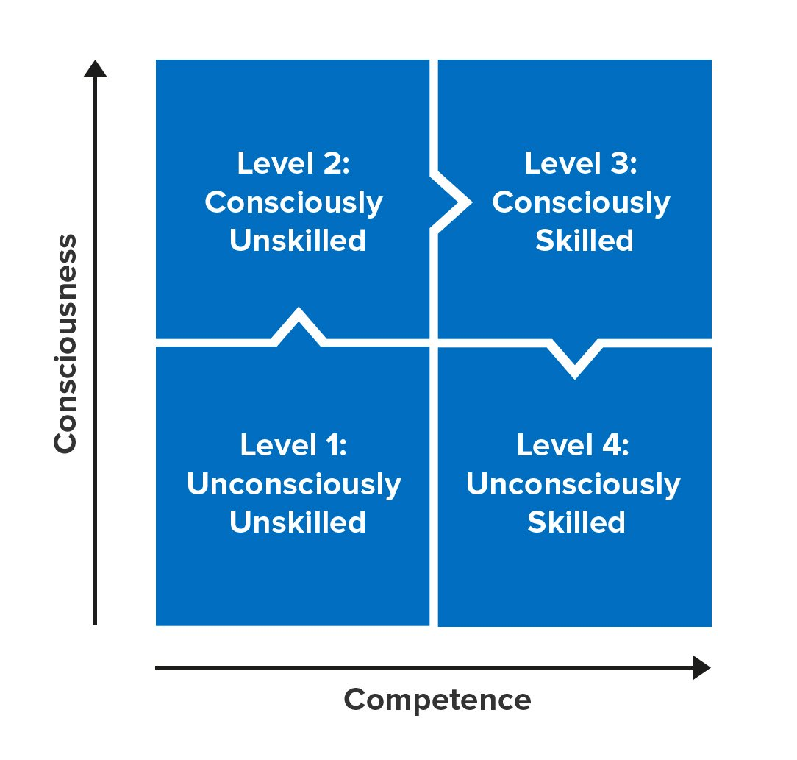
Process of Expertise Development
Memory / Fluency

Slide 73
Knowledge Components (KCs)
Memory / Fluency
Koedinger, K. R., Corbett, A. T., & Perfetti, C. (2012). The Knowledge-Learning-Instruction Framework: Bridging the Science-Practice Chasm to Enhance Robust Student Learning. Cognitive Science, 36(5), 757–798. https://doi.org/10.1111/j.1551-6709.2012.01245.x
Notes:
Memory and Fluency learning mechanisms are best for strengthening the association between a condition and response
Induction and Refinement are best for refining what the conditions or responses are
Understanding and sense-making

Slide 74
A Standard Model of the Mind
Memory / Fluency
Laird, J. E., Lebiere, C., & Rosenbloom, P. S. (2017). A Standard Model of the Mind: Toward a Common Computational Framework across Artificial Intelligence, Cognitive Science, Neuroscience, and Robotics. AI Magazine, 38(4), 13. https://doi.org/10.1609/aimag.v38i4.2744

Slide 75
Memory / Fluency Principles
1 | Spacing | Space practice across time > mass practice all at once
2 | Sequence Scaffolding (Scaffolding) | Sequence instruction toward higher goals > no sequencing
3 | Needs expectations (Exam expectations) | Students expect to be tested > no testing expected
4 | Recall Practice (Testing) | Quiz for retrieval practice > study same material
5 | Segmenting | Present lesson in learner-paced segments > as a continuous unit
6 | Feedback | Provide feedback during learning > no feedback provided
Notes:
Exam expectations is the sense I will need to do this again, testing effect is the act of testing strengths retrieval

Slide 76
Three Types of Learning Processes
Memory and fluency-building
Induction and refinement: processes that improve the accuracy of knowledge; includes perception, generalization, discrimination, classification, categorization, schema induction, and causal induction

Slide 77
Induction / Refinement
Process of Expertise Development

Slide 78
Knowledge Components (KCs)
Induction / Refinement
Koedinger, K. R., Corbett, A. T., & Perfetti, C. (2012). The Knowledge-Learning-Instruction Framework: Bridging the Science-Practice Chasm to Enhance Robust Student Learning. Cognitive Science, 36(5), 757–798. https://doi.org/10.1111/j.1551-6709.2012.01245.x
Notes:
Memory and Fluency learning mechanisms are best for strengthening the association between a condition and response
Induction and Refinement are best for refining what the conditions or responses are
Understanding and sense-making

Slide 79
Induction / Refinement
7 | Pretraining | Practice key prior skills before lesson > jump in
8 | Worked example | Worked examples + problem-solving practice > practice alone
9 | Concrete Grounding (Concreteness fading) | Concrete to abstract representations > starting with abstract
10 | Guided attention | Words include cues about organization > no organization cues
11 | Linking | Integrate instructional components > no integration
12 | Goldilocks | Instruct at intermediate difficulty level > too hard or too easy
13 | Activate preconceptions | Cue student's prior knowledge > no prior knowledge cues
14 | Immediate Feedback timing (feedback timing) | Immediate feedback on errors > delayed feedback
15 | Interleaving | Intermix practice on different skills > block practice all at once
16 | Application | Practice applying new knowledge > no application
17 | Variability | Practice with varied instances > similar instances

Slide 80
Three Types of Learning Processes
Memory and fluency-building
Induction and refinement
Understanding and sensemaking: Explicit, verbally mediated learning in which students attempt to understand or reason. This includes comprehension of verbal descriptions, explanation-based learning, scientific discovery, and verbal rule-mediated deduction.

Slide 81
Understanding / Sense-Making
Process of Expertise Development

Slide 82
Knowledge Components (KCs)
Understanding / Sense-Making
Koedinger, K. R., Corbett, A. T., & Perfetti, C. (2012). The Knowledge-Learning-Instruction Framework: Bridging the Science-Practice Chasm to Enhance Robust Student Learning. Cognitive Science, 36(5), 757–798. https://doi.org/10.1111/j.1551-6709.2012.01245.x
Notes:
Memory and Fluency learning mechanisms are best for strengthening the association between a condition and response
Induction and Refinement are best for refining what the conditions or responses are
Understanding and sense-making

Slide 83
Sense-making / Understanding
18 | Comparison | Compare multiple instances > only one instance
19 | Audio-Visual (Multimedia) | Graphics + verbal descriptions > verbal descriptions alone
20 | Narration (Modality) | Verbal descriptions presented in audio > in written form
21 | Redundancy | Verbal descriptions in audio > both audio & written
22 | Spatial contiguity | Present description next to image element described > separated
23 | Temporal contiguity | Present audio & image element at the same time > separated
24 | Coherence | Extraneous words, pictures, sounds excluded > included
25 | Realistic Challenge (anchored learning) | Real-world problems > abstract problems
26 | Metacognition | Metacognition supported > no support for metacognition
27 | Explanation | Prompt for self-explanation > give explanation > no prompt
28 | Questioning | Time for reflection & questioning > instruction alone
29 | Cognitive dissonance | Present incorrect or alternate perspectives > only correct
30 | Interest | Instruction relevant to student interests > not relevant

Slide 84
Three Types of Learning Processes
Memory and fluency-building
Induction and refinement
Understanding and sensemaking

Slide 85
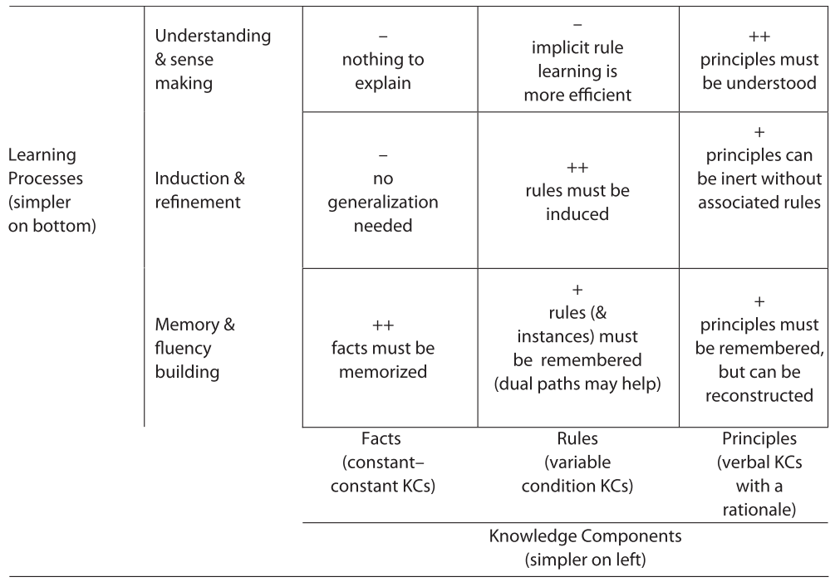
Different Types of KCs are Supported by Different Learning Processes

Slide 86
Possible additional Learning Processes?
Memory / fluency-building, Induction / refinement, and Understanding / sensemaking cover most learning scenarios
Don’t really explain the initial transition to consciously unskilled

Slide 87
Process of Expertise Development
Awareness Building?

Slide 88
Sets of Learning Science Principles
Memory / Fluency | 1 | Spacing | Space practice across time > mass practice all at once
 | 2 | Sequence Scaffolding (Scaffolding) | Sequence instruction toward higher goals > no sequencing
 | 3 | Needs expectations (Exam expectations) | Students expect to be tested > no testing expected
 | 4 | Recall Practice (Testing) | Quiz for retrieval practice > study same material
 | 5 | Segmenting | Present lesson in learner-paced segments > as a continuous unit
 | 6 | Feedback | Provide feedback during learning > no feedback provided
Induction / Refinement | 7 | Pretraining | Practice key prior skills before lesson > jump in
 | 8 | Worked example | Worked examples + problem-solving practice > practice alone
 | 9 | Concrete Grounding (Concreteness fading) | Concrete to abstract representations > starting with abstract
 | 10 | Guided attention | Words include cues about organization > no organization cues
 | 11 | Linking | Integrate instructional components > no integration
 | 12 | Goldilocks | Instruct at intermediate difficulty level > too hard or too easy
 | 13 | Activate preconceptions | Cue student's prior knowledge > no prior knowledge cues
 | 14 | Immediate Feedback timing (feedback timing) | Immediate feedback on errors > delayed feedback
 | 15 | Interleaving | Intermix practice on different skills > block practice all at once
 | 16 | Application | Practice applying new knowledge > no application
 | 17 | Variability | Practice with varied instances > similar instances
Sense-making / Understanding | 18 | Comparison | Compare multiple instances > only one instance
 | 19 | Audio-Visual (Multimedia) | Graphics + verbal descriptions > verbal descriptions alone
 | 20 | Narration (Modality) | Verbal descriptions presented in audio > in written form
 | 21 | Redundancy | Verbal descriptions in audio > both audio & written
 | 22 | Spatial contiguity | Present description next to image element described > separated
 | 23 | Temporal contiguity | Present audio & image element at the same time > separated
 | 24 | Coherence | Extraneous words, pictures, sounds excluded > included
 | 25 | Realistic Challenge (anchored learning) | Real-world problems > abstract problems
 | 26 | Metacognition | Metacognition supported > no support for metacognition
 | 27 | Explanation | Prompt for self-explanation > give explanation > no prompt
 | 28 | Questioning | Time for reflection & questioning > instruction alone
 | 29 | Cognitive dissonance | Present incorrect or alternate perspectives > only correct
 | 30 | Interest | Instruction relevant to student interests > not relevant
Extraneous | Signaling | People learn better from a game when cues highlight the organization of the essential material area added
 | Redundancy | People do not learn better in games where words are printed and spoken rather than formal style
 | Immersion | People do not learn better when a game is rendered in realistic 3-D virtual reality rather than in 2-D
Essential | Pretraining | People learn better in a game when they receive pretraining in the key concepts
 | Modality | People learn better in games where words are spoken rather than printed
Generative | Self-explanation | People learn better in a game when they are asked to select an explanation for their moves
 | Explanatory Feedback | People learn better in games when they receive explanatory feedback after key moves
 | Prompting | People learn deeply in games when they are asked to reflect
 | Personalization | People learn better in games when words are in conversational style rather than formal style
 | Image | People do not learn much better in games when an agent’s image is on the screen
 | Narrative theme | People do not learn better in games with strong narrative themes

Slide 90
How do you use principles in Design?

Slide 91
How do you use principles during design activities?
Unsolved problem in instructional design theory!
Some Ideas:
Treat them like Design Lenses

Slide 92
Design Lenses
Based on the idea that questions are never wrong
Lenses are small sets of questions you should ask yourself about your design
They are not blueprints or recipes, but tools for examining your design
~113 lenses in Schell’s deck (depends on edition)

Slide 93
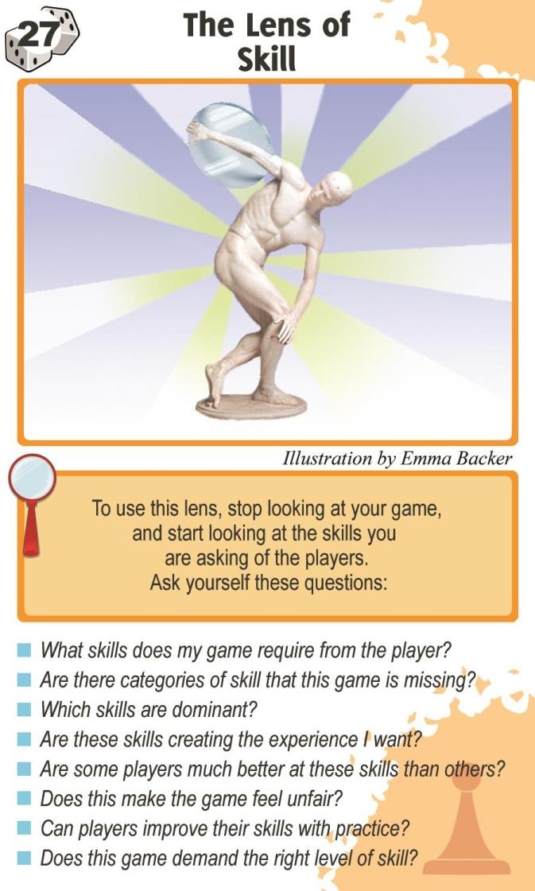
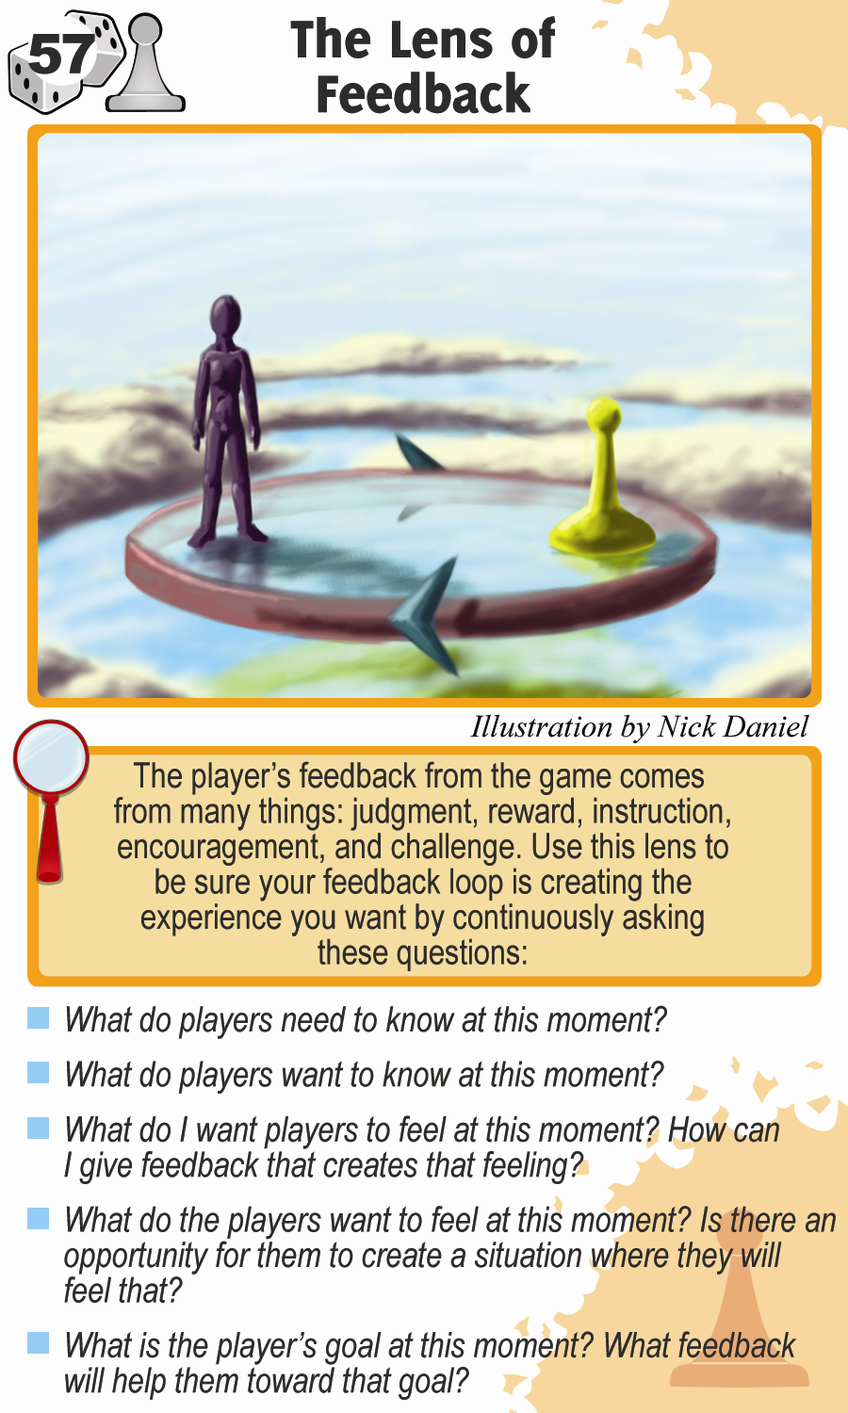
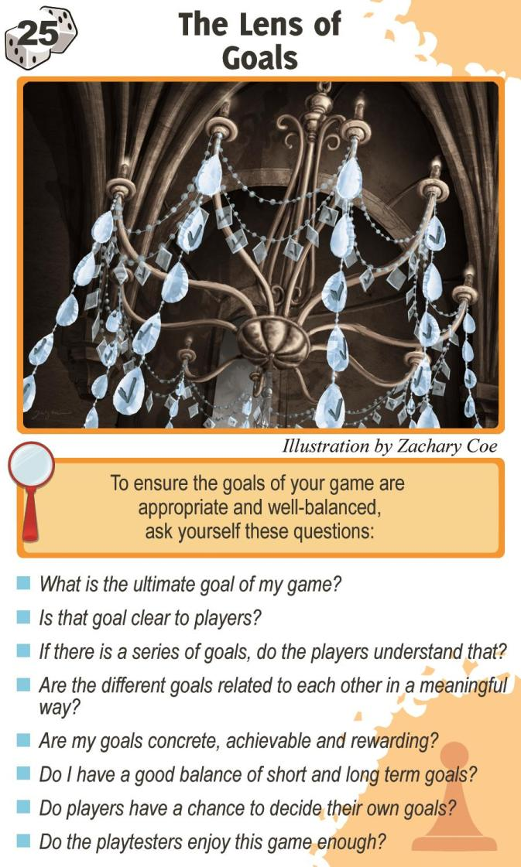

Slide 94
Techniques for Design Lenses
Study each lens one at a time and find one that is relevant
Deal out 5 and consider what each says about your current design
Deal a hand to each team member and have them talk about the most relevant one

Slide 95
How do you use principles during design activities?
Unsolved problem in instructional design theory!
Some ideas:
Treat them like Design Lenses
Treat them like Usability Heuristics

Slide 96
Usability Heuristics
Generally accepted set of best practices in HCI backed by research
The common Nielsen list has 10
usability.gov has 208

Slide 97
Nielsen’s Heuristics
Visibility of system status: The system should always keep users informed about what is going on, through appropriate feedback within reasonable time.
Match between system and the real world: The system should speak the users' language, with words, phrases and concepts familiar to the user, rather than system-oriented terms.
User control and freedom: Users often choose system functions by mistake and will need a clearly marked "emergency exit" to leave the unwanted state without having to go through an extended dialogue.
Consistency and standards: Users should not have to wonder whether different words, situations, or actions mean the same thing.
Error prevention: Either eliminate error-prone conditions or check for them and present users with a confirmation option before they commit to the action.
Recognition rather than recall: Minimize the user's memory load by making objects, actions, and options visible.
Flexibility and efficiency of use: Accelerators may often speed up the interaction for the expert user such that the system can cater to both inexperienced and experienced users.
Aesthetic and minimalist design: Dialogues should not contain information which is irrelevant or rarely needed.
Help users recognize, diagnose, and recover from errors: Error messages should be expressed in plain language (no codes), precisely indicate the problem, and constructively suggest a solution.
Help and documentation: Any such information should be easy to search, focused on the user's task, list concrete steps to be carried out, and not be too large.

Slide 98
Heuristic Evaluation
“In a heuristic evaluation, usability experts review your site’s interface and compare it against accepted usability principles. The analysis results in a list of potential usability issues.”
https://www.usability.gov/how-to-and-tools/methods/heuristic-evaluation.html
Treat learning principles like heuristics and view your current game design against their recommendations

Slide 99
How do you use principles during design activities?
Unsolved problem in instructional design theory!
Some ideas:
Treat them like Design Lenses
Treat them like Usability Heuristics
Checkout the site I made: http://www.edugames.design/principles
Draft of content updates: http://www.edugames.design/principles-draft
New content we’re using in a study: https://interactive-principles.netlify.app/
*If you know how to publish react to github pages and want to help me make some updates please get in touch

Slide 100
Other ideas
When designing game from scratch, brainstorm with principles in mind
Vet ideas against other EDGE components (Game Elements, Educational Goals)
Or the other way around
When redesigning an existing game, look at which related principles can be brought into play

Slide 101
Take-Aways
Principles summarize results from educational research
Lots of them out there; helps to know a bit where they’re coming from
Some suggestions on using principles:
Use the Koedinger et al. table for broadly matching objectives and principles
Look for proven examples of what principles to combine; preferably, with evidence in the research literature, popular “instructional design patterns” are second best (but better than nothing)
EDGE framework: need to think about how the use of instructional design principles relates to your aesthetic and educational goals
Notes:
Should our design process include some activities specifically focused on getting students to think about how the principles apply in their design? E.g., should the deliverables be a discussion of how the design addresses the principles?

Slide 102
For next time
RWPs for next week are posted
First Critique Blog Submission Opportunity Feb 8
If you haven’t already
Introduce yourself on Slack http://edugames.design/slack
Fill out the pre survey http://edugames.diesng/pre-survey
If you have any feedback about how live sessions are going please let me know: http://edugames.design/feedback

