Slide 1
5 – Educational Game Design Process
Design of Educational Games
05418/05818 Human-Computer Interaction Institute
Erik Harpstead

Slide 2
Announcements
Crit Post Submission Opportunity 1 is Next Tuesday @23:59 US Eastern Time

Slide 3
Any Questions about Crit Post Assignments?
Do we submit the game first then post?
Yes

Slide 4
Plan for Today
Check in on the timeline of the course
Talk about Design Processes in General
Introduce the Tandem Transformational Game Design Process
Walkthrough an iterative case study of the process
Talk about some logistical realities of ed game design

Slide 5
3 Wisdoms of Educational Game Design
Educational Goals
But how do you do it?
Game Elements
Learning Mechanisms
Notes:
Educational game = game designed to meet pre-defined educational objectives
Educational game development project will be more successful if:
Educational objectives have been clearly specified early on
Designers have a notion of how the game’s mechanics, though the dynamics, realize the intended aesthetics
Game observes well-established instructional design principles

Slide 6
Month | Day | Week | Topic | Blogs | Assignments | Group Projects
Jan | 17 | 1 | Introduction + the EDGE Framework | Blogs Out
 | 19 |  | Educational Goals
 | 24 | 2 | Game Elements
 | 26 |  | Learning Mechanisms
 | 31 | 3 | Process
Feb | 2 |  | Knowledge Elicitation |  | 1 Out
 | 7 | 4 | Transfer | Blog 1 In
 | 9 |  | Integration |  | 1 DUE; 2 Out
 | 14 | 5 | Ideation |  | 2A DUE (Friday)
 | 16 |  | Prototyping + Playtesting
 | 21 | 6 | Motivation |  | 2B DUE (Friday) | Team Formation Survey
 | 23 |  | In-class Playtesting
 | 28 | 7 | Pre-Production and Final Project Kick-off | Blog 2 In | 2C DUE (Friday) | Teams Formed (Monday)
Mar | 2 |  | Evaluation |  | 1 Out | Final Project Scoping Proposal (Friday)
 | 7 |  | Spring Break; No Class
 | 9 |  | Spring Break; No Class
 | 14 | 8 | Pitching and Peer Feedback
 | 16 |  | Final Project Pitches |  |  | Pitch
 | 21 | 9 | [Special Topics] + Studio Time | Blog 3 In
 | 23 |  | [Special Topics] + Studio Time
 | 28 | 10 | Check-in 1 A (half of teams)
 | 30 |  | Check-in 1 B (half of teams) |  |  | Check-in 1 Report
Apr | 4 | 11 | [Special Topics] + Studio Time
 | 6 |  | Group Work
 | 11 | 12 | [Special Topics] + Studio Time | Blog 4 In
 | 13 |  | Carnival; No Class
 | 18 | 13 | Check-in 2 A (half of teams)
 | 20 |  | Check-in 2 B (half of teams) |  |  | Check-in 2 Report
 | 25 | 14 | [Special Topics] + Studio Time
 | 27 |  | Last Lecture
May | TBD |  | Final Project Showcase | Blog Make Up |  | Final Project
Background & EDGE Framework
You are Here
Process Techniques
&
Practice
A Course in
3 Acts
Final Projects
&
Special Topics / Theory
http://edugames.design/schedule

Slide 7
Zoom in on Act 2 Topics
 |  | Week | Topic | Blogs | Assignments | Group Projects
 | 31 | 3 | Process
Feb | 2 |  | Knowledge Elicitation
 | 7 | 4 | Transfer | Blog 1 In | 1 Out
 | 9 |  | Integration
 | 14 | 5 | Ideation |  | 1 DUE; 2 Out
 | 16 |  | Prototyping + Playtesting |  | 2A DUE (Friday)
 | 21 | 6 | Motivation |  |  | Team Formation Survey
 | 23 |  | In-class Playtesting |  | 2B DUE (Friday)
 | 28 | 7 | Pre-Production and Final Project Kick-off | Blog 2 In |  | Teams Formed (Monday)
Mar | 2 |  | Evaluation |  | 2C DUE (Friday) | Final Project Scoping Proposal (Friday)
Knowledge Elicitation
Prototyping & Playtesting
Starting Final Projects

Slide 8
Zoom in on Act 2 Assignments
 |  | Week | Topic | Blogs | Assignments | Group Projects
 | 31 | 3 | Process
Feb | 2 |  | Knowledge Elicitation
 | 7 | 4 | Transfer | Blog 1 In | 1 Out
 | 9 |  | Integration
 | 14 | 5 | Ideation |  | 1 DUE; 2 Out
 | 16 |  | Prototyping + Playtesting |  | 2A DUE (Friday)
 | 21 | 6 | Motivation |  |  | Team Formation Survey
 | 23 |  | In-class Playtesting |  | 2B DUE (Friday)
 | 28 | 7 | Pre-Production and Final Project Kick-off | Blog 2 In |  | Teams Formed (Monday)
Mar | 2 |  | Evaluation |  | 2C DUE (Friday) | Final Project Scoping Proposal (Friday)
Knowledge Elicitation
Prototyping & Playtesting

Slide 9
Design Processes

Slide 10
The General Challenge of Design
How do I get to something from nothing?
How do I get from something to something better?

Slide 11
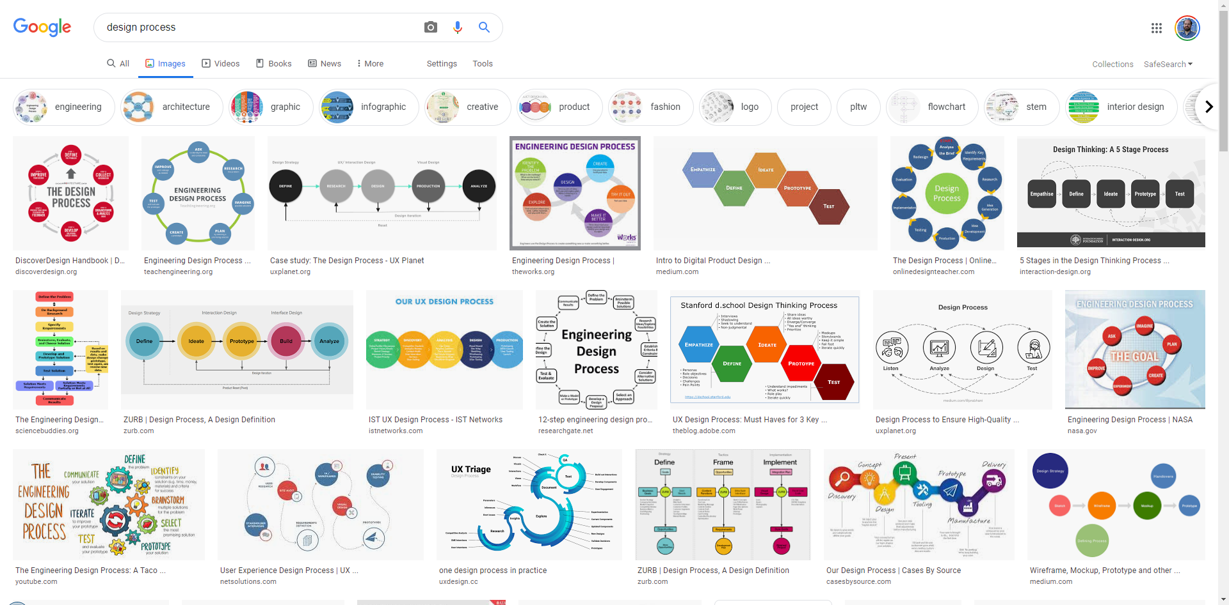

Slide 12
What design processes are you familiar with, what are their steps?
The Double Diamond
Diverge
Converge
Diverage
Converage
ASB
Analysis
Synthesis
Bridge
Engineering design process
Define the problem
Solve it
Evaluate
Architecture
Problem defining
Testing the problem
Prototyping
Problem Seeking
Backwards Design
Goals
Assessments
Instruction
Cog tutor model
The above + CTA
ADDIE
Analyze
Design
Develop
Implement
Evaluate

Slide 13
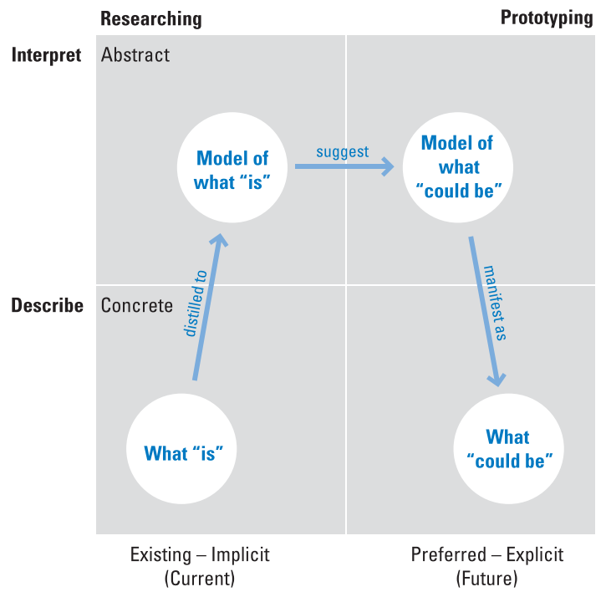
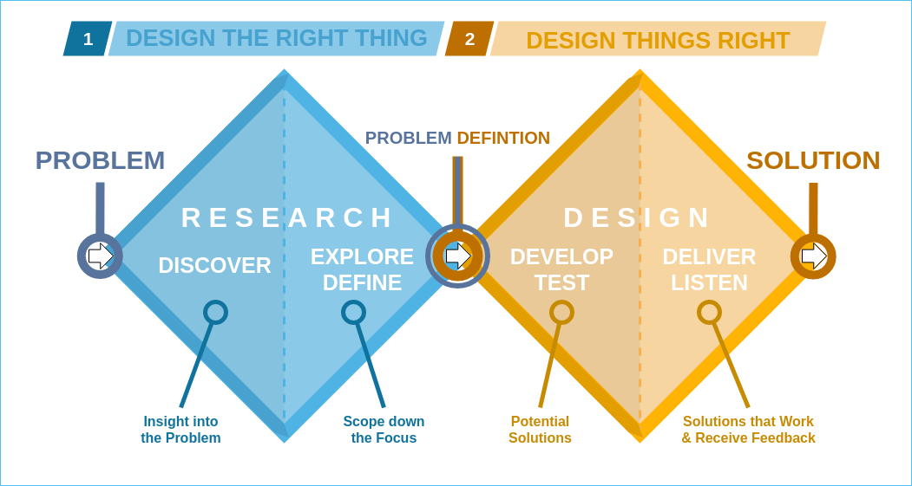
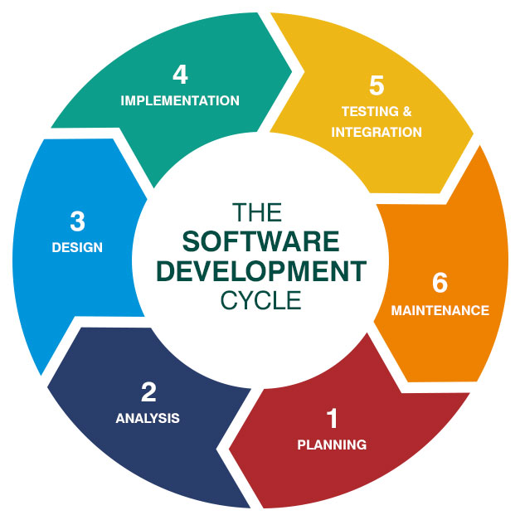
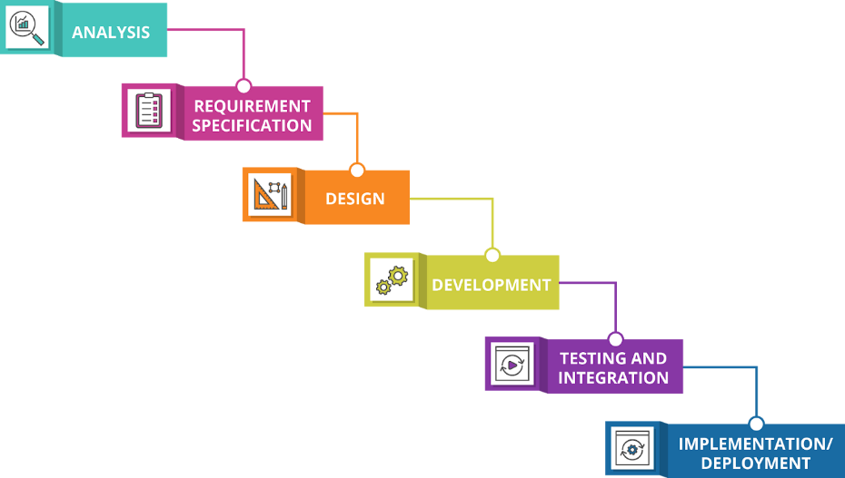
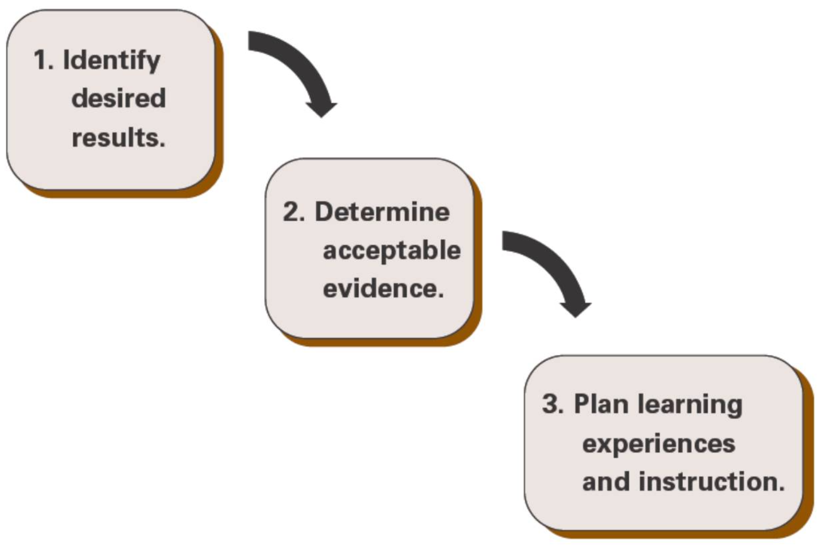
Double Diamond
Analysis Synthesis Bridge
Design Thinking
Plan
Design
Develop
Test
Release
Feedback
Waterfall Software Engineering
Backwards Design
Software Development Life Cycle
Agile / Scrum
*Attributions in presenter notes
Notes:
Double Diamond: https://en.wikipedia.org/wiki/Double_Diamond_(design_process_model)
Analysis-Synthesis-Bridge: [1] Hugh Dubberly, Shelley Evenson, and Rick Robinson. 2008. The analysis-synthesis bridge model. interactions 15, 2: 57. https://doi.org/10.1145/1340961.1340976
5-Stage Process: https://www.interaction-design.org/literature/article/5-stages-in-the-design-thinking-process
Waterfall: https://medium.com/@joneswaddell/the-cascading-costs-of-waterfall-5c3b1b8beaec
Software Development Life Cycle: https://bigwater.consulting/2019/04/08/software-development-life-cycle-sdlc/
Backwards Design: Wiggins, G., & McTighe, J. (2005). Understanding by design. Association for Supervision & Curriculum Development.

Slide 14
A Playful Production Process
Richard Lemarchand
Richard Lemarchand. (2021). A Playful Production Process : For Game Designers (and Everyone). The MIT Press.

Slide 15
Thoughts on PPP?
Interesting how he broke down the stereotypical game developer quota
Combined the design and development process

Slide 16
A Playful Production Process
Richard Lemarchand. (2021). A Playful Production Process : For Game Designers (and Everyone). The MIT Press.

Slide 17
Preproduction vs Production
Some projects may never pass this line
Richard Lemarchand. (2021). A Playful Production Process : For Game Designers (and Everyone). The MIT Press.

Slide 18
Unique features in PPP
Goals appear part way through
Richard Lemarchand. (2021). A Playful Production Process : For Game Designers (and Everyone). The MIT Press.

Slide 19
Unique features in PPP
Prototypes are part of how you work out ideas
Richard Lemarchand. (2021). A Playful Production Process : For Game Designers (and Everyone). The MIT Press.

Slide 20
Unique features in PPP
Vertical Slices and Game Design Macros are unique deliverables
Richard Lemarchand. (2021). A Playful Production Process : For Game Designers (and Everyone). The MIT Press.

Slide 21
PPP in this course
Assignment 2
Richard Lemarchand. (2021). A Playful Production Process : For Game Designers (and Everyone). The MIT Press.

Slide 22
PPP in this course
Final Project
Richard Lemarchand. (2021). A Playful Production Process : For Game Designers (and Everyone). The MIT Press.

Slide 23
The process we’ll use in this course
+

Slide 24
The process we’ll use in this course
+
+
A little bit of
Cognitive Tutor
Development Process

Slide 25
Tandem Transformational Games Design

Slide 26
Tandem Transformational Game Design
Alexandra To
+ A bunch of people in the OH! Lab
To, A., Fath, E., Zhang, E., Ali, S., Kildunne, C., Fan, A., … Kaufman, G. (2016). Tandem Transformational Game Design: A Game Design Process Case Study. Proceedings of the International Academic Conference on Meaningful Play.

Slide 27
Thoughts on Tandem?
What was game design like before this?
This process contained playtesting as more core component
Which is suspicious…
Other processes have A lot more emphasis on the stakeholders and intended audience
But this said you should also enjoy it

Slide 28
My Take
Both a process for transformational game design and transformational game research
Part of why literature features prominently
Also emphasizes techniques for getting teams to speak a common language

Slide 31
Game-Driven Goal Delineation
Focused on defining and refining the learning (or other) goals for your game
Almost always where you would start and educational project

Slide 32
Where Can you Find Learning Objectives?
Your client
Educational standards
Experts

Slide 33
Common Sources of Objectives
A client
A subject matter expert (SME)
State or other standards
Prior Literature

Slide 34
How can you refine learning objectives?
Cognitive Task Analysis
Create a prototype and let your clients test it out
Alignment with assessments
If they exist
Doing an activity wit hthe stakeholders to get a more specific idea of what they want
Interviewing or speaking wit the end users

Slide 35
Knowledge Elicitation
An empirical process working with experts and/or novices to better understand the knowledge they use or need to do a particular task
Often involves interviews or observations of actual performance on a task
Helpful for defining and refining objectives throughout design
We will talk more about this on Thursday

Slide 37
Goal-Driven Game Design
Iteratively developing game mechanics and systems
Cycling through a process of:
Ideation
Prototyping
Playtesting
Game Designers often emphasize prototyping

Slide 38
Superbrothers. 2010. Less Talk, More Rock. boingboing. Retrieved May 17, 2018 from https://boingboing.net/features/morerock.html

Slide 39
What did you think? (Less Talk More Rock)
Reminds me of other process in architecture / design
Newer games tend to have a lot more tutorials / handholding
Interesting point
Seems to skip the step of “gaining legitimacy”
Lets you ahv ea tangible prototype yo ucan tlak about rather than higher level ideas
They seem to have an affinity for a particular genre
a game with a lot of cut scenes and voice acting
The reading was more a radical take on a specific process
Last of Us is an interesting example of the play don’t show dichotomy
A bit of a parallel to PPP (prototypes come first)

Slide 40
VS

Slide 41
Remember these people?

Slide 42
Remember these people?
Talk

Slide 43
Remember these people?
Rock

Slide 44
Talking about game ideas in words is hard

Slide 45
Does this sound like a good idea for a game?
You play as a low-level government bureaucrat and the game consist of you going over paperwork looking for clerical errors or inconsistencies before deciding whether or not to approve a document.

Slide 46
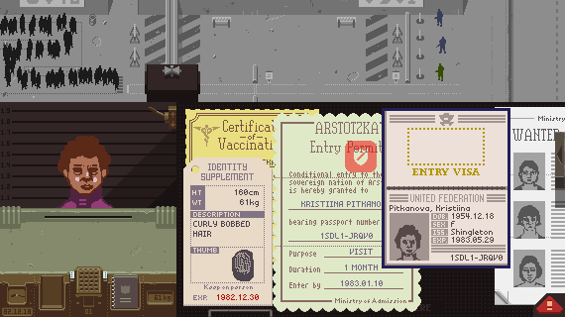

Slide 47
What about this idea?
You play in a 3D world of unit blocks and can work together with other players to dig into the ground in order to mine resources and bring them back the surface.

Slide 48
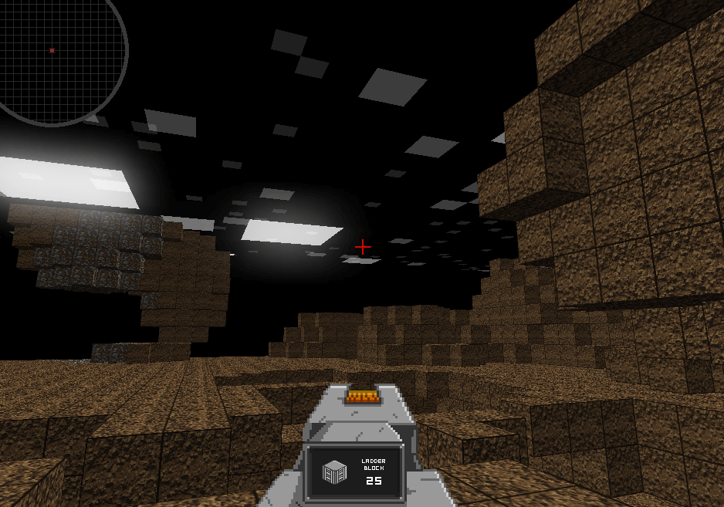

Slide 49
Talk vs Rock in Third Order Design
“Rock” Lives Here
Game Mechanics
and Systems
Dynamic
Gameplay
Player Experience
Knowledge
Change
“Talk” often focuses on these things
Notes:
Ephemeral
Unpredictable
Invisible
Are we screwed?

Slide 50
Prototyping and Playtesting
Want to get to the experience as quickly as you can so you can decide if its on the right track
We will talk more about this in a couple weeks and is the focus of assignment 2

Slide 52
Alignment
Checking in to make sure you’re game and you goals agree with each other
Making adjustments to the process and going back into one of the other loops
Often where you think about the EDGE Framework
Where formative and summative evaluations take place
We will talk more about these with the spectrum of evaluation

Slide 53
Alignment with the EDGE Framework
Consider your design from the each lens
Think about a change from that lens would impact the others
Educational Goals
Game Elements
Learning Mechanisms
Notes:
Educational game = game designed to meet pre-defined educational objectives
Educational game development project will be more successful if:
Educational objectives have been clearly specified early on
Designers have a notion of how the game’s mechanics, though the dynamics, realize the intended aesthetics
Game observes well-established instructional design principles

Slide 54
Any surprising elements or notable holes to the approach?
Good to see putting something in front of someone before yo ugo all the way to release

Slide 56
ENGAGE
Collaboration between HCII and ETC
Developing educational games to teach STEM topics to Pre-K – 3rd graders
Also explore positive social emotional learning
Focusing first on teaching stability and balance to 1st grade

Slide 57
RumbleBlocks Iteration 1

Slide 58
Iteration 1

Slide 59
Funder Requirements
Develop science games for K-3 Learners
Several teams participated nationally
We were assigned to work on non-projectile physics (statics)

Slide 60
Goals for Science Process & Content from National Research Council Framework

Slide 61
Structure-Building Context
The Young Scientist Series:
Building Structures with Young Children
By Ingrid Chalufour and Karen Worth
The second installment in the Young Scientist
Series, Building Structures with Young
Children guides children's explorations to help deepen their understanding of the physical science present in building block structures, including concepts such as gravity, stability, and balance. This nationally field-tested curriculum supports children’s early development of important science inquiry skills such as questioning, investigating, discussing, and formulating ideas and theories through curriculum ranging from exploring and designing structures to building block creations.

Slide 62
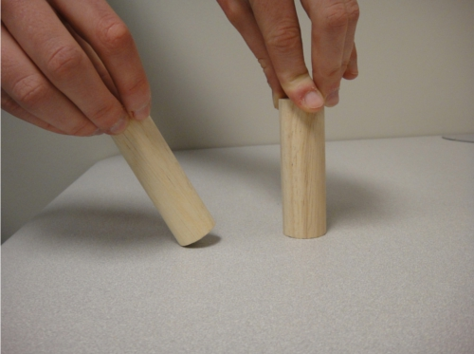
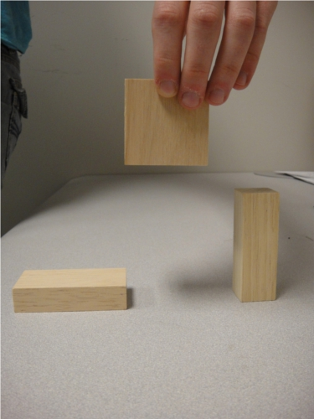
Early interactions with kids
What will happen?
Why?
Which block should I place the square on to build a tall tower that won’t fall over?
Why?
Notes:
Do kids understand gravity?
How do they describe their reasoning behind fall objects
---
Do they have an idea of what makes a good base?

Slide 63
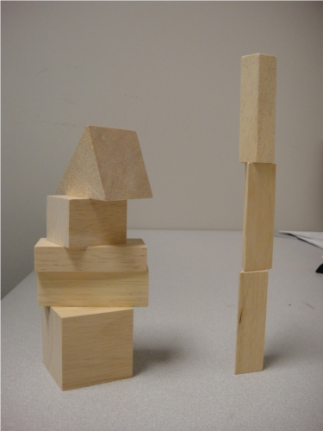
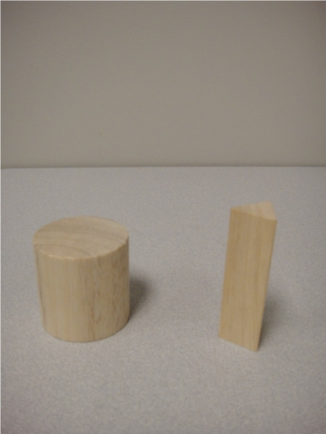
Early interactions with kids
Which tower is less likely to fall over if the table is bumped?
Why?
Which of these would make a better base?
Why?
Notes:
Can they distinguish stable structures from unstable ones?
Do they characterize the distinction using center of mass?
---
Do they understand the concept of a base?
Can they use qualities other than orientation to determine a good base?

Slide 64
Early interactions with kids
Make the Tallest Tower
How do they build without direction?
What patterns do they use in forced choice tasks of blocks?

Slide 65
Initial Educational Objectives Science Content
Principles for designing stable systems | 1 | Shorter objects tend to be more stable
 | 2 | Objects with a wider base tend to be more stable
 | 3 | Objects with more weight at the bottom and less at the top tend to be more stable
 | 4 | Symmetrical objects tend to be more stable
 | 5 | No single principle is always true; these principles interact with one another to affect stability
Stability and instability in physical systems | 1 | Gravity is an invisible force that pulls and object downwards
 | 2 | An object has a center of mass (where mass is evenly distributed on all sides)
 | 3 | An object is subject to the force of gravity, which acts at the center of mass
 | 4 | An object will topple when its center of mass is not over its base
Notes:
gravity, stability, and balance
principles were culled from various building structures curricula/books and our own exploration of the domain
Similar to FOSS and Science Start! Goals
The Young Scientist Series:
Building Structures with Young Children
By Ingrid Chalufour and Karen Worth

Slide 66
Iteration 1

Slide 67
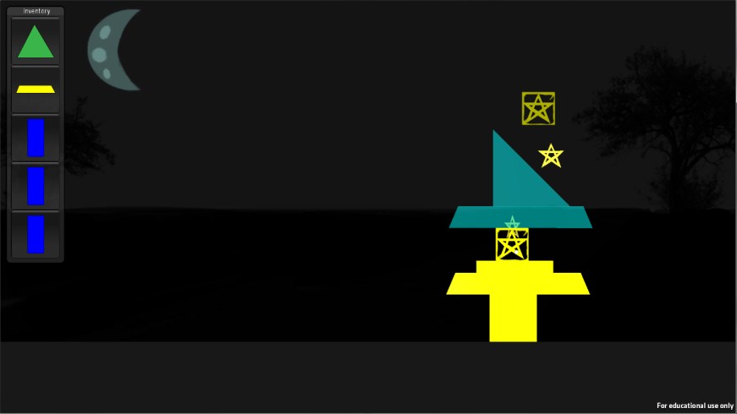
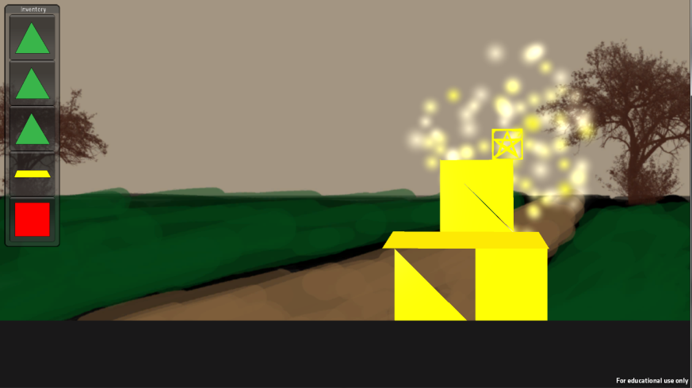
Early Game Demos

Slide 68
Early Game Demos
Implemented several kinds of building mechanics
Click and drag vs selecting place
Fixed pallets of pieces vs a scroll
Played with towers sticking together vs falling apart
Building things up toward a goal made sense
Towers falling apart was fun
Gameplay dynamics heavily dependent on available blocks
Some shapes (ex: triangles) where a lot harder to use
Big blocks made things too easy

Slide 69
Iteration 1

Slide 70
Aligning Design Concepts with Stated Goals
Principles for designing stable systems | 1 | Shorter objects tend to be more stable
 | 2 | Objects with a wider base tend to be more stable
 | 3 | Objects with more weight at the bottom and less at the top tend to be more stable
 | 4 | Symmetrical objects tend to be more stable
 | 5 | No single principle is always true; these principles interact with one another to affect stability
Stability and instability in physical systems | 1 | Gravity is an invisible force that pulls and object downwards
 | 2 | An object has a center of mass (where mass is evenly distributed on all sides)
 | 3 | An object is subject to the force of gravity, which acts at the center of mass
 | 4 | An object will topple when its center of mass is not over its base
Notes:
The Shorter principle seems to conflict with the mechanic of building towers, was that going to be a problem?
How could we reason through the interconnection of principles?

Slide 71
RumbleBlocks Iteration 2

Slide 72
Iteration 2

Slide 73
More Formal Knowledge Elicitation
No existing instruments to assess the targeted building principles
Novel approach: Use contrasting cases to isolate a single principle
Student explanations of contrasting cases provide further insight into misconceptions or prior conceptions
Piloted instrument with ~14 kindergarteners (CMU Children’s School)
Notes:
Leads students to notice features such as height, width, symmetry, etc.
Allows us to measure students’ understanding of a particular stability principle
Traditionally used in constructivist instructional approaches (e.g., structured invention tasks)
In-game instruction
Students may see a series of cases about a single stability principle and generalize a pattern across them
Student A sees cases on principle A; Student B sees cases on principle B; they work together to predict A-B integrating cases
Students select a pair of cases as supporting evidence for a scientific claim

Slide 74
“because it’s taller”
Student prediction
Principle: Height
Correct prediction
If the table shakes, will these two blocks fall at the same time or will one fall first?

Slide 75
“because it’s pointy at the top”
Misconception: objects with narrow tops are less stable
Student prediction
Principle: low weight
Correct prediction
If the table shakes, will these two blocks fall at the same time or will one fall first?
Notes:
The one on the left falls first.
Relates to our third principle: More weight at the bottom and less weight at the top tends to be more stable
OTHER RESPONSES:
“this one is fatter, this one is skinnier”
“they both have the same amount of support”

Slide 76
“because they both have the same amount of support”
Student prediction
Principle: Symmetry
Correct prediction
If the table shakes, will these two blocks fall at the same time or will one fall first?
Notes:
The one on the left falls first
Relates to our fourth principle: Symmetrical objects tend to be more stable
OTHER RESPONSES:
“because it only has one thing to balance on”
“because this one has one turn at the bottom and this one has two turns at the bottom”

Slide 77
“because it’s a little bit crooked”
Students tend to reason from a single principle
Student prediction
Principles: Symmetry and low weight
Correct prediction
If the table shakes, will these two blocks fall at the same time or will one fall first?
Notes:
The one on the left falls first
Integrating case: integrates two principles – symmetry and weight at the bottom
OTHER RESPONSES:
“I’m just guessing” – sophisticated response. He can’t figure it out using a single principle, so he’s confused. At least he knows he’s confused!
“because it’s leaning” “because it has more turns and this one only has an angle”

Slide 78
“because it’s taller”
Students tend to reason from a single principle
Student prediction
Principles: height and base width
Correct prediction
If the table shakes, will these two blocks fall at the same time or will one fall first?
Notes:
These should fall at the same time because the ratio of height to width is proportional
This is an ambiguous integrating case, that many studnets have difficulty with
OTHER RESPONSES:
“because it’s less heavy”
“the smaller one”
“because it has a little amount of support”

Slide 79
Accuracy of Students’ Predictions
Single Principle
Width | Height | Symmetry | Low weight
79% | 71% | 50% | 21%
Multiple Principles
Non-amb | Ambiguous
60% | 31%
Requires reasoning from 2 principles
Notes:
Table of proportion of correct predictions about single principles
Students have good understanding of wide base and height principles
Their understanding of symmetry and low weight are less solid.
The do particularly poorly on low weight cases, perhaps due to their persistent misconception that “pointy” things are less stable
We had two kinds of items that required students to think about two principles
Non-ambiguous items where one principle is so exaggerated that it clearly “wins”
Ambiguous items where each principle contributes equally (so kids should say “they fall at the same time” or “I’m not sure because it’s taller but also wider…”)
Kids perform quite poorly on the ambiguous items, which suggests that they have a hard time dealing with ambiguity, where the answer is “unclear”. This also suggests (and the qualitative data confirms this) that students reason from a single principle for a given problem.

Slide 80
Example Non-explanations
No explanation
“I just think so”
“I don’t know”
Explanations that don’t answer “why”
“because it could tip over and go whee”
“it would start to fall. it would break into a million pieces on the floor”
“this one go poof”

Slide 81
Observations
Misconceptions
Heavier structures are more stable
Bigger structures are more stable
“Pointy” structures are less stable
Imprecise understandings
“Skinny” (rather than narrow base) structures are less stable
Other difficulties
1/3 of the sample had difficulty explaining “why”
Children had difficulty on multiple-principle items
Some children responded consistently across items with a single principle
It was difficult for children to reason about all 4 principles.
Notes:
So "skinny is less stable" depends on what is meant by skinny. If the whole block is skinny, then yes. But if only the top is skinny, then no.
Other observations
1/3 of the sample had difficulty explaining “why”. This suggests a need for in-game explanation scaffolds.
Children had tremendous difficulty on items that required reasoning from more than 1 principle. This suggests a need for instruction to integrate the principles.
Some children responded consistently across items with a single principle, others were inconsistent, driven by the particular item. In general, it was difficult for children to reason about all 4 principles.

Slide 82
Design implications
Moved away from multi-principle levels
Basing the game around reaching a target height (technically violating a principle) would be ok because kids were good at that already
Initially moved away from including explanation based mechanics because kids were bad at formulating explanations
We did eventually add a more scaffolded explanation system in later

Slide 83
Iteration 2

Slide 85
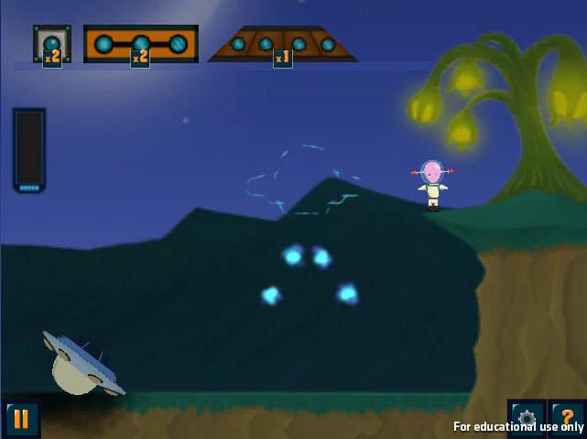
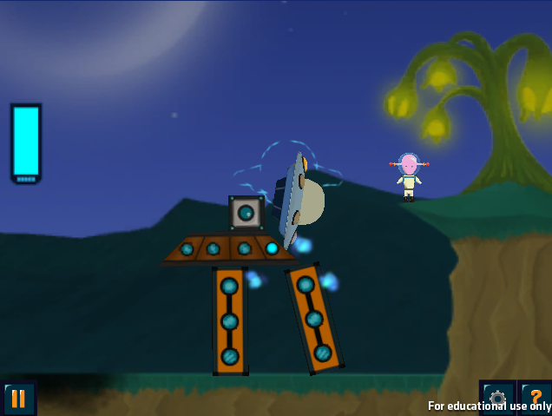
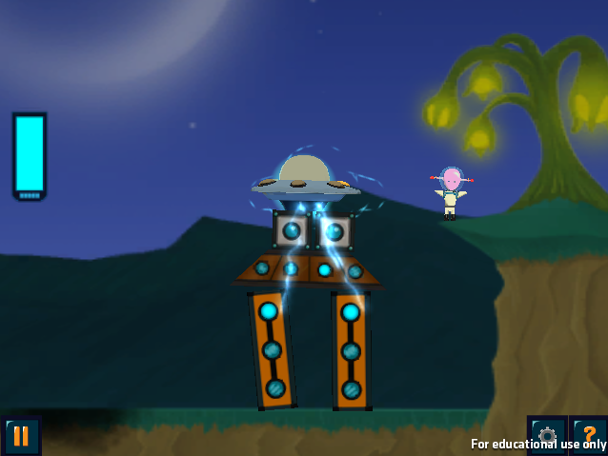
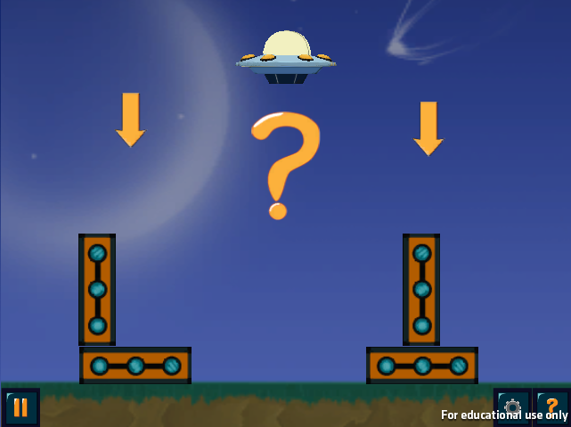
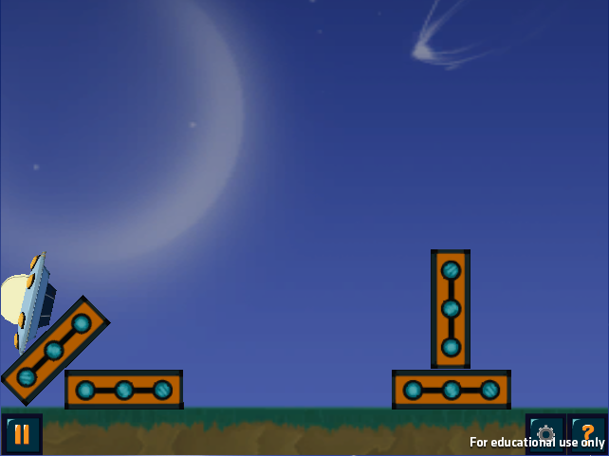
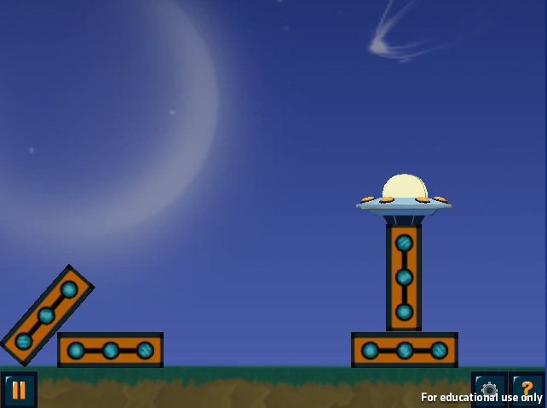
Different Types of Levels
Build
Contrasting Cases
Notes:
RB is a block-building game w/ an alien theme
There are two kinds of levels in RumbelBlocks
Standard levels
-- The goal is to construct a tower that will reach a certain height and withstand an earthquake, using a given set of blocks. Towers must also cover energy dots which scaffold learners into building structures that follow the principles. Here, the dots lead learners to build a symmetrical tower.
-- Apply physics principles to achieve game goals but without strong scaffolds that focus learners on noticing the principles.
Contrast levels
--- Players choose which of two towers will remain standing in the earthquake, then receive feedback.
– Use contrast to draw attention to principles.

Slide 86
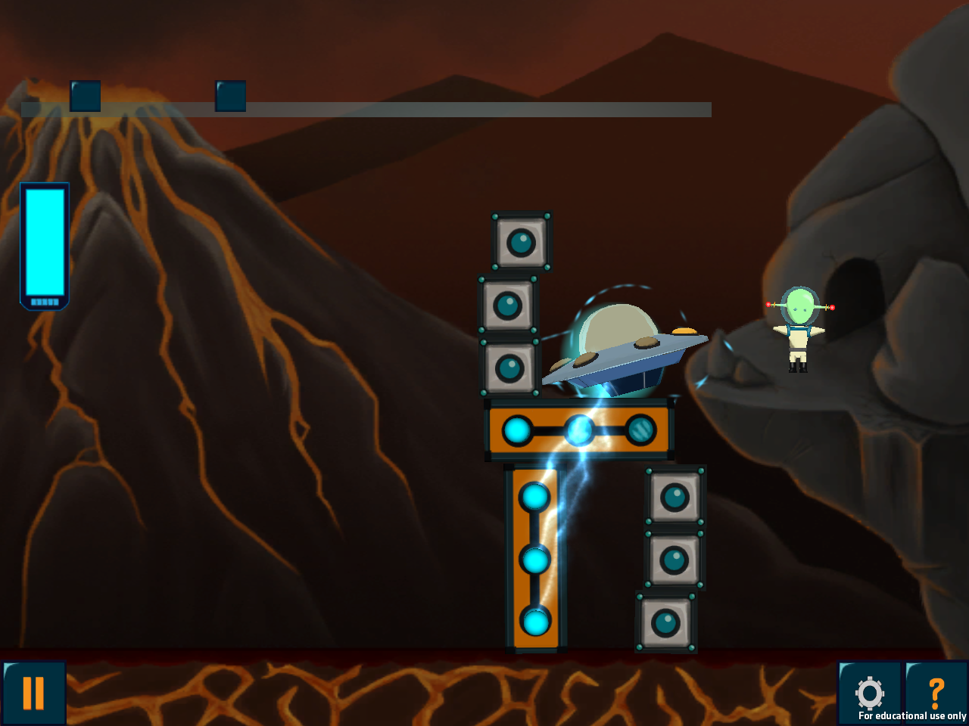
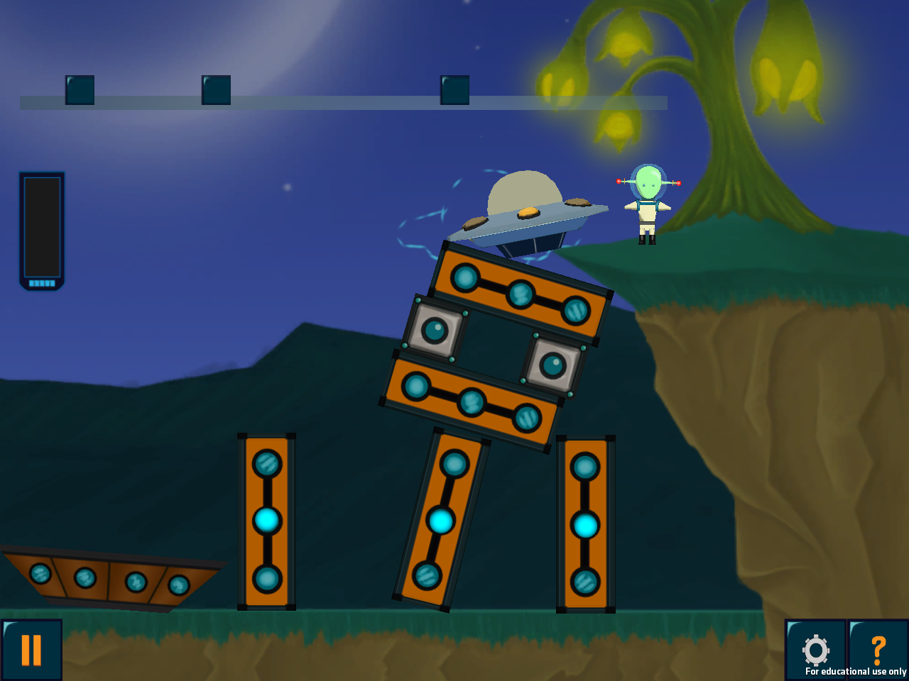
Mechanical flaws in early prototypes

Slide 87
Iteration 2

Slide 88
Formal Evaluation
First big playtest of the game with students in classrooms
281 K-3 students from 2 Pittsburgh Public Schools
Implemented counter-balanced pre-posttest levels in-game
In-game PRE
In-game POST
External PRE
Game play
(~40 min total)
External POST
Day 1
Day 2
Day 3
Day 4

Slide 89
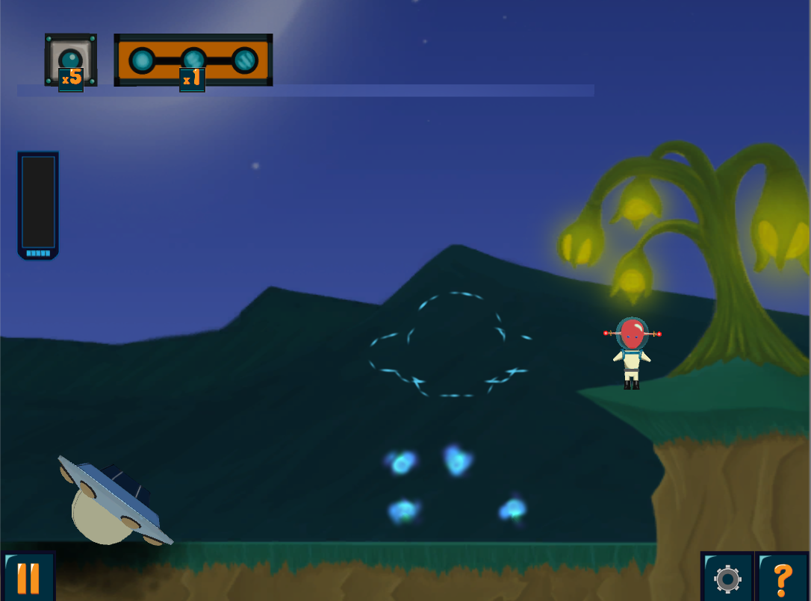
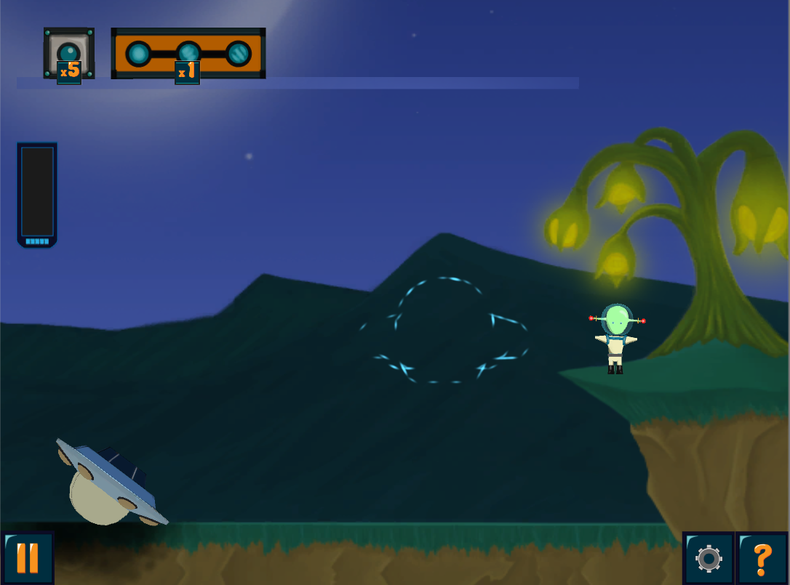
In-Game pre-posttests
Original Level Design
Pre-posttest Level Design

Slide 90
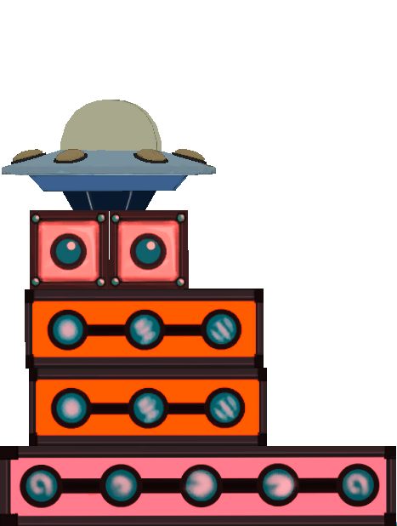
Principle-Relevant Metrics (PRMs)
Base Width
Center of Mass Height
Symmetry Angle
Notes:
Normalized per level to account for

Slide 91
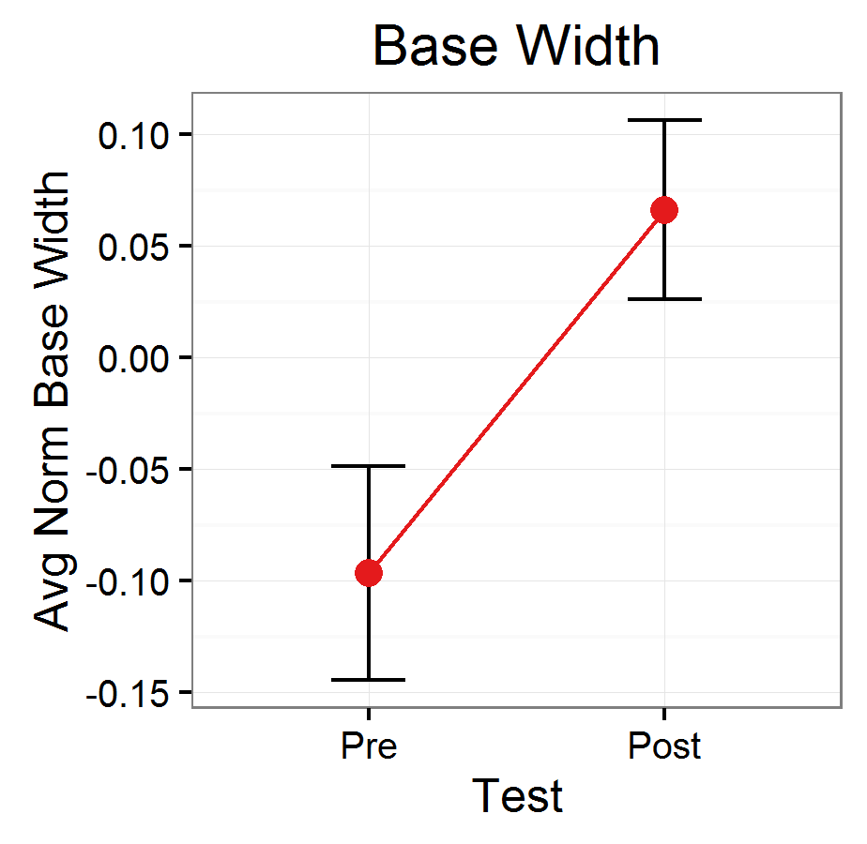
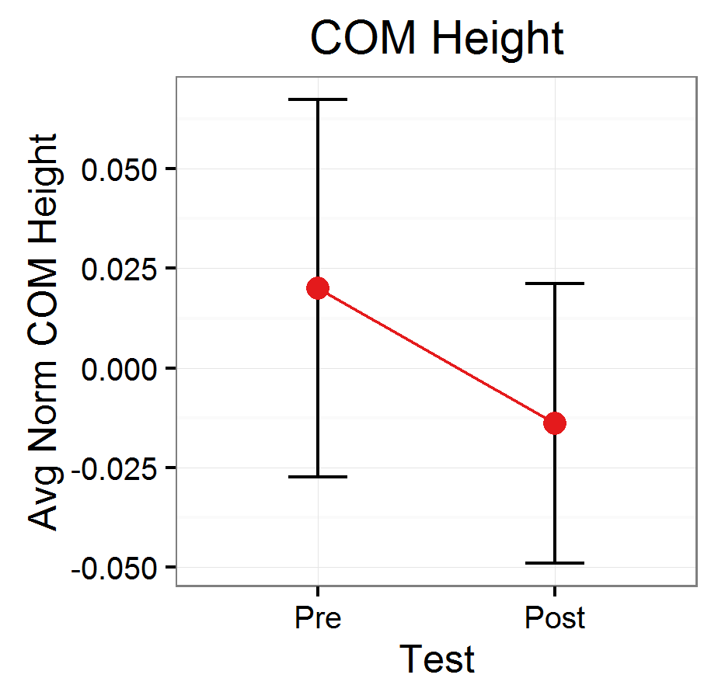
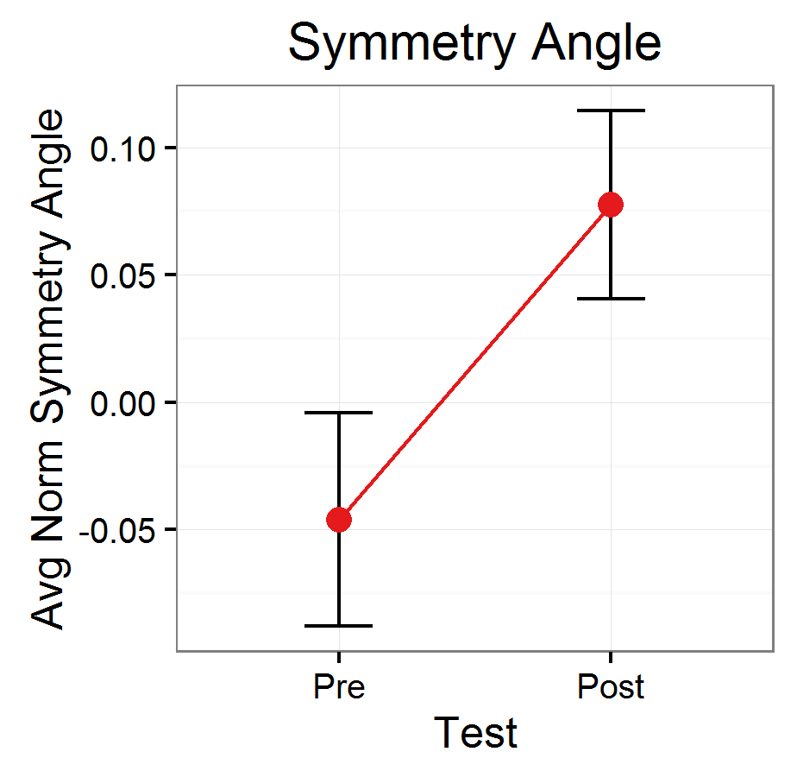
In-Game Pre-posttest Results
** p < .01
* p < .05
Notes:
174 students in these analyses

Slide 92
Principles Predictive of Success?
Can you predict whether a tower would stand, or fall based on the principle-relevant metrics?
If not, then the game may be giving misleading or confusing feedback to learners
Ran a regression analysis predicting success from the PRMs of a solution
Found that Base Width and Symmetry Angle are good, COM Height not so much
Coefficient | B | SE B | p
(Intercept) | 1.08 | 0.45 | -
Base Width | 0.14 | 0.03 | < 0.001 | ***
COM Height | -0.05 | 0.05 | 0.295
Symmetry Angle | 0.05 | 0.01 | < 0.001 | ***

Slide 93
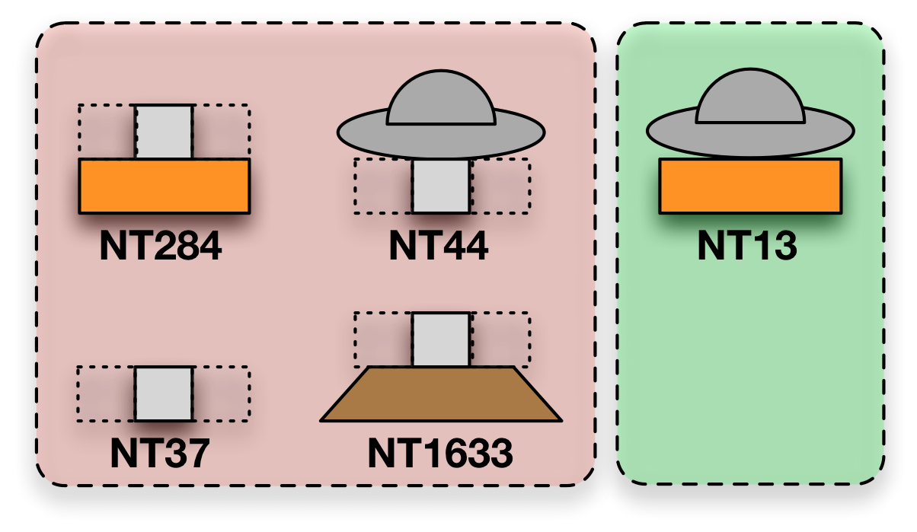
Issues we found
Students don’t seem to learn the low-center of mass principle very well
Did some fancy ML pattern analysis and found:
Micro-faults in towers are predictive of success and failure
Principles are based on whole structures
How might we fix these things?
Failure
Success

Slide 94
How might you address this micro-fault issue?
Maybe replace the spaceship with an alien
We could show them the center of mass
You could give the alien tools to attach all the blocks together

Slide 95
Continued Iterations…
Explored several more iterations:
Introduced self-explanation mechanics
Improved learning ☺
Explore several design variations to fix micro-faults issue
Did not improve learning ☹
Ultimately the project ended and the game is stuck where we left it

Slide 97
Practicalities of Ed Game Design

Slide 98
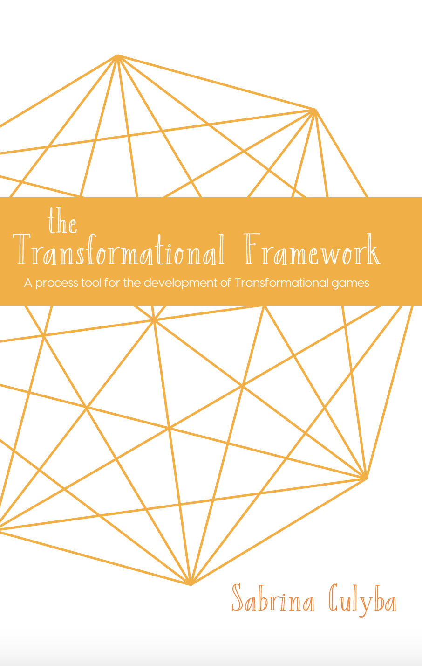
Game Development Primer and Production Considerations
Sabrina Culyba
Culyba, S. H. (2018). The Transformational Framework: A process tool for the development of Transformational games. Retrieved from http://press.etc.cmu.edu/index.php/product/the-transformational-framework/

Slide 99
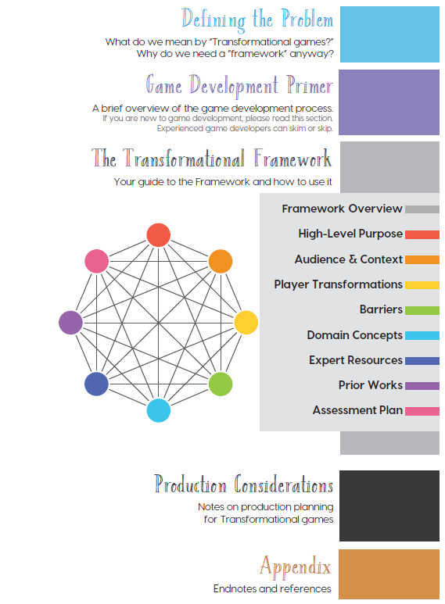
Some Quick Context
You read these

Slide 100
Other thoughts (Culyba)

Slide 101
Game Dev Timeline
Concept
Pre-production
Production
pre-Alpha
Alpha
Beta
QA
Ship

Slide 102
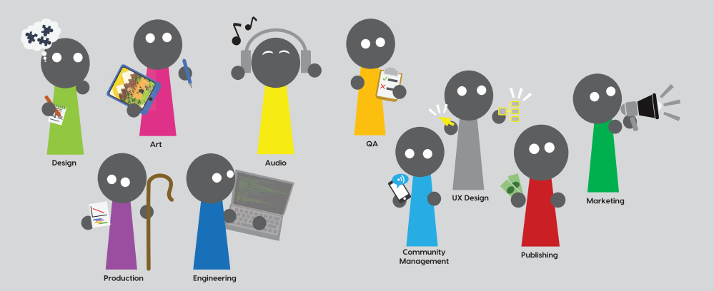
The Game Development Team

Slide 103
What you should ask for as a developer
“Everyone” is not an audience
Not always obvious what is hard vs easy
Surprises are bad
Part of managing risk is making cuts
Have a clear chain of approval
Late feedback is the worst feedback

Slide 104
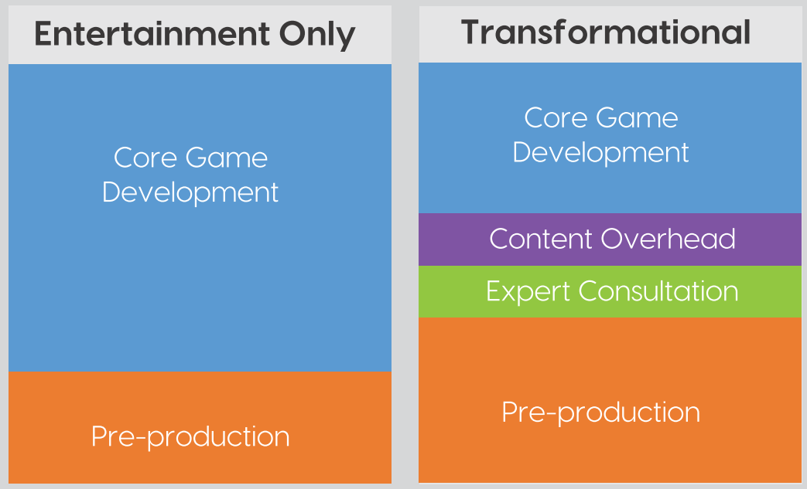
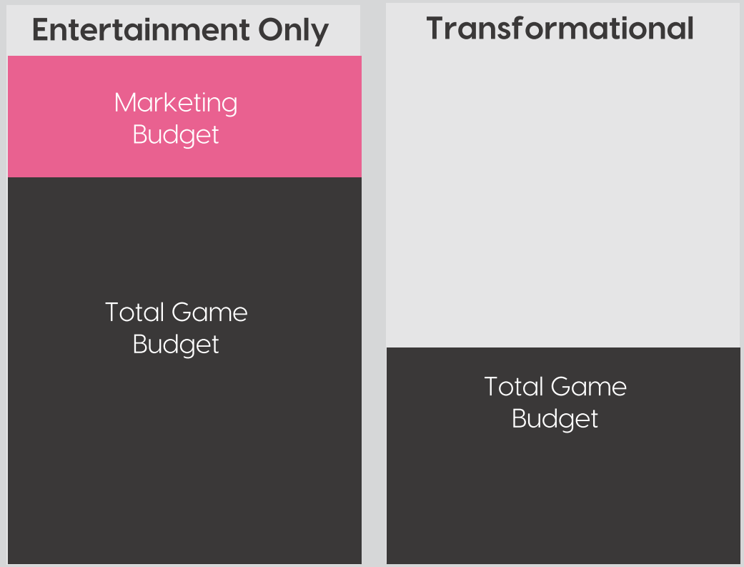
Doing More with Less…
Relative Effort Required
Relative Resources Available

Slide 105
Additional Considerations
Pre-production will take longer
More people will be involved in content and review
You have to test for more than fun/engagement
Educators’ use of your game is dependent on the support you provide
Stakes are generally higher
content mistakes are more important and fixing them is a priority

Slide 106
For next time
Crit Post Submission Opportunity 1 is Next Tuesday @23:59 US Eastern Time
You will want access to both a note book (something to write with) and a laptop for Thursday
I’ll try to “publish” the rest of Act 2 to Canvas by the end of this week
If you have any feedback about how live sessions are going please let me know: https://edugames.design/feedback

