Slide 1
10 – Prototyping + Playtesting
Design of Educational Games
05418/05818 Human-Computer Interaction Institute
Erik Harpstead

Slide 2
Announcements
Assignment 2A due Friday
Working on getting grades back on existing assignments
Crit 1 Grades will be released next week

Slide 3
Plan for Today
Prototyping
Playtesting
Do a playtesting activity

Slide 4
Prototyping

Slide 5
Prototypes Ask Questions
Do players learn from playing our game?
How well does our core mechanics work?
What do players do with our rules?
Game Mechanics
and Systems
Dynamic
Gameplay
Player Experience
Knowledge
Change
Is the currency system balanced?
Does the player experience look the way we want it to?
Notes:
Ephemeral
Unpredictable
Invisible
Are we screwed?

Slide 6
Kinds of prototyping
Individual Prototypes (what PPP calls Playful Prototypes)
Implement a specific piece of the game
Usually a single system or collection of mechanics
Accumulative Prototypes
Integrates several systems together to test interactions between them

Slide 7
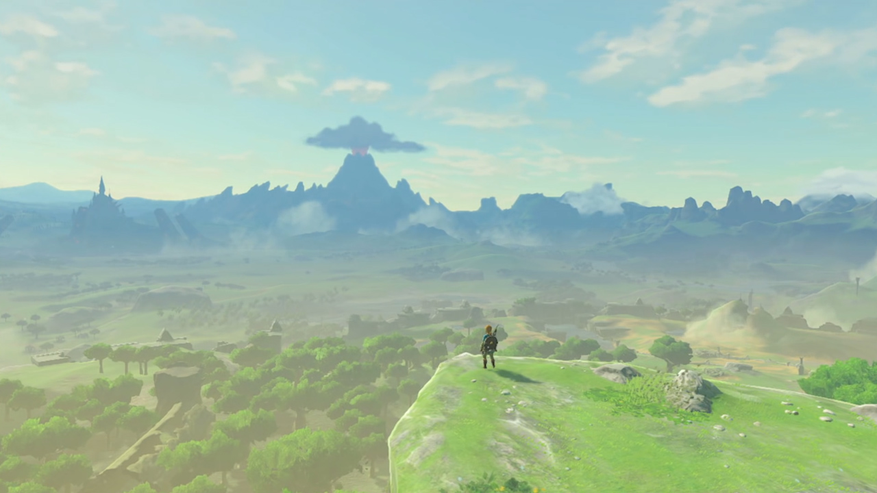
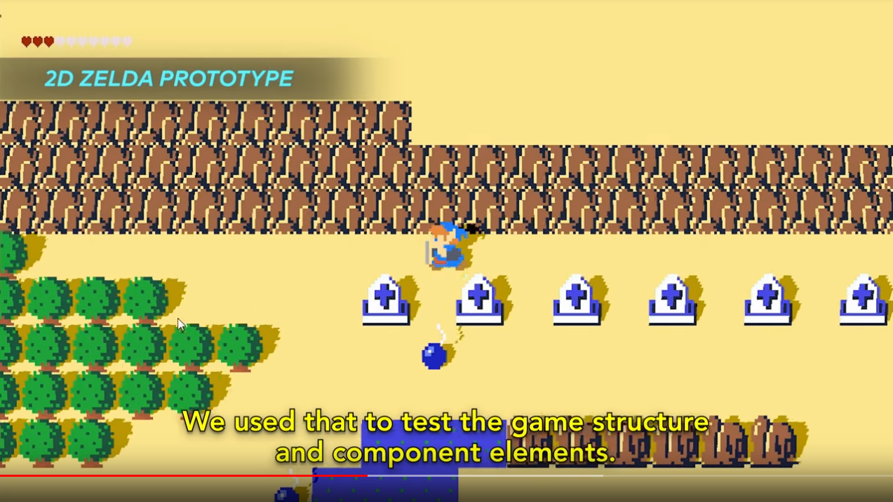
Examples of Prototypes in Industry Video
Extended GDC Talk - https://www.youtube.com/watch?v=QyMsF31NdNc

Slide 8
Materials for Paper Prototyping
Index cards, pencils, and dice
Blank Board game Pieces
https://www.thegamecrafter.com/publish/products

Slide 10
Materials for Paper Prototyping
Index cards, pencils, and dice
Blank Board game Pieces
https://www.thegamecrafter.com/publish/products
Other Board Games
Monopoly
Ameritrash Board Games are great

Slide 11
Argent: The Consortium
Contents:
6 Player boards (2 sided)
15 University tiles (2 sided)
133 Cards
30 Spell cards
6 Starting Spells
19 Voter cards
35 Vault cards
32 Supporter cards
6 Round tracker cards
5 Bell tower cards
30 Intelligence/Wisdom tokens
50 Mana tokens
40 Gold tokens
1 First player token
5 Room lock tokens
20 Merit badge tokens
42 Loyalty badge tokens (7 each color)
30 Mage pawns (5 each color)
60 Knowledge cubes (10 each color)
6 Influence trackers (1 each color)
5 Mage power reference cards
Rulebook
https://boardgamegeek.com/boardgame/144797/argent-consortium

Slide 12
Materials for Paper Prototyping
Paper, pencils, and dice
Blank Board game Pieces
https://www.thegamecrafter.com/publish/products
Other Board Games
Monopoly
Ameritrash Games are great
Rapid prototyping tools
Laser cutters, 3D printers

Slide 14
Materials for Paper Prototyping
Paper, pencils, and dice
Blank Board game Pieces
https://www.thegamecrafter.com/publish/products
Other Board Games
Monopoly
Ameritrash Games are great
Rapid prototyping tools
Laser cutters

Slide 15
Materials for Paper Prototyping
Paper, pencils, and dice
Blank Board game Pieces
https://www.thegamecrafter.com/publish/products
Other Board Games
Monopoly
Ameritrash Games are great
Rapid prototyping tools
Laser cutters
Programmer Art”
http://kenney.nl/assets
http://game-icons.net/

Slide 16
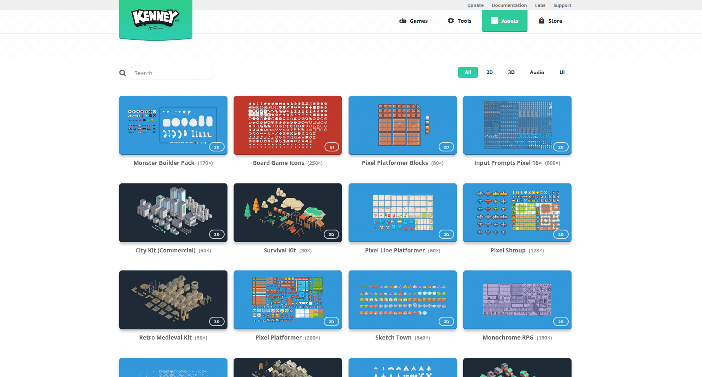

Slide 17
Paper Prototyping Digitally
Normally we emphasize paper prototyping in this class but the hybrid format makes that hard
A number possible solutions to this problem

Slide 18
Playingcards.io

Slide 20
Playingcards.io
Pros
Free
Easy to playtest
Implements common game structures
Cons
Hard to do non-card based mechanics

Slide 21
Miro

Slide 22
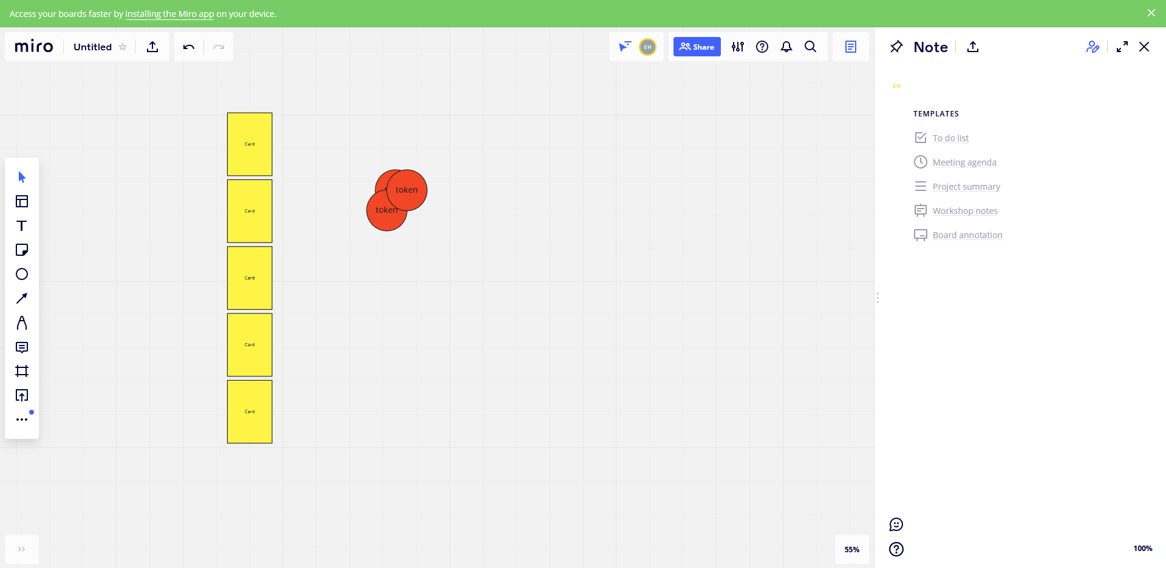

Slide 23
Miro
Pros
Free
Flexible shared space
Cons
Doesn’t have structures for common game pieces
Hard to do some verbs like shuffling cards or drawing from a set

Slide 24
Tabletop Simulator

Slide 26
Tabletop Simulator
Pros
Easy to implement a number of different games
Can easily spawn in new elements for prototyping
Cons
Not free
Non-browser software
Playtesters also need to own the game

Slide 27
Tabletopia

Slide 28
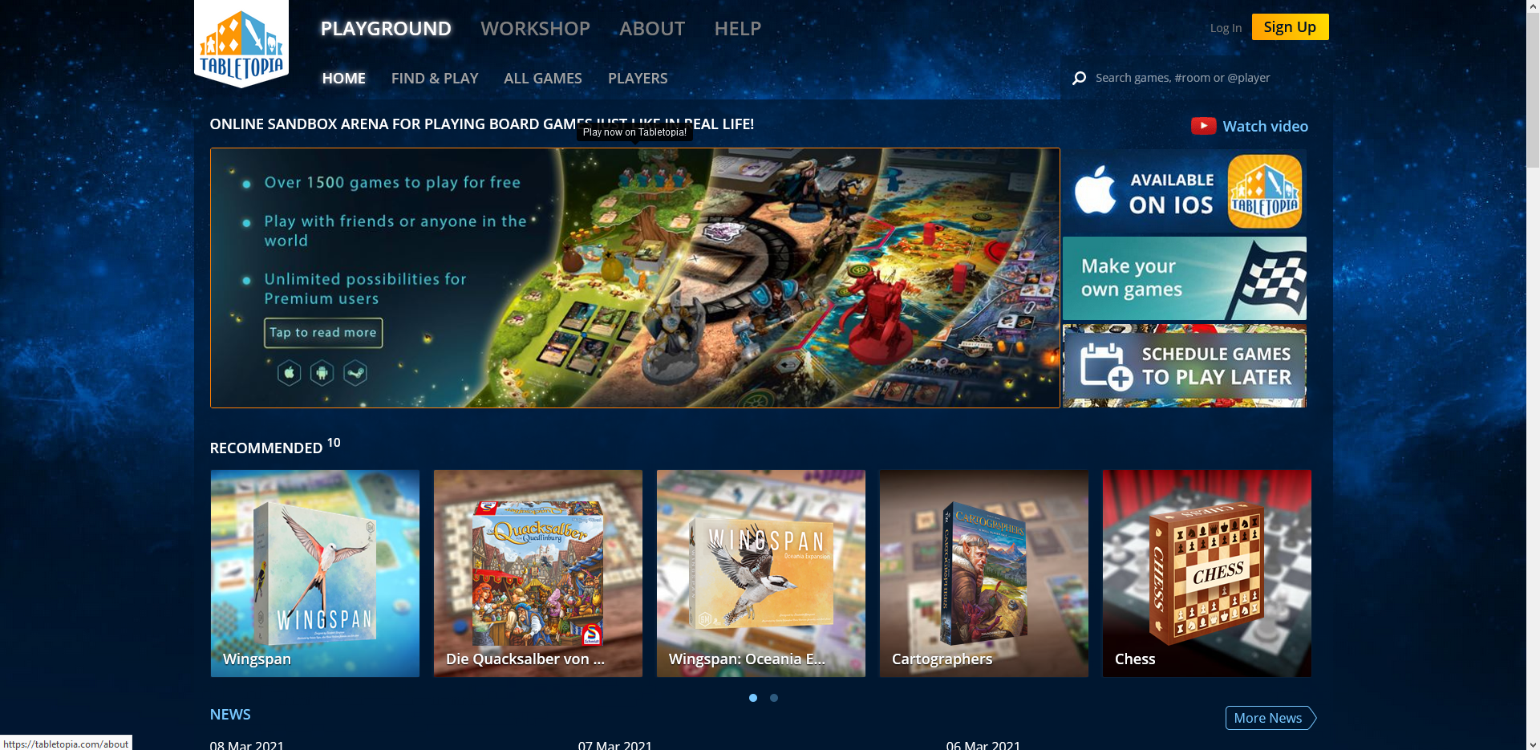

Slide 29
Tabletoptopia
Pros
Can implement a wide range of game concepts
Options for free playtesting within additional software
Cons
Editor experience goes through an approval pipeline
Limited capacity for rapid prototyping
Basically wants you to have already designed the game

Slide 31
Playtesting

Slide 32
Playtesting can be an Emotional Experience
You as the designer
Your Player
Original: https://www.tiktok.com/@tired_actor/video/6912855387788102918

Slide 33
Playtesting can be an Emotional Experience
Inviting criticism of your work is intimidating
Finding people you can ask for feedback is hard
Getting negative feedback sucks

Slide 34
Why do it?
“This was also a sure way to settle any design arguments. It became obvious that any personal opinion you had given really didn’t mean anything, at least not until the next play-test session. Just because you were sure something was going to be fun didn’t make it so; the play-testers could still show up and demonstrate just how wrong you really were.”
-Ken Birdwell
https://www.gamedeveloper.com/design/the-cabal-valve-s-design-process-for-creating-i-half-life-i-

Slide 35
Why do we playtest?
It would suck even more if we produced a thing that didn’t work
To make it good you have ot have it suck a lot first
To challenge assumptions or test assumptions we have
To prove to yourself or investor that it’s work actually making 0r that you can make it
Test the motivation if its enough
Also accessibility

Slide 36
Playtesting with a Purpose
Have a plan for why you are playtesting
3 high-level purposes
Judeth Oden Choi, Jodi Forlizzi, Michael Christel, Rachel Moeller, Mackenzie Bates, and Jessica Hammer. 2016. Playtesting with a Purpose. In Proceedings of the 2016 Annual Symposium on Computer-Human Interaction in Play - CHI PLAY ’16, 254–265. https://doi.org/10.1145/2967934.2968103

Slide 37
Playtesting with a Purpose
Explore
Understanding your players
Mapping out a design space
Searching for your core experience
Judeth Oden Choi, Jodi Forlizzi, Michael Christel, Rachel Moeller, Mackenzie Bates, and Jessica Hammer. 2016. Playtesting with a Purpose. In Proceedings of the 2016 Annual Symposium on Computer-Human Interaction in Play - CHI PLAY ’16, 254–265. https://doi.org/10.1145/2967934.2968103

Slide 38
Playtesting with a Purpose
Explore
Refine
Iterate on an existing experience
Hone in on player experience goals
Judeth Oden Choi, Jodi Forlizzi, Michael Christel, Rachel Moeller, Mackenzie Bates, and Jessica Hammer. 2016. Playtesting with a Purpose. In Proceedings of the 2016 Annual Symposium on Computer-Human Interaction in Play - CHI PLAY ’16, 254–265. https://doi.org/10.1145/2967934.2968103

Slide 39
Playtesting with a Purpose
Explore
Refine
Prove
Communicating to stakeholders
Evaluating claims of efficacy or experience
Judeth Oden Choi, Jodi Forlizzi, Michael Christel, Rachel Moeller, Mackenzie Bates, and Jessica Hammer. 2016. Playtesting with a Purpose. In Proceedings of the 2016 Annual Symposium on Computer-Human Interaction in Play - CHI PLAY ’16, 254–265. https://doi.org/10.1145/2967934.2968103

Slide 40
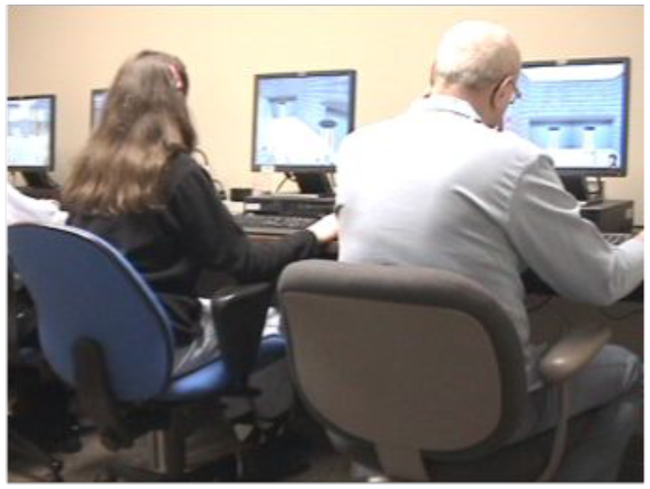
Playtesting with a Purpose
Notes:
Eben used to tell this story from Simcoach about a man who had never used a mouse before

Slide 41
When should you playtest?

Slide 42
When should you playtest?
When you have a question you need answered
Prototypes ask questions
Playtests answer them

Slide 43
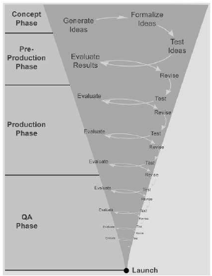
Explore
Refine
Prove

Slide 44
Who do you playtest with?

Slide 45
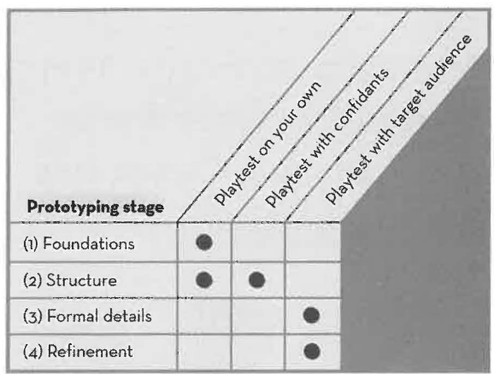
Who are your testers?
Ideal: represent your target audience
Depending on goal:
Non-representative players
Stakeholders (clients, trainers, parents, etc)
Other Designers / Developers

Slide 46
How many testing sessions?
Similar to recommendations for Knowledge Elicitation
>0
~3 until you are no longer surprised
If you plan to support multiple player counts you should test the different sizes

Slide 47
Repeat vs Fresh Testers
“Tissue Tests” of the first time player experience only work once per player
Game designs can be volatile in early stages so fresh tests are less important
Repeat early stage testers can also be great design partners
True first-time test are more important in later stages (particular for refining rulebooks or tutorials)

Slide 48
How do you playtest?

Slide 49
How do you playtest?
Setting goals and asking questions
Choosing appropriate methods
Capturing and applying data to an iterative design process

Slide 50
Goals for the test
What do you want to know about?
Aesthetics players experience?
Learning Objectives?
Is the game balanced?
Does this new mechanic work?
Questions for each playtest
More specific = better

Slide 51
Plenty of Methods
Observation
Focus Groups
Surveys
1-on-1 Interviews
Creative Activities
Think Alouds
A/B Tests
Pre/Post Testing
Self Report
Video closet
Blog

Slide 52
Plenty of Methods
Observation
Focus Groups
Surveys
1-on-1 Interviews
Creative Activities
Think Alouds
A/B Tests
Pre/Post Testing
Self Report
Video closet
Blog
We talked about these in Knowledge Elicitation

Slide 53
Plenty of Methods
We’ll talk about these with Evaluation
Observation
Focus Groups
Surveys
1-on-1 Interviews
Creative Activities
Think Alouds
A/B Tests
Pre/Post Testing
Self Report
Video closet
Blog

Slide 54
Plenty of Methods
Mostly focus on these today
Observation
Focus Groups
Surveys
1-on-1 Interviews
Creative Activities
Think Alouds
A/B Tests
Pre/Post Testing
Self Report
Video closet
Blog

Slide 55
Observation
Watch someone play your game
Don’t say anything (sit on your hands)
Take notes

Slide 56
Observation
Introductions (~2-3 min)
Warm-up Discussion (~5min)
Play Session (~15-20 min)
Discussion of Experience (~15-20 min)

Slide 57
Observation vs. Interview
Look at what the person is actually doing
More reliable than what they report afterwards
There can be a substantial disconnect between what players say and what they do (e.g., frustration during game play, positive comments afterwards)
Triangulate from multiple sources where possible

Slide 58
Should You Provide Help?
PPP says no but I think recommendations are more mixed
Basic idea: “You don’t come in the box”
But be mindful of insight vs time
Seeing players struggle can be helpful
Players getting no where is not helpful
Have back ups ready to adjust on the fly
Make digital prototypes adaptable

Slide 59
Collecting Data
Several Main Sources of Data
Recording Observations
Gameplay Telemetry
Asking Players Questions

Slide 60
Recording Observations
Take notes on what you observe during the session
Look for any issues or confusions the player experiences
Can be useful to audio/video record sessions to review later
Valuable to record both what is happening in the game and how players react to it

Slide 61
Gameplay Telemetry
Logging meaningful player actions for later analysis
Useful for seeing broad patterns in player behavior
Tells you what players do, not why they do it

Slide 62
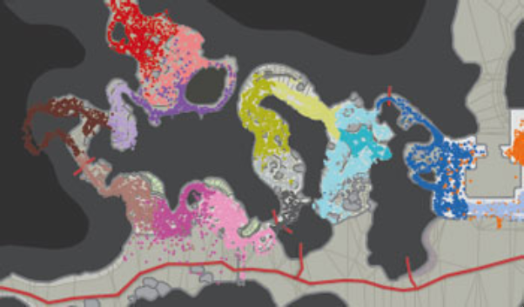
Gameplay Telemetry
[Thompson, 2007]
Notes:
Measure-then-record
Record-then-measure
Record-to-measure
Record-to-capture

Slide 63
Definitive Guide to Playtesting Questions
Avoid yes/no questions
Bad: “Did you not understand the tree hint?” Better: “Was there anything special about the tree puzzle?” Best: “What could have helped you solve the tree puzzle?”
Avoid leading questions
Bad: “Did you not understand the tree hint?” Better: “Was there anything special about the tree puzzle?” Best: “What could have helped you solve the tree puzzle?”
Ask questions in their frame not yours
Bad: “What gave you speed boost?” Better: “What did the red power-up do?” Best: “What power-ups do you remember? What did they do?”

Slide 64
Definitive Guide to Playtesting Questions
What was the most Frustrating moment or aspect of what you just played?
What was your Favorite moment or aspect of what you just played?
Was there anything you Wanted to do that you couldn’t?
If you had a magic Wand to wave, and you could change, add, or remove anything from the experience, what would it be?
What were you Doing in the experience?
How would you Describe this game to your friends and family?

Slide 65
Analysis
Applying data to an iterative design process
Analysis
Ideation / Refinement

Slide 66
https://www.gdcvault.com/play/1024300/Board-Game-Design-Day-The @ ~36min mark

Slide 67
The EOTA Method
A technique for peer playtesting in game design classes
Nice approach for this class
Has 3 roles:
Designer (whoever made the game)
Players (whoever played the game)
Peers (other people observing the session in class)

Slide 68
The EOTA Method
Experience: players describes their experience with the game

Slide 69
The EOTA Method
Experience
Observation: players and peers point out anything they observed during the session

Slide 70
The EOTA Method
Experience
Observation
Theory: players and peers theorize about why they saw what they saw

Slide 71
The EOTA Method
Experience
Observation
Theory
Advice: Based on the theories players and peers make suggestions about what to do next

Slide 72
Let’s Practice the EOTA Method

Slide 73
Playtesting Activity
Break back into groups based on your suits:
Card holders 1-4 will be Players and the rest act as Peers
Playtest the game Sissyfight 3000 (materials provided)
Once you’ve finished playing, we will go through the EOTA method
Players share their experience
Peers talk about observations
All theorize about why something is an issue
All come up with advice on what to do next

Slide 74
Player Experiences
Strategy was to play defense cards every other round and otherwise use team
Mostly did solo cards because it felt like a way to chip off points
It seemed like the team option was overkill because it could knock somoen down so quickly
Similar to a game called Cash and Guns
Had some confusion about defend
Decided that if defend a 1 you lose nothing
Does a team target count for the defend rule?
I wish the target cards were a different color or marked differently

Slide 75
Peer Observations
People saying this feels mean
Thought that the most interesting aspect of the game was the politicking between rounds
Had to encourage the meanness as an outsider
Everyone started being cagey but once there was blood in the water they all got into it
The Group missed a rule
do you mention it?
Felt like the solo cards hard low impact compared to team
Everyone thought about the actions and points instead of the themeing
Should the players be able to talk to each other to team up?
Why don’t they team up more?
Wasn;t sure if you were allowed to talk otherwise it would be too easy
When you do team up the person getting attacked defaults to defend
Thought there was going to be this big moral about taking damage for hurting others
Talking would make me the first target
The defend mechanic didn’t seem super rewarding (maybe if you could choose who to defend against)
It’s a card game but no one is drawing cards

Slide 76
Group Theories
The relative weakness of solo to team cards made it more social
The chasing from mechanics -> theme something is broken
Talking would make things too easy
Picking your defend target would speed up the game
More card affordances could be used
People were being too cautious because of the low health

Slide 77
Advice
The instructions should describe what signaling is allowed
The team card could scale nonlinearly
Adding single points rather than multiplying
Could modify the defend card to make it more rewarding
Maybe if you’re getting teamed you get to redirect damage
Keep the game at 10 health
Actually include some playground insults built into the game
Even the terms are pretty mechanical
Maybe give people different goals
You could change the frame (gain points instead of lose them)

Slide 78
How did that activity go?
Having more than the one session would be more helpful
Hard to balance the low fidelity versus the design
Coming up with more of a protocol before
What can the peer do in particular?
Setting up what it is you want feedback on

Slide 79
Take Aways
Even if you’re scared… get your game out of your head and in front of others.
Remember:
You set the goal and frame your questions,
You select a method and test,
You analyze the results and...
You decide how to respond in your design

Slide 80
For next time
Remember:
Assignment 2A is DUE Friday
If you have any feedback about how live sessions are going please let me know: https://edugames.design/feedback

