Slide 1
13 – Pre-Production + Final Project Kickoff
Design of Educational Games
05418/05818 Human-Computer Interaction Institute
Erik Harpstead

Slide 2
Announcements
Critique Submission Deadline 2 Today at 11:59PM
  Reminder we drop your lowest 2 scores so ok to choose to skip a submission deadline
Assignment 1 and Assignment 2C Due Friday
Final Project teams assigned

Slide 3
Announcements
Mid-semester grades will contain:
  Crit1
  Assignment 1
  Assignments 2A & 2B
  All RWPs
  ~35% of overall final grade
They might contain:
  Assignment 2C
  Crit 2

Slide 4
Plan for Today
Briefly talk about upcoming final project deliverables
Show off some prior final projects
Give you a chance to meet with your final project teams

Slide 5
Month | Day | Week | Topic | Blogs | Assignments | Group Projects
Jan | 17 | 1 | Introduction + the EDGE Framework | Blogs Out
 | 19 |  | Educational Goals
 | 24 | 2 | Game Elements
 | 26 |  | Learning Mechanisms
 | 31 | 3 | Process
Feb | 2 |  | Knowledge Elicitation |  | 1 Out
 | 7 | 4 | Transfer | Blog 1 In
 | 9 |  | Integration |  | 1 DUE; 2 Out
 | 14 | 5 | Ideation |  | 2A DUE (Friday)
 | 16 |  | Prototyping + Playtesting
 | 21 | 6 | Motivation |  | 2B DUE (Friday) | Team Formation Survey
 | 23 |  | In-class Playtesting
 | 28 | 7 | Pre-Production and Final Project Kick-off | Blog 2 In | 2C DUE (Friday) | Teams Formed (Monday)
Mar | 2 |  | Evaluation |  | 1 Out | Final Project Scoping Proposal (Friday)
 | 7 |  | Spring Break; No Class
 | 9 |  | Spring Break; No Class
 | 14 | 8 | Pitching and Peer Feedback
 | 16 |  | Final Project Pitches |  |  | Pitch
 | 21 | 9 | [Special Topics] + Studio Time | Blog 3 In
 | 23 |  | [Special Topics] + Studio Time
 | 28 | 10 | Check-in 1 A (half of teams)
 | 30 |  | Check-in 1 B (half of teams) |  |  | Check-in 1 Report
Apr | 4 | 11 | Studio Time with Friends
 | 6 |  | Studio Time with Friends
 | 11 | 12 | Studio Time with Friends | Blog 4 In
 | 13 |  | Carnival; No Class
 | 18 | 13 | Check-in 2 A (half of teams)
 | 20 |  | Check-in 2 B (half of teams) |  |  | Check-in 2 Report
 | 25 | 14 | Studio Time with Friends
 | 27 |  | Last Lecture
May | TBD |  | Final Project Showcase | Blog Make Up |  | Final Project
Background & EDGE Framework
Process Techniques
&
Practice
You are Here
A Course in
3 Acts
Final Projects
&
Special Topics / Theory
http://edugames.design/schedule

Slide 6
Month | Day | Week | Topic | Blogs | Assignments | Group Projects
Feb | 28 | 7 | Pre-Production and Final Project Kick-off | Blog 2 In | 2C DUE (Friday) | Teams Formed (Monday)
Mar | 2 |  | Evaluation |  | 1 Out | Final Project Scoping Proposal (Friday)
 | 7 |  | Spring Break; No Class
 | 9 |  | Spring Break; No Class
 | 14 | 8 | Pitching and Peer Feedback
 | 16 |  | Final Project Pitches |  |  | Pitch
 | 21 | 9 | [Special Topics] + Studio Time | Blog 3 In
 | 23 |  | [Special Topics] + Studio Time
 | 28 | 10 | Check-in 1 A (half of teams)
 | 30 |  | Check-in 1 B (half of teams) |  |  | Check-in 1 Report
Apr | 4 | 11 | Studio Time with Friends
 | 6 |  | Studio Time with Friends
 | 11 | 12 | Studio Time with Friends | Blog 4 In
 | 13 |  | Carnival; No Class
 | 18 | 13 | Check-in 2 A (half of teams)
 | 20 |  | Check-in 2 B (half of teams) |  |  | Check-in 2 Report
 | 25 | 14 | Studio Time with Friends
 | 27 |  | Last Lecture
May | TBD |  | Final Project Showcase | Blog Make Up |  | Final Project
Scoping Proposal
Concept Pitch
Check-in 1 “Sprint”
Zoom in on
Act 3
Check-in 2 “Sprint”
Final Deliverable “Sprint”
http://edugames.design/schedule

Slide 7
Updates going Forward
More time devoted to working with your groups on the final project
Most topic sessions (starting after Spring Break) will only be about half the time to allow for group work
All RWPs become optional from here on
  If you make an entry you get positive credit, if you don’t you get excused
Topics are selected based on the special topics survey:
http://edugames.design/topics

Slide 8
Pre-Production

Slide 9
Two Primary Artifacts in Pre-production
The Vertical Slice
The Game Design Macro

Slide 10
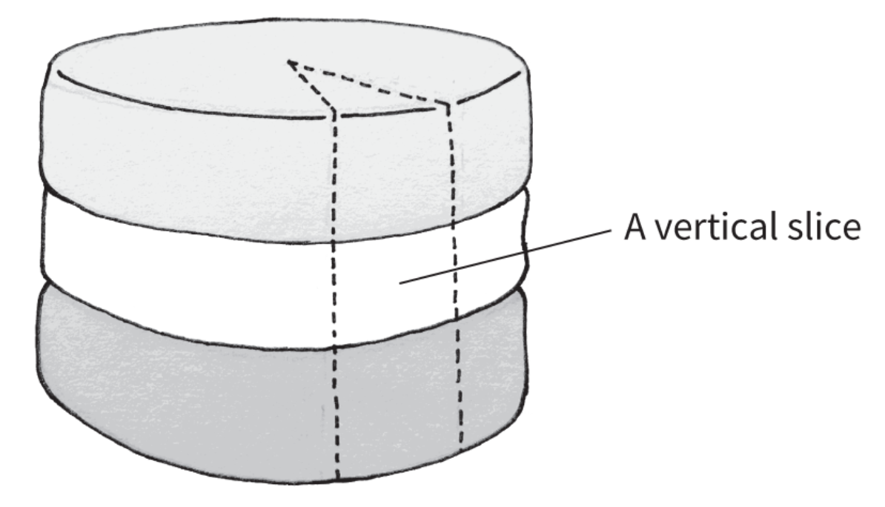
Lemarchand, 2022

Slide 11
The Vertical Slice
Provides sample of all of the core features that would be necessary to build your game
Used to prove you can actually do all the sub pieces of your experience and know how they fit together

Slide 12
The Vertical Slice usually contains:
Your Core Loop
  Roughly a sample level / sequence
Any Special Sequences your game might have
  If you plan for other sequences what are those?
The logic that connects sequences together
  If you can create 2 levels and the transition between them you can make as many as you need
Answer to the 3C’s (or equivalent for genre)
  Character
  Camera
  Controls

Slide 13
Vertical Slice Size
Rarely an instantiation of your entire game
  Though tabletop games will usually be more polished
Consider creating a “beautiful corner”
  A small section of the overall plan that is polished to the level you would expect of the final game
  The rest of the game may still be grey boxes or rough plans

Slide 14
Game Design Macro
A document that maps out a plan for production
Describes your project goals or design pillars that could be used to take a game to full production
Provides a brief plan for:
  Core gameplay
  Aesthetic direction
  Rough narrative arc
Sometimes contains a Game Design Macro Chart

Slide 15
Game Design Macro Chart
Lays out your sequences of levels relating them to designer and player goals as well as any key elemental changes
Not necessarily relevant to all types of games
Lemarchand, 2022

Slide 16
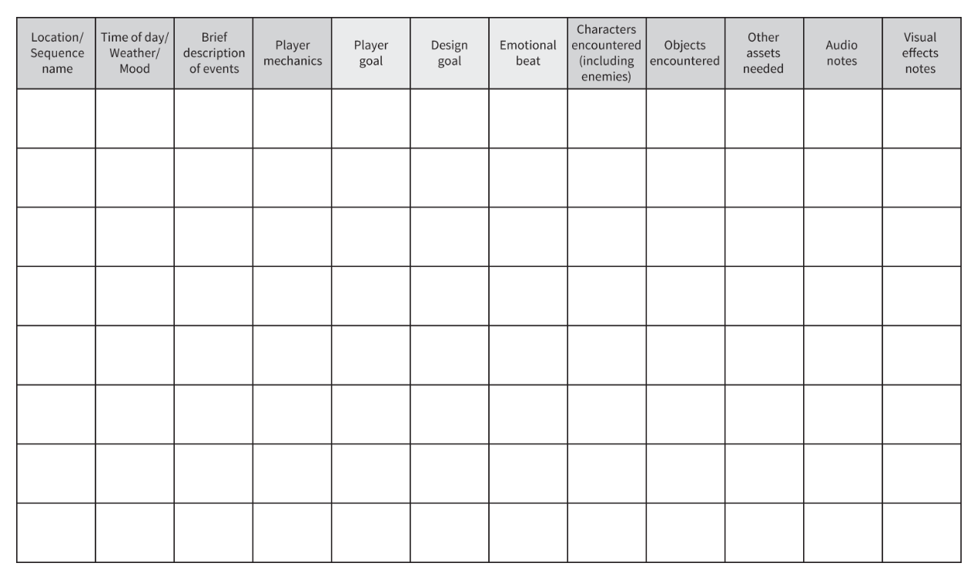
Game Design Macro Chart
Lemarchand, 2022

Slide 17
Final Project Guidelines

Slide 18
Final Project Goal
Make an Excellent Educational Game!
With a team of ~5 people
Target audience, subject area, and platform are up to you, subject to a few limitations
Expected size depends on format:
  Non-digital / tabletop games are usually ~15-60 min of gameplay
  Digital games are usually ~5-15 min of gameplay

Slide 19
Design Limitations
No Arithmetic (basic math) Fluency games
  Unless you can convince me you have a really compelling idea the world has enough of these
No Digital Games with 3D Art or Animation
  Unless you can prove to me right now that you know how to work with 3D art

Slide 20
Available Platforms
Platforms I can easily support
  Board games
  HTML 5
  PC (Mouse + KB or controller)
  Android (prefer phone but have tablet)
Platforms that would be trickier but possible
  iOS
  Mac OS
  Any VR/AR platform
  Physical games requiring lots of space
  Any other special hardware you don’t provide
  Most consoles
    I have access to most of them but you probably can’t get a dev kit in time

Slide 21
Main Deliverables
Game Design Macro Document
Production Log
Playable Prototype

Slide 22
Game Design Macro Document
A short (5-10 page) document describing high-level plan for your game
Would be used to guide full production if the project was continued
Two main sections:
  Learning Design Overview – What are you concrete learning goals? How are they designed into your game?
  Game Design Overview – What is your core gameplay? What are the important elements of your game?

Slide 23
Production Log
A record of all your various working documents or notes in chronological order
Gives us the ability to see the progression of your design work through the course of the project
A running document of links is fine, doesn’t need a lot of elaboration as long as we can easily tell what a link leads to

Slide 24
Show Some Examples Here

Slide 25
Playable Prototype
A playable prototype of your game that we can play without your live assistance
  Tabletop games should have a rulebook
  Digital games should provide guidance on controls
Fine to approach it as a “vertical slice” of a larger game
  Ex: build and polish 2 example levels/puzzles and the mechanism for moving between them rather than building a ton of levels

Slide 26
Assessment Components and Dimensions
We will be looking at 5 main components of your work and assessing them along 5 dimensions
Each check-in stage of the project will use the same rubric as if it was final so you can gauge formative progress

Slide 27
5 Assessment Components
Learning Design
  Elicitation and specification of the educational content that your game will be about
Experience Design
  Formulation and evolution of the kind of experience you want your game to create for players.
Ideation / Prototyping
  Exploration of a design space through brainstorming and prototyping ideas
Playtesting / Evaluation
  Collection of player feedback as well as any evidence of learning and how it informed the design process.
The Game
  The final game that you ultimately produce

Slide 28
5 Assessment Dimensions
Clarity – Can we understand what you were intended to convey?
Quality – Is the work well executed and thorough?
Credibility – Is the work backed by rigorous processes and principled decision making?
Integration – Does the work in one component connect to the others?
Innovation – Is the work interesting, novel, or cool?

Slide 29
Timeline
Date | Step
Mar 3 | Scoping Proposal
Mar 16 | In-class Pitch
Mar 28 / 30 | Check-in 1 Presentation + Report
Apr 18 / 20 | Check-in 2 Presentation + Report
[FINALS WEEK TBD] | Final Project Showcase + Final Product

Slide 30
Scoping Proposal
Laying out who your team is
A description of your initial ideas for:
  Topic area
  Kind of game
  Audience
A collaboration plan with a google drive or other location to follow progress
If you have multiple possible directions, mention them and we can weigh in
AT MOST 2 Pages
Not graded for substance, just complete/incomplete

Slide 31
In-Class Concept Pitch
An initial concept pitch to the class
Mainly a chance to get preliminary peer feedback
Again mostly graded for complete / incomplete

Slide 32
Check-ins
A presentation to the class on your project
A group report to me about current status
An individual reflection from each team member on their view of the current status of the team

Slide 33
Check-in Presentations
Short presentations containing:
  Brief description of your team and high-level direction
  Description of the current state of the game / work
  Challenges you are facing/faced since the last presentation
  Plans for next steps
Will be graded for containing the above
Gives you a chance to get peer feedback and workshop your ideas / challenges with the class

Slide 34
Check-in Reports
A short report where you describe the current state of each component (~1-2 paragraphs each) and link to your working files for further support
Will be graded against the same rubric as the final deliverable but using a lower bar for overall score
  Check-in 1: 35 points
  Check-in 2: 90 points
  Final: 125 points

Slide 35
Check-in Reflections
A short response (~1 paragraph) to a few questions to help us gauge everyone’s thoughts on the progress of their teams
Submitted individually not as a team
Not graded for substance just completion

Slide 36
Final Project Showcase
Setup your game for the public to come by and see your work
I (or external people I recruit) will walk around for you to give a “show floor pitch” of your game as if you were trying to convince a producer to green light the game for production
Make the case for why it would be worth developing further and why its likely to work

Slide 37
Final Deliverable
Your final Game Design Macro document
Your final Production Log
A playable version of your game

Slide 38
Questions?

Slide 39
Initial Final Project Steps
Final Project Scoping Proposal (Due Friday)
Final Project Pitch (in class Thursday after Spring Break)
  You will get time on Tuesday to work on the Pitch

Slide 40
Final Projects Examples from Prior Years

Slide 41
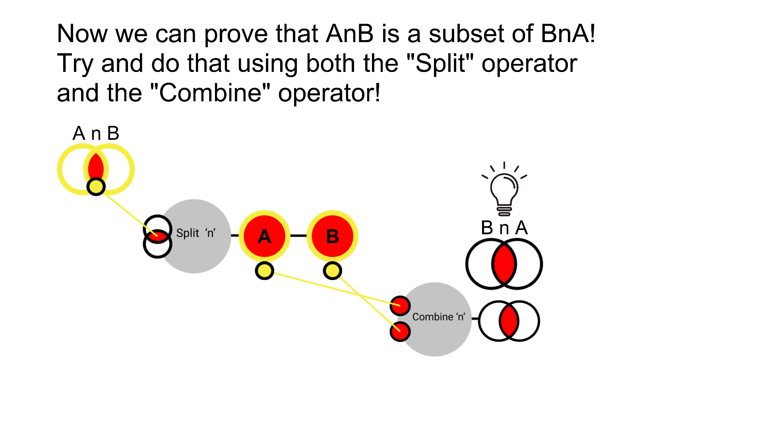
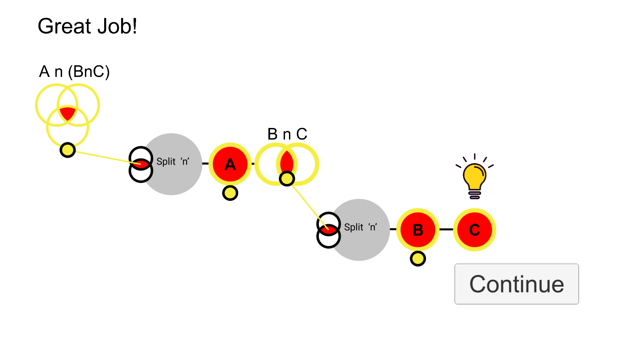
Set Theory

Slide 42
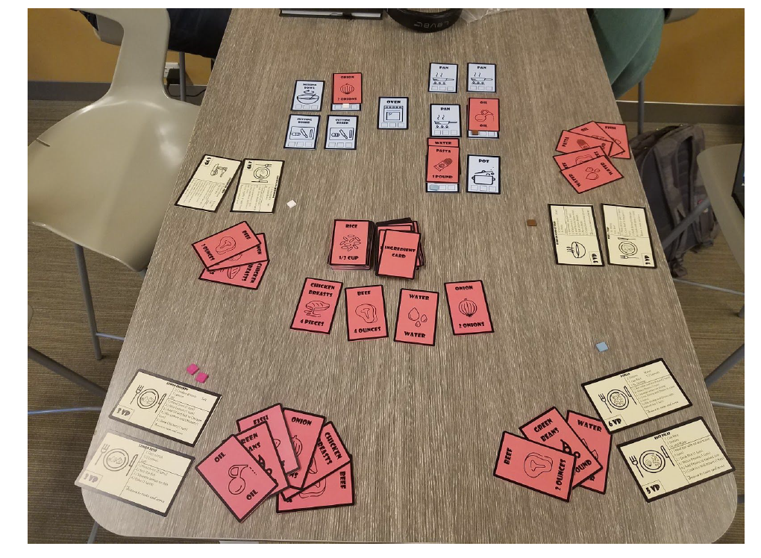
Recipe Planning

Slide 43
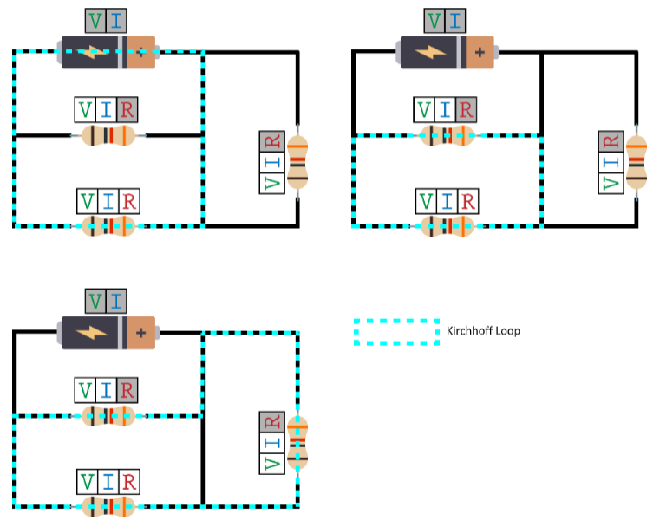
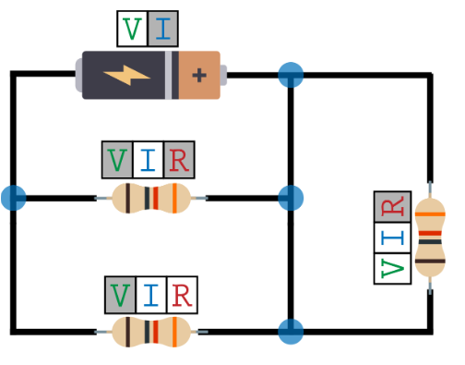
Kirchoff’s Law in Electrical Circuits

Slide 44
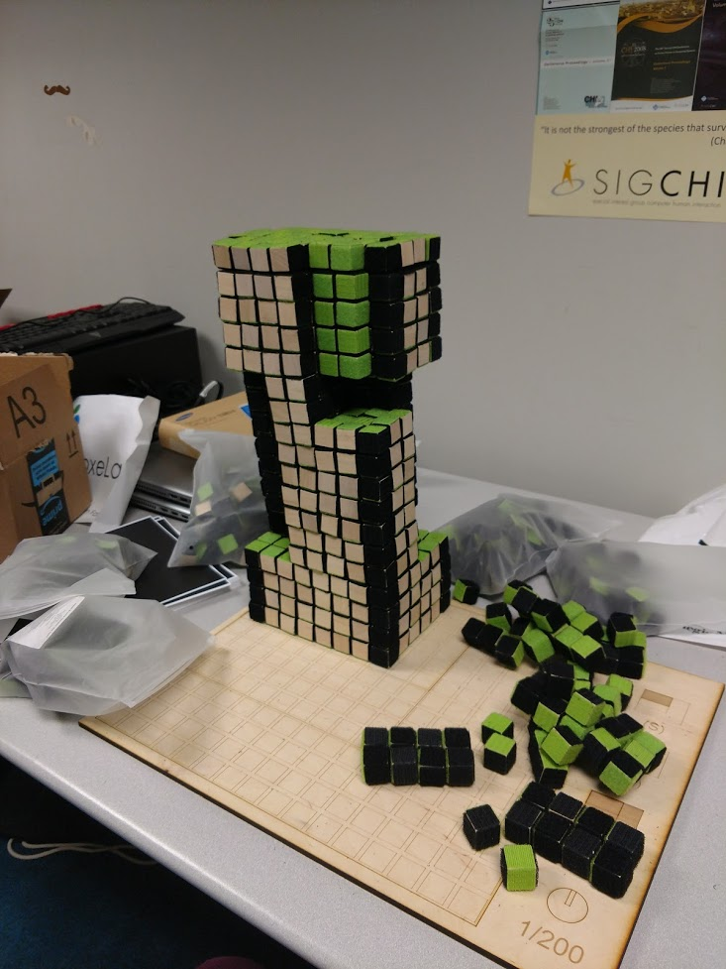
Architectural
Massing
Design

Slide 45
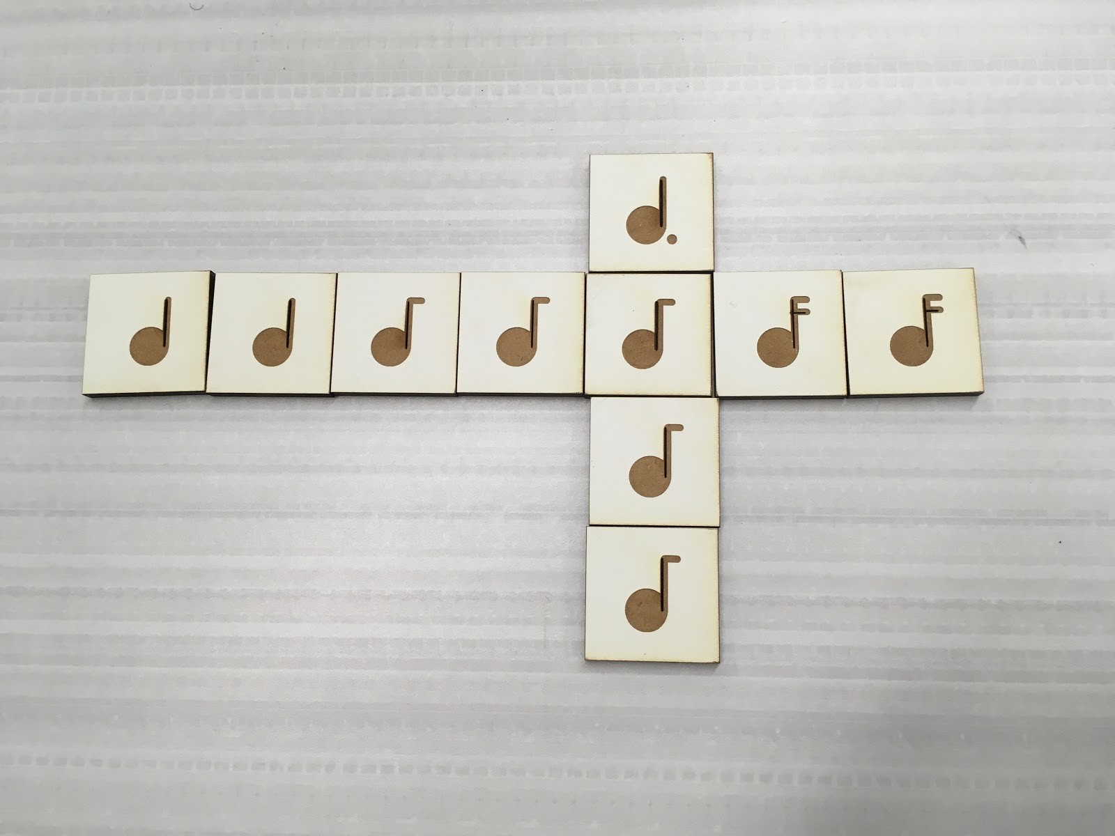
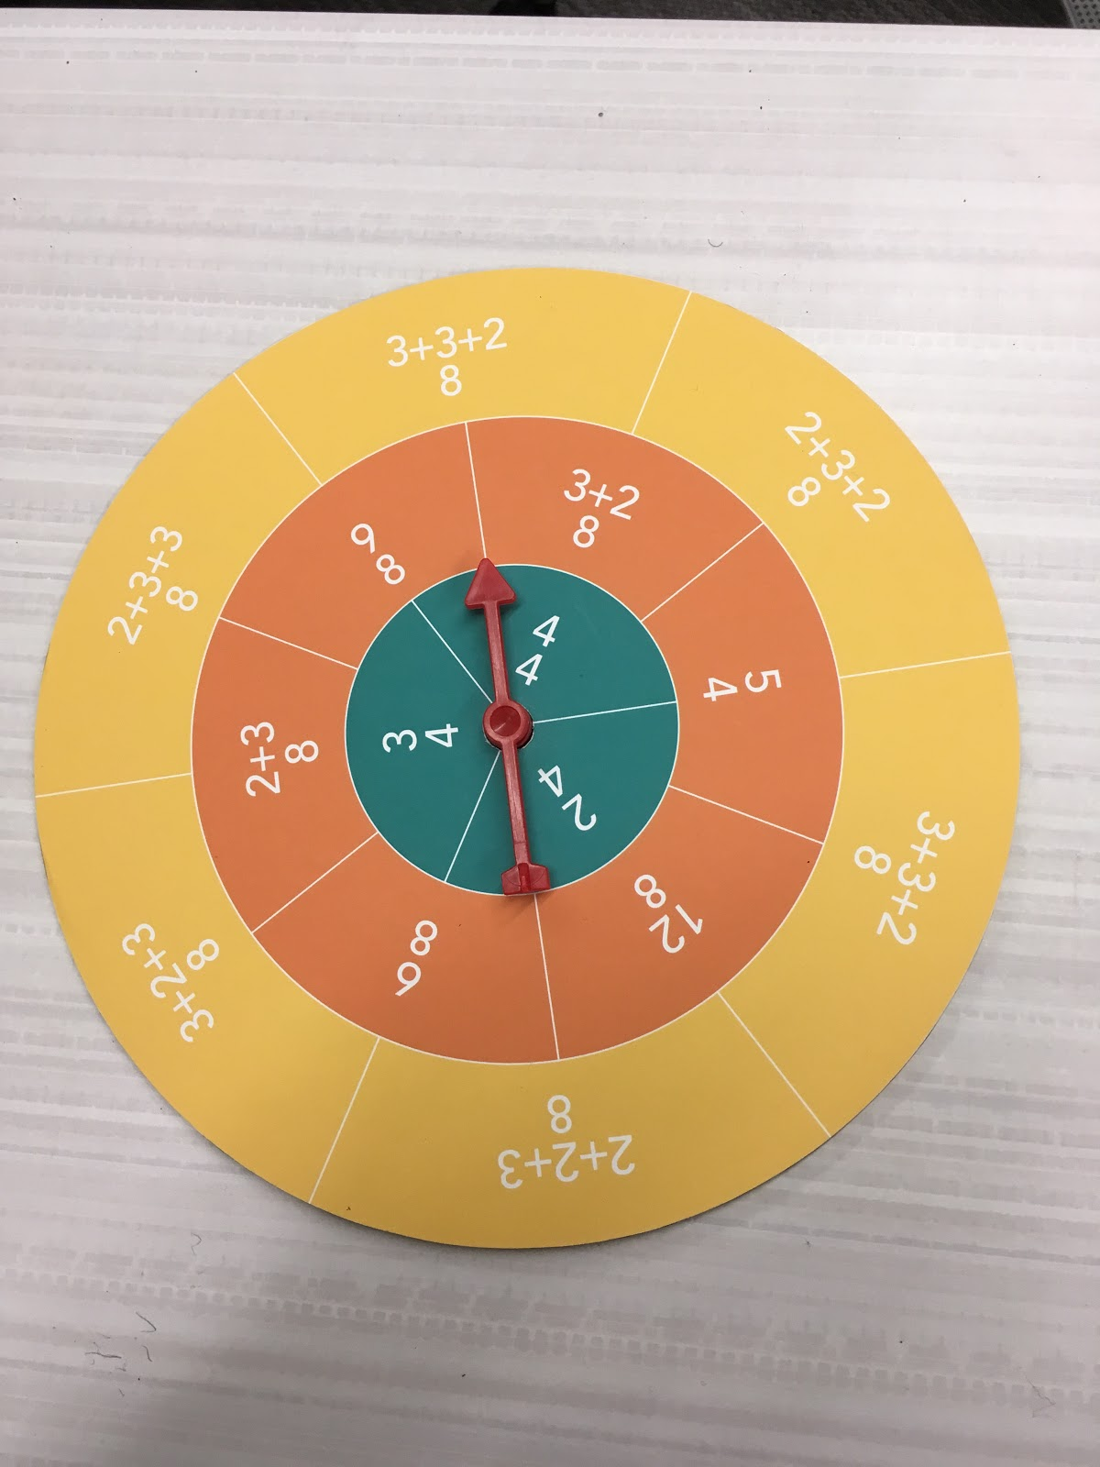
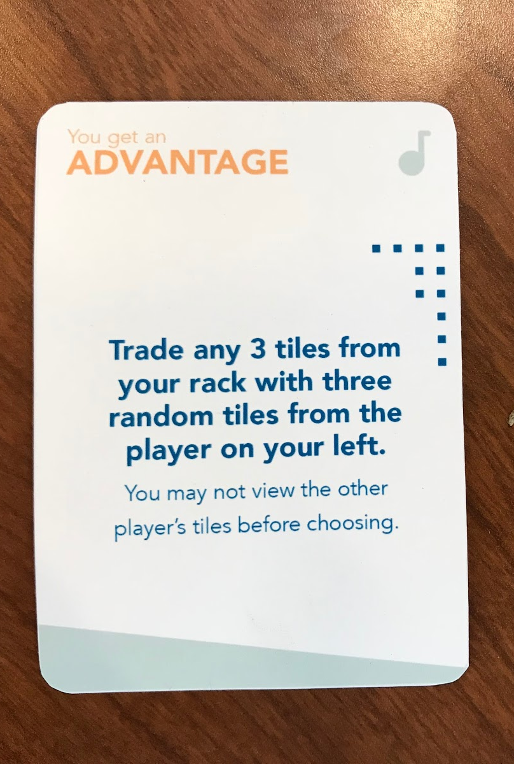
Eurhythmics

Slide 46
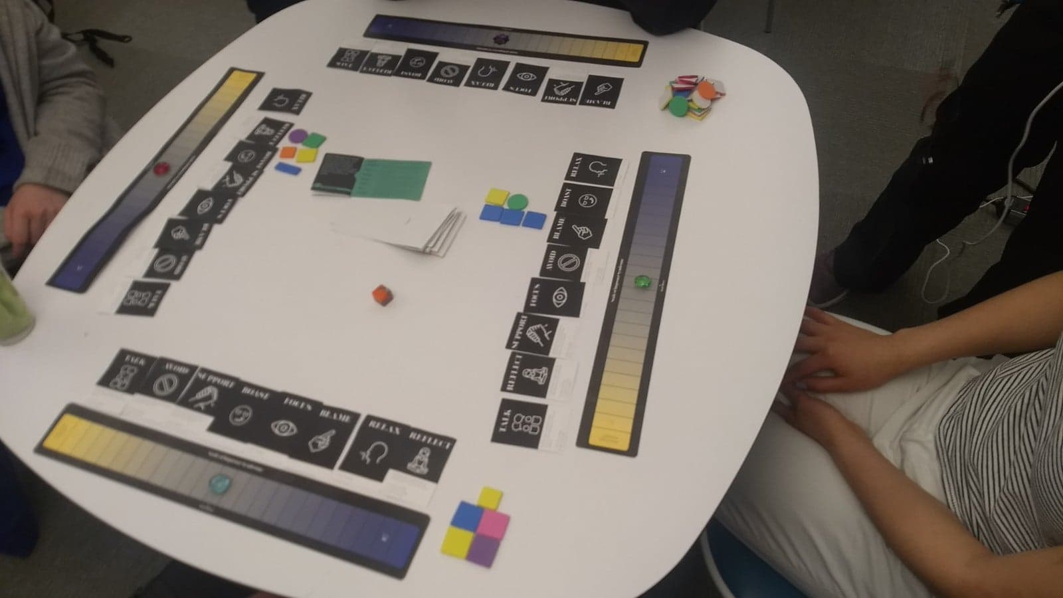
Dealing with Imposter Syndrome

Slide 47
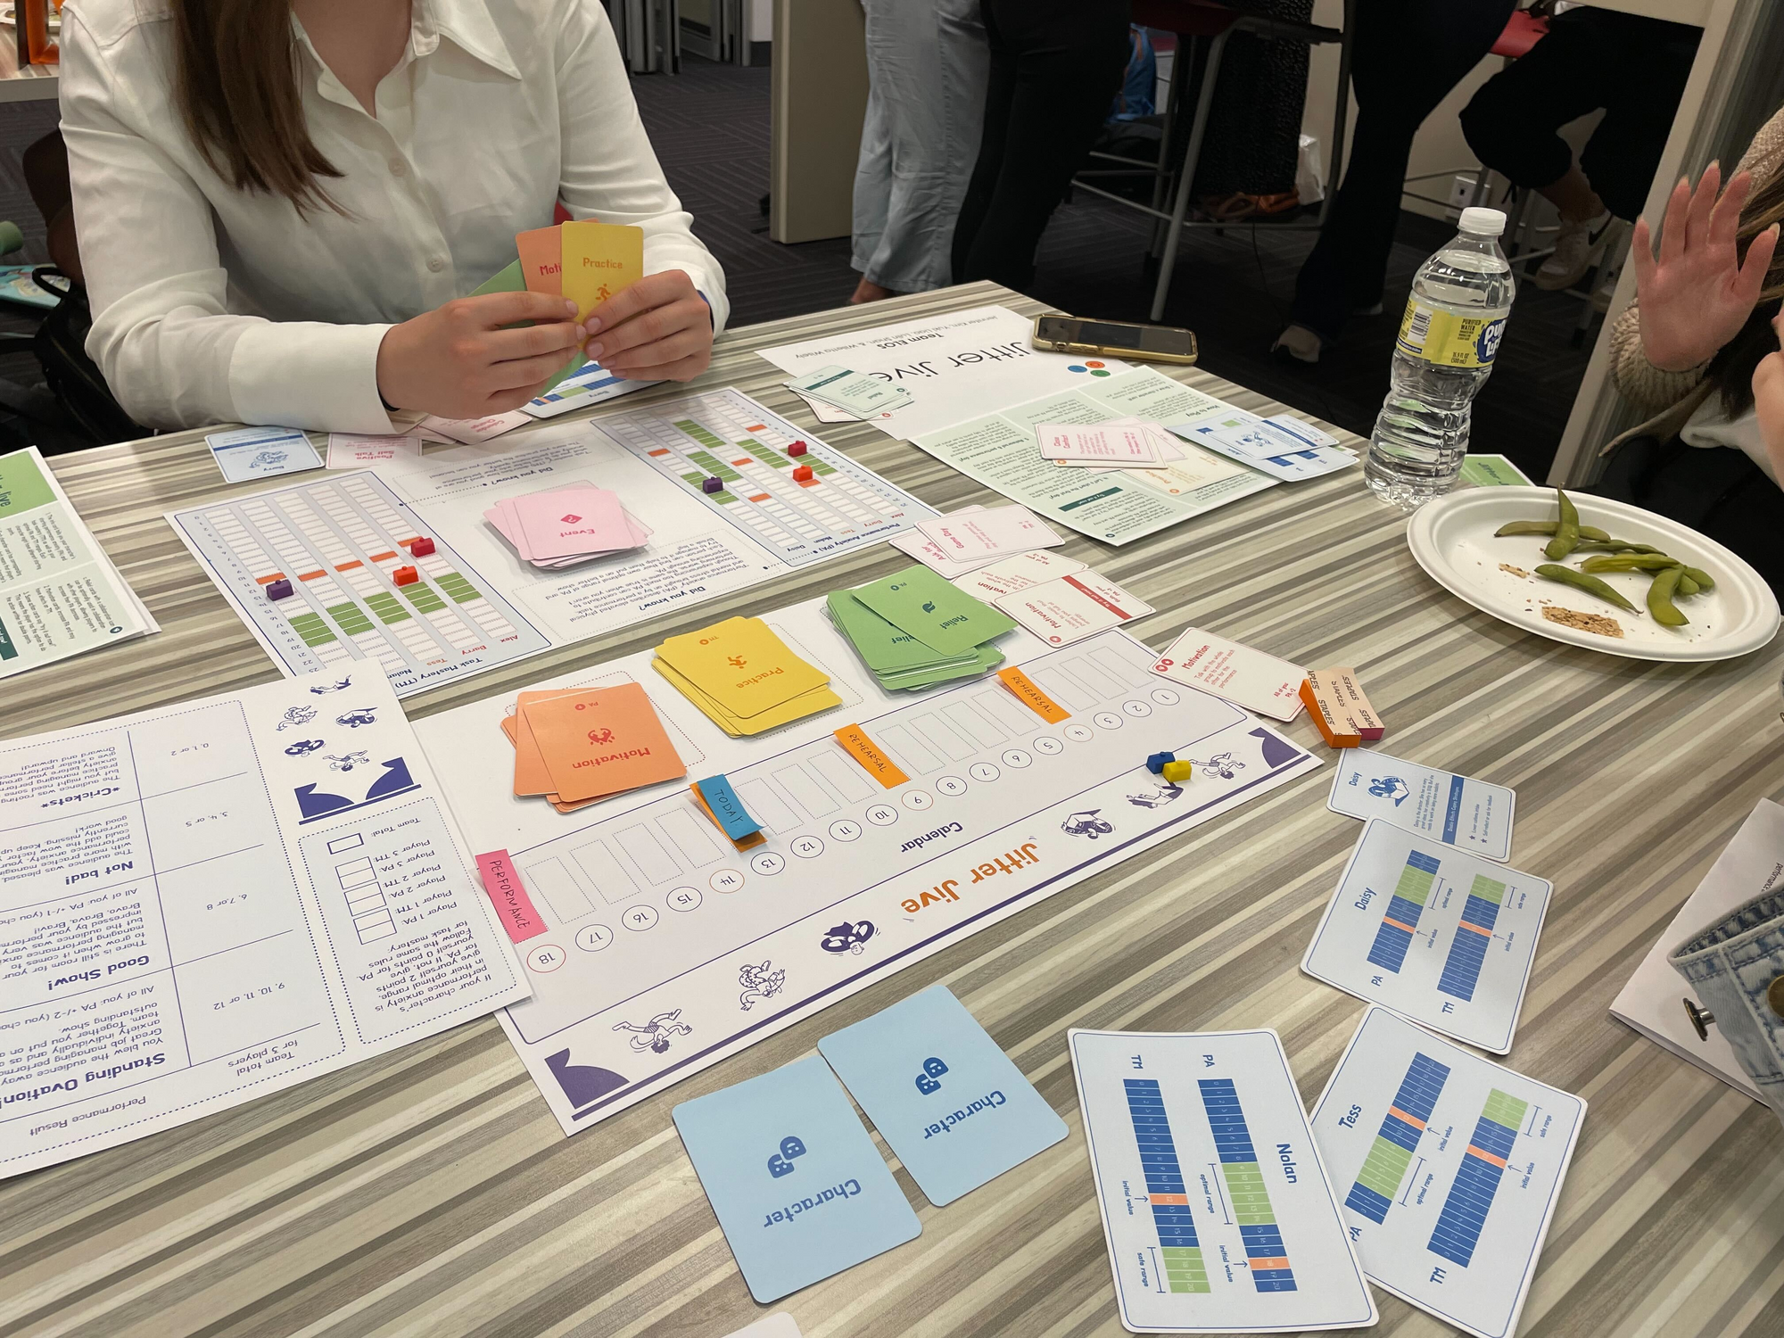
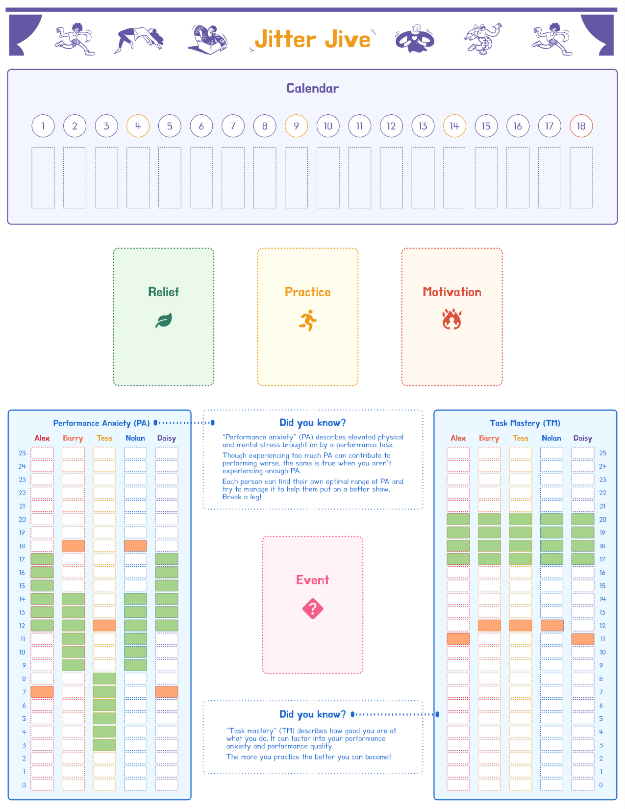
Performance Anxiety Management

Slide 48
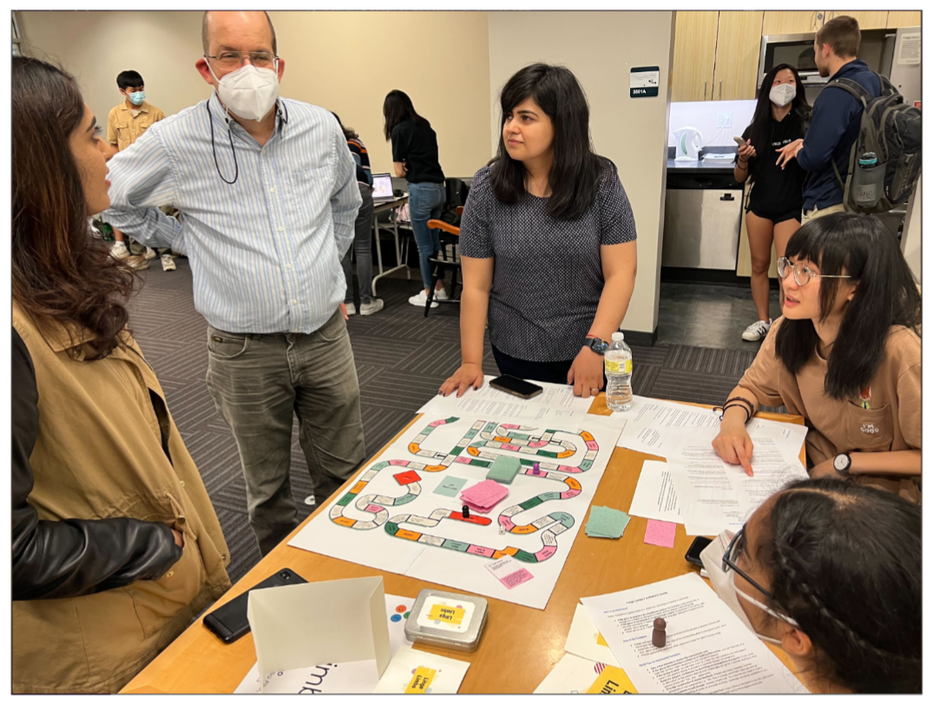
Idiomatic Language Practice

Slide 49
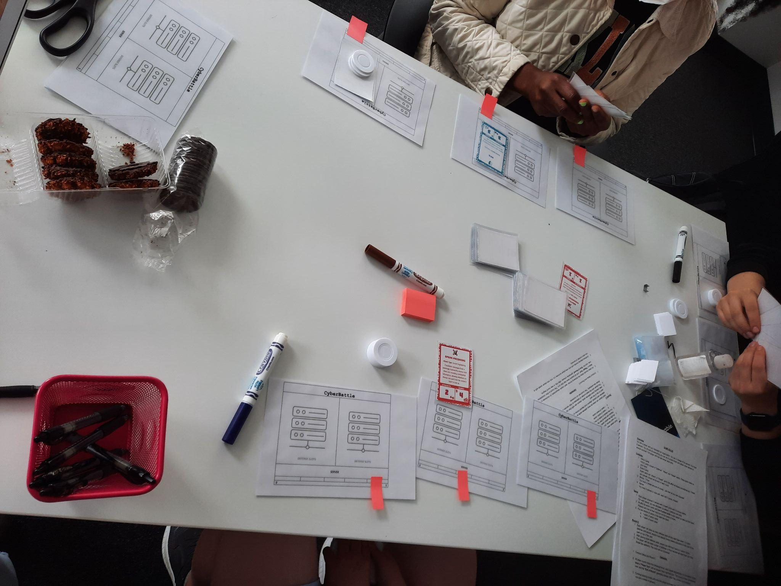
Cyber Security Best Practices

Slide 50
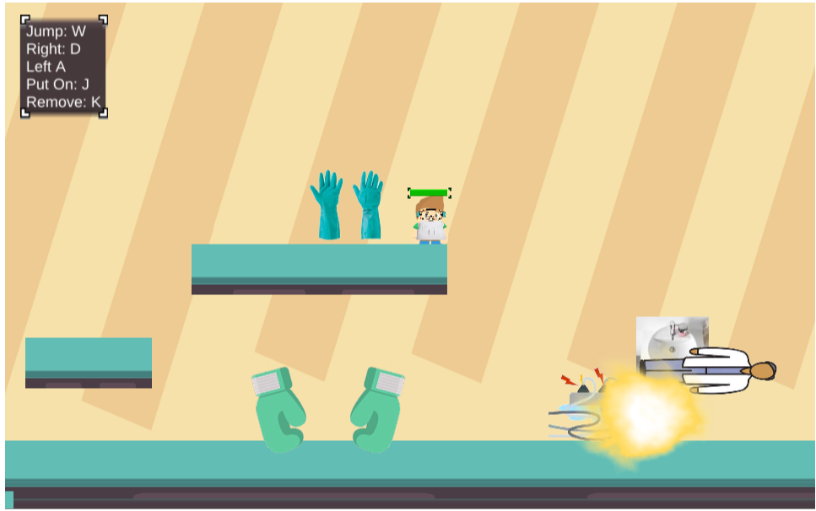
Chemistry Lab Safety

Slide 51
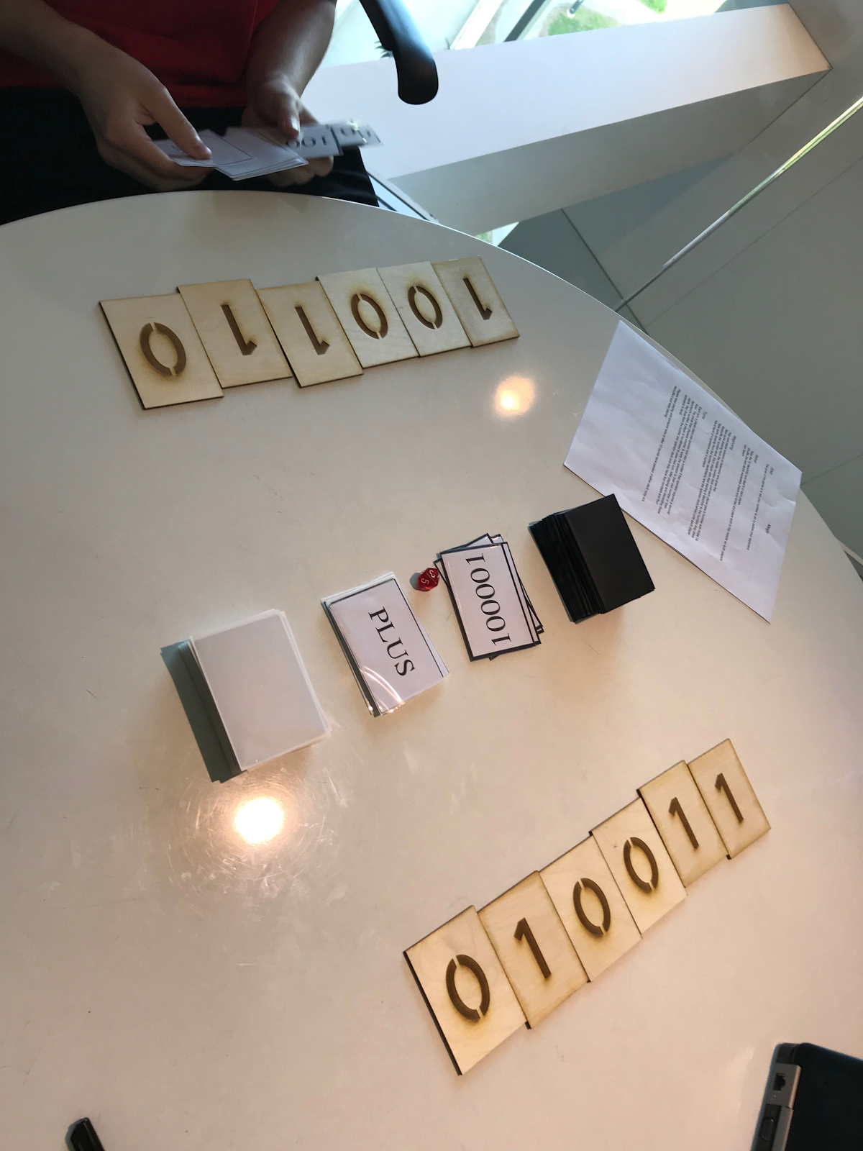
Binary Operators

Slide 52
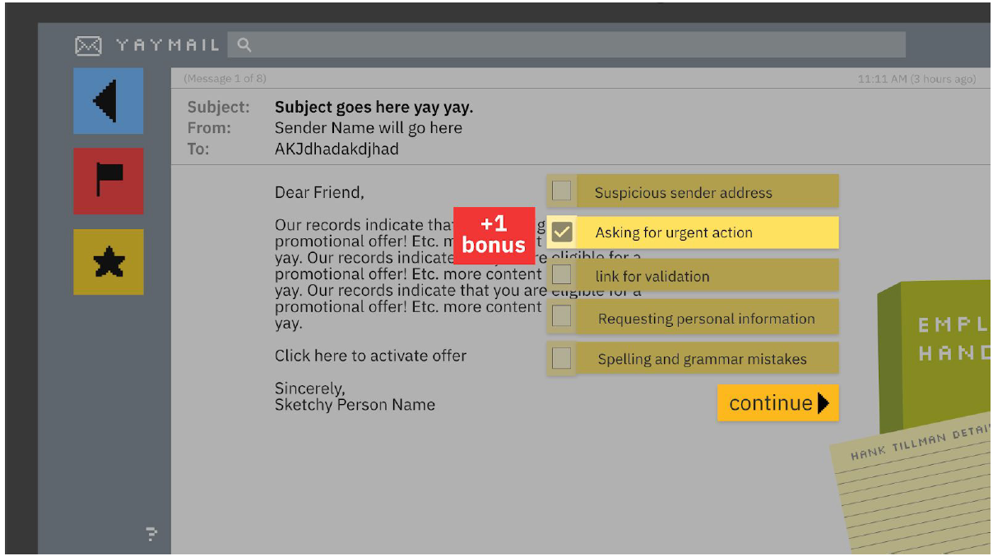
Spam Email Detection

Slide 53
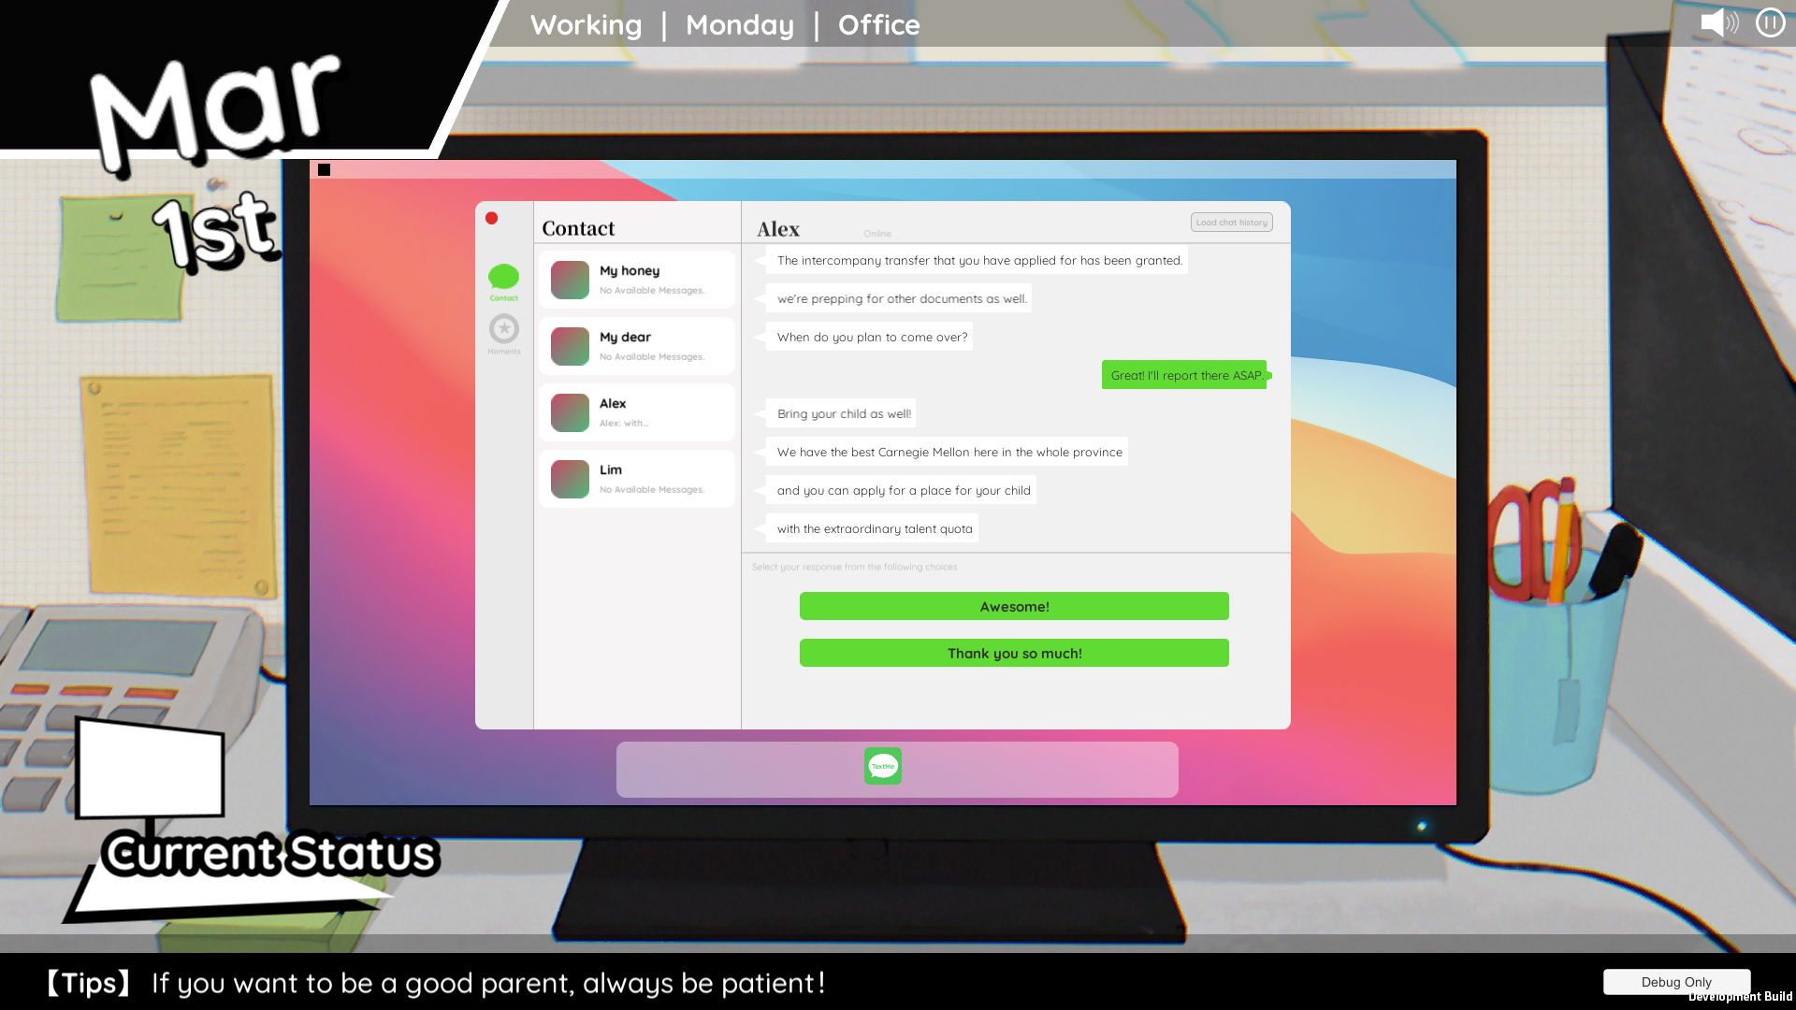
Parenting Skills for Chinese Parents

Slide 54
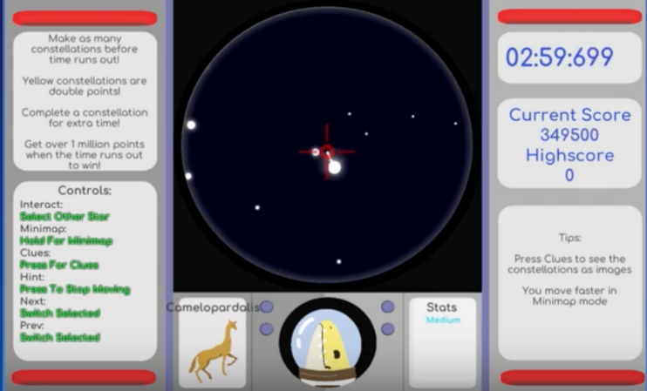
Identifying Constellations

Slide 55
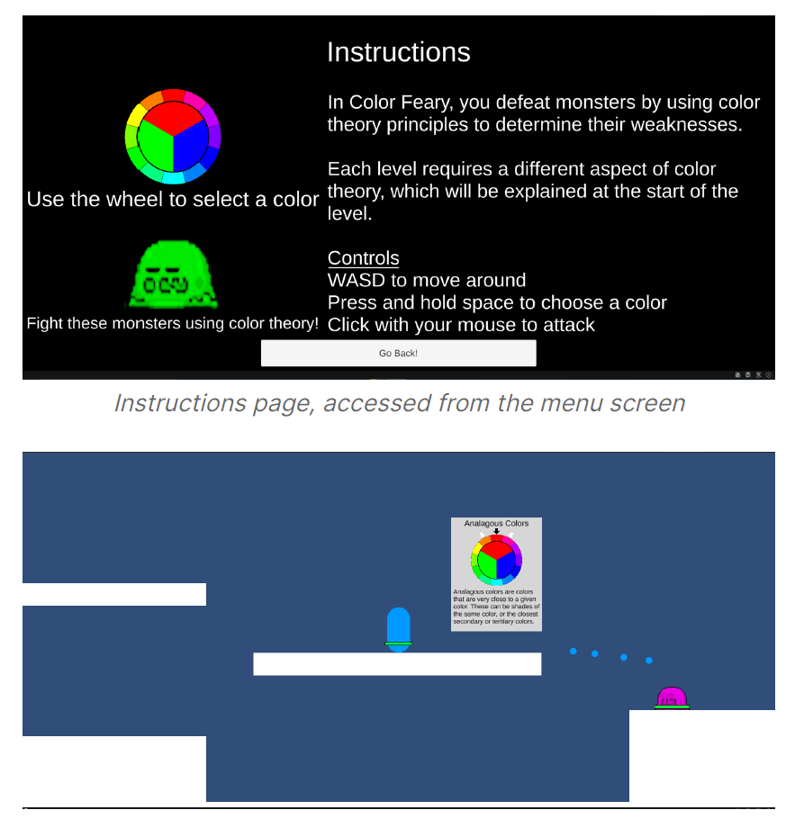
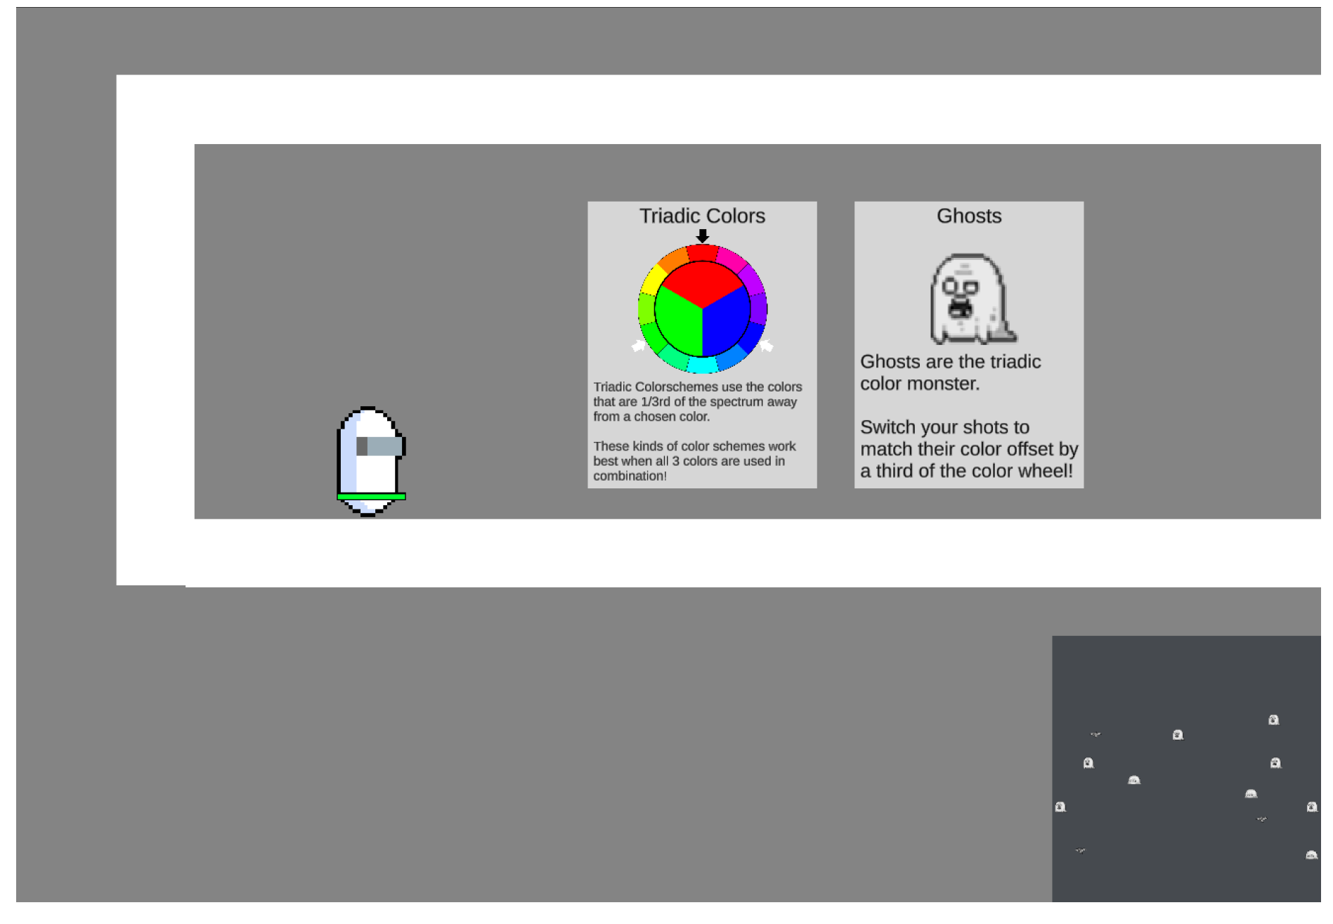
Color Theory

Slide 56
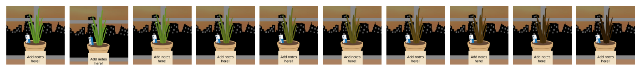
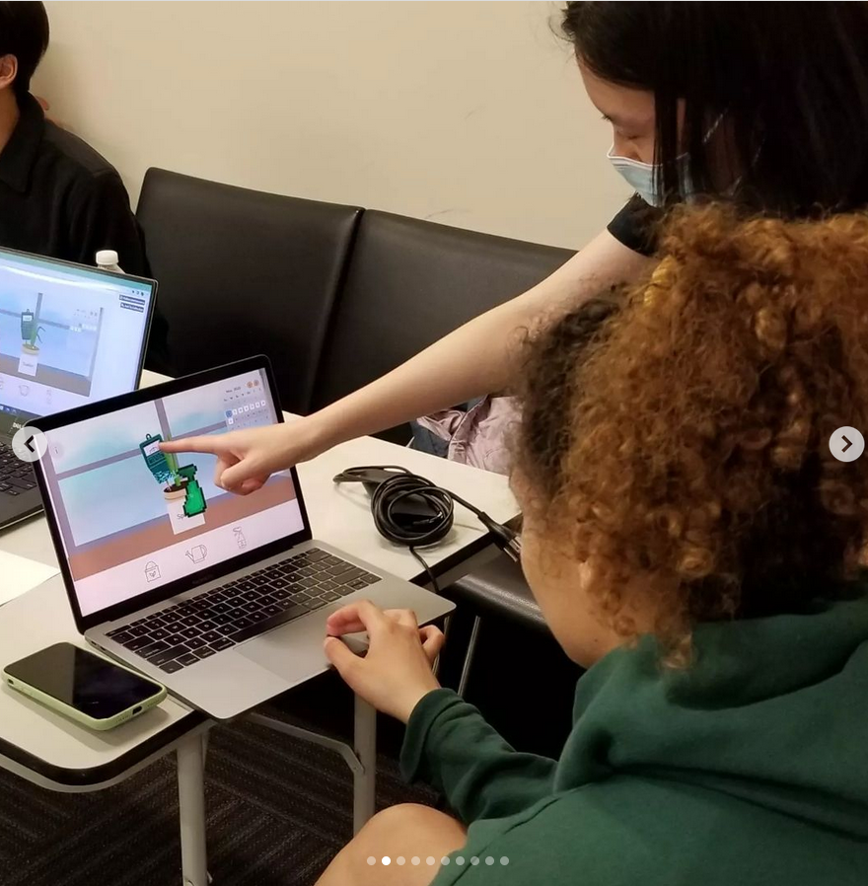
Home Plant Care

Slide 57
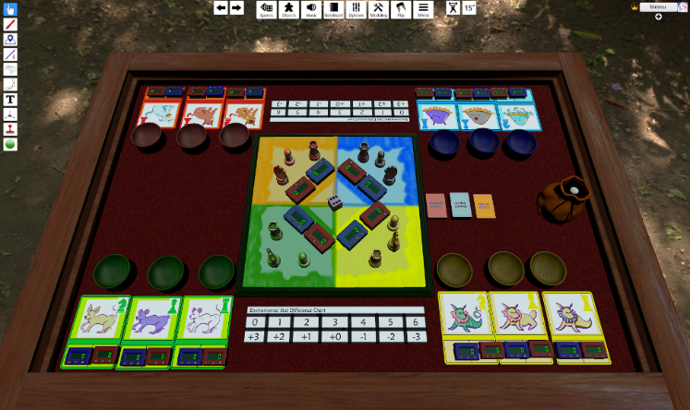
Evolution as Environmental Pressure

Slide 58
Environmentally conscious consumption

Slide 59
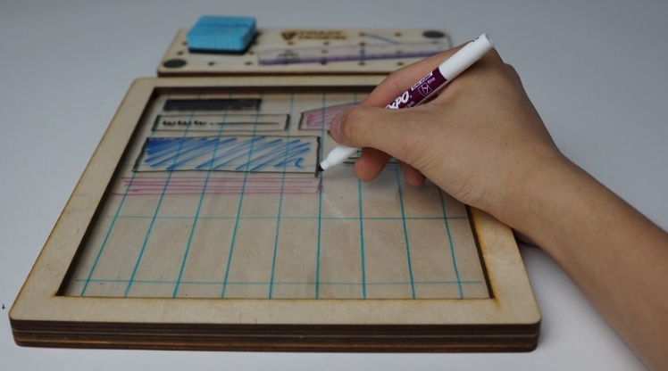
Graphic Design

Slide 60
Game from class have gone on to win awards

Slide 61
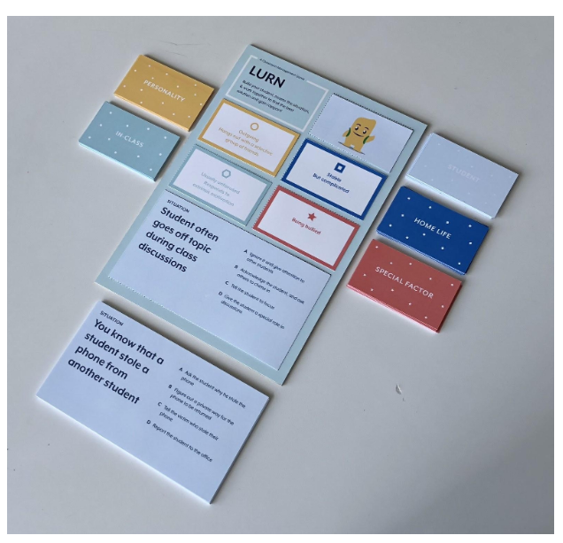
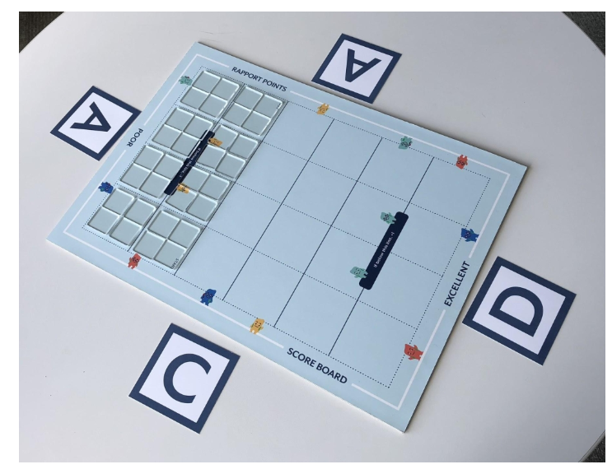

Classroom Management
Won gold in the student game category at Serious Play 2019!

Slide 62
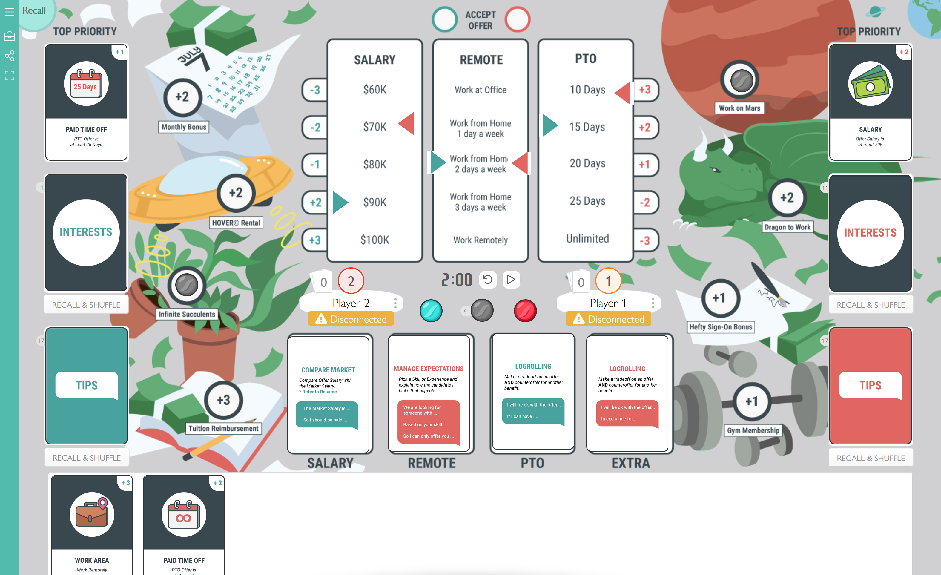

Salary and Benefit Negotiation

Slide 63
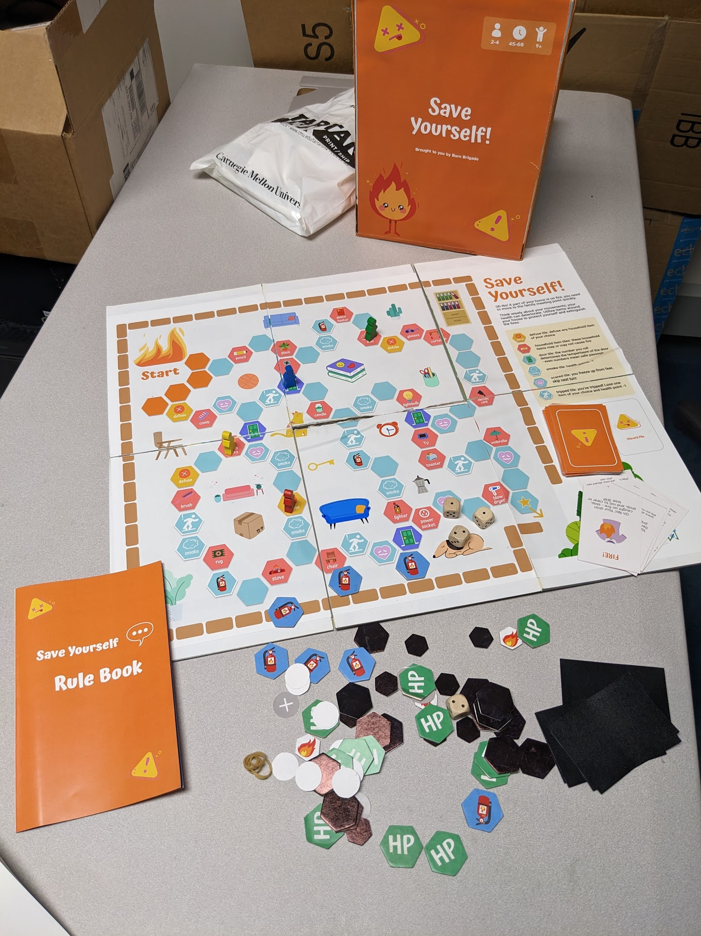
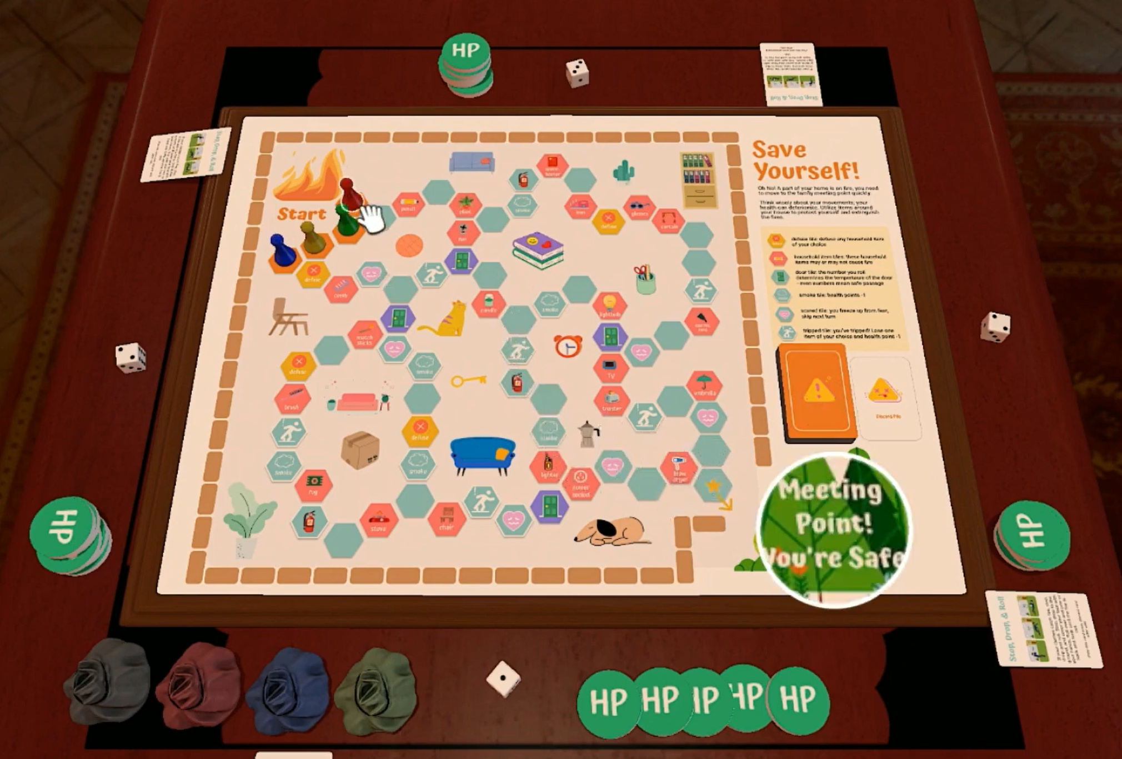

Fire Safety for Young Kids
https://www.youtube.com/watch?v=h1RZrhnvv50

Slide 64
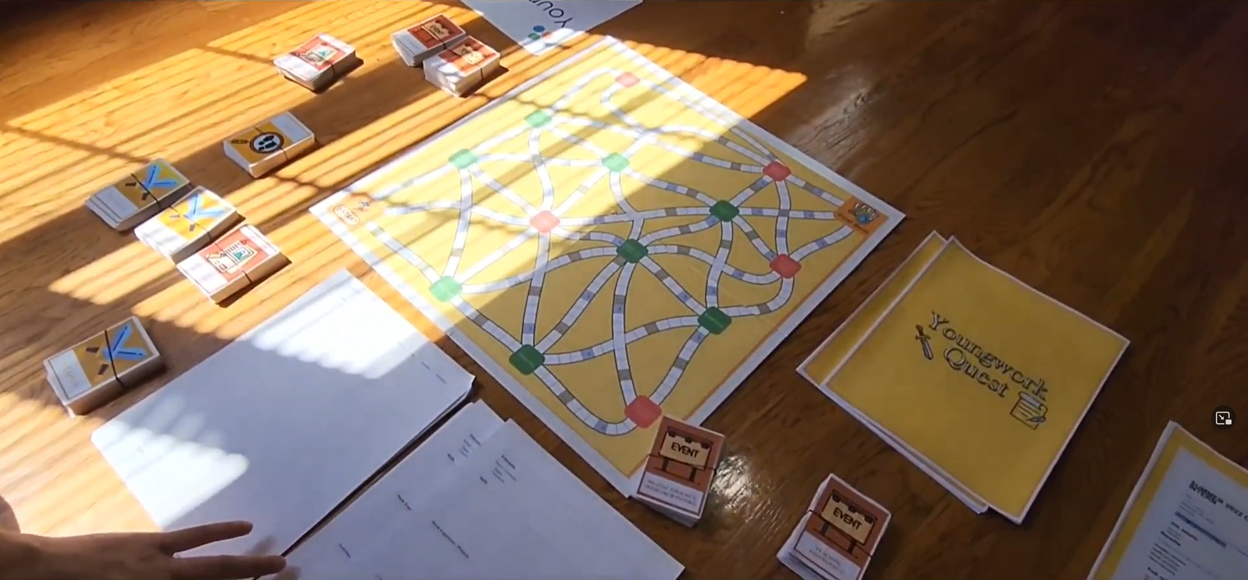
Preparing for Applying for Jobs
https://drive.google.com/file/d/1Mez9Fb86IC-yf37ZgOFH3tA1iArp0eR-/view

Slide 65
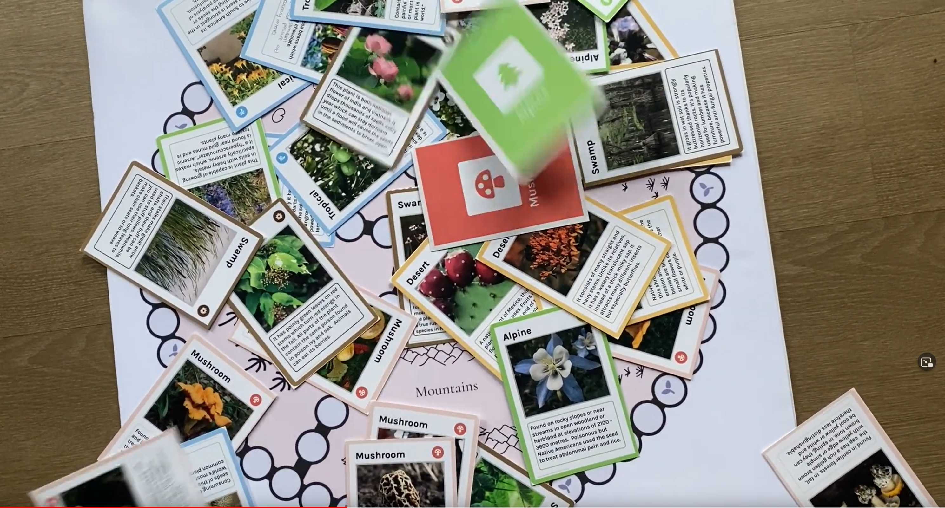
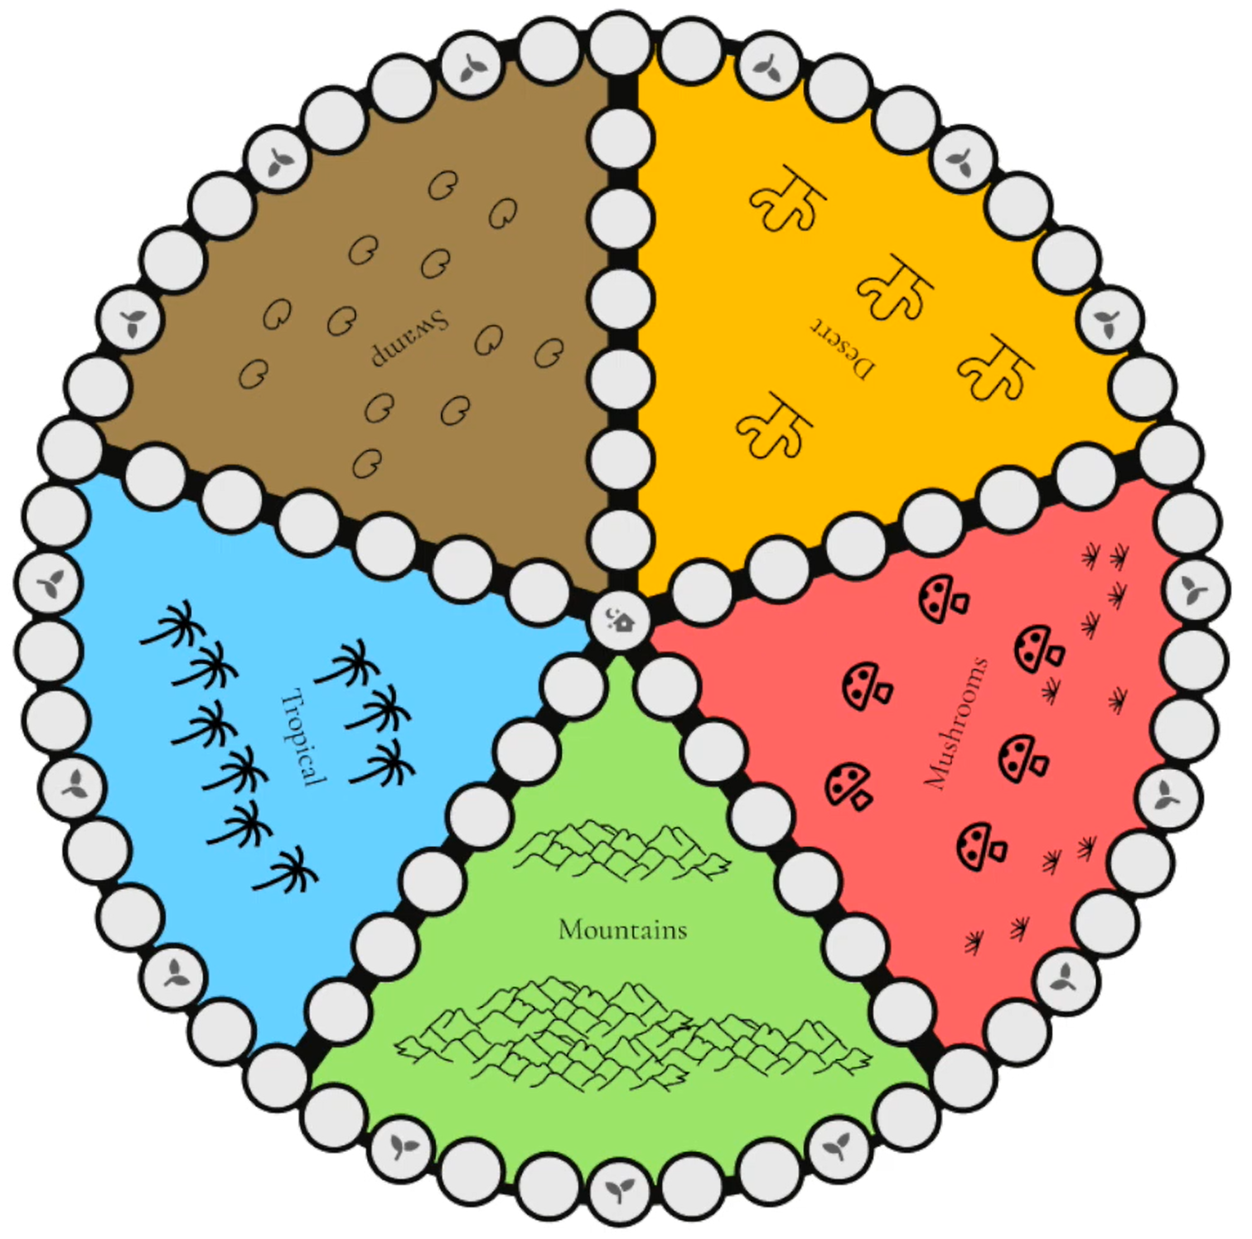
Wild Botany and Plant Foraging
https://www.youtube.com/watch?v=9giKqBCmAy0

Slide 66
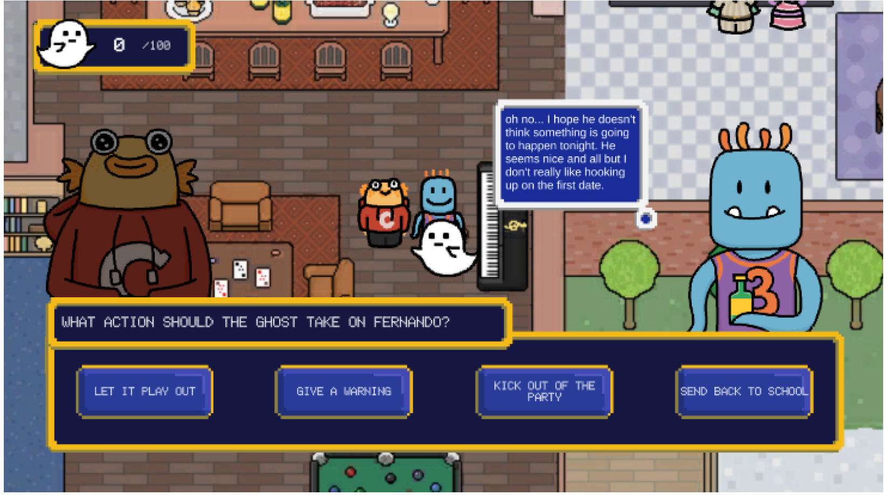

Consent and healthy sexual relationships
Student Game Design Competition Finalist at:

Slide 67
TTS Games from Prior Years
https://steamcommunity.com/sharedfiles/filedetails/?id=2093629113
https://steamcommunity.com/sharedfiles/filedetails/?id=2093103493
https://steamcommunity.com/sharedfiles/filedetails/?id=2093073473
https://steamcommunity.com/sharedfiles/filedetails/?id=2072876542
https://steamcommunity.com/sharedfiles/filedetails/?id=2072788827
https://steamcommunity.com/sharedfiles/filedetails/?id=2059086966

Slide 68


Slide 69
Meet with your teams!

Slide 70
For next time
Remember:
  Crit 2 Submission Deadline tonight
  Assignment 2C is Due Friday
  Final Project Scoping Proposals due Friday
If you have any feedback about how live sessions are going please let me know: https://edugames.design/feedback

Slide 71
